Slide 1
Changes in nuclear and radiological threats and hazards from a Norwegian perspective Øyvind Gjølme Selnæs NERIS Workshop, Roskilde 3-5 April 2019

Slide 2
NRPA Report 2018:10
2008: Comprehensive report (NRPA Report 2008:11)
2010: Six planning scenarios decided by the government
Now: Changes in nuclear and radiological threats and hazards

Slide 3
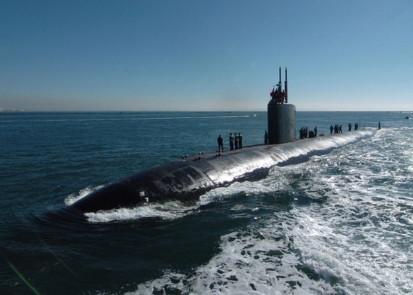
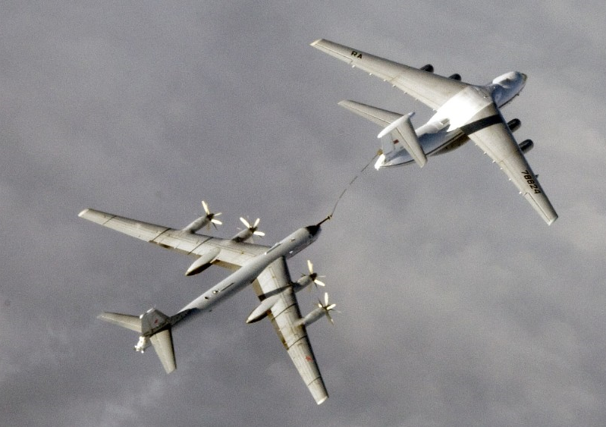
Increased Russian and NATO military activities in the High North
Notes:
Increase in the activities of naval nuclear-powered vessels in the High North, with an increased probability of Norway being affected by events related to such vessels close to Norway of in Norwegian waters. Norway may also be affected by events related to vessels carrying nuclear weapons.

Slide 4
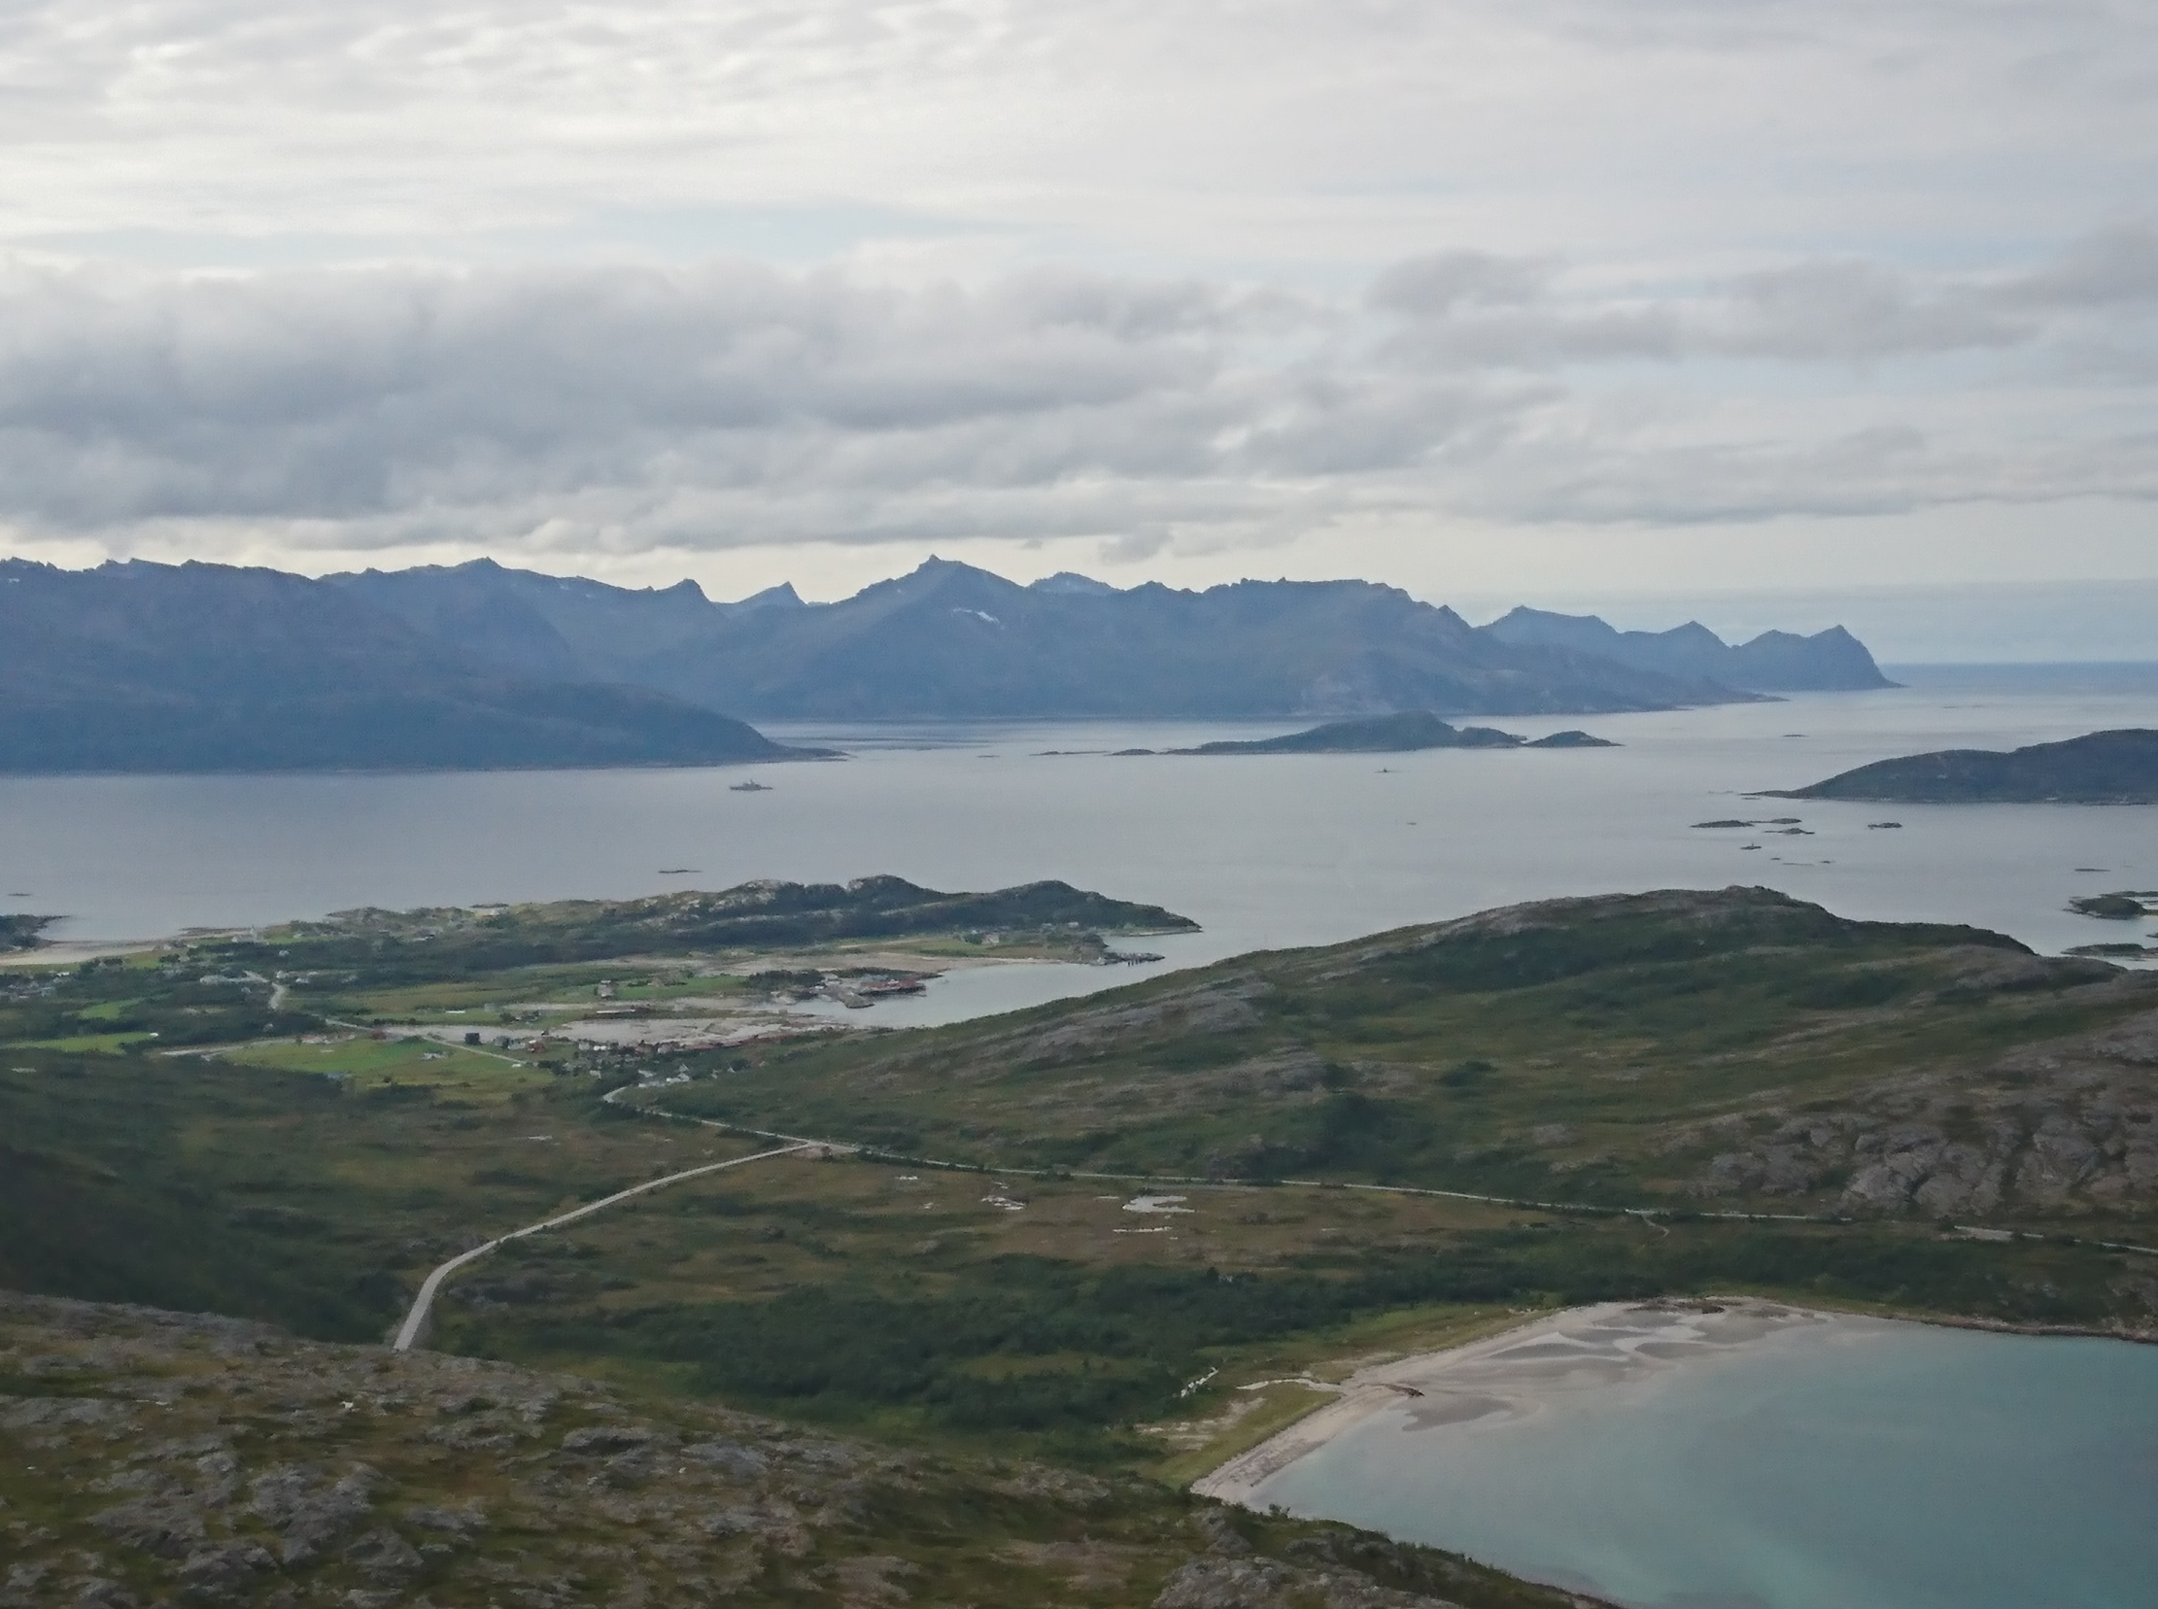
More frequent visits from NATO nuclear-powered vessels to Norwegian harbours and coastal areas
Notes:
Significant increase. From 10-15 visits per year a few years ago, Norway now receives 30-40 visits per year from British, French and American nuclear-powered vessels.
More frequent visits implies an increase in risk for Norway being affected by smaller or larger events in connection to these vessels. Groundings, collisions, leakages, fires or major reactor incidents will require handling from Norwegian authorities.

Slide 5
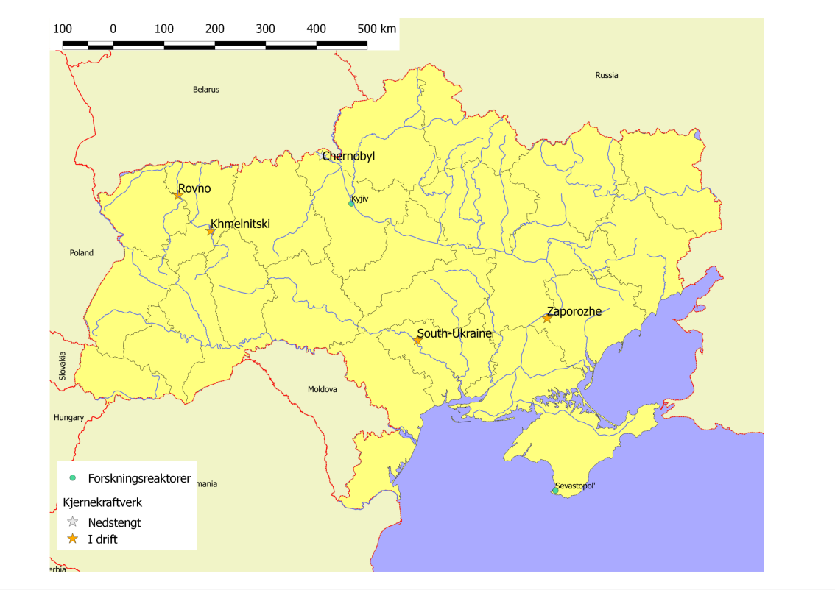
Research reactors
Nuclear power plants
Closed down
In operation
The situation in Ukraine
Notes:
Unstability in East Ukraine and Dunbas continues to challenge nuclear and radiological safety and security in the country. Important national competence located in Sevastopol is no longer under Ukraine authority and Uraine radiation protection and nuclear safety authorities have no control on radiation sources in occupied areas. Lack of national control in these areas increases the risk of illegal trafficking of radiation sources and nuclear materials.
This situation in Ukraine is ongoing.

Slide 6
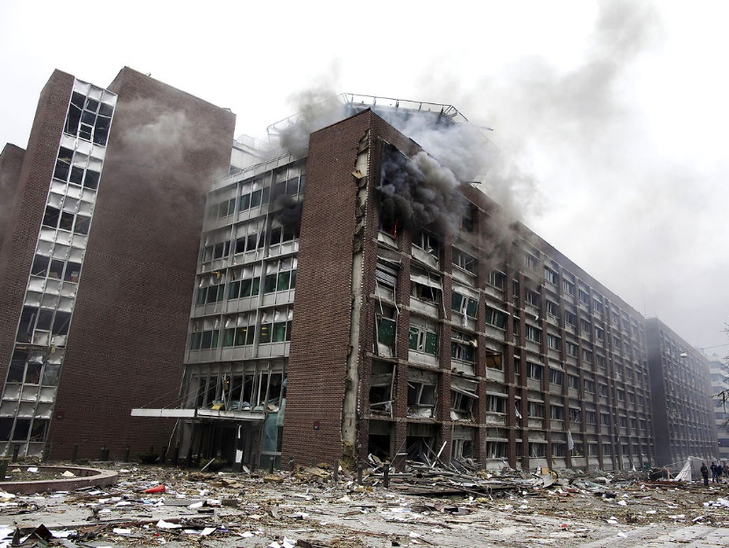
National and international terrorism, sabotage
Notes:
The nature of nuclear and radiological threats and hazards has changed during the last years. There is an increased likelihood for nuclear and radiological meterial being used in malicious acts. There is an increased likelihood for malicious acts being directed towards nuclear facilities, storage sites for radioactive materials and enterprises managing radioactive materials. These factors highlight the importance of maintaining good nuclear safety and security both nationally and internationally.

Slide 7
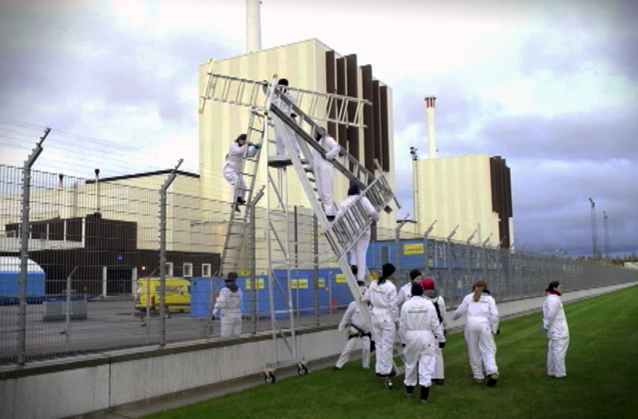
Demonstrations and other actions directed towards nuclear power plants
Notes:
Several incidents of nuclear power plants being targeted by political activists.
In Sweden, both Forsmark, Ringhals and Oskarshamn have been targeted.
Even though such actions have no consequences for the safety of the reactors at the site, they pose challenges for operators and authorities.

Slide 8
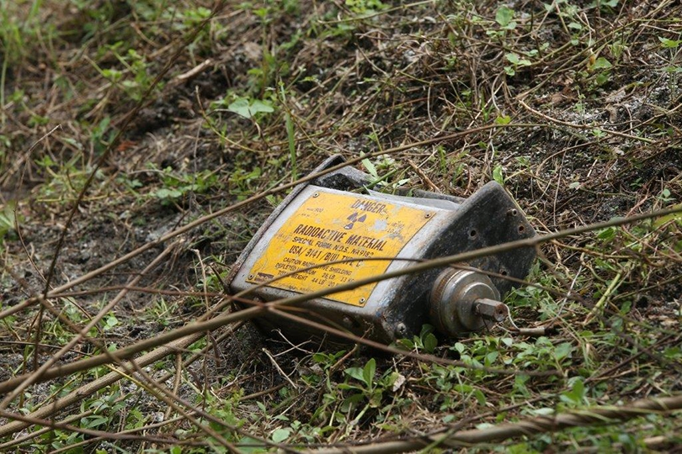
Orphan nuclear or radiological material, smuggling and other illegal trafficking of such material
Notes:
Internationally: The trand remains the same, with 10-20 reported incidents a year. In Norway, there have been on average 2-3 incidents annually where orphan radioactive sources have been discovered.
Internationally, there is an increased focus on minimising the risk for nuclear or radiological material becoming orphan and inmproved border control to limit illegal trafficking.

Slide 9
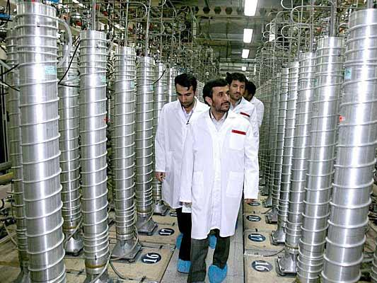
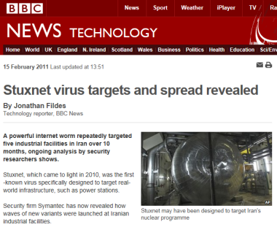
Hybrid warfare
Notes:
Several incidents the last years where state actors conduct operations directed towards infrastructure and critical systems in another country. Operations have been directed towards digital systems, also at nuclear facilities. E.g. Stuxnet damaging hardware in Natanz, Iran in 2010.
Sabotage or unauthorised access to control and warning systems may have consequences for safety and security at nuclear and radiological facilities.
The international development in this area pose challenges also for the safety and security at Norwegian facilities.

Slide 10
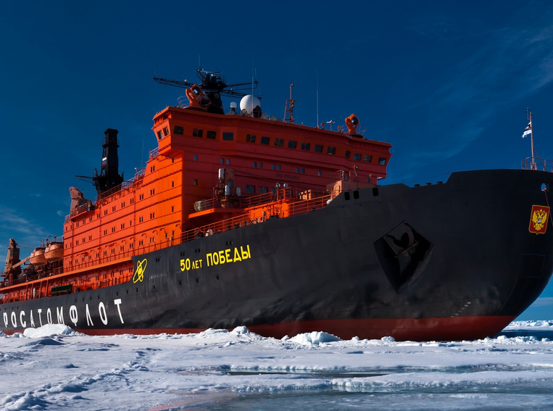
Russian nuclear-powered icebreakers close to Norway
Notes:
Today: Fleet of six icebreakers, all with home port in Murmansk. Three new have been built, the first one is expected to be commissioned in 2019.
Norwegian authorities assume an increase in the traffic of nuclear-powered icebreakers close to Norway in the years to come.

Slide 11
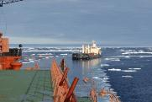
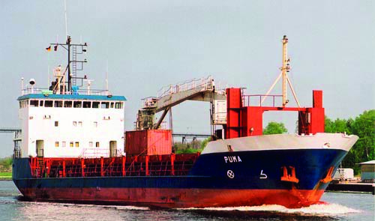
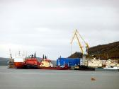
To Japan
The Northern Sea Route
Murmansk
Sellafield
Mayak
La Hague
Transport of spent nuclear fuel and other radiactive waste along the coast of Norway
Notes:
Repatriation of spent nuclear fuel from the Soviet era from nuclear facilities to Russia. The transports often go past the coast of Norway to Murmansk and further management in Russia. The program is coming to an end.
Norwegian authorities expect an increase in Russian nuclear industry and nuclear fuel management, and assume that transport of spent nuclear fuel and other radioactive material along the Norwegian coast will continue.
Climate change and increased commerical traffic along the North East Passage: We also assume there will be an increase in traffic of reprocessed fuel, spent fuel and other radioactive waste from European Reprocessing Facilities and Asian customers.

Slide 12
Floating nuclear power plant
Notes:
Akademician Lomonosov – Finalised from the warft in St. Petersburg and towed along the coast of Norway to Murmansk in April/May 2018 for loading of the reactors and testing there, before further towing to Pevek on the Chukotka peninsula in 2019.
Norwegian authorities follow the development closely, and assume more transports of floating nuclear power plants with or without nuclear fuel may be possible in the future.
The towing of a floting nuclear power plant in Norwegian economic zone or in close and vulnerable Arctic waters poses a new type of activity. If anything were to happen during such a towing, it may have consequences for Norway or Norwegian interests.

Slide 13
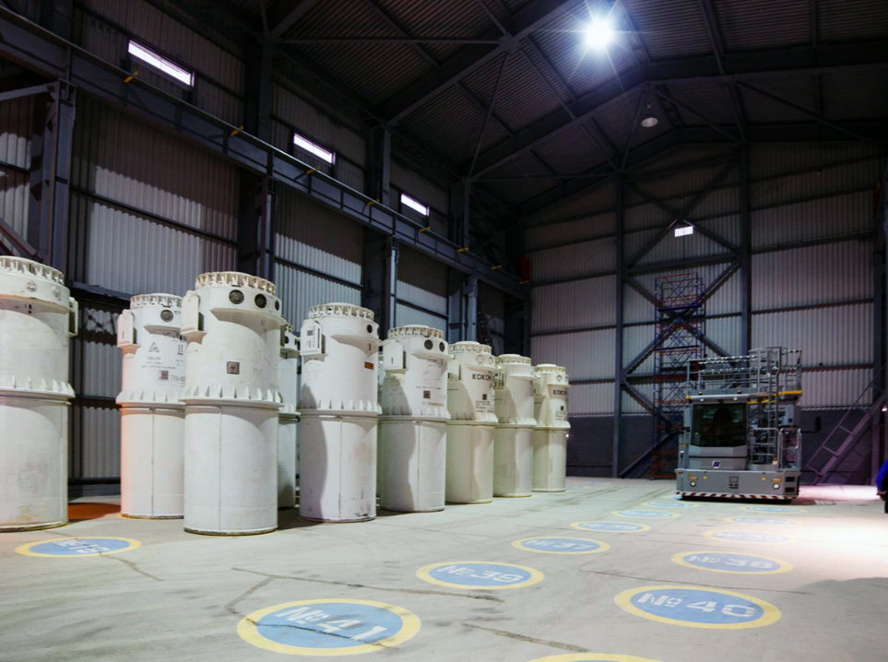
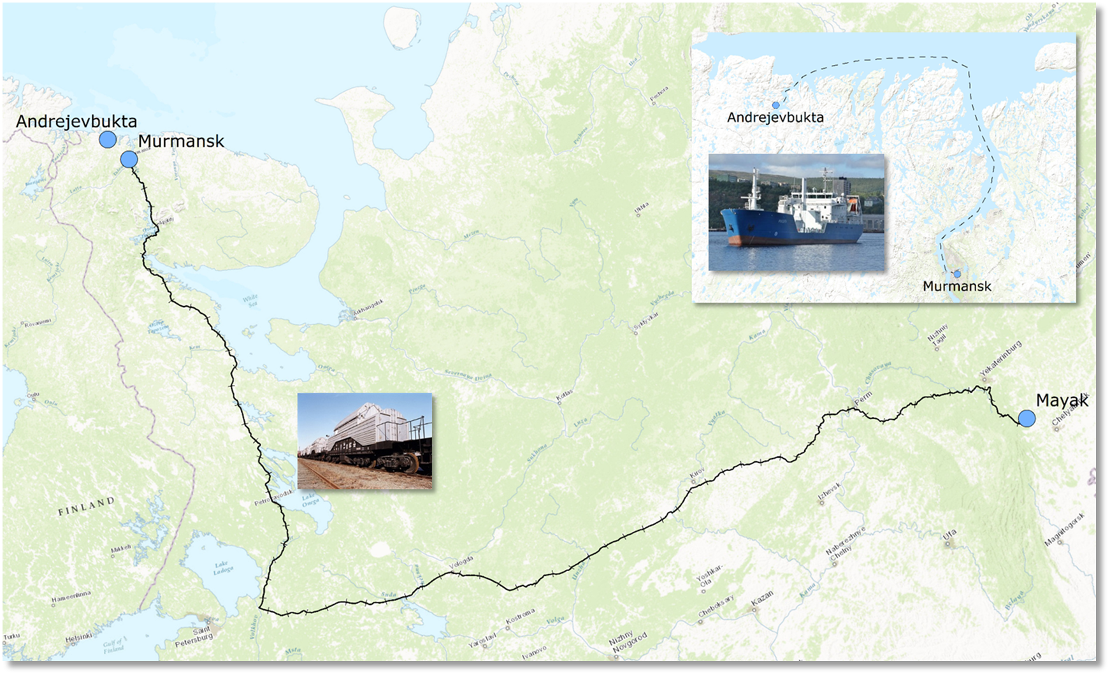
Removal of radioactive waste from Andreev Bay
Notes:
Norwegian-Russian cooperation since 1997 to improve the conditions and facilitate the safe removal of the nuclear waste.
Removal began in 2017, and is expected to take at least 5-6 years. Demanding operations. Reduced risk in the long term, but there is a hightened risk while the operation is ongoing.
In the further cooperation, Norwegian authorities focuses on consequence assessments of possible accidents, emergency preparedness, exercises, etc.

Slide 14
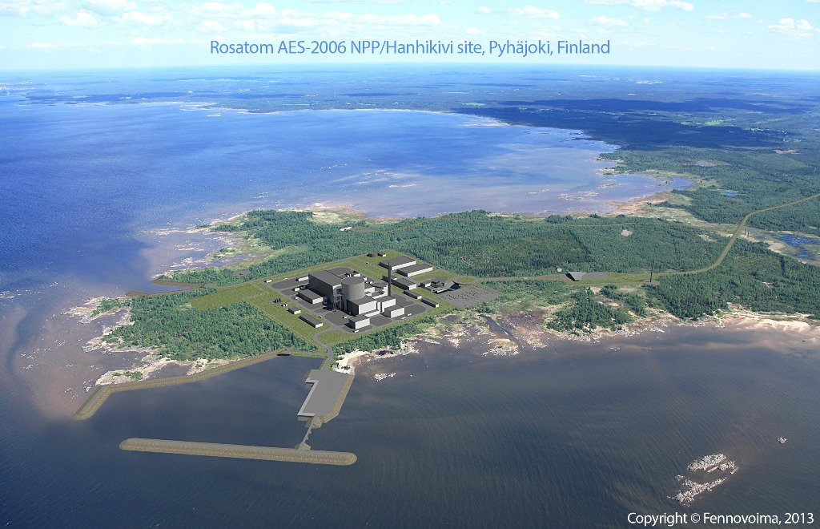
Civilian nuclear power industry and reprocessing facilities
Notes:
Nuclear renaissance and optimism, approx. 60 nuclear reactors are under construction, mainly in Asia and Europe.
Of the countries neighbouring Norway, Finland, Great Brittain and Belarus are construction new power plants. Finland, Ukraine and France are expanding exisiting power plants with more reactors. Russia are also expanding with new reactors, including two new reactors at Leningrad NPP.
Many reactors in operation today are built in the 1970s and 80s, with a planned lifetime of 25-30 years. Many countries have after technical assessments and safety upgrades prolonged the lifetime. The safety standards continues to improve. The average age of the nuclear reactors continue to grow. More than half of all reactors have been in operation for more than 30 years.
Release from events at foreign reprocessing facilities may hace consequences for Norway. To European examples are Sellafield and La Hague. The largest risks are posed by the storage facilities for highly active liquid waste. At Sellafield, there has been a reduction in the amount of this waste the last decade, but there are still considerable amounts remaining.

Slide 15
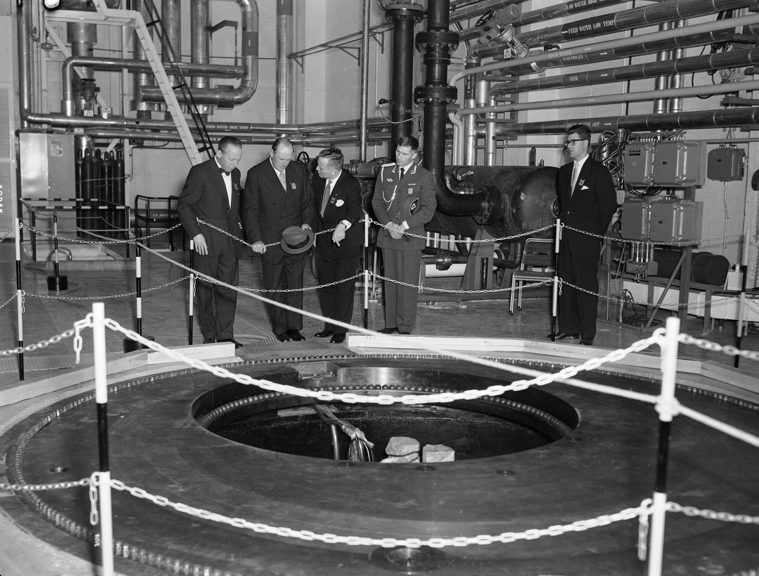
Closure of the research reactor in Halden
Notes:
Been in operation since 1959. Decided closed by the board in June 2018.
Will lead to a demanding work with dismantlement and waste management of the facility and the spent fuel for many years to come. The decommision work will pose a significant change in the activities at the facility. There is a risk of incidents during this period. There is a need for thorough planning and safe conduction of the work. NRPA will monitor the safety of this work closely.

Slide 16
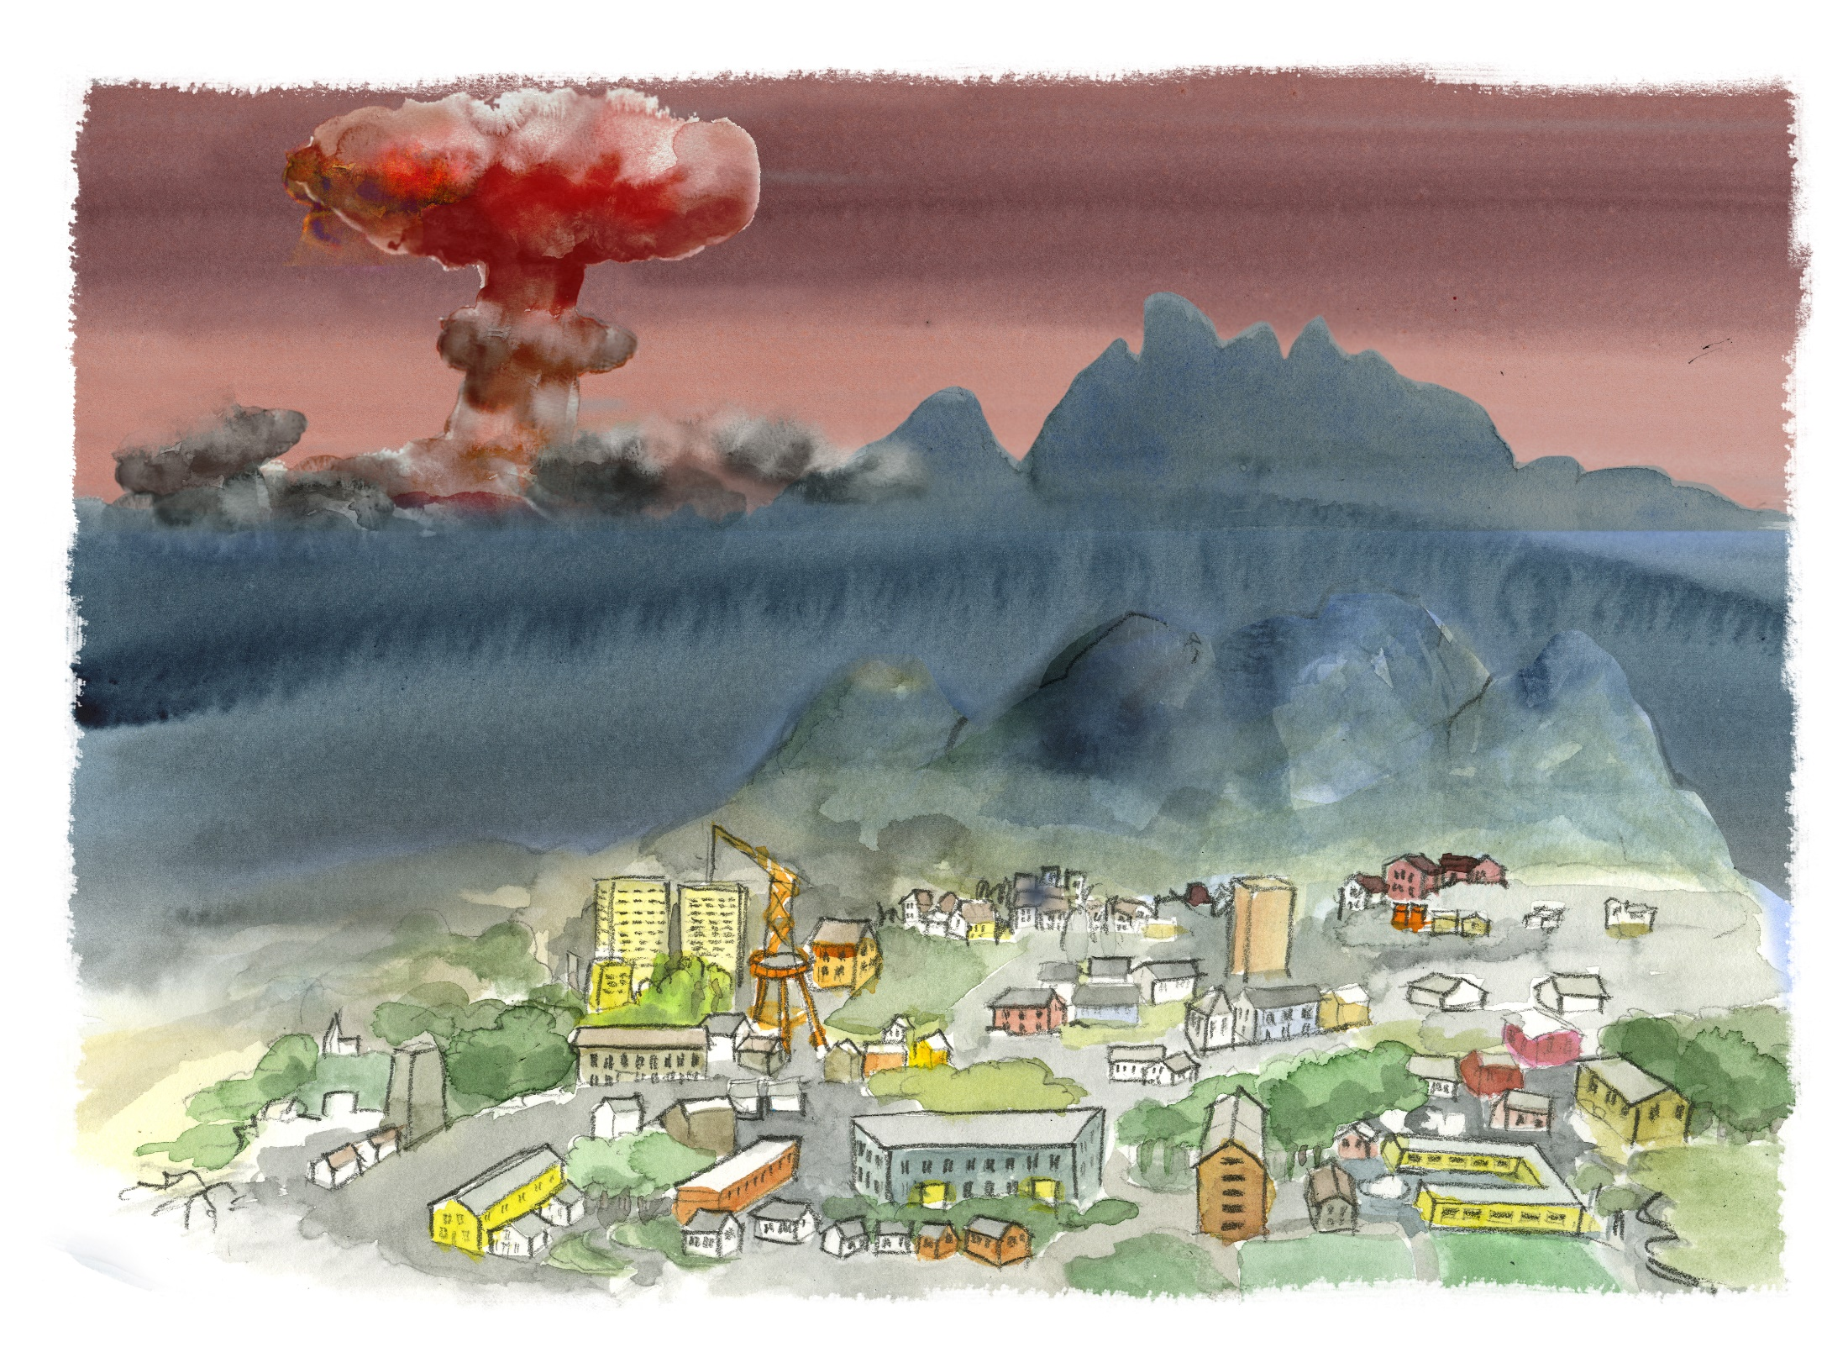
Nuclear weapons
Notes:
Norwegian authorities are again considering the use of nuclear weapons against Norway or close to Norway as a not unthinkable scenario.

Slide 17
Summary
There has been changes in nuclear and radiological threats and hazards the last years:
Increase in activities involving nuclear or radiological materials
Increased risk of malicious acts
Clearing up old legacies
Decommissioning work
This raise new challenges for the ongoing work on national nuclear emergency and response.

