Slide 1
Decision support diagrams for public protective actions during nuclear emergencies 5th NERIS Workshop, 3-5 April 2019
Jan Johansson, Peder Kock, Anna Maria Blixt Buhr, Jonas Lindgren, Jonas Boson, Simon Karlsson

Slide 2
Responsibilities during nuclear emergencies
Decision making
Decision making rests with the organisations normally responsible for the sector or the administrative region
The County Administrative Boards are responsible for decisions on civil protection (e.g. evacuation and sheltering)
Advice
SSM is responsible for providing recommendations and expert advice on i.a. protective actions, dispersion prognosis, radiation monitoring and conditions at the NPP
Licensee
A licensee is required to take prompt actions in order to classify the event, alert authorities, assess possible releases and restore the facility to a safe and stable state

Slide 3
Prerequisites
Based on emergency class and estimated release magnitude
Adapted to the possibilities for protective actions offered by the present emergency response planning
Covers an event from facility emergency to termination of the emergency
Decisions on protective actions primarily at predetermined distances
Some protective actions to be implemented all around the NPP whereas others within the area at risk
High threshold to terminate decided protective actions

Slide 4
Protective actions
Precautionary evacuation
Evacuation
Sheltering
ITB
Relocation
Actions to reduce inadvertent ingestion of radioactive substances on the skin
Decontamination of people
Medical care
Food restrictions

Slide 5
Release magnitude
Influences distances where protective actions are implemented
Release magnitude | Xe-133 | I-131 | Cs-137
FMS¹ | ~5E+18 Bq | ~1E+15 Bq | ~1E+14 Bq
10xFMS¹ | ~5E+18 Bq | ~1E+16 Bq | ~1E+15 Bq
100xFMS¹ | ~5E+18 Bq | ~1E+17 Bq | ~1E+16 Bq
¹FMS stands for ”Functioning Mitigation Systems” where the release corresponds to the requirements on mitigation systems in a governmental decision from 1986

Slide 6
Objective for protective actions
Protective action | Less than FMS | Between FMS and 10xFMS | Between 10xFMS and 100xFMS
Evacuation¹ | 0-5 km | 0-15 km | 0-15² km
Sheltering | 5-15 km | 15-25 km | 15-50 km
ITB | 5-15 km | 15-25³ km | 15-50³ km
¹Both precautionary evacuation and evacuation
²Evacuation out to 25 km can be considered in sectors without larges communities
³Additional distribution of ITB is required

Slide 7
Time to and duration of release
Time to release
Influences the area affected by the release
Influences if complementary and additional ITB can be distributed
Influences when to recommend sheltering
Influences when to recommend intake of ITB
Influences when to recommend food restrictions
Duration of release
Influences the area affected by the release
Influences when sheltering can/must be discontinued

Slide 8
Area at risk and adjustment of distances
Area at risk
Area that may be affected by a release to such an extent that protective actions are necessary
Area at risk can cover certain sectors or the full circle around the NPP
Adjustment of distances
Distances for evacuation, sheltering and ITB may be adjusted based on the actual weather situation
Adjusted distances based on dispersion prognosis and present release magnitude FMS, 10xFMS or 100xFMS

Slide 9
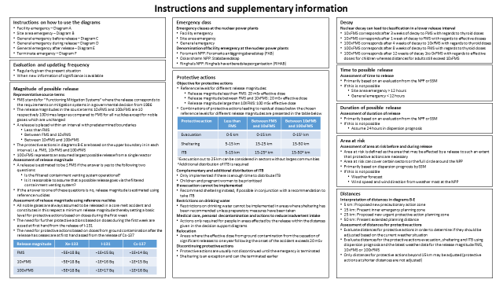
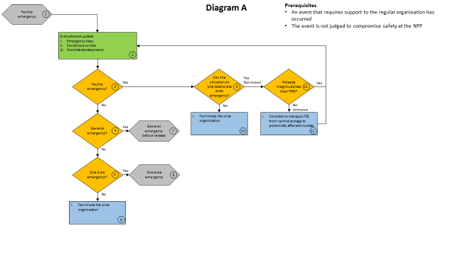
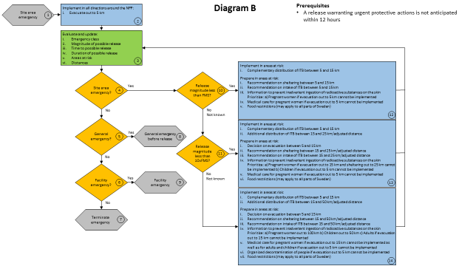
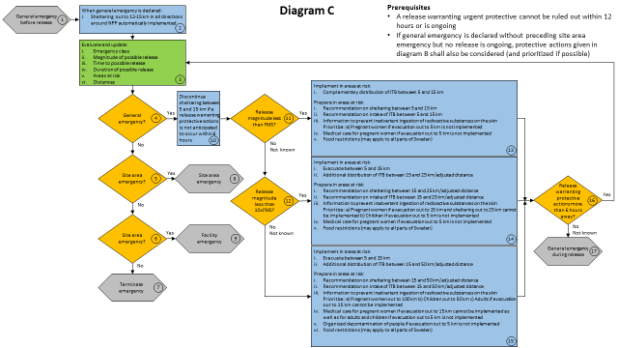
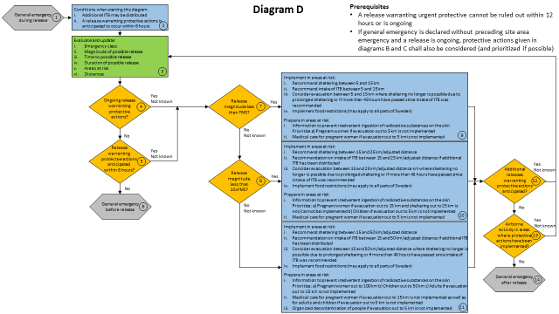
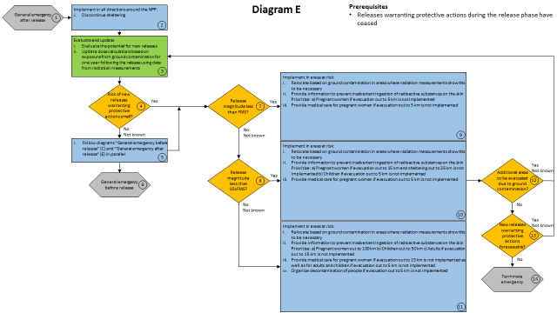
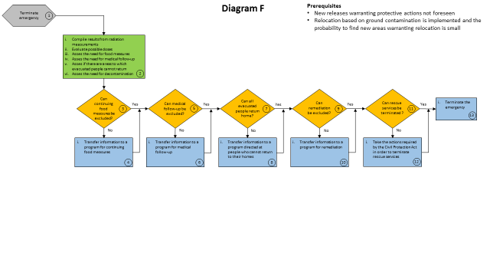
Questions?
Contact: jan.johansson@ssm.se

