Slide 1


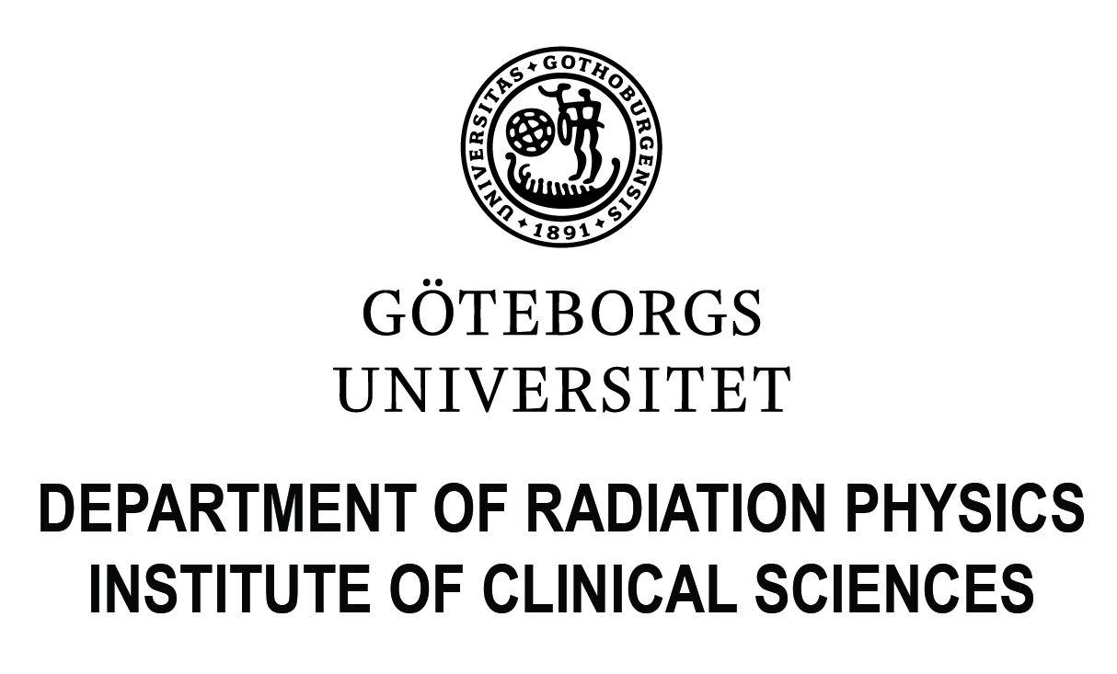

Large-scale measurements of internal contamination in case of a nuclear accident
NERIS Workshop 2019
3-5 April 2019
Roskilde, Denmark
Martin Hjellström
Nikola Markovic
Mats Isaksson

Slide 2
~15 whole-body counters
>70 gamma cameras
Computer models for MC-calculations
Guidelines for the use of gamma cameras as screening instruments

