Slide 1
Preparedness for a “dirty bomb” attack: antidotes and screening capacities as
complementary medical countermeasure resources
Matthias Port,¹ Daniela Stricklin,² Andreas Lamkowski,¹ Stefan Eder,¹ Michael Abend,¹ Alexis Rump¹
¹Bundeswehr Institute of Radiobiology, Munich, Germany;
²Office of Domestic and International Health Studies US Deparment of Energy, USA
*Presentation at HFM 223, RTG, Munich 2018
Notes:
In radiological emergencies, there is a risk of radionuclide incorporation. The radiological doses absorbed can be reduced by decorporation treatment. Antidote requirements depend on the scenario and treatment strategy (“urgent approach”: immediate treatment of all patients with possible incorporation; “precautionary approach”: treatment after confirmation of incorporation). We calculated the number of daily antidote doses for different scenarios and the differences in outcome for both treatment strategies.
The number of potentially contaminated victims was varied from 1,000 to 60,000 (a maximum that might seem plausible for “dirty bomb” scenarios), the proportion of patients actually needing decorporation treatment from 0.1 % to 100 %, the radioactive screening capacities from 250 to 2,500 people/day and treatment duration from 10 to 90 days. The outcomes were assessed as total statistical lifetime saved assuming an inhalation of 1 mCi cesium-137 and the achievable dose reductions by a Prussian Blue treatment.
Assuming 1 % of the potentially contaminated people actually needing treatment and applying an “urgent approach” the requirements for 1,000 victims range from 1,100 to 3,400 and for 60,000 victims from 489,000 to 4,400,000 daily doses, depending on treatment duration and screening capacities. The “urgent approach” is associated with larger stockpile requirements than the “precautionary approach”, up to several hundred times in large scale scenarios. The impact of the screening capacities is particularly important in large scale scenarios, a low proportion of people needing treatment and extended treatment duration. The outcome is better for an “urgent approach” particularly in large scale scenarios and low screening capacities [1].
If only a small fraction of the victims actually needs treatment, their timely identification by enhancing screening capacities may be the most efficacious way to reduce antidote requirements. In large scale scenarios, it might be necessary to abandon the medically preferable “urgent approach” for an antidote-sparing “precautionary approach”.

Slide 2
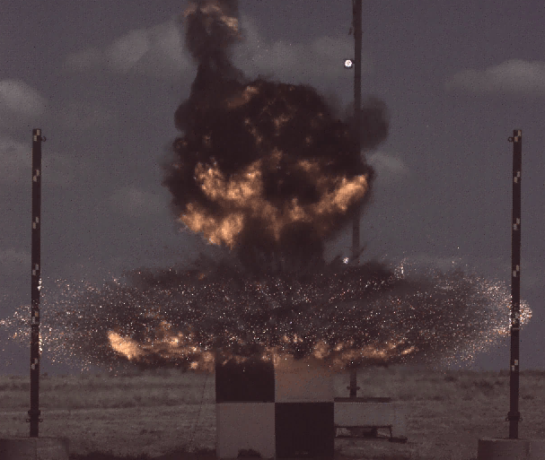
„Dirty bomb“ detonation
Type of injuries
Mechanical trauma / Blast
Burns
External irradiation
Internal contamination

Slide 3
National Stockpiles for RN emergencies
G-CSF
Potassium iodide
Ca(DTPA), Zn(DTPA)
Prussian Blue
(DMPS,DMSA)

Slide 4
Differences in decorporation strategies
Precautionary Approach | Middle of the Way Approach | Urgent Approach
Sources: GB, US, AUS, FRA authors | Source: Defence R & D Canada | Source: Autorité de Sureté Nucléaire (FRA) | Source: Bundeswehr Institute of Radiobiology
Efficacy depends on the time of treatment start Indication of treatment depends on the committed effective dose: < 20 mSv: no indication 20-200 mSv: case by case decision > 200 mSv: indication Administration of iodide within 4-6 h after incorporation Otherwise no clear cut statements on when to start the treatment | Indication for treatment basically depends on the committed effective dose Internal dosimetry (whole body counting, excretion measurements, calculation) takes time. Treatment may be started before results are available No standard. The decision when to start the treatment is taken case by case. | In case of a suspicion of radionuclide(s) incorpo-ration, treatment is started after identification of the nuclides, a priori within 2 h The continuation of the treatment depends on the internal dosimetry results | Treatment is started after the identification of the nuclide(s) as soon as possible. There is no clearly defined time limit The continuation of the treatment depends on the internal dosimetry results

Slide 5
Precautionary Approach
Indication of treatment depends on the committed effective dose
- Identification of nuclide(s)
- Dose necessary to initiate treatment
Urgent Approach
Treatment is started after the identification of the nuclide(s) as soon as possible. There is no clearly defined time limit
The continuation of the treatment depends on the internal dosimetry results
- Identification of nuclide(s)

Slide 6
Impact of the initiation time and duration of the decorporation treatment on its efficacy (incorporation of Pu-239 through a wound)
Treatment duration: 180 days
Treatment start time
 | None | 1h | 2h | 6h | 12h | 1d | 2d | 10d | 30d | 90d | 180d
Dose (mSv) | 823 | 9.7 | 10 | 14 | 24 | 57 | 143 | 501 | 581 | 663 | 701
Efficacy | 0 | 0.99 | 0.99 | 0.98 | 0.97 | 0.93 | 0.83 | 0.39 | 0.29 | 0.19 | 0.15
Treatment initiation: 1 h after incorporation
Treatment duration
 | None | 14d | 30d | 90d | 120d | 150d | 180d
Dose (mSv) | 823 | 199 | 149 | 50 | 29 | 17 | 10
Efficacy | 0 | 0.76 | 0.82 | 0.94 | 0.97 | 0.98 | 0.99
Rump et al., Adv Wound Care 2017; 6(1): 1-9.

Slide 7
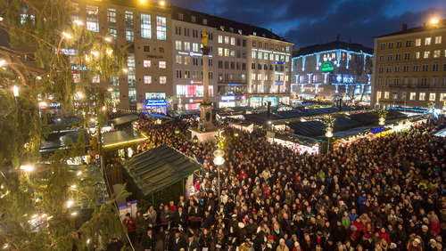
Scenario of a „dirty bomb“ attack
Homeland Security Council: Radiological attack with Cs-137 (Scenario Nr. 11):
540 fatalities , 810 injured, no acute radiation syndrome , 60,000 people contaminated
Christmas Market on the Marien square in Munich: 5,000 m² x 1 = 5,000 people
Cranger Fun Fair: At the same time 42,600 people in open areas + 11,000 in shops. Evacuation plannings for 55,000 people
People counts in German Streets
Ranking 2013 | Ranking 2012 | City | Street | People/hour
1 | 1 | München | Kaufingerstraße | 15,496
2 | 2 | München | Neuhauser Straße | 13,384
3 | 9 | Wien | Kärntner Straße | 8,364
4 | 6 | Stuttgart | Königstraße | 8,215
5 | 13 | Hamburg | Mönckebergstraße | 8,204

Slide 8
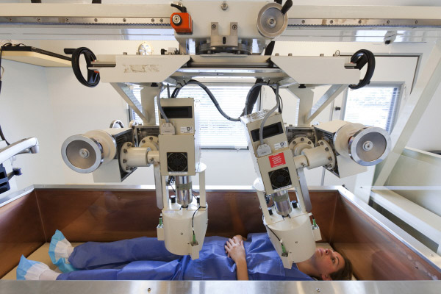
Consequences of an „urgent approach“
Huge antidote requirements in large scale scenarios (60,000 people treated for 10 days means 600,000 daily doses, for 90 days 5,400,000 daily doses)
High screening capacities might reduce antidote requirements if the number of victims actually needing treatment < 100%
Mobile whole body counters are commercialized
Speed of examination depends on the detection limit
Detection of 300 Bq Cs-137 in 3 min is possible
Screening capacities 15 – (30) – (50) people / h

Slide 9
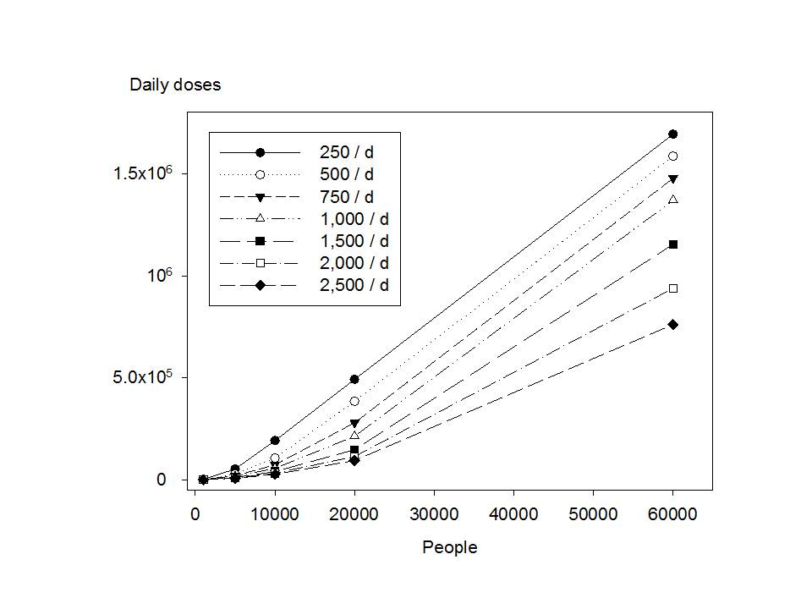
Antidote daily doses needed („urgent approach“)
People | Treatment duration | Screening capacity
 |  | 2500/d | 2000/d | 1000/d | 500/d | 250/d
1,000 | 10 d | 1,090 | 1,090 | 1,090 | 1,585 | 2,578.5
1,000 | 30 d | 1,290 | 1,290 | 1,290 | 1,785 | 2,778.5
1,000 | 90 d | 1,890 | 1,890 | 1,890 | 2,385 | 3,378.5
5,000 | 10 d | 7,925 | 9,410 | 15,350 | 27,725 | 38,862.5
5,000 | 30 d | 8,925 | 10,410 | 16,350 | 28,725 | 53,475
5,000 | 90 d | 11,925 | 13,410 | 19,350 | 31,725 | 56,475
10,000 | 10 d | 25,750 | 30,700 | 55,450 | 77,725 | 88,862.5
10,000 | 30 d | 27,750 | 32,700 | 57,450 | 106,950 | 192,337.5
10,000 | 90 d | 33,750 | 38,700 | 63,450 | 112,950 | 211,950
20,000 | 10 d | 91,100 | 110,900 | 155,450 | 177,725 | 188,862.5
20,000 | 30 d | 95,100 | 114,900 | 213,900 | 384,675 | 492,337.5
20,000 | 90 d | 107,100 | 126,900 | 225,900 | 423,900 | 819,900
60,000 | 10 d | 488,625 | 510,900 | 555,450 | 577,725 | 588,862.5
60,000 | 30 d | 760,500 | 938,700 | 1,369,350 | 1,584,675 | 1,692,337.5
60,000 | 90 d | 796,500 | 974,700 | 1,865,700 | 3,417,525 | 4,408,762.5
Assumption: 1 % of the potentially contaminated people actually need treatment
Further assumption for the figure: Treatment duration 30 days
Source: Rump et al., Am J Disaster Med 2017; 12(4): 227-241

Slide 10
Antidote requirements: Urgent vs. Precautionary approach
People |  | Needing decorporation treatment
 |  | 0.1 % | 1 % | 10 % | 50 % | 100 %
1,000 | urg | 1,029 | 1,290 | 3,900 | 15,500 | 30,000
 | prec | 30 | 300 | 3,000 | 15,000 | 30,000
 | ratio | 34.3 | 4.3 | 1.3 | 1.03 | 1
5,000 | urg | 15,135 | 16,350 | 28,500 | 82,500 | 150,000
 | prec | 150 | 1,500 | 15,000 | 75,000 | 150,000
 | ratio | 100.9 | 10.9 | 1.9 | 1.1 | 1
10,000 | urg | 55,245 | 57,450 | 79,500 | 177,500 | 300,000
 | prec | 300 | 3,000 | 30,000 | 150,000 | 300,000
 | ratio | 184.2 | 19.2 | 2.7 | 1.2 | 1
20,000 | urg | 210,390 | 213,900 | 249,000 | 405,000 | 600,000
 | prec | 600 | 6,000 | 60,000 | 300,000 | 600,000
 | ratio | 350.7 | 35.7 | 4.2 | 1.4 | 1
60,000 | urg | 1,365,435 | 1,369,350 | 1,408,500 | 1,582,500 | 1,800,000
 | prec | 1,800 | 18,000 | 180,000 | 900,000 | 1,800,000
 | ratio | 758.6 | 76.1 | 7.8 | 1.8 | 1
Assumptions: treatment duration 30 days and screening capacities of 1,000/day
Source: Rump et al., Am J Disaster Med 2017; 12(4): 227-241

Slide 11
„Urgent“ versus „precautionary” approach Differences in outcome
Scenario: incorporation of 1 mCi cesium-137 in a soluble compound by acute inhalation. Assumption: Prussian Blue treatment for 30 days.
Reduction of the committed effective dose by decorporation treatment
No treatment |  | Treatment start time
 |  | 1h | 2h | 6h | 12h | 1d | 2d | 10d | 30d | 90d | 180d
mSv | 291 | 188 | 188 | 190 | 193 | 199 | 207 | 221 | 231 | 252 | 271
The mean statistical life time saved
over all age groups: 0.42 day / mSv
Statistical life time saved in years
„Urgent approach“:
- Prussian Blue treatment - started after 24 h in all victims with possible Cs-incorporation.
- Screening capacities will determine the antidote requirement, but not the outcome
People | Needing decorporation treatment
 | 0.1 % | 1.0 % | 10 % | 50 % | 100 %
1,000 | 0.11 | 1.06 | 10.6 | 52.9 | 105.8
60,000 | 6.35 | 63.5 | 635.0 | 3,174.9 | 6,349.7
People | Needing decorporation treatment
 | 0.1 % | 1 % | 10 % | 50 % | 100 %
 | 250/d
1,000 | 0.097 | 0.97 | 9.71 | 48.6 | 97.1
60,000 | 2.44 | 24.4 | 244.3 | 1,221.6 | 2443.3
 | 2,500/d
1,000 | 0.106 | 1.06 | 10.6 | 52.9 | 105.8
60,000 | 4.91 | 49.1 | 491.6 | 2453.0 | 4906.0
„Precautionary approach“:
Prussian Blue treatment started after confirmation
of incorporation (at different time points).
- Screening capacities will determine the total outcome, but not the antidote requirements.
Source: Rump et al., Am J Disaster Med 2017; 12(4): 227-241

Slide 12
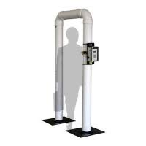
Alternative: Increase of screening capabilities e.g. Portal monitors
„Fast track“ mode
„Walk through“
1000 persons / h
FEMA standard for radiological emergency response: Detection of 37 kBq (1 µCi) Cs-137
Intake 37 kBq per inhalation: 0.25 mSv
Detection of 37 kBq 1day after intake: Intake 61.8 kBq, 0.41 mSv

Slide 13
Conclusion I
The efficacy of a decorporation treatment is best if started early after radionuclide(s) incorporation („urgent approach“). The possibilities to compensate a delay in treatment initiation by extending treatment duration are limited.
It is not possible to give a clear cut time slot limiting decorporation efficacy. Depending on the situation, it seems to be in a range of hours to several days.

Slide 14
Conclusion II
start early
no clear time cut
The “urgent approach” is associated with larger stockpile requirements than the “precautionary approach”, up to several hundred times in large scale scenarios.
Timely identification of the victims actually needing treatment by enhancing (mobile) screening capacities may be the most efficacious way to reduce antidote requirements.
In large scale scenarios, it might be necessary to abandon the medically preferable “urgent approach” for an antidote-sparing “precautionary approach”.

