Slide 1
Comparison of ensembles of atmospheric dispersion simulations Lessons learnt from the CONFIDENCE project about uncertainty quantification
5th NERIS workshop
5 April 2019
Session: Challenges in estimating the source term and operational radiological picture (on-site versus off-site)
I. KORSAKISSOK, WP1 members
Spyros Andronopoulos, Poul Astrup, Peter Bedwell, Karine Chevalier-Jabet, Hans De Vries, Gertie Geertsema, Florian Gering, Thomas Hamburger, Heiko Klein, Susan Leadbetter, Anne Mathieu, Tamas Pazmandi, Raphaël Périllat, Csilla Rudas, Andrey Sogachev, Peter Szanto, Jasper Tomas, Chris Twenhöfel, Joseph Wellings

Slide 2
Context
Context Input uncertainties Uncertainty propagation Perspectives
In case of an accidental release of radionuclides
Atmospheric dispersion models are used to forecast the health and environmental impact
A tool for decision making: countermeasures (evacuation, sheltering, stable iodine intake)
A tool to reconstruct the contamination events combining simulation and measurements
Results are subject to many uncertainties
It can include stochastic uncertainties (i.e physical randomness), epistemological uncertainties (lack of scientific knowledge), ambiguities (ill-defined meaning), value uncertainties (when the required endpoint is ill-defined), judgemental uncertainties (e.g. setting of parameter values in codes), computational uncertainties (i.e. inaccurate calculations), modelling errors (i.e. however good the model is, it will not fit the real world perfectly)
We should also address social and ethical uncertainties, in the analysis of risk and in decision making

Slide 3
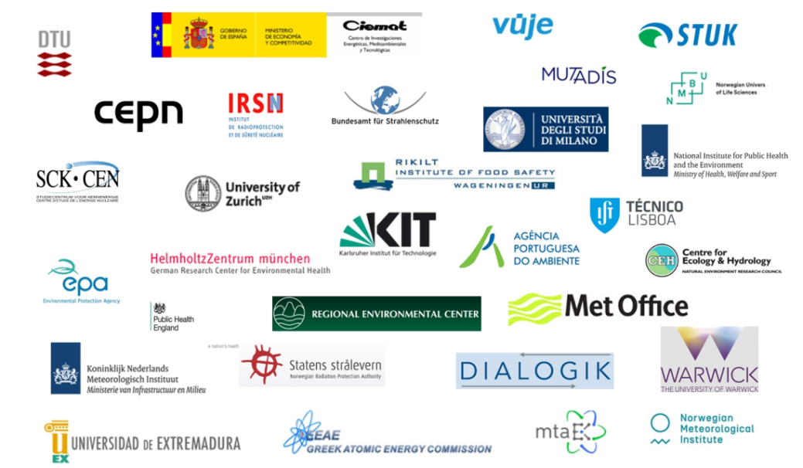
Context Input uncertainties Uncertainty propagation Perspectives
The CONFIDENCE project
COping with uNcertainties For Improved modelling and DEcision making in Nuclear emergenCiEs
The CONFIDENCE Project will perform research focussed on uncertainties in the area of emergency management and long-term rehabilitation. It concentrates on the early and transition phases of an emergency, but considers also longer-term decisions made during these phases.
Duration 3 years: 1.1.2017 – 31.12.2019
31 partners from 17 European countries
Budget: 6.201.026 €, request to EC: 3.252.487 €
Part of CONCERT
7 work packages (WPs)
WP1: uncertainties in the pre and early release phase (atmospheric dispersion simulations)
WP2, WP3: data assimilation, measurements, radioecological models
WP4, WP5: stakeholders, transition phase to long-term recovery
WP6: visualization and decision-making
WP7: education and training

Slide 4
Context Input uncertainties Uncertainty propagation Perspectives
WP1: uncertainties in atmospheric dispersion simulations
1.1 Analyzing and ranking sources of uncertainties (Lead: IRSN)
Using ensemble data for meteorological uncertainties (Lead: UK MetOffice)
Using meteorological measurements to reduce uncertainties (Lead: EEAE)
Uncertainties related to source term (Lead: IRSN)
Uncertainties related to models (Lead: PHE)
1.2 Uncertainty propagation and analysis (Lead: IRSN)
Simulation and comparisons to observations for the Fukushima case
Simulation for the synthetic European case studies
1.3 Emergency response and dose assessment
Food chain uncertainty propagation (Lead: BfS)
Recommendations and operational methodology in an emergency context (Lead: PHE)
DONE
2017
DONE 2018 / IN PROGRESS
IN PROGRESS
2019

Slide 5
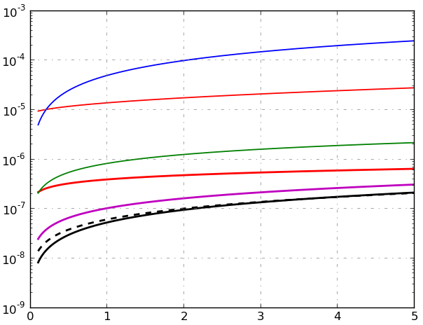
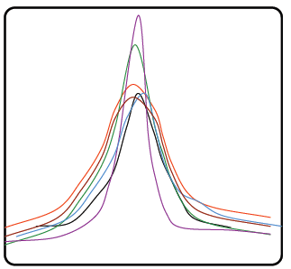
How to quantify the uncertainty of data?
Context Input uncertainties Uncertainty propagation Perspectives
Model parameters
Experts’ judgment, literature review
pdf

Slide 6
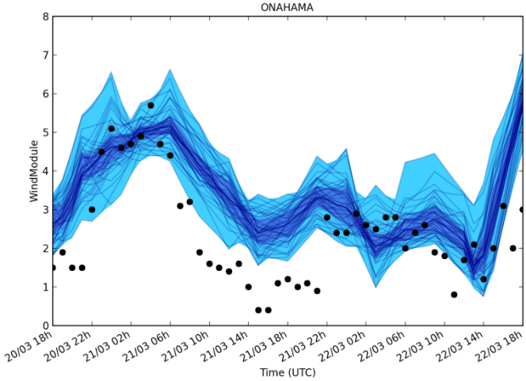
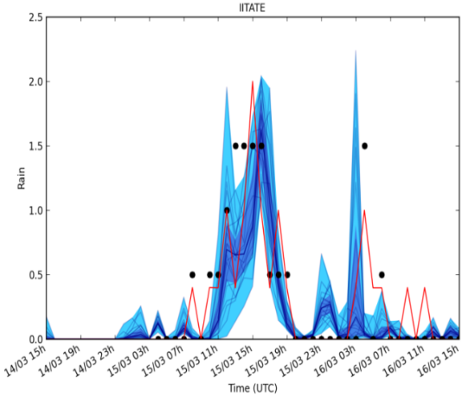
How to quantify the uncertainty of data?
Context Input uncertainties Uncertainty propagation Perspectives
Model parameters
Using meteorological forecast ensembles
pdf
Input : meteo

Slide 7
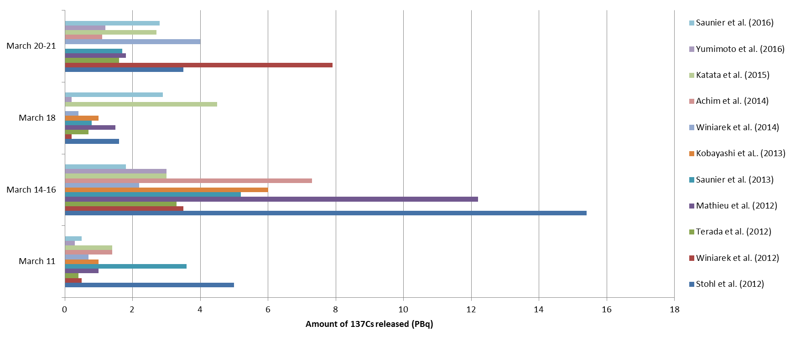
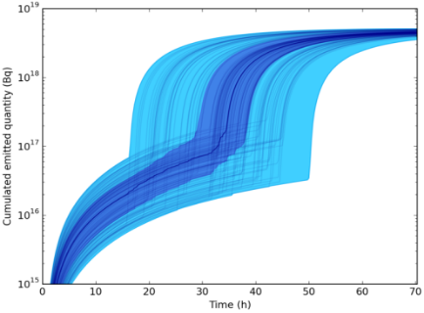
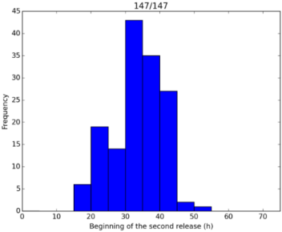
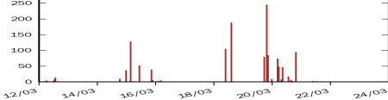
How to quantify the uncertainty of data?
Context Input uncertainties Uncertainty propagation Perspectives
Past-accident analysis (Fukushima ) literature review
Model parameters
pdf
Input : meteo
Emergency : May rely on experts’ judgment / ensemble of ST
European projects
Input: source term
¹³¹I

Slide 8
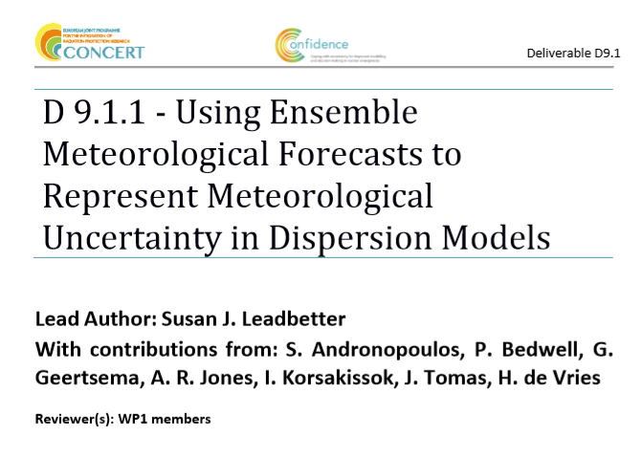
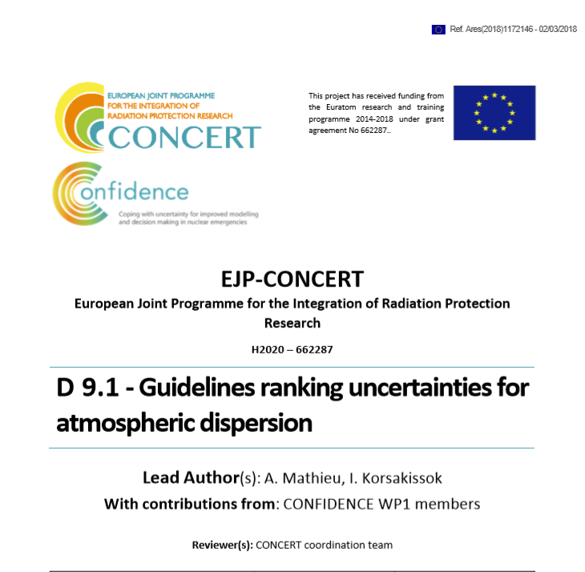
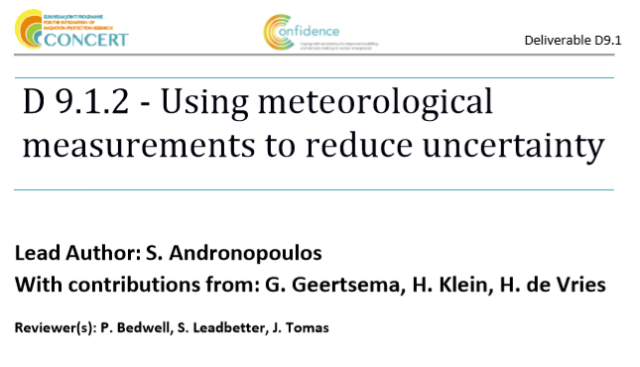
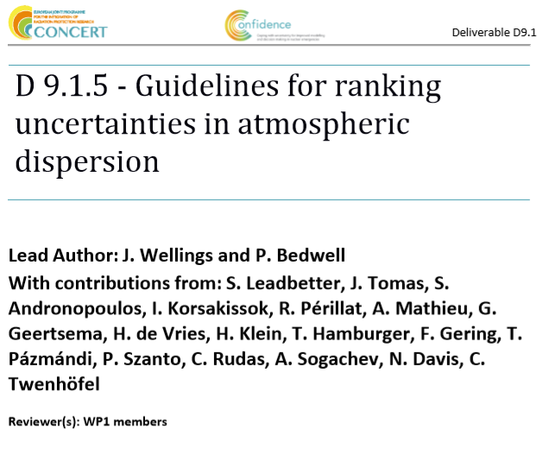
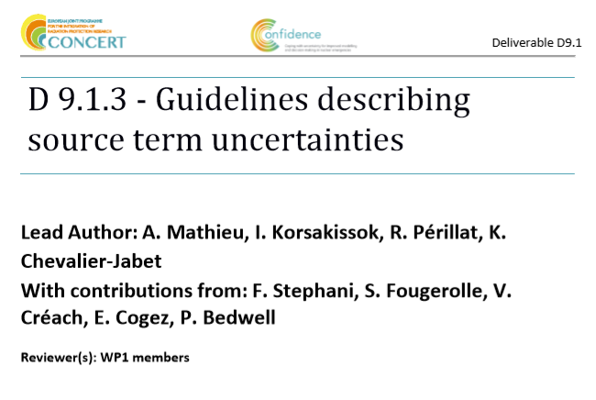
Further on input uncertainties…
Context Input uncertainties Uncertainty propagation Perspectives
http://www.concert-h2020.eu/en/Publications

Slide 9
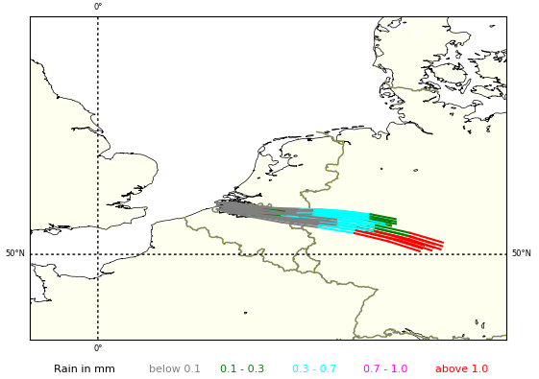
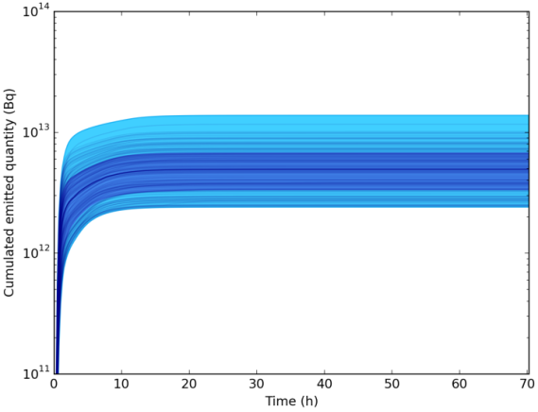
Context Input uncertainties Uncertainty propagation Perspectives
WP1 Case study: Borssele
Indicative plume trajectories based on analysed weather between 10m and 500m, for a release at 12 UTC 11/01/17, and associated rain (cumulated on one hour).
Meteorological scenario
Ensemble (KNMI), 10 members, 2,5 km resolution
72-hours forecast, 1-hour time step
11-13 January 2017: “Easy case” (established wind direction), rain
Long release scenario: ensemble (FASTNET)
Duration 72 hours
Extracted from a database built with ASTEC severe accident code
Release time 11 January at 06 UTC without uncertainties
Second major release = opening of the venting containment system
Aerosols are filtered for the second release
Representative of model uncertainties (release phase)
(a) ¹³⁷Cs
Short release scenario
Duration 4 hours - Release time 11 January at 12 UTC
8 radionuclides, no kinetics
Representative of uncertainties in the pre-release phase
(b) ¹³¹I

Slide 10
Context Input uncertainties Uncertainty propagation Perspectives
Short release scenario
Release time 11 January at 12 UTC +/- 6 hours
Release height 50m +/- 50m
Released quantity X [1/3, 3]
Radionuclide | Xe-133 | I-131 | I-132 | Te-132 | Cs-134 | Cs-136 | Cs-137 | Ba-137m
Activity(Bq) | 3.51E18 | 2.25E16 | 2.84E16 | 1.37E16 | 2.69E15 | 6.37E14 | 2.06E15 | 2.78E14
Participant | Number of simulations | Source perturbations
 |  | Release height | Release time | Released quantity
IRSN | 100 (Monte Carlo) | [0, 100m] uniform | [-6h, 6h] uniform | [1/3, 3] uniform
BfS | 150 | [0m, 50m, 100m] | T0 + [-6h, -3h, 0h, +3h, +6h]
MetOffice/ PHE | 90 | [50m] | T0 + [-6h, 0h, +6h] | [x1/3, x1, x3]
EEAE | 50 | [50m] | T0 + [-6h, -3h, 0h, +3h, +6h]
MTA EK | 150 | [0m, 50m, 100m] | T0 + [-6h, -3h, 0h, +3h, +6h]
RIVM | 650 | [0m, 25m, 50m, 75m, 100m] | [-6h, +6h] with a time step of 1 hour (13 steps)
DTU | 10 | - | - | -

Slide 11
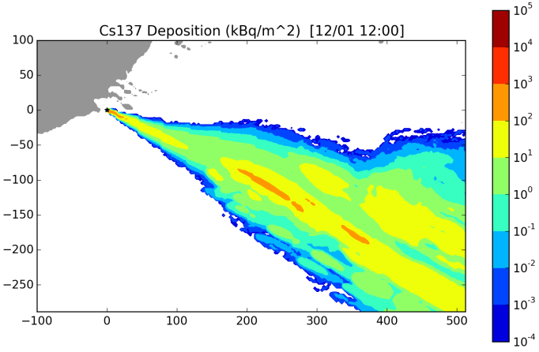
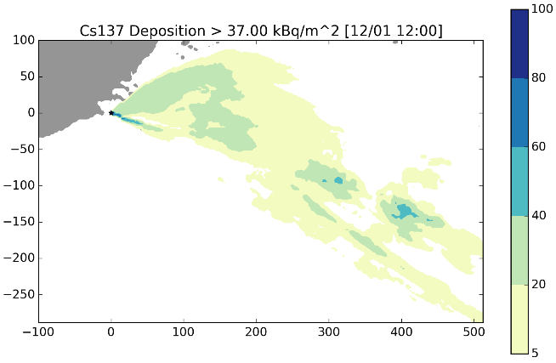
Context Input uncertainties Uncertainty propagation Perspectives
Short release scenario
Endpoints: consequences computed at T0+24h
Ground deposition of ¹³⁷Cs and ¹³¹I
Post-Chernobyl reference level: 37 kBq/m² for ¹³⁷Cs
Other levels: 10 kBq/m² for ¹³⁷Cs, ¹³¹I
Effective dose and inhalation thyroid dose for 1-year old child – 10, 50, 100 mSv
How to use ensemble results?
Deterministic: one simulation
¹³⁷Cs deposition, threshold 37 kBq/m²
Probabilistic: ¹³⁷Cs ground deposition for N simulations
N maps of deposition: “postage stamp”
Median (or 25th, 75th percentile…) of the N deposition maps
For a given threshold t
N maximum distances D_{i} above t
Map of probability of exceeding t
Maximum
distance D above threshold
Mean 361 km
Range 16–586 km

Slide 12
Context Input uncertainties Uncertainty propagation Perspectives
Short release: “postage stamp”
¹³⁷Cs deposition (kBq/m²)
at T0+24h - UK MetOffice
T0 = 12:00 UTC
T0 = 06:00 UTC
T0 = 18:00 UTC
Different meteorological fields

Slide 13
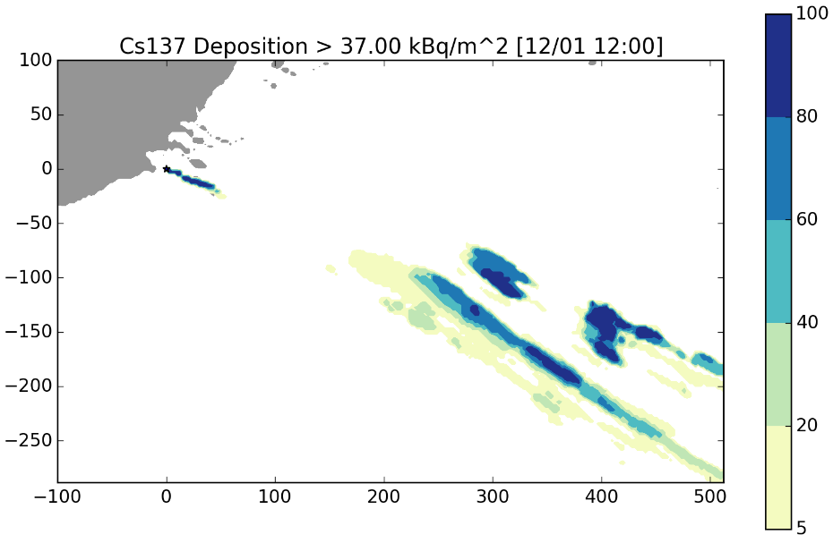
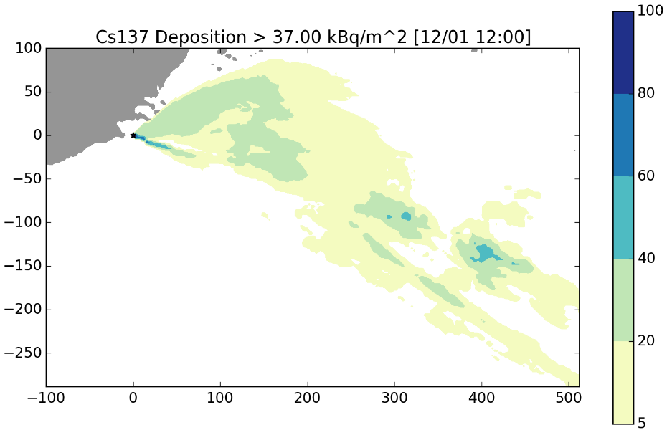
Context Input uncertainties Uncertainty propagation Perspectives
Short release: probability maps
Maps of probability of threshold exceedance
For a threshold of 37 kBq/m² for the ¹³⁷Cs deposition
Example of UK MetOffice (NAME model)
Mean 557 km
Range 517–585 km
Mean 361 km
Range 16–586 km
10 simulations (meteorology only)
90 simulations (meteorology + source term)
With source perturbations
Maximum distance of threshold exceedance is lower
Surface covered by low probabilities is larger

Slide 14
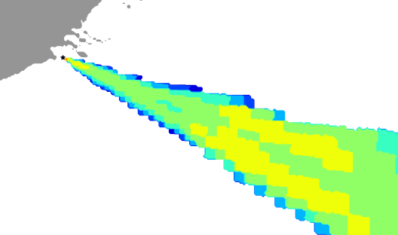
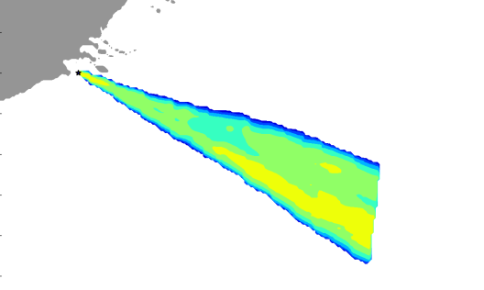
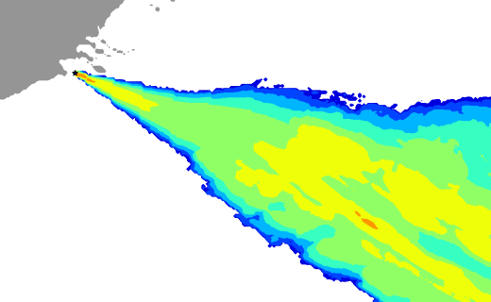
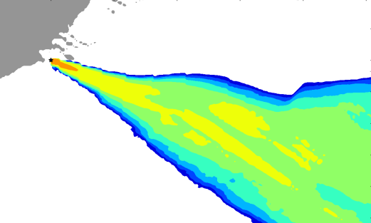
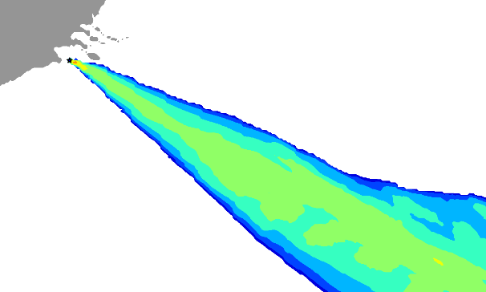
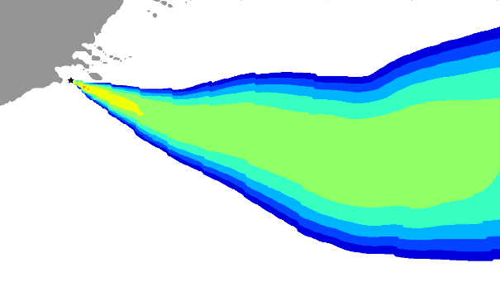
Short release: median of ¹³⁷Cs deposition (kBq/m²)
Context Input uncertainties Uncertainty propagation Perspectives
RIMPUFF – Gaussian puff
RIMPUFF – Gaussian puff
DIPCOT– Gaussian puff
BfS
DTU
EEAE
NAME – Lagrangian
LdX– Eulerian
NPK-puff – Gaussian puff
MetOffice
IRSN
RIVM
SINAC – Gaussian puff
10 simulations (meteorology only)
Differences may come from:
Type of models (Gaussian, Eulerian, Lagrangian)
Different wet deposition schemes
Diffusion coefficients
Modelling domain, interpolation…
MTA EK

Slide 15
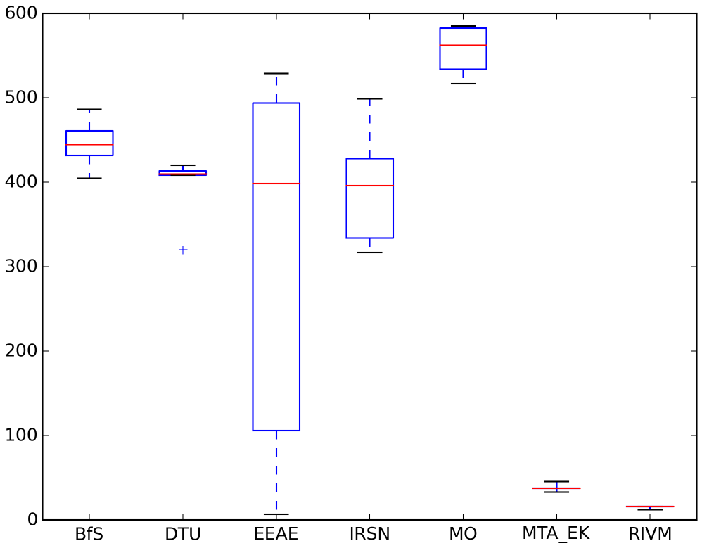
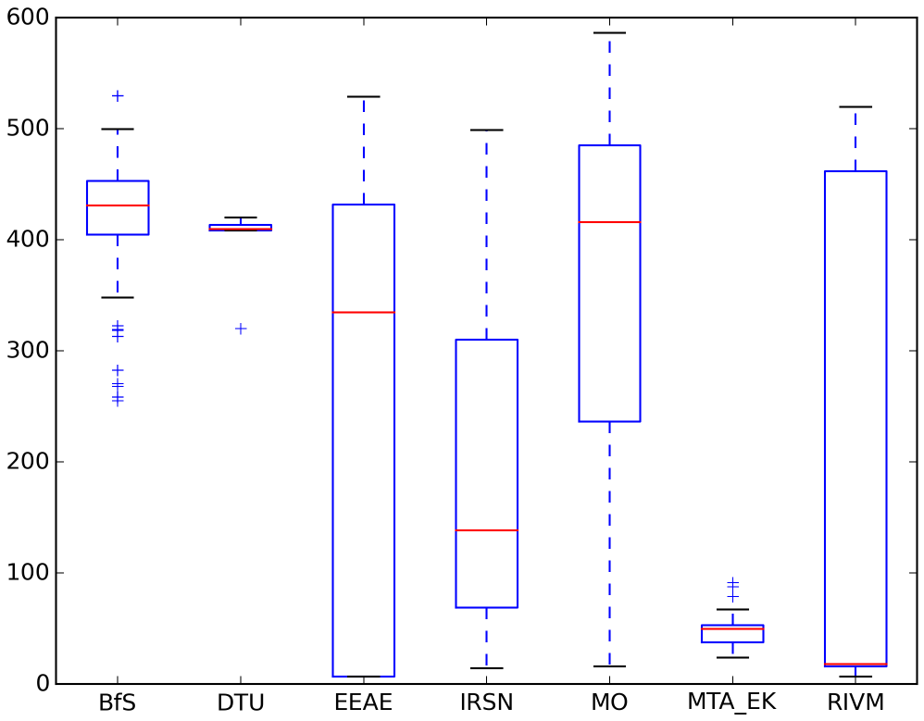
Context Input uncertainties Uncertainty propagation Perspectives
Short release: box plots
Maximum distance from the source (km)
For a threshold of 37 kBq/m² for the ¹³⁷Cs deposition
10 simulations (meteorology only)
10-650 simulations (meteorology + source term)
Larger variability (boxes’ size) with ST perturbations
Inter-model variability not totally encompassed by the range of variation

Slide 16
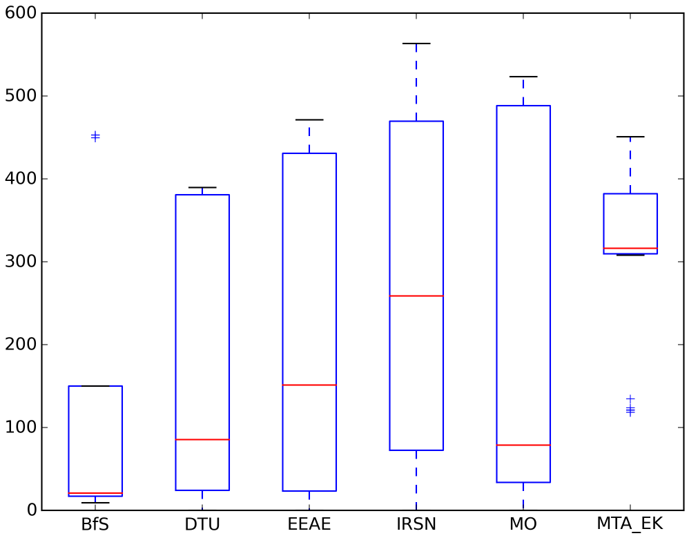
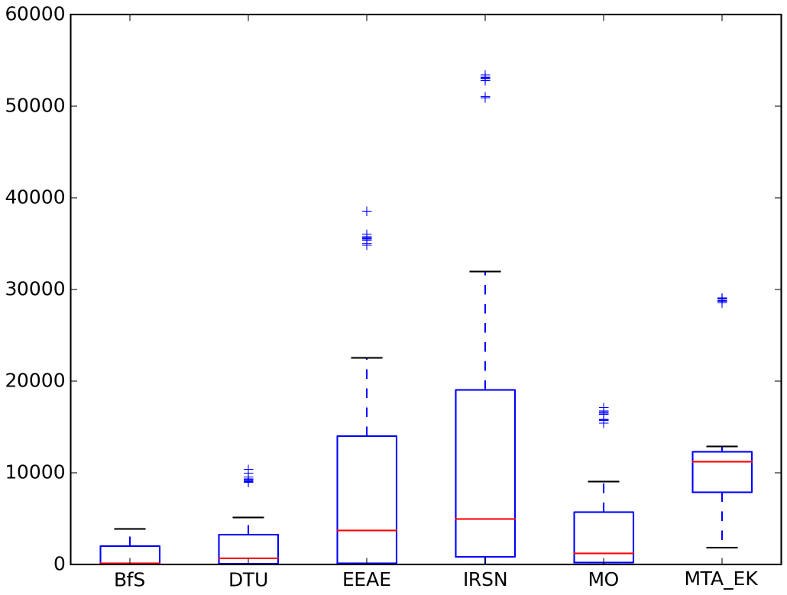
Context Input uncertainties Uncertainty propagation Perspectives
Long release: box plots
Maximum distance from the source (km) and surface (km²)
For a threshold of 10 kBq/m² for the ¹³¹I deposition
Maximum distances
Surfaces
Inter-model variability mostly encompassed within the range of each ensemble
Surfaces are less dependent on outliers and may be more reliable

Slide 17
Conclusions
Context Input uncertainties Uncertainty propagation Perspectives
Influence of source perturbations
Importance of taking into account source perturbations
Larger ensembles’ spread
More perturbations induce lower distance above a given threshold
Inter-model variability
Less important when overall uncertainties are larger
Some models or configurations may be more appropriate to the case
Part of this variability may be taken into account
An uncertainty assessment with only one model will always be partial
Uncertainty assessment
Lower threshold induces higher distances / probability
Surface above threshold (instead of distance) limits the effect of outliers
Importance of choosing correctly the threshold and percentile

Slide 18
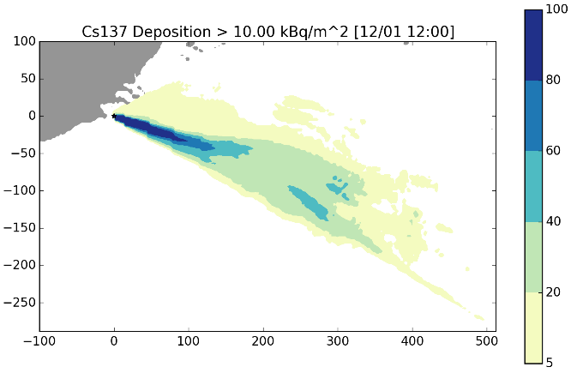
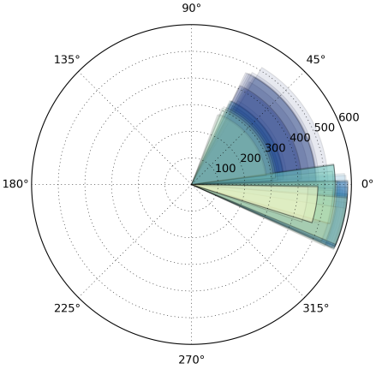
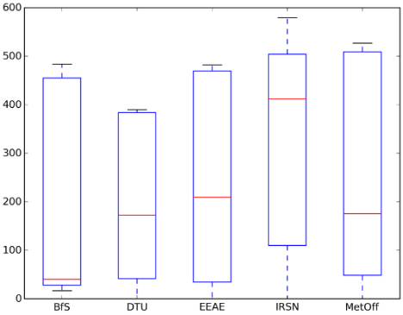
Uncertainties in an emergency context
Context Input uncertainties Uncertainty propagation Perspectives
Our knowledge of uncertainties will always be partial…
Deep uncertainties, lack of information
Have to tackle the main sources of uncertainties!
Avoid false confidence in probabilistic results…
Computational time: how many members are needed to correctly represent uncertainties? How to reduce computational time?
Reducing the number of members: clustering techniques, adaptive sampling
Model reduction: emulators, model assumptions
Adaptation to the endpoint: domain size and resolution…
How to include uncertainties in output products for decision makers?

Slide 19
Context Input uncertainties Uncertainty propagation Perspectives
Next steps…
Case studies in progress
Ensemble runs for Borssele more challenging case “front passage” ongoing
Fukushima and Western Norway ongoing (not synchronised between participants)
Other tasks in the remaining year
Food chain uncertainty propagation
Recommendations and operational methodology in an emergency context
Dissemination
Training course (May 2019, Slovak Republic)
Special CONFIDENCE session at HARMO 19th (June 2019, Belgium)
Dissemination workshop (December 2019, Slovak Republic)
https://www.eu-neris.net/
Thank you for your attention!

