Slide 1
Remote Monitoring of Nuclear Power Plants in Baden-Wuerttemberg -
From Measurement to Emergency Protection
NERIS Platform Workshop
Bratislava, 6-8 February 2012
Thomas Wilbois
Christian Grimm
Matthias Hagmann
Thomas Wilbois
Yongxiang Ren
Walter Scheuermann
Ulrich Neff

Slide 2
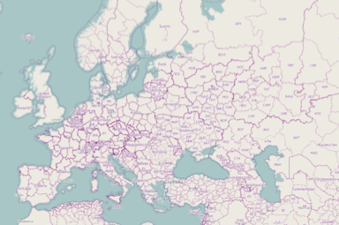
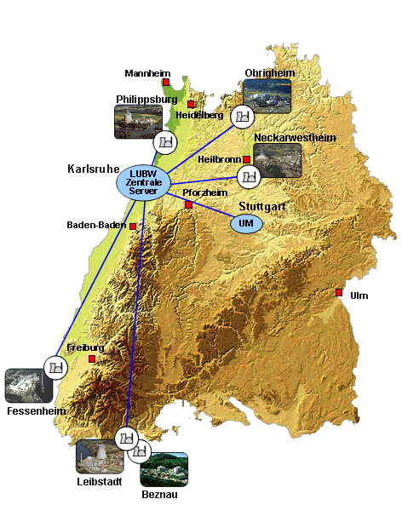
Geographical survey.
Source: Open Streetmap
Monitoring Areas
Philippsburg (KKP)
Neckarwestheim (GKN)
Obrigheim (KWO)
Fessenheim (F)
Leibstadt, Beznau (CH)
Gundremmingen
Biblis
Cattenom
Mülheim-Kärlich

Slide 3
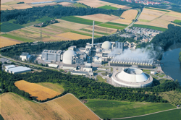
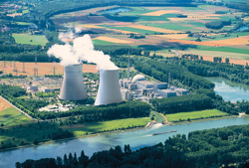
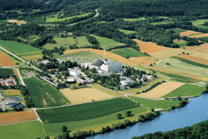
Duties and responsibilities of the System.
Monitoring of operational parameters and emissions of the plants perfomed by the supervisory authority and the assessor (TÜV)
Immission measuring network: ambient dose rate and aerosol concentrations, weather-stations (LUBW)
National and International data exchange
Dispersion calculation (prognostic and diagnostic): exposition of the public
Decision support tool for emergency protection :
  Radiological situation report
  Combined presentations of all data sources (incl. Calculations)
Simulation tool for the creation and implementation of excercises

Slide 4
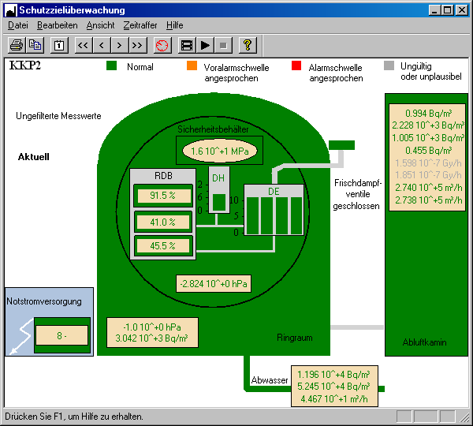


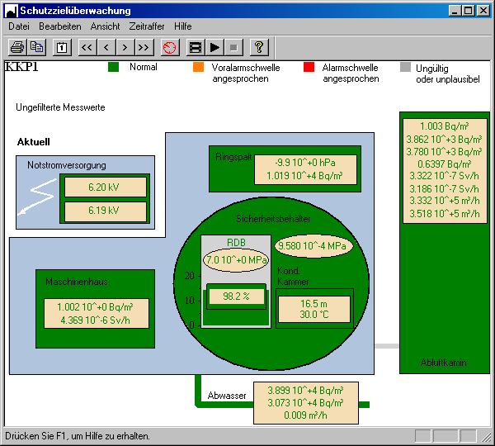
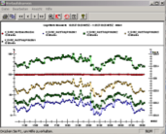
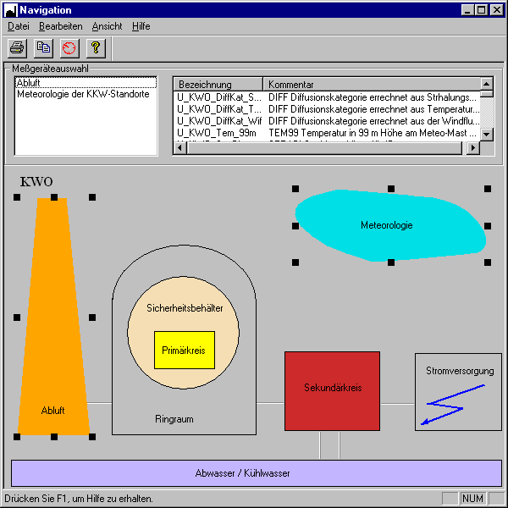
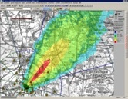


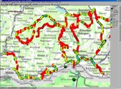

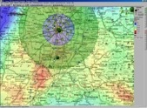

Basic System Architechture.
Power Plants
Internet
On-call duty
Ministry
KFÜ-Client
Immissions
Phone based
Alerting system
KFUe
WebServer
Local Database
Meteorology
Regional
administration
Central
database
(Oracle RAC)
KFÜ-Client
Measuring Teams
Dispersion
Calculation
Terminal server
Communikation
Server
Operating Company
External Networls
KFÜ-Client
LUBW Karlsruhe
Terminal server
Raw data Acquisition, Processing, Alerting Evaluations

Slide 5
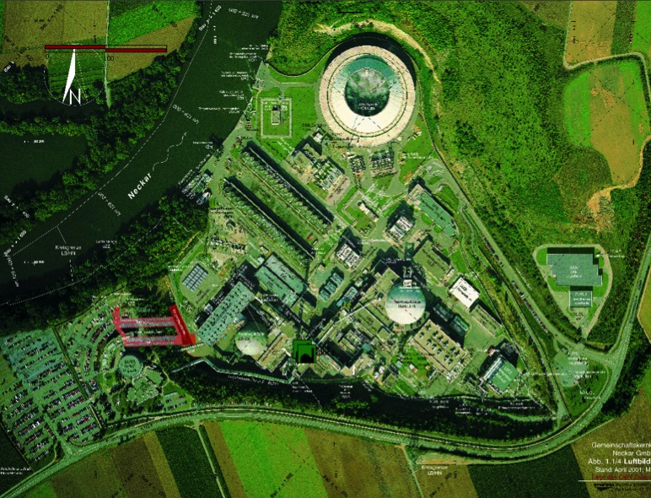
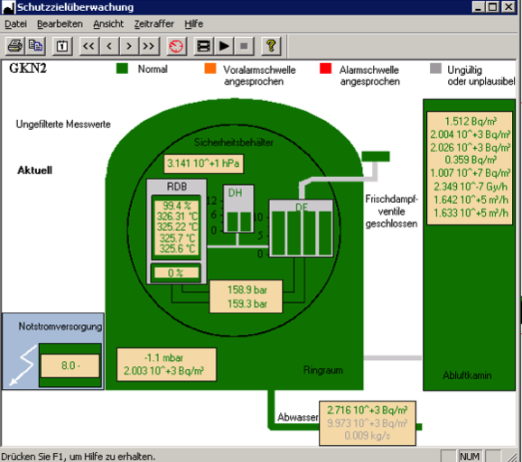
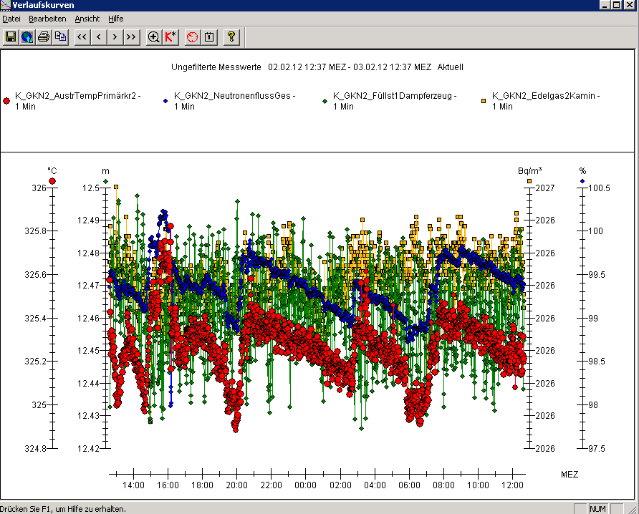
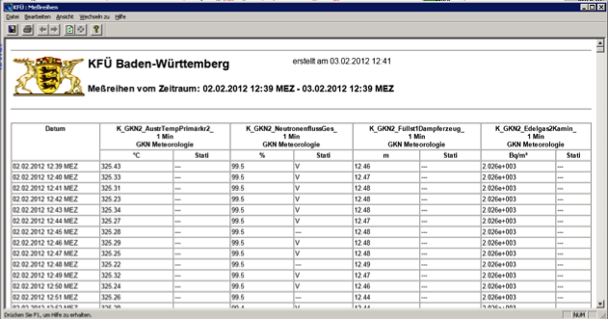
Supervision: Operational parameters and emissions.

Slide 6
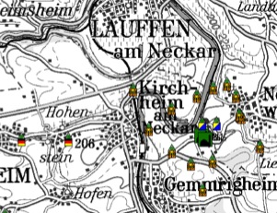
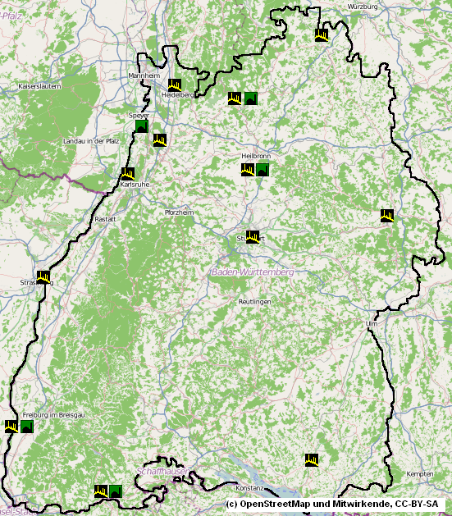


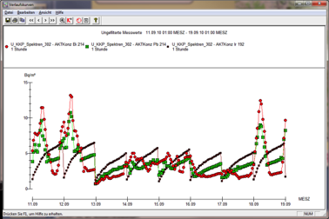

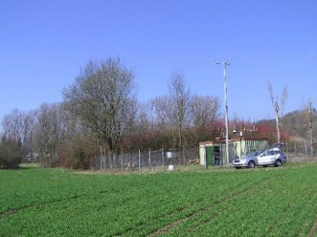
The KFUe radiation measuring network.
Ambient dose rate measuring
network (~110 stations)
2 Skylink Receivers (>100 km)
Königsstuhl & Feldberg
6 Shortlink Receivers (~10 km)
Close to each plant site (+1 mobile)
Aerosole air concentrations
11 Aerosole stations located at
Plant sites (5)
Within the country (6)
Mobile (3)

Slide 7
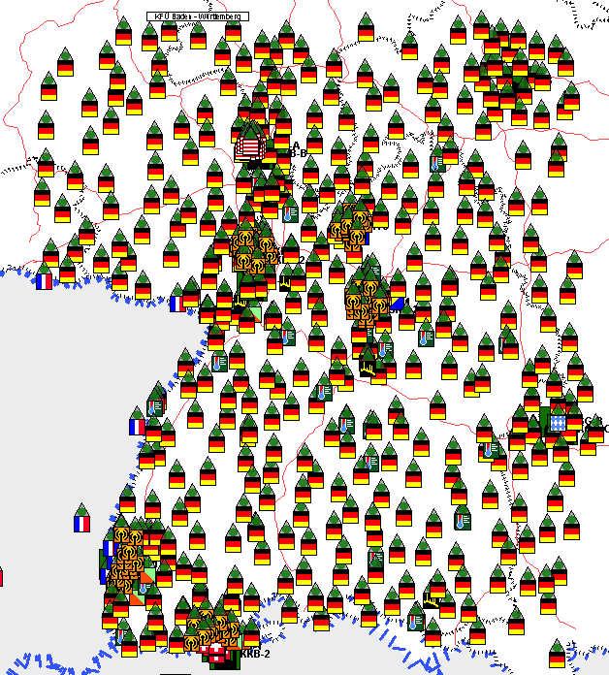
All stations including data exchange.
    KFUe
    Measurements
    Bavaria,
    Gundremmingen
    Hesse, Biblis
    DWD
    BfS
    IRSN
    MADUK

Slide 8
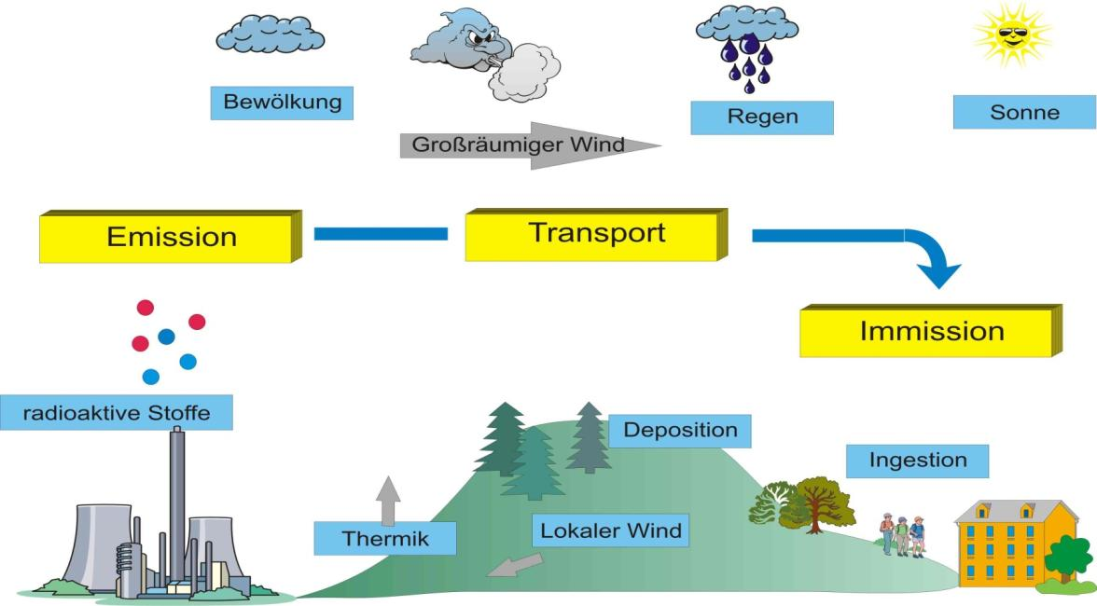


Dispersion calculation (IKE).
Measurements
Forecasts
Large Scale Wind regime, Fallout, Washout
Dose calculations
γ, β submersion
Inhalation
Terristic radiation
Ingestion
Turbulence
Thermal
Local wind regime

Slide 9
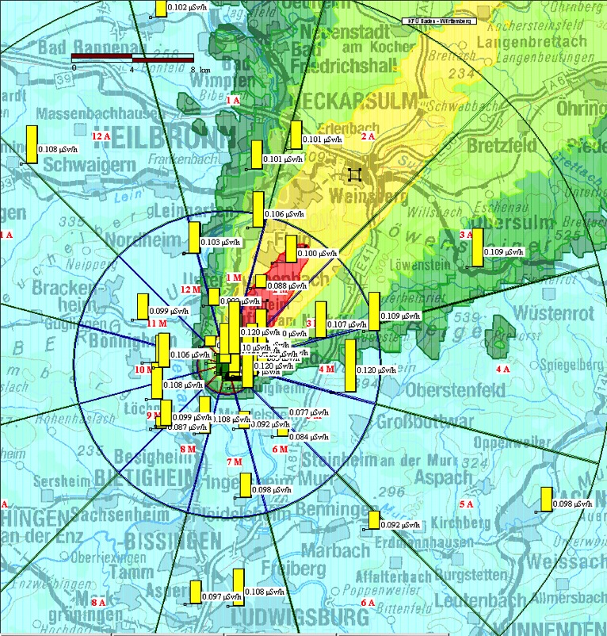
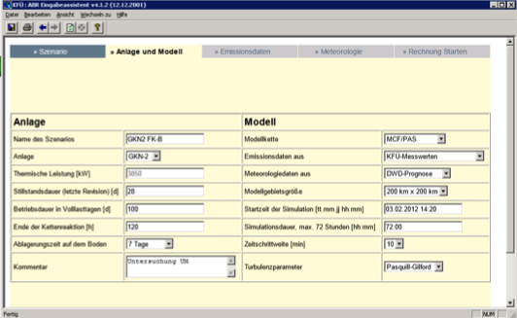
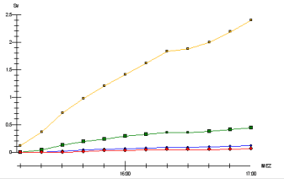
Dispersion Calculation in the system.
Automatic and manual modes
Several methods for treatment of source term and meteorology
Diagnostic and prognostic calculations
Lagrange particle model based on
  Topography
  diagnostic Wind regime (3D)
  dispersion parameters (turbulent part)
  Models for dry and wet deposition
Dose module

Slide 10
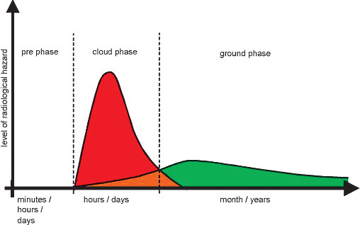


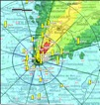
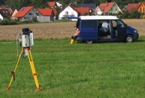
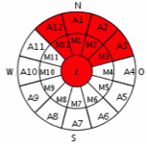
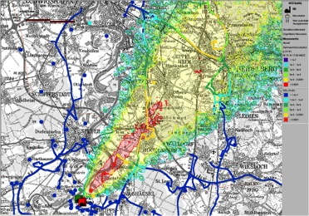
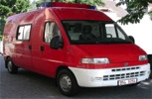
Phases in nuclear emergency.
Stationary measurements
Dispersion calculations
Measures
Stationary measurements
Mobile measurements
Measures
BfS-
Aerogamma
Measurement
teams
ABC-Explorers

Slide 11
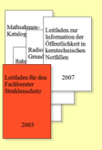
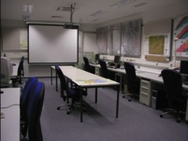
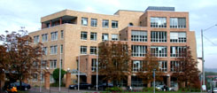

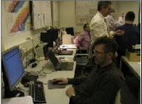
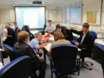



§
Measures and reference levels.
§
§
Measure | Dose | Reference level
Intake of iodine tablets | thyroid inhalation dose (7 days integration time including dose commitment) | 50 mSv (children, pregnant women) 250 mSv (adults)
Sheltering | Effective dose (children) (7 days integration time including dose commitment) | 10 mSv
Evacuation | Effective dose (children) (7 days integration time including dose commitment) | 100 mSv

Slide 12
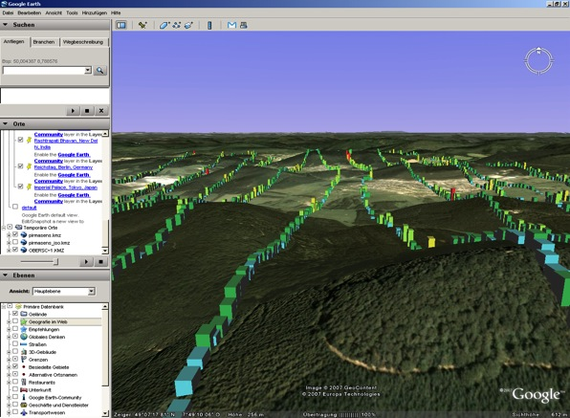

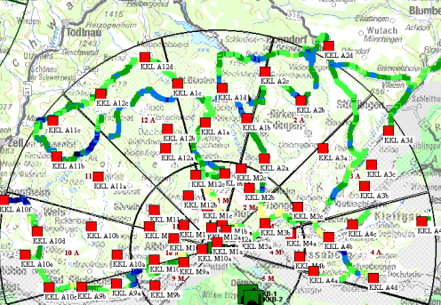
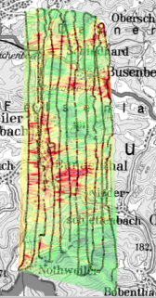
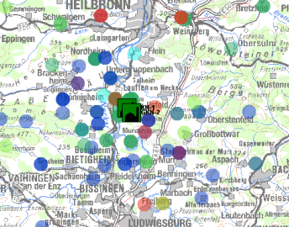
Providing Information for Emergency protection.
Weather forecasts and radar precipitation (DWD)
Stationary Measurements
Exchange of dispersion calculation results (and source terms)
Import of ABC-Explorer data, manual & Insitu-Measurements
Aerogamma data of the BfS
Interface to Electronic Situation Report System (ELD)

Slide 13

Thank you.
Questions?
Flyer available
http://www.um.baden-wuerttemberg.de/servlet/is/62324/
Application of the ABR to the Fukushima accident:
ATW, June 2011
Same system is in operation at
  Rhineland-Palatinate, Saarland
  KHG (on behalf of the operating companies)

