Slide 1
Case study on the improved use of collective dose for nuclear and radiological emergencies
Johan Camps, Geert Olyslaegers & Damien Braekers
Belgian Nuclear Research Centre (SCK•CEN)
Institute for Environment, Health and Safety
jcamps@sckcen.be
1st NERIS Platform Workshop, Preparedness for nuclear and radiological emerengency response and recovery: implementation of ICRP recommendations
Bratislava/Park Inn Danube, 6-8 February 2012

Slide 2
Introduction
Why interest in collective dose? 2 observations:
  Experience from emergency exercises (Belgium)
    Decisions often strictly guided by intervention levels
    Little collective issues (except for practical implementation of countermeasures)
  Communication of impact of accident:
    INES rating results in a comparison
    How to summarize difference between accidents of same INES rating
    Post accident analysis by e.g. UNSCEAR
ICRP recommendations related to collective dose and can collective dose contribute to emergency preparedness and response if it is used according these recommendations?

Slide 3
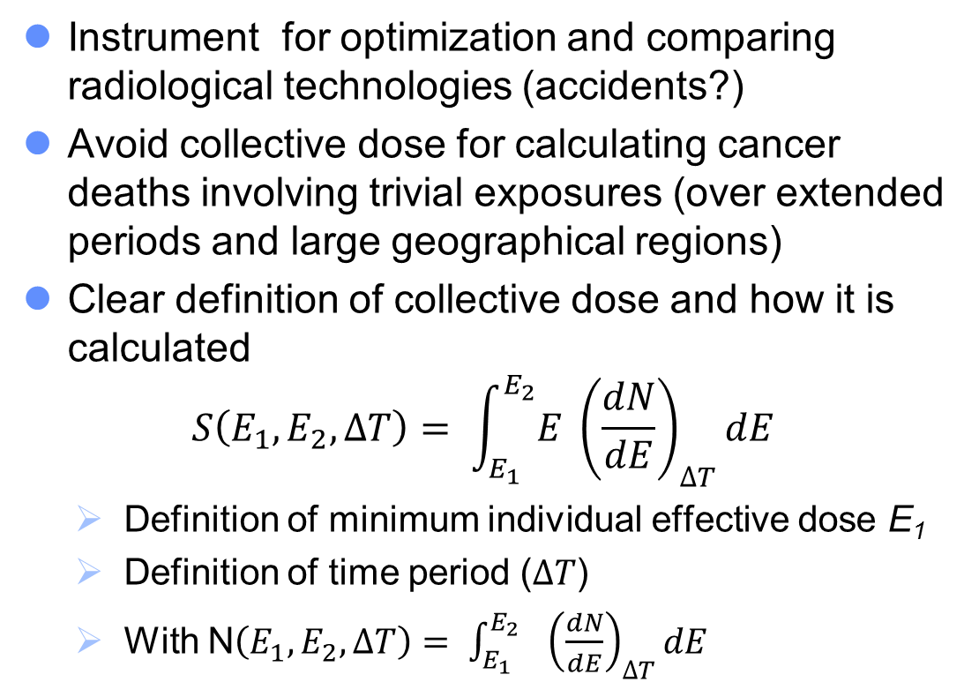
ICRP recommendations – Collective dose
Instrument for optimization and comparing radiological technologies (accidents?)
Avoid collective dose for calculating cancer deaths involving trivial exposures (over extended periods and large geographical regions)
Clear definition of collective dose and how it is calculated
$$S\left(E_{1}, E_{2}, ∆T\right)= \int_{E_{1}}^{E_{2}}{E} {\left(\frac{dN}{dE}\right)}_{∆T}dE$$
  Definition of minimum individual effective dose E₁
  Definition of time period ($∆T$)
  With N$\left(E_{1}, E_{2}, ∆T\right)= \int_{E_{1}}^{E_{2}}{ }{\left(\frac{dN}{dE}\right)}_{∆T}dE$

Slide 4
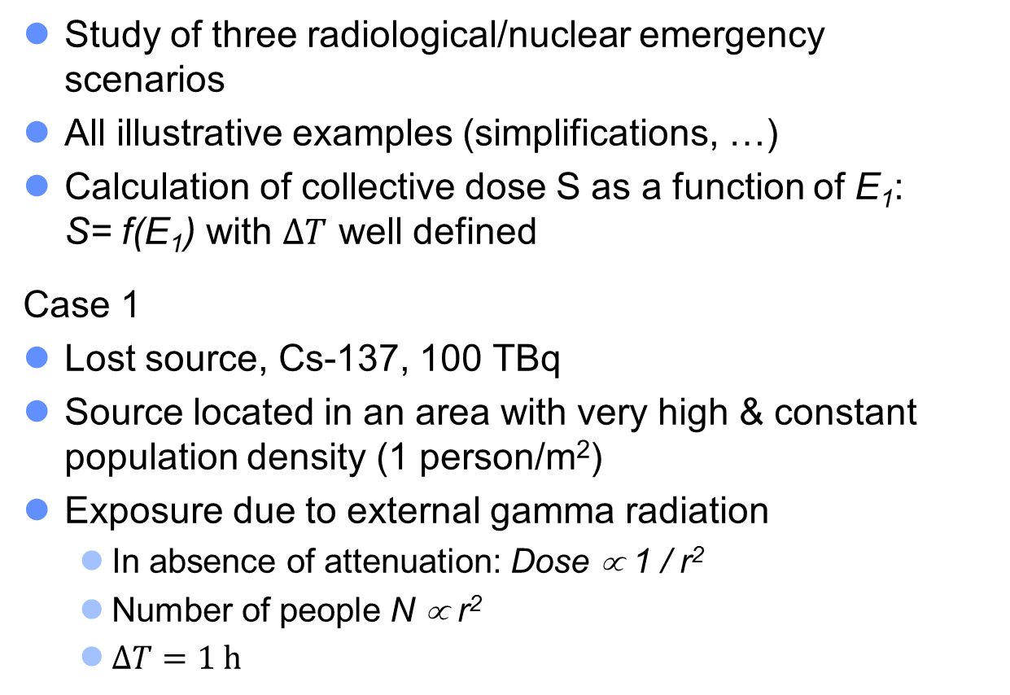
Case study - Case 1
Study of three radiological/nuclear emergency scenarios
All illustrative examples (simplifications, …)
Calculation of collective dose S as a function of E₁: S= f(E₁) with $∆T$ well defined
Case 1
Lost source, Cs-137, 100 TBq
Source located in an area with very high & constant population density (1 person/m²)
Exposure due to external gamma radiation
  In absence of attenuation: Dose ∝ 1 / r²
  Number of people N ∝ r²
  $∆T=1 h$

Slide 6
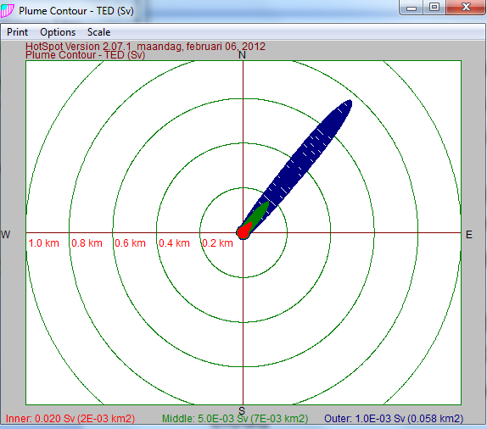

Case 2
Cs-137, 100 TBq (idem as case 1)
Activity dispersed (explosion)
  Typical meteorological conditions (u= 3 m/s, neutral conditions)
  Simple dispersion model: use of HOTSPOT v2.07 for calculation effective dose
High and constant population density (same as case 1): 1 person/m²
Effective dose from cloud passage and inhalation ($∆T$ short)
Calculation without and with depletion of the cloud
Calculation of collective dose: S = f(E₁)

Slide 8
Comparison case 1 – case 2
100 TBq
Cs-137
Lost source –
external radiation
Dispersed source –
inhalation and cloud shine

Slide 9
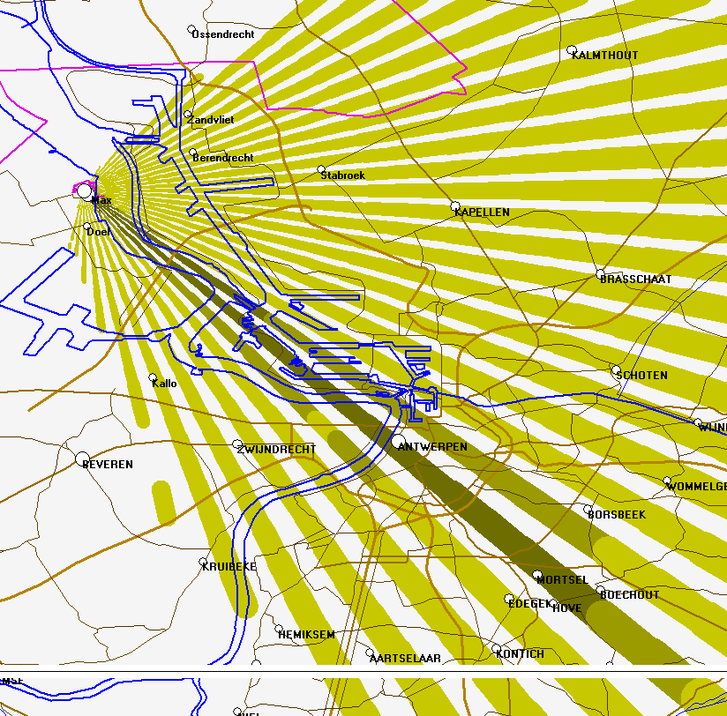
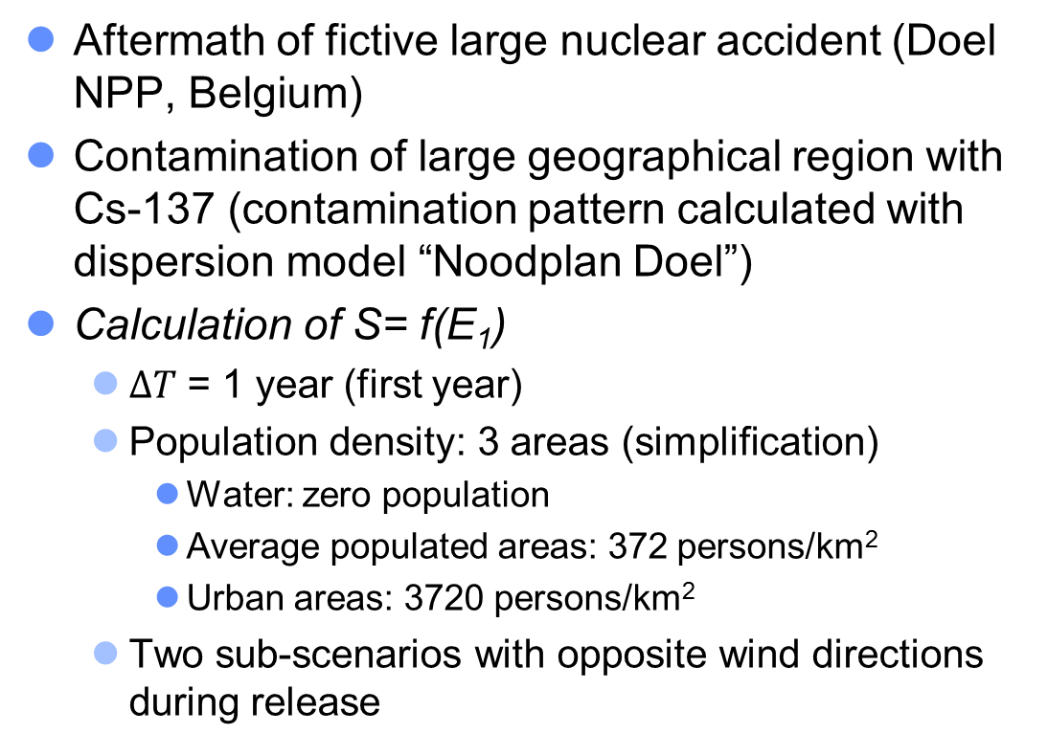
Case 3
Aftermath of fictive large nuclear accident (Doel NPP, Belgium)
Contamination of large geographical region with Cs-137 (contamination pattern calculated with dispersion model “Noodplan Doel”)
Calculation of S= f(E₁)
  $∆T$ = 1 year (first year)
  Population density: 3 areas (simplification)
    Water: zero population
    Average populated areas: 372 persons/km²
    Urban areas: 3720 persons/km²
  Two sub-scenarios with opposite wind directions during release

Slide 10
Calculated deposition pattern (Bq/m²)
for opposite wind directions
5e6 1e6 1e5 1e4 1e3 Bq/m²

Slide 12
Discussion
S= f(E₁): due to (a combination of) different physical factors, S reaches a maximum value if E₁ → 0
  The importance of trivial individual doses to S depends on the scenario
The graphical representation of S= f(E₁) can have an added value in comparing scenarios and the optimization of the protection strategy
  Alternative is calculation of S for specific values of E₁ (e.g. 1, 20, 100 mSv)

Slide 13
Discussion (cont’d)
A way of comparing accidents (especially interesting if INES rating is equal)?
  If E₁ and ΔT are defined equal !
  Cfr. analysis of IRSN related to Fukushima (IRSN report DRPH/2011-010)
To be of operational interest: to be implemented in decision support systems → further experience

Slide 14
Conclusion
Calculation of collective dose as a function of minimum individual effective dose can
  give insight in collective exposure and
  can support decisions related to overall protection strategy
Calculation of collective dose forces to take into account the number of exposed individuals
Thank you
Questions ?

