Slide 1
Emergency Exposure Situations: IAEA Safety Standards and Guidance
Elena Buglova
Head, Incident and Emergency Centre

Slide 2
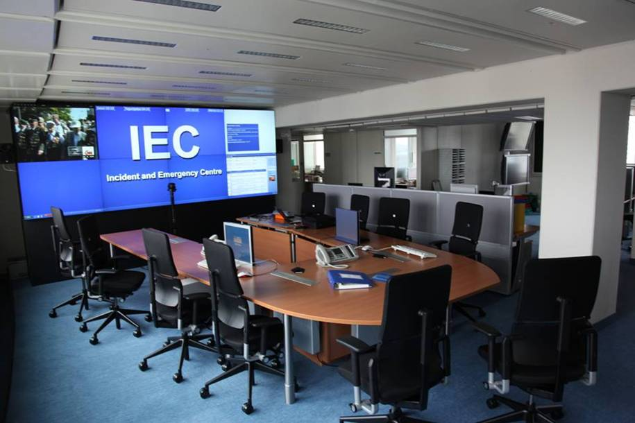
Incident and Emergency Centre (IEC)
Global Focal Point for
International Preparedness and Response to
Nuclear and Radiological Safety or Security related Incidents, Emergencies, Threats or Events of Media Interest

Slide 3
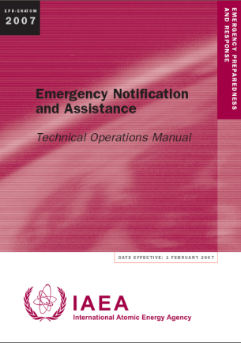
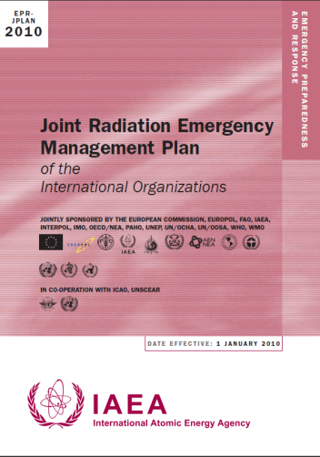
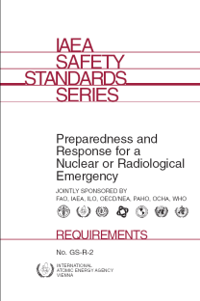
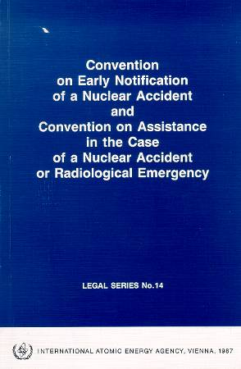
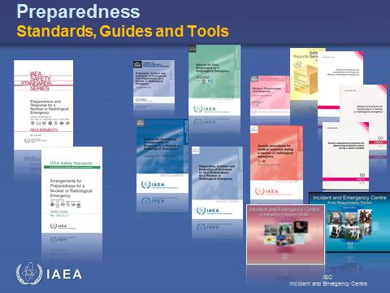
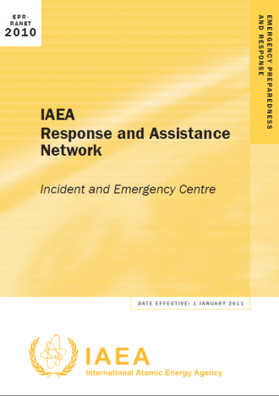
Basis for IEC Activities

Slide 4
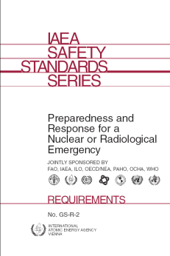
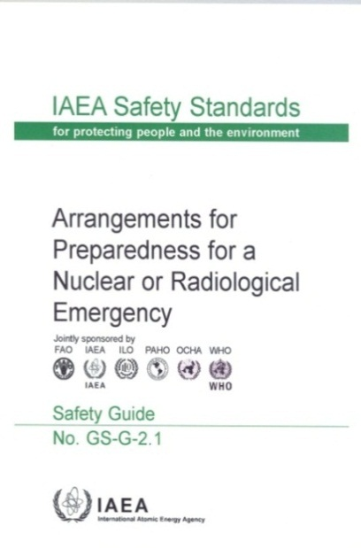
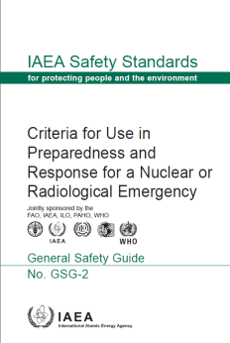
Safety Standards in EPR

Slide 5
Safety Requirements
Preparedness and Response for Nuclear or Radiological Emergency:
Requirements GS-R-2 (2002)
establishes requirements for an adequate level of preparedness and response for a nuclear or radiological emergency in any State
Notes:
IAEA Training in Emergency Preparedness and Response
5

Slide 6

Safety Guides
Arrangements for Preparedness for a Nuclear or Radiological Emergency:
Safety Guide GS-G-2.1 (2007)
Assists in fulfilling requirements for efficient EPR
Notes:
IAEA Training in Emergency Preparedness and Response
6

Slide 7
Examples of addressed issues

Slide 8
Areas and Zones
Notes:
Threat Category I and II Facilities – Emergency Zones and Radius Sizes Table A5-II provides suggestions for the approximate radius of the emergency zones and food restriction planning radius for threat categories I and II facilities. Site or facility specific studies could also be used to determine appropriate radii for the zones.
The suggestions are provided with recognition of the great uncertainties involved and variation by a factor of two or more during application is reasonable. The choice of the suggested radii represents a judgment of the distance to which making advanced arrangements is reasonable in order to ensure effective response. In a particular emergency, protective actions may have been warranted only in a small part of the zones. For the worst possible emergencies, protective actions might need to be taken beyond the radii suggested.
The sizes are shown in terms of a radius of a circle centred at the source of the potential release or criticality. However, the actual boundary of the zones should not be a circle but should be established to conform to geographical features such as roads, rivers, or political boundaries as illustrated in Figures 2 and 6. Following Table A5-II, there is a discussion of the basic philosophy used to establish the size.
See [EPR-Method, 2003, Appendix 5, pages 126-129].

Slide 9
Suggested Emergency Zones and Area Sizes
Facilities | Precautionary action zone (PAZ) | Urgent protective action planning zone (UPZ)
Threat category I facilities | radius | radius
Reactors > 1000 MW(th) | 3–5 km | 5–30 km
Reactor 100–1000 MW(th) | 0.5–3 km | 5–30 km
A/D₂ from Appendix III is ≥ 10⁵ | 3–5 km | 5–30 km
A/D₂ from Appendix III is ≥ 10⁴–10⁵ | 0.5–3 km | 5–30 km
Threat category II facilities
Reactors 10–100 MW(th) | None | 0.5–5 km
Reactors 2–10 MW(th) | None | 0.5 km
A/D₂ from Appendix III is ≥ 10³–10⁴ | None | 0.5–5 km
A/D₂ from Appendix III is ≥ 10²–10³ | None | 0.5 km
Fissionable mass is possible within 500 m of site boundary | None | 0.5–1 km

Slide 10
Response Time Objectives
Element/task | Threat category I facility |  |  |  | Threat category II facility |  |  |  |  |  | Threat category III facility
 | Facility | Local | National |  | Facility |  | Local |  | National |  | Facility |  | Local
Establishing emergency management operation (the objective is timed from the time at which the emergency is classified by the facility operator)
Announce who is the director of on-site emergency response to those on the site | < 15 min
Activate emergency operations facility and/or incident command post (see Appendix VIII) | < 1 h | <1 h |  | < 1 h |  | < 1 h |  |  |  |  |  | < 2 h

Slide 11
Safety Guides
Criteria for Use in Planning Response to Nuclear and Radiological Emergencies:
General Safety Guide GSG-2 (2011)
Provides
  Generic criteria
  Operational intervention levels (OILs)
  Emergency actions levels
  Observables
  Plain language explanation of actions vs OILs
Notes:
IAEA Training in Emergency Preparedness and Response
11

Slide 12
Examples of addressed issues

Slide 13
System of Generic & Operational Criteria
Notes:
IAEA Training in Emergency Preparedness and Response
13

Slide 14
Criteria in Establishing Protection Strategy
Notes:
IAEA Training in Emergency Preparedness and Response
14

Slide 15
Generic Criteria for Protective Actions
Notes:
Slide provides a set of generic criteria for use within the protection strategy and are based on reference levels equal to 100 mSv and further details for specific actions in different timeframes.
IAEA Training in Emergency Preparedness and Response
15

Slide 16
Generic Criteria for Preventing Severe Deterministic Health Effects (1)
Acute external, local and contact exposure
Organ or tissue | RBE-weighted dose
Red marrow | 1 Gy
Foetus | 0.1 Gy
Soft tissue | 25 Gy at 0.5 cm to 100 cm²
Skin derma | 10 Gy at 0.4 mm to 100 cm²
Notes:
(Table 2 of GSG-2)
Table gives generic criteria (expressed in the terms of dose that is projected to be received or dose that has been received) for taking precautionary urgent protective actions under any circumstances to prevent severe deterministic health effects. It summarizes generic criteria are established at the level of doses which are approaching thresholds for severe deterministic health effects in case of external exposure.
Dose in Red marrow represents the average RBE-weighted dose to internal organs (e.g., red marrow, lung, small intestine, gonads, thyroid, etc.) and lens of eye from irradiation in a uniform field of strongly penetrating radiation.
Dose in soft tissue reflects RBE-weighed dose delivered at the depth of 0.5 cm under the body surface in tissue due to close contact with a radioactive source (e.g. source carried in hand or pocket).
Dose in skin reflects RBE-weighed dose to the area of 100 cm² of derma (skin structures at a depth of 50 mg/cm² (or 0.5 mm) under the surface).
Slide presents generic criteria (expressed in the terms of dose that is projected to be received or dose that has been received) for taking precautionary urgent protective actions under any circumstances to prevent severe deterministic health effects.
In the case of combined internal and external exposure, the sum of the RBE-weighted doses in certain organ for intake of radioactive material and for external exposure may be used as a basis for calculation of OILs for decision making purposes.

Slide 17
Generic Criteria for Preventing Severe Deterministic Health Effects (2)
Acute intake
Organ or tissue | 30-day committed RBE-weighted dose
Red marrow | 0.2 Gy [RN with Z>89]; 2 Gy [other]
Thyroid | 2 Gy [thyroid seeking RN]
Lung | 30 Gy
Colon | 20 Gy
Foetus | 0.1 Gy
Notes:
(Table 2 of GSG-2)
Table gives generic criteria (expressed in the terms of dose that is projected to be received or dose that has been received) for taking precautionary urgent protective actions under any circumstances to prevent severe deterministic health effects. It summarizes generic criteria are established at the level of doses which are approaching thresholds for severe deterministic health effects in case of intake of radionuclides.
30-day committed RBE-weighted dose is the RBE-weighted absorbed dose delivered over the period of 30 days by the intake that will result in a severe deterministic effects in 5% of exposed people.
In case of internal exposure of red marrow, different criteria are used to account for the significant difference in the radionuclide specific intake threshold values for the radionuclide in these groups which are characterized by different biokinetic in human skeleton.
For purposes of this document "Lung" means the Alveolar-interstitial region of the respiratory tract.
For particular case of exposure of foetal the committed RBE-weighted dose defined for a period of in utero development.
In the case of combined internal and external exposure, the sum of the RBE-weighted doses in certain organ for intake of radioactive material and for external exposure may be used as a basis for calculation of OILs for decision making purposes.

Slide 18
Generic Criteria for Reducing Risk of Stochastic Health Effects (1)
Dosimetric quantity | Projected dose in the first week and urgent protective actions
Total effective dose | 100 mSv | Sheltering, evacuation, decontamination, restriction of food consumption …
Total equivalent dose in foetus or embryo | 100 mSv
Committed equivalent dose in thyroid | 50 mSv | Iodine thyroid blocking
Notes:
IAEA Training in Emergency Preparedness and Response
18
(Table 3 of GSG-2)
The slide provides a set of generic criteria from Table 3 of GSG-2 expressed in the terms of dose that has been projected or received. The set of generic criteria expressed in the terms of projected dose is based on a reference level of 100 mSv. Taking protective actions at this level allow to avoid the occurrence of all deterministic health effects and to reduce the risk of stochastic health effects to acceptable levels. If a protective action is implemented effectively, the majority of the projected dose can be averted. Therefore, for the assessment of efficiency for the individual protective actions or their combination, the concept of averted dose is useful. It represents an important component of the optimization of emergency response planning. In application of generic criteria for individual protective actions the optimization process should be applied.

Slide 19
Generic Criteria for Reducing Risk of Stochastic Health Effects (2)
Dosimetric quantity | Projected dose in the first year and early protective actions
Total effective dose | 100 mSv | Temporary relocation, decontamination, replacement of food, milk and water, public reassurance …
Total equivalent dose in foetus or embryo (for period of in utero development) | 100 mSv
Notes:
IAEA Training in Emergency Preparedness and Response
19
(Table 3 of GSG-2)
The slide provides a set of generic criteria from Table 3 of GSG-2 expressed in the terms of dose that has been projected or received. The set of generic criteria expressed in the terms of projected dose is based on a reference level of 100 mSv. Taking protective actions at this level allow to avoid the occurrence of all deterministic health effects and to reduce the risk of stochastic health effects to acceptable levels. If a protective action is implemented effectively, the majority of the projected dose can be averted. Therefore, for the assessment of efficiency for the individual protective actions or their combination, the concept of averted dose is useful. It represents an important component of the optimization of emergency response planning. In application of generic criteria for individual protective actions the optimization process should be applied.

Slide 20
Guidance Values For Restricting Exposure of Emergency Workers
Tasks | Guidance value
Life saving actions | H_{P}(10) < 500 mSv This value may be exceeded under circumstances which the expected benefits to others clearly overweigh the emergency worker’s own heath risks, and the emergency worker volunteers to take the action and understands and accepts this health risk
Actions, to prevent severe deterministic effects and Actions to prevent the development of catastrophic conditions that could significantly affect people and the environment | H_{P}(10) < 500 mSv
Actions to avert a large collective dose | H_{P}(10) < 100 mSv

Slide 21
Supporting Documents in Preparation
Guidance to support implementation of OILs in a radiation emergency
Procedures to respond to a severe emergency at NPP and spend fuel pool
First training course - March 12-16, 2012

Slide 22
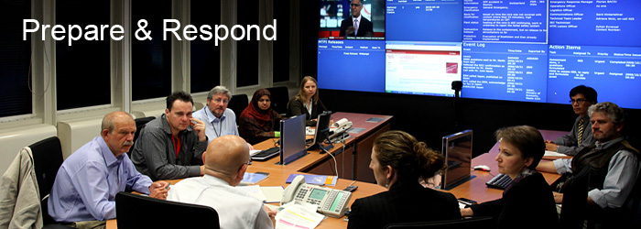
Thank you!
E.Buglova@iaea.org

