Slide 1
NERIS Workshop – Bratislava - February 2012
The IAEA Basic Safety Standards – its implementation
T. Boal, T. Colgan & R. Czarwinski - NSRW

Slide 2
Approval process for revised BSS
RASSC, WASSC, TRANSSC, NUSSC approved draft 4.0 in Nov-Dec 2010
CSS approved revised BSS in May 2011
IAEA Board of Governors approved revised BSS on 12 September 2011
Interim edition to be published by end of 2011
Cosponsors to approve BSS during late 2011 / 2012
Jointly sponsored BSS to be published late 2012 / early 2013

Slide 3
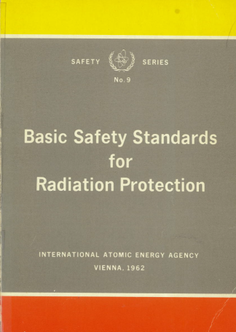
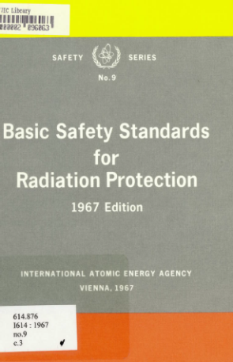
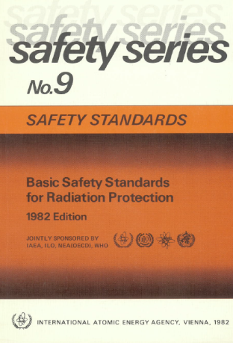
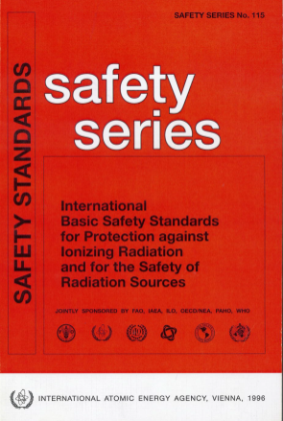
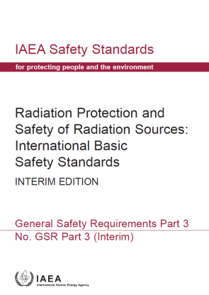
ICRP / BSS
ICRP recommendations
1958 (“Publication 1”)
1966 (Publication 9)
1977 (Publication 26)
1990 (Publication 60)
2007 (Publication 103)
IAEA Basic Safety Standards
1962
1967
1982
1996
2011 – Interim edition

Slide 4
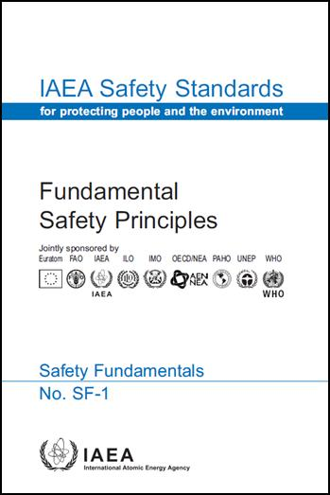
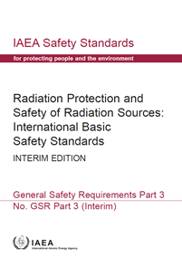
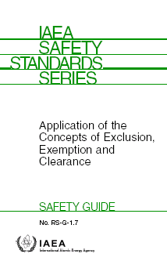
Hierarchy of Safety Standards
  underlying principles - aimed at politicians and regulatory authorities
Fundamentals
  specify obligations and responsibilities
  (“shall” statements)
Requirements
Guides
recommendations to support requirements (“should” statements)
06/02/2012
4

Slide 5
Structure of the Long Term Set of
Safety Requirements
General Safety Requirements
Specific Safety Requirements
Part 1 Governmental, Legal and
Regulatory Framework
1. Site Evaluation for
Nuclear Installations
Part 2 Leadership and Management
for Safety
2. Safety of Nuclear Power Plants
2.1 Design and Construction
2.2 Commissioning and Operation
B. Design of Nuclear Power Plants
Part 3 Radiation Protection and
Safety of Radiation Sources
Part 4 Safety Assessment
for Facilities and Activities
3. Safety of Research Reactors
Part 5 Predisposal Management
of Radioactive Waste
4. Safety of Nuclear Fuel
Cycle Facilities
Part 6 Decommissioning and
Termination of Activities
5. Safety of Radioactive Waste
Disposal Facilities
Part 7 Emergency Preparedness
and Response
6. Safe Transport of
Radioactive Material

Slide 6
New structure
The structure of the revised BSS follows from the new recommendations of ICRP 103
  three exposure situations:
    Planned exposure situation
    Emergency exposure situation
    Existing exposure situation
  three categories of exposure
    Occupational
    Public
    Medical

Slide 7
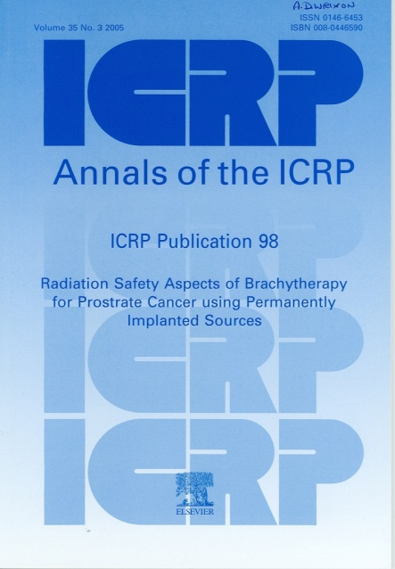
Revised BSS
1. INTRODUCTION
2. GENERAL REQUIREMENTS FOR PROTECTION AND SAFETY
Application of principles of radiation protection
Responsibilities of the government
Responsibilities of the regulatory body
Responsibilities for protection and safety
Management requirements
3. PLANNED EXPOSURE SITUATIONS
Scope
Generic requirements
Occupational exposure
Public exposure
Medical exposure
4. EMERGENCY EXPOSURE SITUATIONS
Scope
Generic requirements
Public exposure
Exposure of emergency workers
Transition from an emergency exposure situation to an existing exposure situation
5. EXISTING EXPOSURE SITUATIONS
Scope
Generic requirements
Public exposure
Occupational exposure
Schedule I EXEMPTION AND CLEARANCE
Schedule II CATEGORIZATION FOR SEALED SOURCES USED IN COMMON PRACTICES
Schedule III DOSE LIMITS FOR PLANNED EXPOSURE SITUATIONS
Schedule IV CRITERIA FOR USE IN EMERGENCY PREPAREDNESS AND RESPONSE
103
The 2007 Recommendations of the International Commission on Radiological Protection

Slide 8
Section 2. GENERAL REQUIREMENTS FOR PROTECTION AND SAFETY
Chapter 2 contains requirements that are applicable to all 3 exposures situations (planned, emergency, existing)
The three radiation protection principles (Requirement 1)
  Justification and optimization apply to all three exposure situations;
  Dose limitation only apply to planned exposure situations
Responsibilities of government / regulatory body
  consistent with Safety Requirements GSR Part 1

Slide 9
Section 2. GENERAL REQUIREMENTS FOR PROTECTION AND SAFETY
Responsibilities of other parties
  Prime responsibility for safety – registrants & licensees
  Principal parties:
    Registrants and licensees
    Employers – occupational exposure
    Radiological medical practitioners - medical exposure
    Designated organizations - emergency exposure situations
    Designated organizations - existing exposure situations
  Principal parties to ensure that all personnel engaged in activities relevant to protection and safety are appropriately educated, trained, and qualified so that they can understand their responsibilities and perform their duties competently ……

Slide 10
Section 3. PLANNED EXPOSURE SITUATIONS
GENERIC REQUIREMENTS
Scope
Graded approach
Justification / Optimization / Dose limits
  Dose limit for lens of the eye has been reduced
Notification and authorization
Safety assessment
Accident prevention
  Defence in depth
  Good engineering design
Emergency plans
  Licensee responsible to prepare emergency plan
  Licensee responsible to implement their emergency plans

Slide 11
Section 4. EMERGENCY EXPOSURE SITUATIONS
Text consistent with ICRP Publication 103 &109
  Dose concepts of residual dose, projected dose, received dose
Government to ensure that an integrated and coordinated emergency management system is established and maintained
Arrangements for protection of public, such as strategies for protection are developed, justified and optimized
  Protection strategies to include:
    Reference levels for residual dose in range of 20-100 mSv
    Generic criteria for some protective actions
    Default triggers – OILs, EALs,

Slide 12
Section 4. EMERGENCY EXPOSURE SITUATIONS
The government shall establish a programme for managing, controlling and recording doses received in an emergency by emergency workers, which shall be implemented by response organizations and employers.
  Requirements for occupational exposure in planned exposure situations apply, … graded approach, except for
  Exceed 50 mSv only in exceptional circumstances
Requirement on governments to ensure that arrangements are in place for the transition from an emergency exposure situation to an existing exposure situation
  Different geographic areas may undergo transition at different times
  Responsible authority to make decision to take transition

Slide 13
Schedule IV and Annex
Schedule IV: Criteria for use in emergency preparedness and response
  Table IV-1: Generic criteria for acute doses at which protective and other actions are expected to be taken under any circumstances to avoid or minimize severe deterministic health effects
  Table IV-2: Guidance values for restricting exposure of emergency workers
Annex: Generic criteria for protective actions .. in emergency exposure situations to reduce risk of stochastic effects
  Compatible with reference level of 20-100 mSv

Slide 14
Section 5: EXISTING EXPOSURE SITUATIONS
GENERIC REQUIREMENTS
Scope includes:
  Exposure due to contamination by residual radioactive material
    Arising from past activities not regulated
    Arising from nuclear or radiological emergency
  Commodities that incorporate radionuclides
  Radon in dwellings and workplaces
  Exposure of aircrew and space crew to cosmic radiation
Government shall ensure that existing exposure situations that have been identified are evaluated to determine which occupational exposures and public exposures are of concern
  Responsibilities are assigned
  Include management of existing exposure in the legal and regulatory framework

Slide 15
Section 5: EXISTING EXPOSURE SITUATIONS
PUBLIC EXPOSURE
Justification of protective actions and remedial actions
Optimization of protection
    Priority given to those groups for whom residual dose exceeds reference level
    All reasonable steps taken to prevent doses remaining above reference level
    Reference levels in range of 1-20 mSv
Remediation of areas contaminated with residual radioactive material (WS-R-3 into BSS)
    Government to establish framework
    Responsibilities of regulatory body / organization for remediation
    Implementation remediation programme
    Post-remediation control measures

Slide 16
Section 5: EXISTING EXPOSURE SITUATIONS
PUBLIC EXPOSURE
  For those areas with long lasting residual radioactive in which the government has decided to allow habitation, government to ensure arrangements in place for ongoing control of exposure with aim of establishing conditions for sustainable living
    Establish reference levels consistent with day today life\
    Establish infrastructure to support continuing “self-help protective actions” in the affected areas, … provision of information, monitoring
Radionuclides in commodities
  Regulatory body to establish specific reference levels for exposure to r/n in construction materials, food, feed, drinking water – reference level is not to exceed 1 mSv
  Food traded internationally as a result of a nuclear or radiological emergency – FAO/WHO - Codex has published guideline values
  Drinking water – WHO guidelines

Slide 17
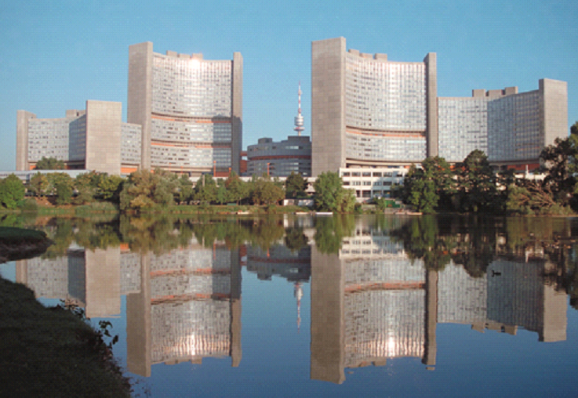
Thank you for your attention
t.boal@iaea.org
06/02/2012
17

