Slide 1

Synthesis of outcomes: conclusions and recommendations, identification of key issues and direction forward
Johan Camps
Belgian Nuclear Research Center
jcamps@sckcen.be
1st NERIS Platform Workshop, Preparedness for nuclear and radiological emerengency response and recovery: implementation of ICRP recommendations
Bratislava/Park Inn Danube, 6-8 February 2012

Slide 2
Experience from real cases
Fukushima
Chernobyl
….
UNSCEAR
N
E
R
I
S
P
L
A
T
F
O
R
M
ICRP
New recom. 103, 109, 111
IAEA BSS
EU BSS
OECD/ NEA
WNA
Authorities
HERCA
Operators
WENRA
Research
Emergency responders, local stakeholders, NGO, .. …..

Slide 3
Introduction
NERIS - an attempt to enhance European response to and recovery from radiological emergencies
  Lot of things to do, not evident to succeed
  NERIS: potential to succeed:
    = independent
    very large and diverse expertise
Application of ICRP recommendations
  Not >100 mSv
  Dose scale with 3 bands: 0-1, 1-20, 20-100
  Depending on controllability of source → lower and lower band
  If you can do better → do better
  Key issue: transition from emergency exposure situation to existing exposure situation

Slide 4
Fukushima
Fukushima response (Japan):
∼in line with ICRP recommendations (3 bands)
lessons
  Sheltering very difficult protective action
  Difficulty on computer code predictions
  Tap water surprises
transition to existing exposure situation (1-20 mSv): use of school playgrounds @ 20 mSv
from September on: lifting of evacuation prepared area → nobody has come back yet
from next April : lowering of Food contamination levels (< 1mSv) → will Europe follow again?
Open questions: e.g. thyroid dose children

Slide 5
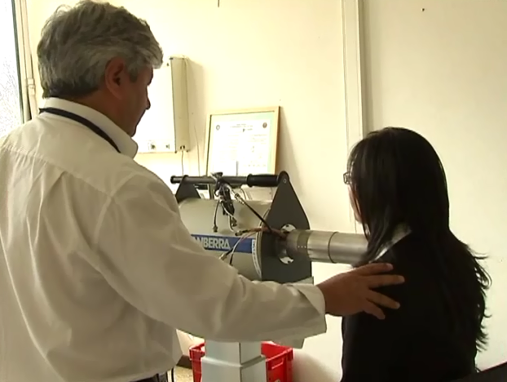
Fukushima
Fukushima response (Europe)
ECURIE activated 12/03,
Import controls:
  binding on import checks on food & feed
  Non-binding for other goods (confusion)
Food levels (25/03) → 500 Bq/kg (Cs-137,134)
Need for:
  Emergency plan: circulation of contaminated goods
  Information exchange (HERCA became very active)
  Improve communication
  Sharing environmental monitoring data
  Harmonization within EU of emergency response
  Thorough reflection on food levels

Slide 6
ICRP recommendations
EU Revision BSS and also other directives (basis ICRP103)
IAEA BSS ready (interim report): basis ICRP
  “should” and “shall” statements
NEA: large number of activities, reference levels link to ICRP
WNA: need for “refinements”
Key issue: how to deal with contradicting advices → makes communication with public difficult.
Don’t confuse the public!

Slide 7
Implementation of
ICRP recommendations
Individual countermeasures → overall protection strategy
  Implementation poses several questions (for development of tools answers are required)
In context of NERIS-TP project: big effort of the development of a screening tool
Is all knowledge available: e.g. radionuclide vector not enough, also physicochemical parameters required.
Can collective dose contribute in optimization of protection strategy?

Slide 8
National experiences
  Germany:
    study on relation of individual intervention levels with the general ICRP reference level (use of 100 mSv/y)
  Finland:
    20 mSv/y effective residual dose
    Operational intervention levels: dose criteria → ambient dose rate → airborne concentration → surface activity
  UK:
    Likely to adopt intervention levels (averted dose) and reference levels (residual dose); expressed as ranges
    New advice will undergo extensive stakeholder consultation
  Baden-Wuerttemberg:
    Full chain from plant status to monitoring over models
  Posters reflect well different national concerns

Slide 9
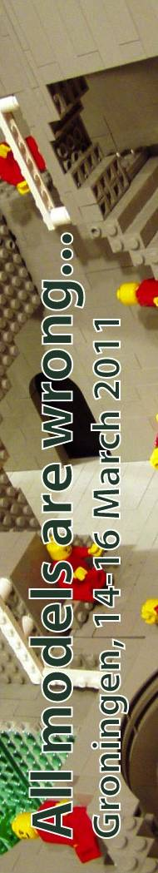
Break-out sessions
  Common aspects in the 4 break-out sessions:
    Use of simulation models and/or tools related to new recommendations: further developments/ coherence
    What are the needs for taking decisions:
      (Exchange of) data: ECURIE or new EU databank (technical backup of NERIS partners)/ R&D or authority perspective
      Tools (Preparedness → strategies – response)
        Plant status
        Models
        Measurements
        Handbooks, stakeholder processes, …
      Expert knowledge/experience/validation of tools/elimination of crazy options/uncertainties/more needed for malicious acts
      The opinion of the public, ethical aspects, communication dimensions (new media)
      Guidance: reference levels - operational intervention levels, …(ICRP60 well integrated → (no) need for strategy related to new ICRP), needs time
Title of a workshop for modelers of complex problems related to uncertainty and model selection

Slide 10
Way forward
NERIS: large momentum (participants in this workshop, growing members, …)
Working groups:
  New ICRP recommendations
  Preparedness at local level
NERIS TP project is running:
  Demonstration of new tools?
  Additional meetings not excluded (more feedback required?)
  Exercises/ demonstrations
New Euratom call 2012: NERIS basis for consortium
Relation of NERIS with other organizations and initiatives (e.g. HERCA, …)

Slide 11
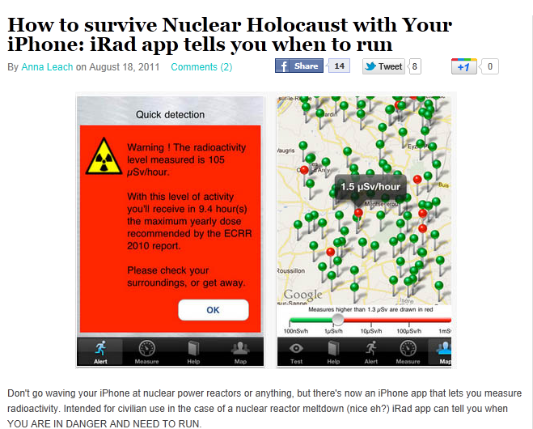
Public takes also action!

Slide 12
Wisdom for travelers: don’t focus on arriving, enjoy being on the road
Thanks for the excellent organization ☺

