Slide 1
NERIS Topical Workshop on Management of Contaminated Goods
22 May 2013
CIEMAT, Madrid, Spain
IAEA work programme
on the control of
foodstuffs and commodities
Igor Gusev
Radiation Protection Unit

Slide 2
Current situation
The IAEA’s Radiation Safety Standards Committee (RASSC) asked the IAEA Secretariat to establish a Working Group with other interested international organizations to document the various international standards for foodstuffs that are in existence, the basis on which they have been derived and the circumstances in which they are intended to be used.
Feeding stuffs and commodities do not fall within the scope of the Working Group.

Slide 3
Membership of RASSC Working Group
European Commission (EC)
Food and Agriculture Organization (FAO) of the United Nations
International Atomic Energy Agency (IAEA)
Nuclear Energy Agency (NEA/OECD)
World Health Organization (WHO)
Observer:
International Commission on Radiological Protection (ICRP)

Slide 4
Discussion Paper
summarize the current international standards for radioactivity in food and drinking water for human consumption, the radiation protection criteria used as the basis for such standards, and the circumstances in which such standards are intended to be used;
document examples of national standards with identification of international standards and/or other basis on which these standards are derived, and describe the circumstances in which such national standards are intended to be used;

Slide 5
Discussion Paper (con’t)
identify possible misinterpretations and/or gaps in the existing international standards;
propose steps that need to be taken by the international organizations and Member States to facilitate the recognition, understanding and implementation of the international standards.

Slide 6
1st WG meeting 6–8 May 2013
FAO D. Byron and A. Bruno
NEA T. Lazo
WHO M. Perez
ICRP J.-F. Lecomte
Consultants from:
Belarus (J. Kenigsberg), Ireland (C. McMahon),
Japan (T. Homma, Y. Yamada), Russia (A. Titov)
IAEA staff

Slide 7
Remark
The following description of the output of the Working Group is preliminary and is subject to change after the draft review.

Slide 8
Some misinterpretations and gaps
There is a lack of understanding about which organizations set standards appropriate for
different situations.
This results in misinterpretation of guidelines developed for specific conditions, e.g. the WHO guidelines on radionuclide levels in drinking water (2011) were established for lifetime consumption and are not applicable in emergency exposure situations, where GSG-2 criteria and OILs should be used.

Slide 9
Some misinterpretations and gaps (cont’d)
The management of foodstuffs as part of the process for transition from an emergency exposure situation to an existing exposure situation with a step-by-step approach is not developed yet .
Apparently the transition to an existing exposure situation should be managed as part of an emergency situation. An IAEA Safety Guide is proposed on this subject.

Slide 10
Some misinterpretations and gaps (cont’d)
There seems to be some uncertainty among users concerning the duration of Codex Alimentarius applicability - it requires more explanation for users
in the absence of such a time limit.
There is a strong need to foster interaction between relevant national authorities inside the country to ensure that proper standards will be applied in a correct manner in the event of a nuclear or radiological emergency (e.g. interaction between radiation protection authorities, nuclear safety authorities, food safety authorities and health authorities).

Slide 11
Some misinterpretations and gaps (cont’d)
After the transition phase from an emergency exposure situation to an existing exposure situation, if 1 mSv/year
was taken as the reference, there is no space for change.
Apparently, some number in the 1 – 20 mSv range should be selected. At the beginning of an existing situation some operational level will be present.

Slide 12
Some misinterpretations and gaps (cont’d)
There are no pre-established international levels
for food in an existing exposure situation.
After the discussion, the Working Group concluded that there is not a gap in the international requirements, but rather the elaboration of the process to facilitate countries at national level taking into account important national factors such as dietary factors, threats to potential vulnerable populations etc. Step-by-step improvement strategy developed through dialogue with stakeholders regarding the evolution of reference levels should be appreciated and be flexible enough to deal with peculiar characteristics of the situation.

Slide 13
Some misinterpretations and gaps (cont’d)
Assumptions on dose criteria applied in the affected country and in the international trade in existing exposure situation may be the same, but due to different diet contamination factors and other factors they should result in different operational levels.
The experience, however, after the Fukushima accident was that importing countries tended to apply the same levels to imports that were used to protect local population that was exposed to higher percentage of contaminated food in their diets.

Slide 14
Next steps (2013)
22 May IAEA internal review and comments
23 May text goes to meeting members
28 May deadline for comments
31 May text to be uploaded to RASSC website
24 June deadline for comments from RASSC members
1 July resolution of comments
2-5 July discussion at RASSC
Next steps: depend upon decision taken at RASSC

Slide 15
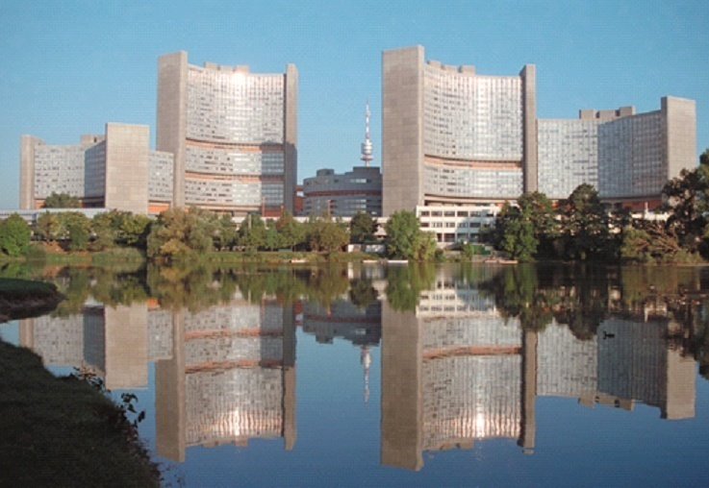
Thank you for your attention
i.gusev@iaea.org

