Slide 1
NERIS Topical Workshop on the Management of Contaminated Goods
22 May 2013 – CIEMAT - Madrid, Spain
International standards with regard to restriction/replacement of contaminated food, milk and drinking water in the accident State/affected States
V. Kutkov, E. Buglova, T. McKenna IEC/NS

Slide 2
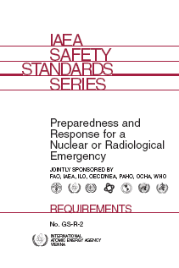
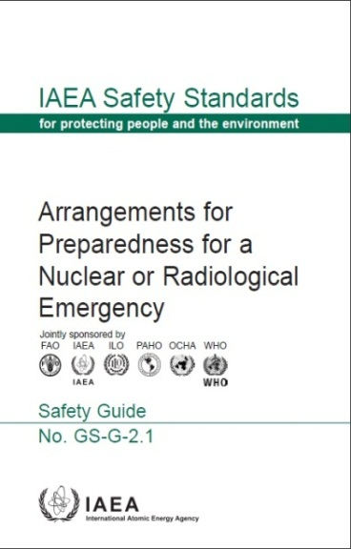
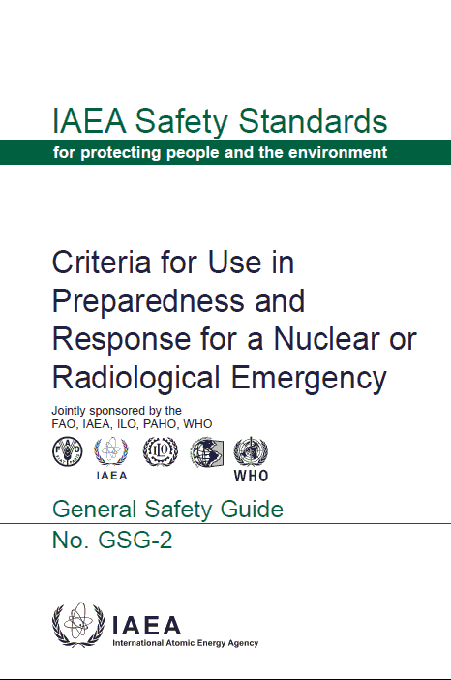
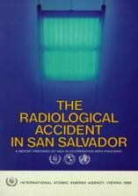
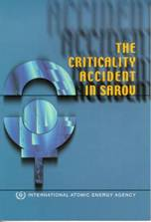
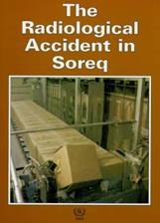
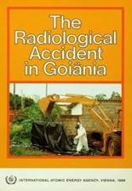


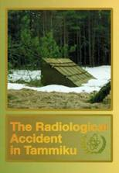
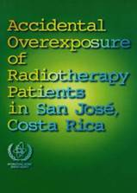
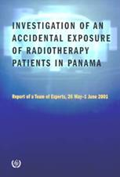
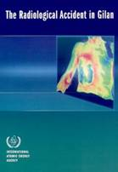
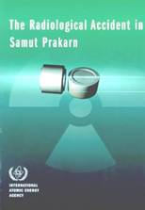
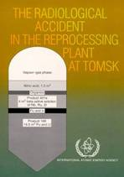
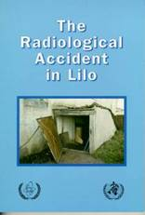
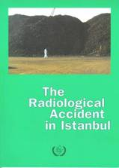
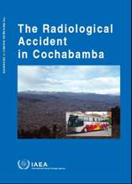
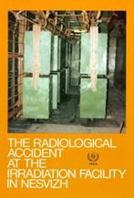

Introduction: Learning lessons

Slide 3

Conceptual background for criteria
The 2007 Recommendations of the International Commission on Radiological Protection (2007)
1990: ICRP-60
Single protective action
Action level of avertable dose
2007: ICRP-103
Protective strategy
Reference level of residual dose
Notes:
IAEA Training in Emergency Preparedness and Response
3

Slide 4
Detectability of stochastic effects
278. "…further follow-up and improved information on the doses received will be needed before the shape of the dose response at low doses for both morbidity and mortality can be determined with confidence at doses below about 100-200 mSv.
[UNSCEAR Report 2000
Annex G: Biological effects at low radiation doses]
UNSCEAR Report 2010
UNSCEAR Report 2012

Slide 5
Application of the effective dose
(153) The main and primary uses of effective dose in radiological protection for both occupational workers and the general public are:
  prospective dose assessment for planning and optimisation of protection; and
  retrospective dose assessment for demonstrating compliance with dose limits, or for comparing with dose constraints or reference levels.
(2007 Recommendations of the ICRP)

Slide 6
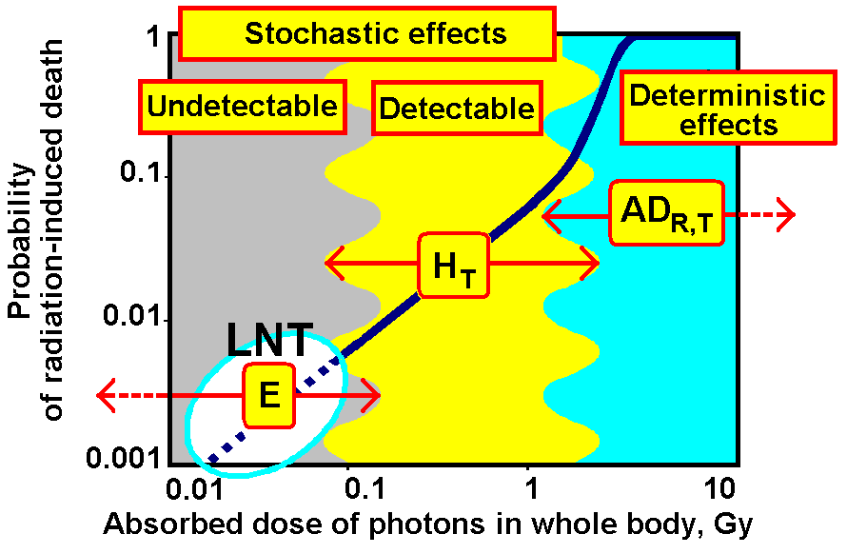
Application of dosimetric quantities

Slide 7
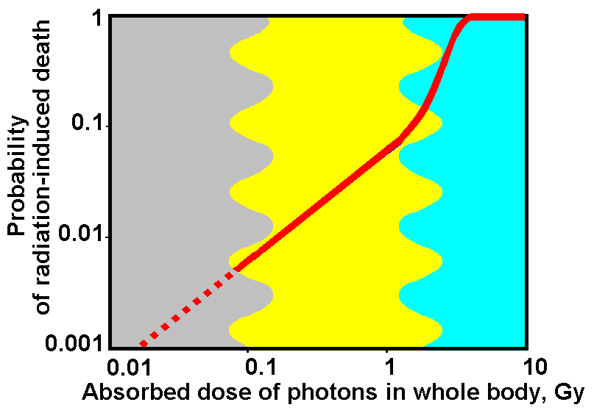
Human protection and safety
Safety
Protection

Slide 8
Basic principles of protection strategy
All possible efforts should be made to prevent severe deterministic health effects and to reduce the occurrence of stochastic effects
A reference level expressed in terms of residual dose shall be set, typically an effective dose in the range 20–100 mSv, that includes dose contributions via all exposure pathways
The protection strategy shall include planning for residual doses to be as low as reasonably achievable below the reference level, and the strategy shall be optimized at preparedness stage

Slide 9
General Safety Guide GSG-2
Criteria for Use in Preparedness
and Response for a Nuclear or Radiological Emergencies:
General Safety Guide
No. GSG-2
(18 March 2011)
Jointly sponsored by the
FAO, IAEA, ILO, PAHO, WHO
Published in En, Ar, Fr, Ru
Notes:
.

Slide 10
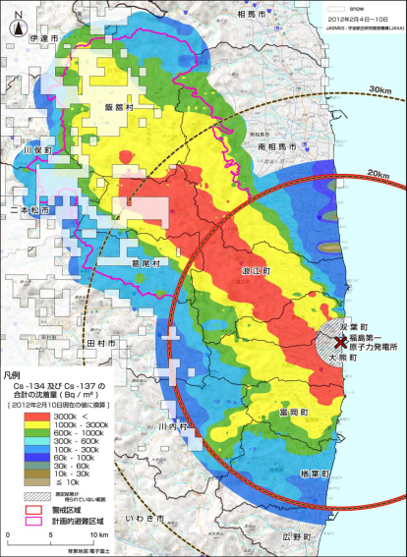
The new document in EPR Series
Actions to Protect the Public in an Emergency due to Severe Conditions at a Light Water Reactor
.
EPR-NPP Public Protective Actions [2013]
Fukushima Daiichi
11 March 2011
Project started
18 March 2011
10
Notes:
IAEA Training in Emergency Preparedness and Response
10

Slide 11
Strategy to reduce the risk of stochastic effects: Generic Criteria
PROJECTED DOSE | PROTECTIVE STRATEGY
 | URGENT actions ► Dose in 7 DAYS | EARLY actions ► Dose in 1 YEAR
Total effective dose | 100 mSv | 100 mSv
Total equivalent dose in foetus or embryo | 100 mSv | 100 mSv
Committed equivalent dose in thyroid | 50 mSv | NA

Slide 12
Ensuring safety of the public in emergency exposure situation
Restriction/Replacement of contaminated food, milk and drinking water is one of components of URGENT and EARLY protective strategies together with sheltering, evacuation, relocation, decontamination, etc.
Reference level for public exposure during 1st year
10 mSv | Appendix IV. Generic criterion for food, milk and water to reduce the risk of stochastic effects in an emergency

Slide 13
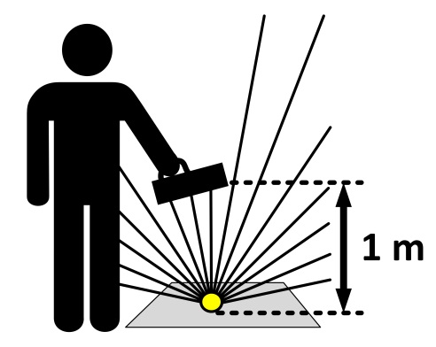
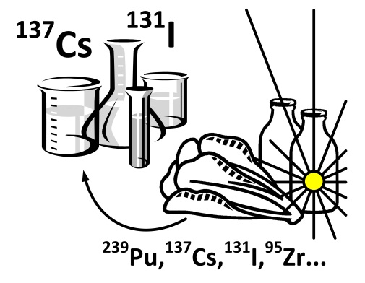
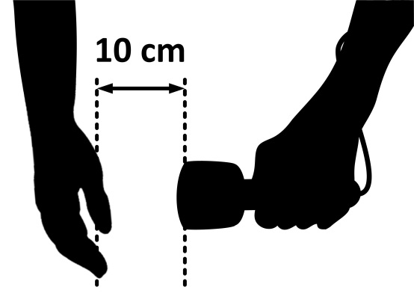

Operational Interventional Levels
OILs – a predetermined default operational triggers for quantities that are measured by a field monitoring instrument or determined by laboratory analysis.
Protective and other response actions
Dose rate above
the ground
Food and water concentrations
Dose rate from skin contamination
Dose rate from thyroid
13

Slide 14
Basis for development of foods’ OILs
Apply for the domestic use of foods in an emergency exposure situation
100% of the food, milk and water are initially contaminated due to ground deposition and are consumed for a full year
Intervention, natural weathering and dilution with a time are not concerned.
Radionuclide concentration in foods decrease with a time due to decay only
Representative person – infant: 1 year old ICRP reference person consuming 500 kg per annum

Slide 15
Control of radionuclides in foodstuffs at radiological emergency
OIL | RN | Activity concentration of single radionuclide in foodstuff | Implementation of protective actions
OIL6 | Cs-137 | 2000 Bq/kg | For the confirmation foodstuffs and drinking water restrictions
 | I-131 | 3000 Bq/kg
 | Sr-90 | 200 Bq/kg
 | Pu-239 | 50 Bq/kg

Slide 16
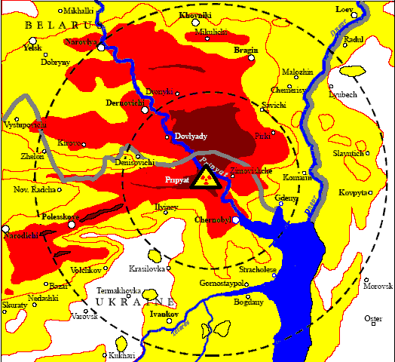
Emergency exposure situation
UNKNOWN SOURCE TERM
1986
2011
16
Notes:
IAEA Training in Emergency Preparedness and Response
16

Slide 17
Fukushima test case
17
17
Notes:
IAEA Training in Emergency Preparedness and Response
17
Workshop on Expanded Response in Nuclear Emergencies
Module L-ER-9. Sources and Pathways of Public Exposure in Emergency

Slide 18
Generic and operational criteria

Slide 19
Size of the emergency zones and distances
Emergency zones and distances | Power ≥ 1000 MW(th) | Power ≥ 100 to 1000 MW(th)
PAZ: Precautionary action zone | 3 to 5 km
UPZ: Urgent protective action planning zone | 15 to 30 km
EPD: Early action planning distance | 100 km | 50 km
FRD:Ingestion and commodities planning distance | 300 km | 100 km
19
Notes:
IAEA Training in Emergency Preparedness and Response
19

Slide 20
Control of alimentary pathway at Urgent phase if NPP emergency
20

Slide 21
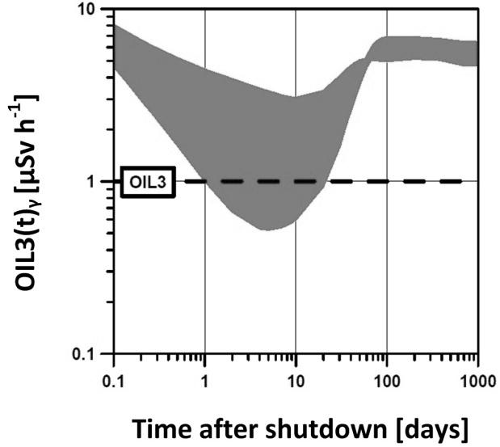
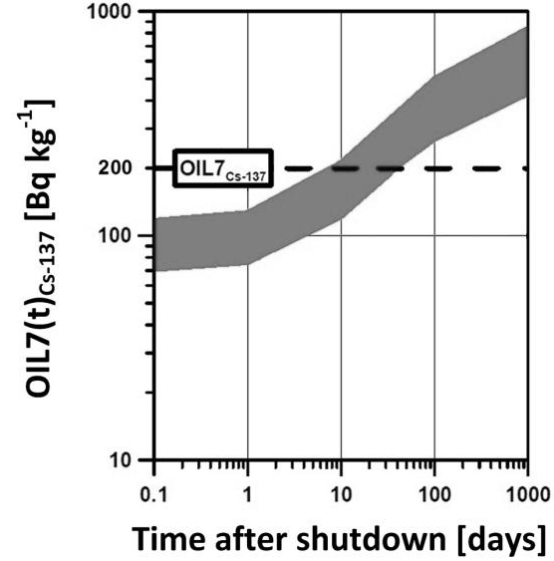
Pathways considered in calculation of OIL3 and OIL7
21

Slide 22
Control of radionuclides in foodstuffs at NPP emergency
OIL | Default value | Assessed monitoring result | Implementation of urgent actions
OIL3 | 1 μSv/h | Ambient dose rate at 1 m above ground level | For initial foodstuffs and drinking water restrictions
OIL7 | 1000 Bq/kg | Concentration of marker I-131 in foods | For the confirmation and/or extension of initial foodstuffs and drinking water restrictions
 | 200 Bq/kg | Concentration of marker Cs-137 in foods

Slide 23
Summary: from GS-R-2 to GSR Part 7
Introduction of the new dose concepts, dosimetric quantities and criteria
    Generic and operational criteria of projected dose for protective and other actions to avoid or minimize severe deterministic effects
    Generic and operational criteria of projected dose for protective actions corresponding to the reference levels of residual dose to reduce risk of stochastic effects
23

Slide 24
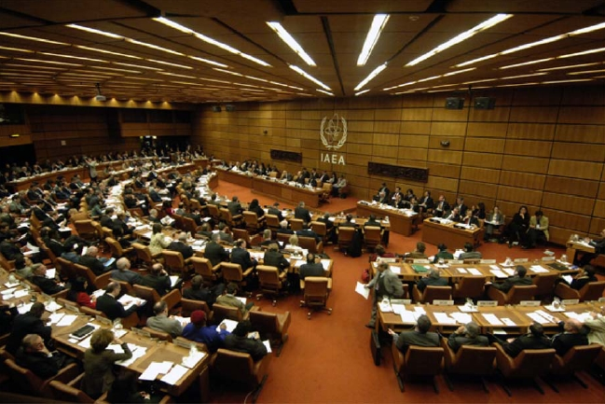

Any questions?

