Slide 1
The Advanced Source Inversion Module of JRODOS
S. Andronopoulos¹, I. Kovalets^{2,3}, O. Pylypenko^{2,3}, D. Treebushny⁴, R. Hofman⁵, P. Seibert⁵, I. Ievdin^{3,6}
¹NCSR Demokritos, Institute of Nuclear and Radiological Sciences and Technology, Energy and Safety, Agia Paraskevi, Greece
²Institute of Mathematical Machines and Systems Problems NAS of Ukraine, Kiev, Ukraine
³Ukrainian Center of Environmental and Water Projects, Kiev, Ukraine
⁴Karlsruhe Institute of Technology, Karlsruhe, Germany
⁵University of Vienna, Austria
⁶BfS—Federal Office for Radiation Protection, Oberschleissheim, Germany

Slide 2
Some background information
Source-Inversion Advanced module developed and firstly integrated in JRODOS by the PREPARE project
  Estimation of time-dependent emission rate and nuclide composition from a NPP accident, based on gamma dose-rate (GDR) measurements (top-down approach)
  Methodology based on minimization of a cost function using “Source-Receptor Functions” (SRF) formulated on the ADM DIPCOT

Slide 3
Purpose of presentation
Dissemination of testing of JRODOS-integrated SIA
Methodology:
  Hypothetical NPP accident with a defined “true” source term
  Artificial GDR measurements by running ADM
  Assume a first-guess source term
  Run the SIA and examine closeness of the estimated source term to the true one

Slide 4
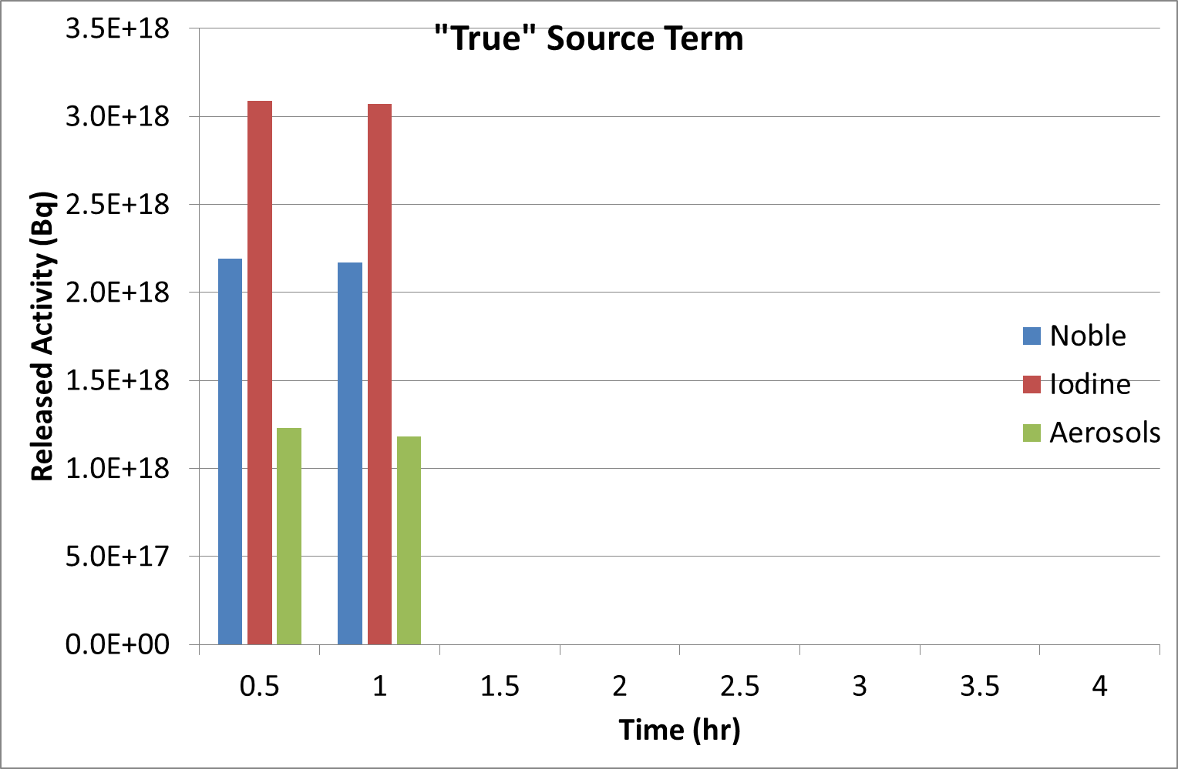
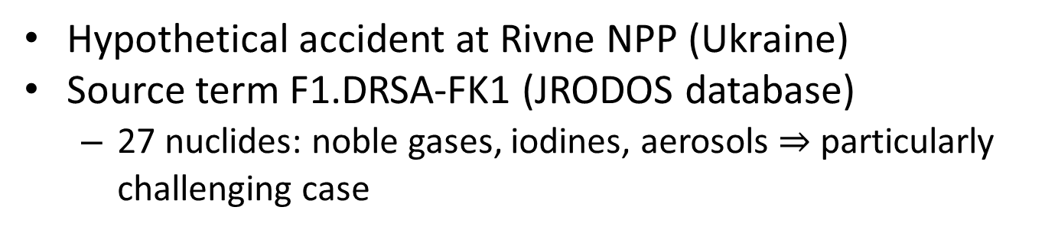
Test-case definition
Hypothetical accident at Rivne NPP (Ukraine)
Source term F1.DRSA-FK1 (JRODOS database)
  27 nuclides: noble gases, iodines, aerosols particularly challenging case

Slide 5
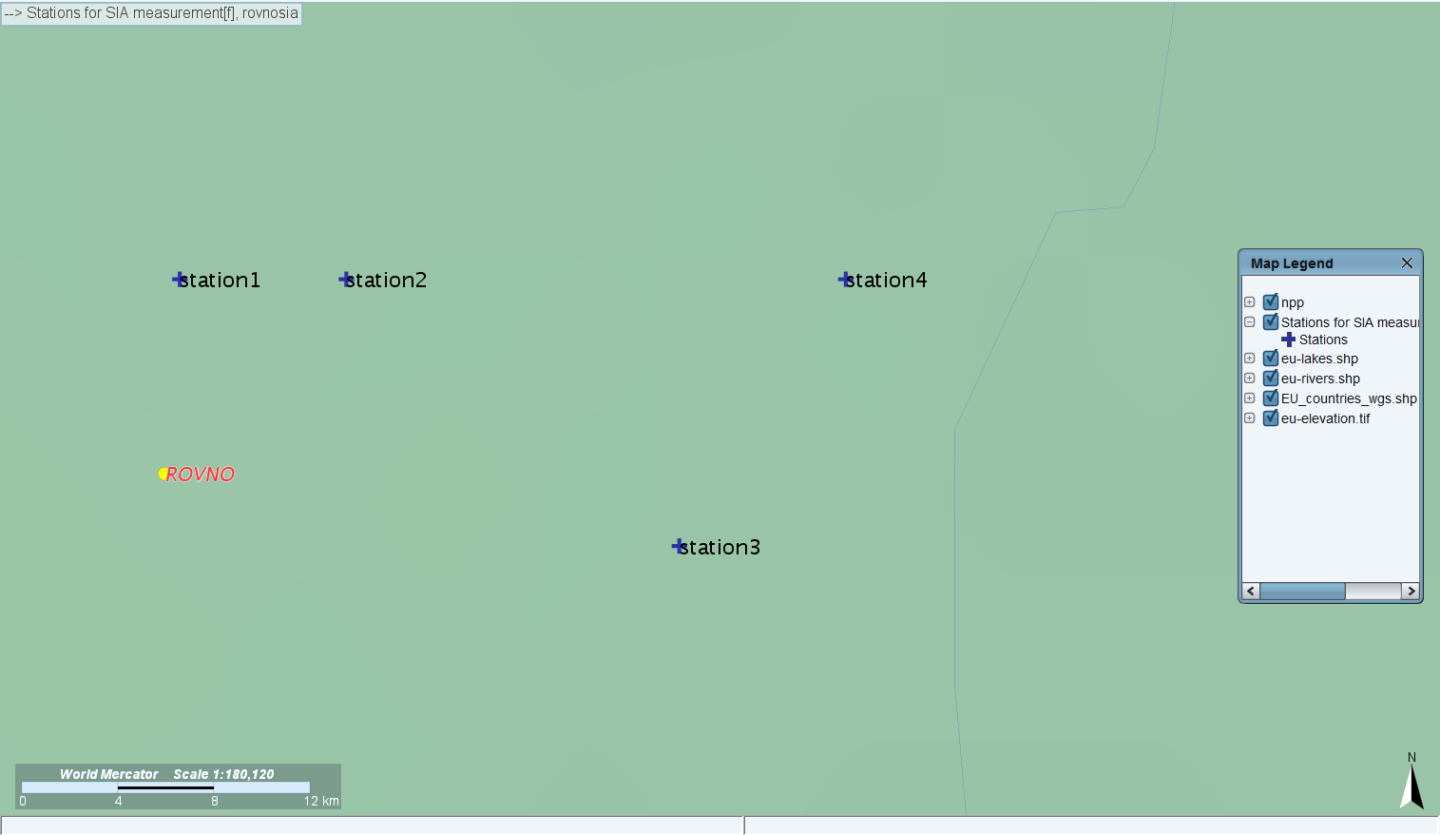
Measurements
Artificial GDR measurements generated by DIPCOT at artificial sensors around the NPP
Distances of sensors from the NPP: 8-30 km
Artificial meteorology: time-varying wind direction, constant wind speed, D-stability, no precipitation

Slide 6
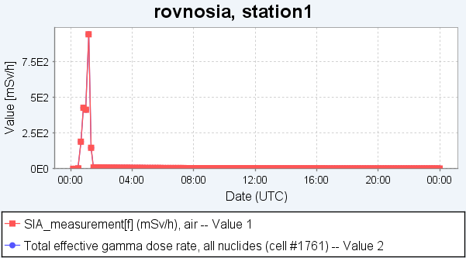
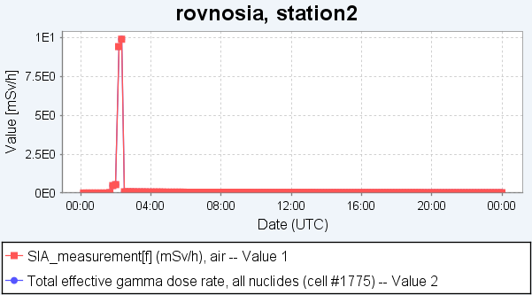
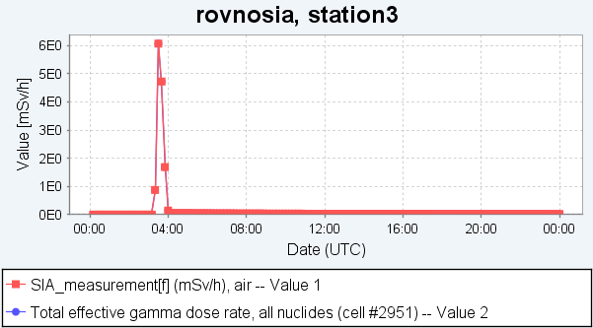
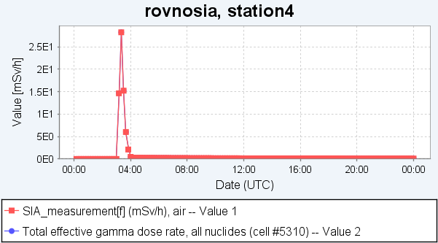
Measurements (cont’d)
“Measurements” imported in JRODOS database

Slide 7
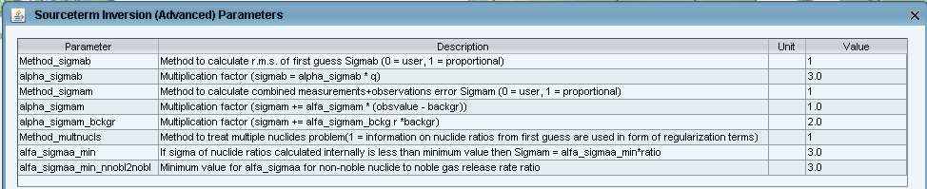
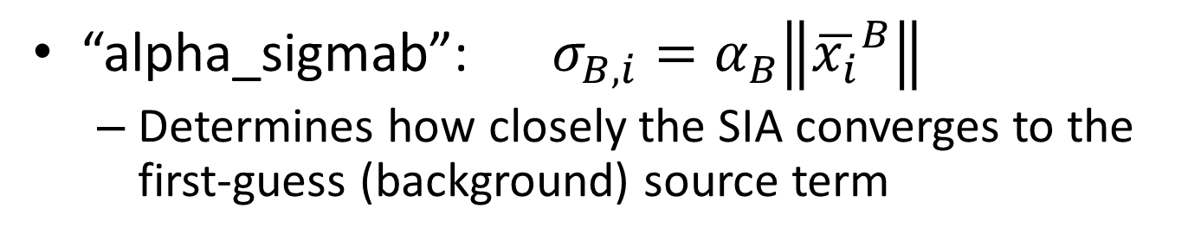
SIA parameters
Control the calculation of regularization terms
They affect the SIA method performance
What are the optimal values?
“alpha_sigmab”: $σ_{B,i}=α_{B}\left\|{\overline{x_{i}}}^{B}\right\|$
  Determines how closely the SIA converges to the first-guess (background) source term

Slide 8
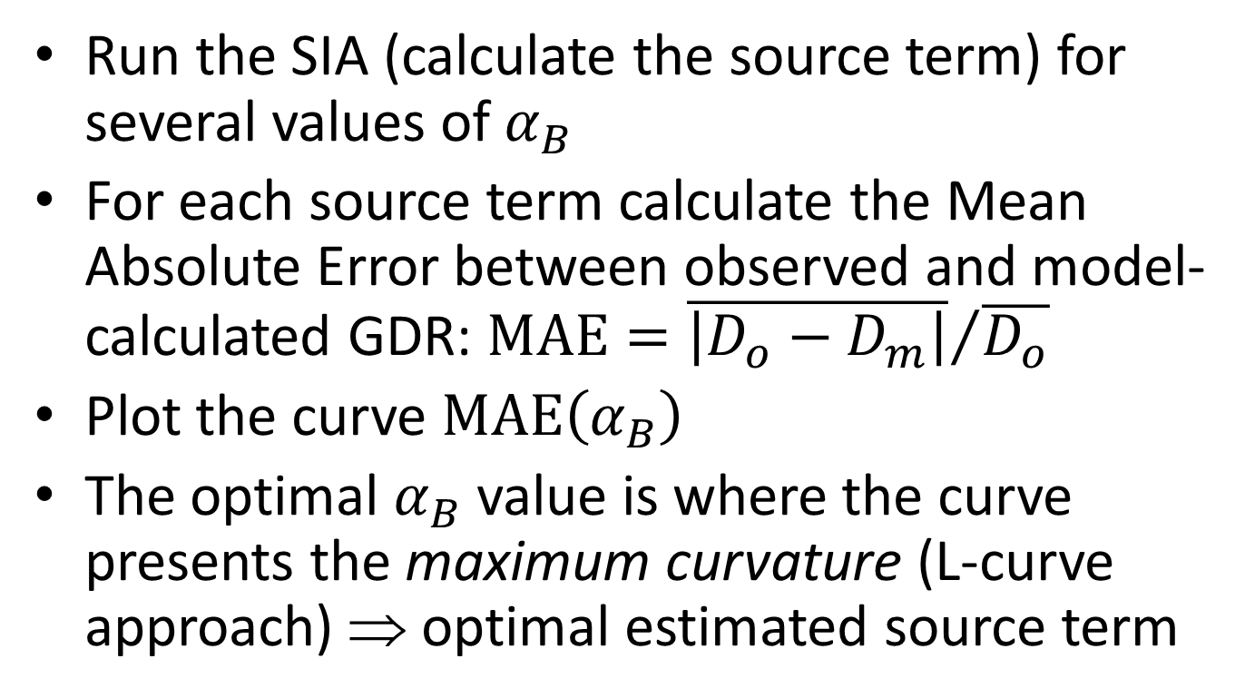

What is the optimal $α_{B}$ value?
Run the SIA (calculate the source term) for several values of $α_{B}$
For each source term calculate the Mean Absolute Error between observed and model-calculated GDR: $\text{MAE}={\overline{\left|D_{o}−D_{m}\right|}}/{\overline{D_{o}}}$
Plot the curve $\text{MAE}\left(α_{B}\right)$
The optimal $α_{B}$ value is where the curve presents the maximum curvature (L-curve approach) ⇒ optimal estimated source term

Slide 9
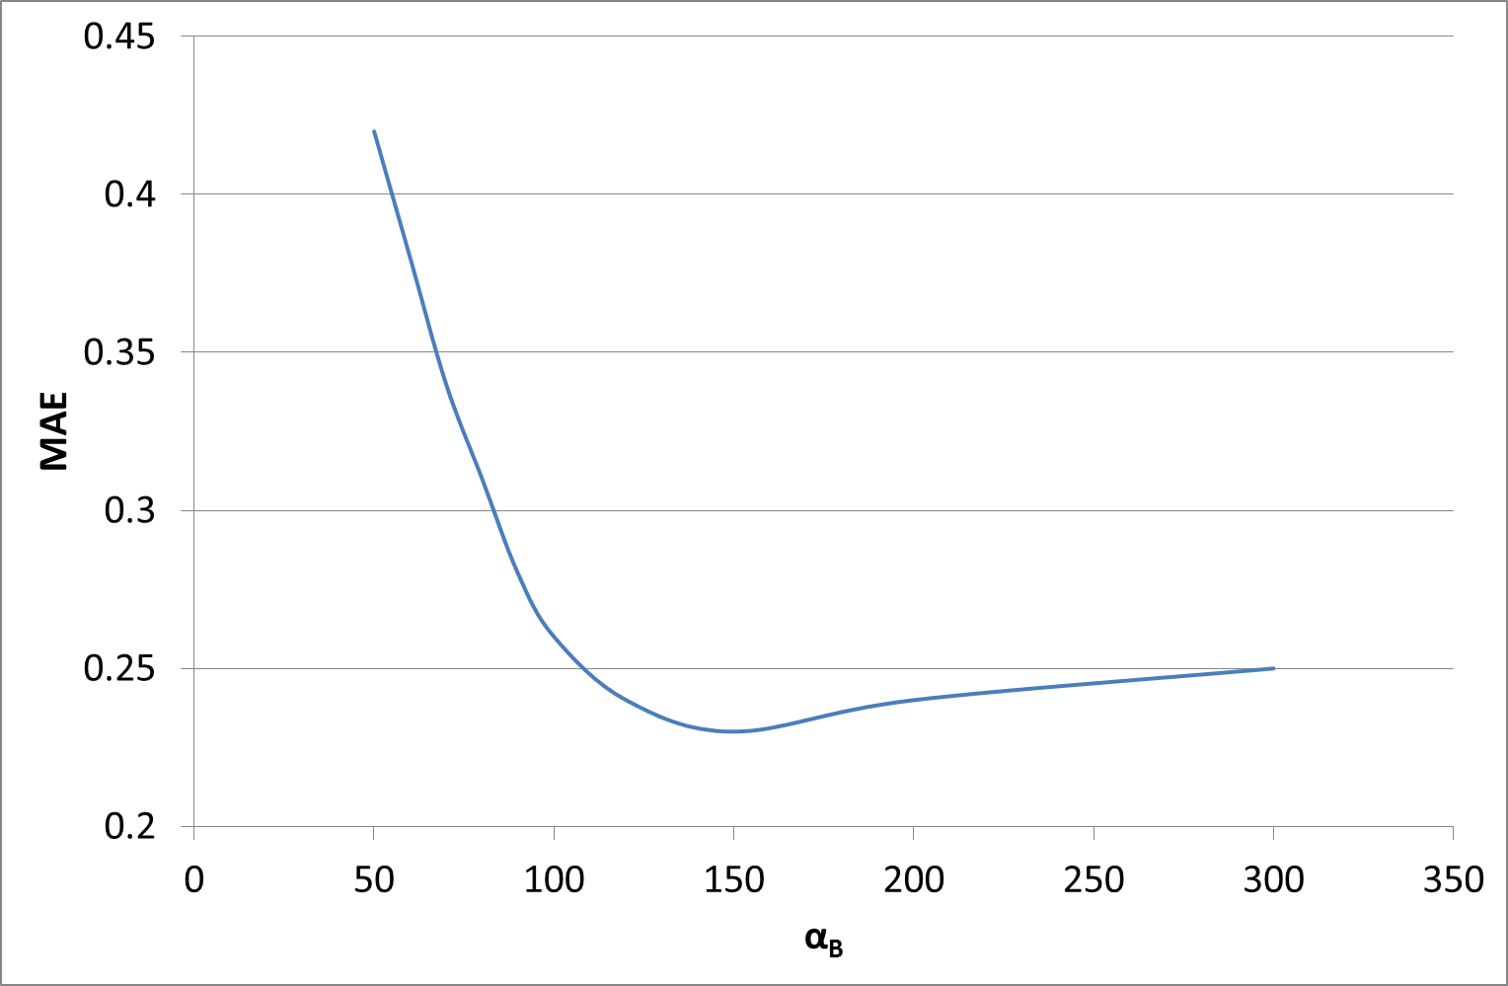
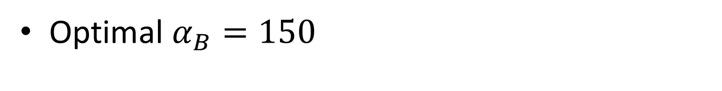
1st test
First-guess source term equal to 1/10th of the true one
Optimal $α_{B}=150$

Slide 10
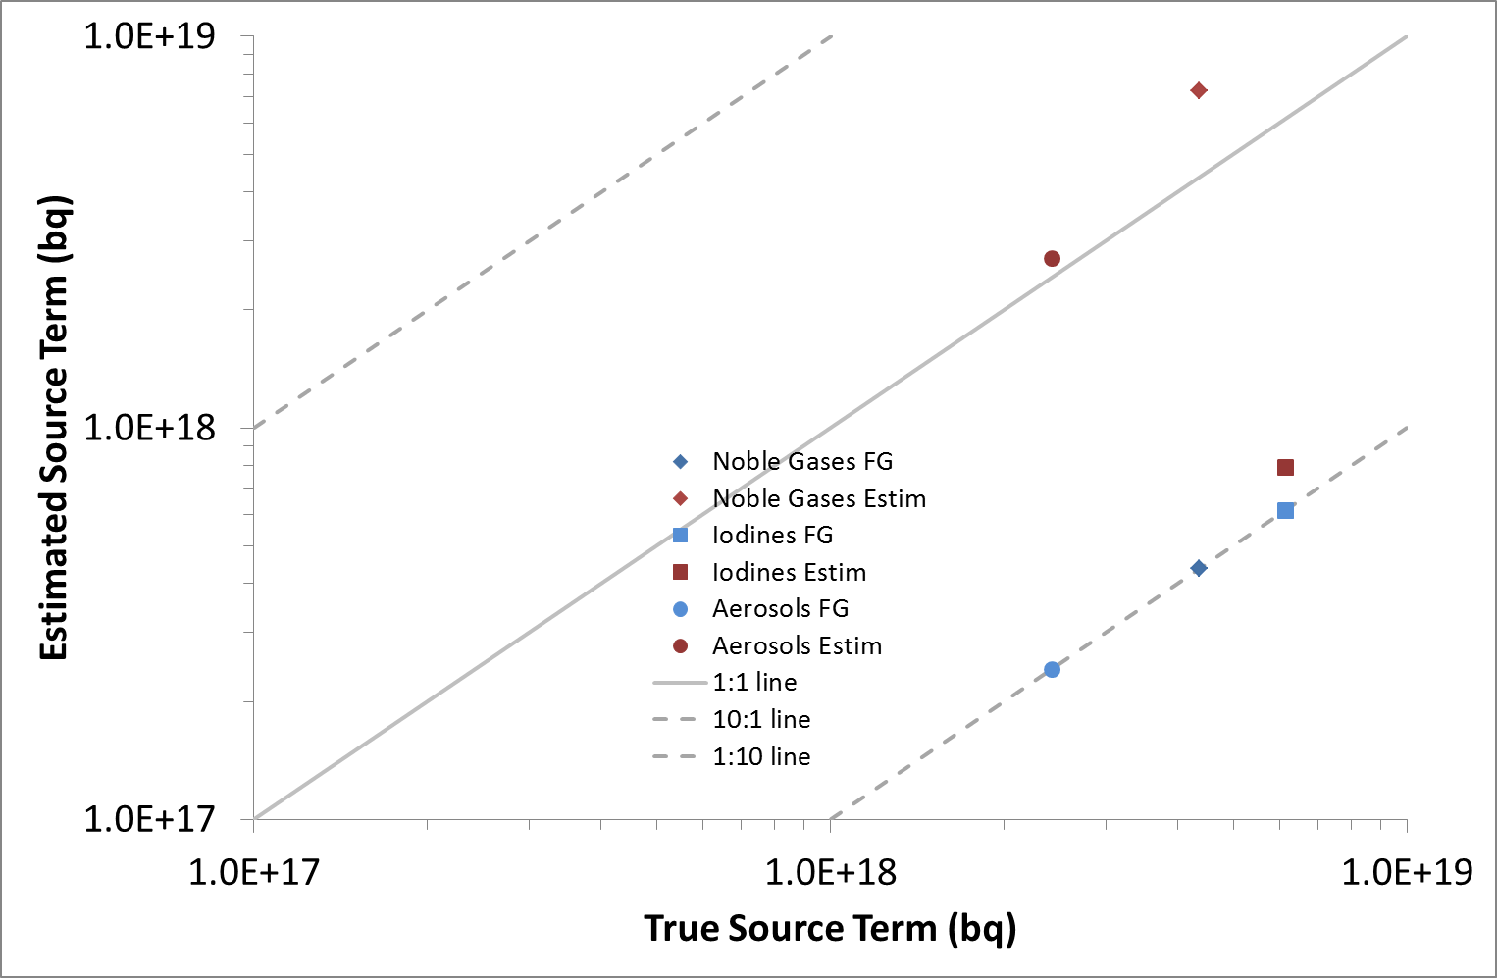
1st test – results – total releases

Slide 11
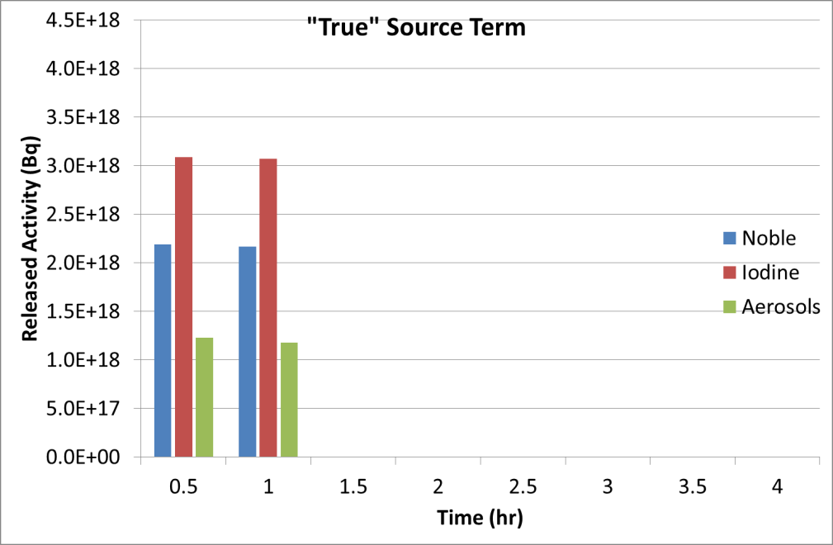
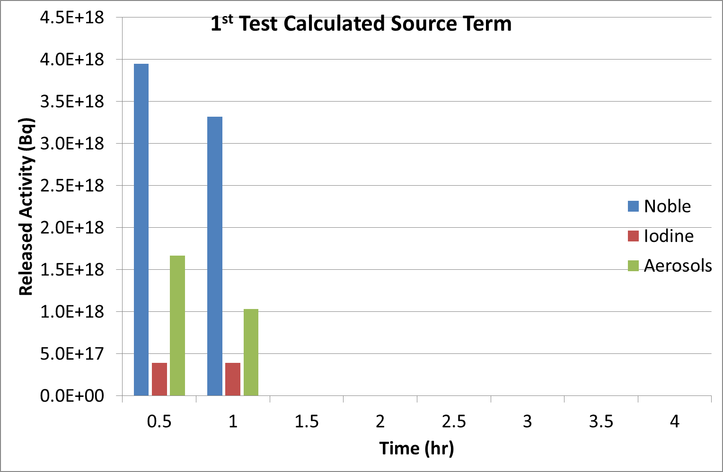
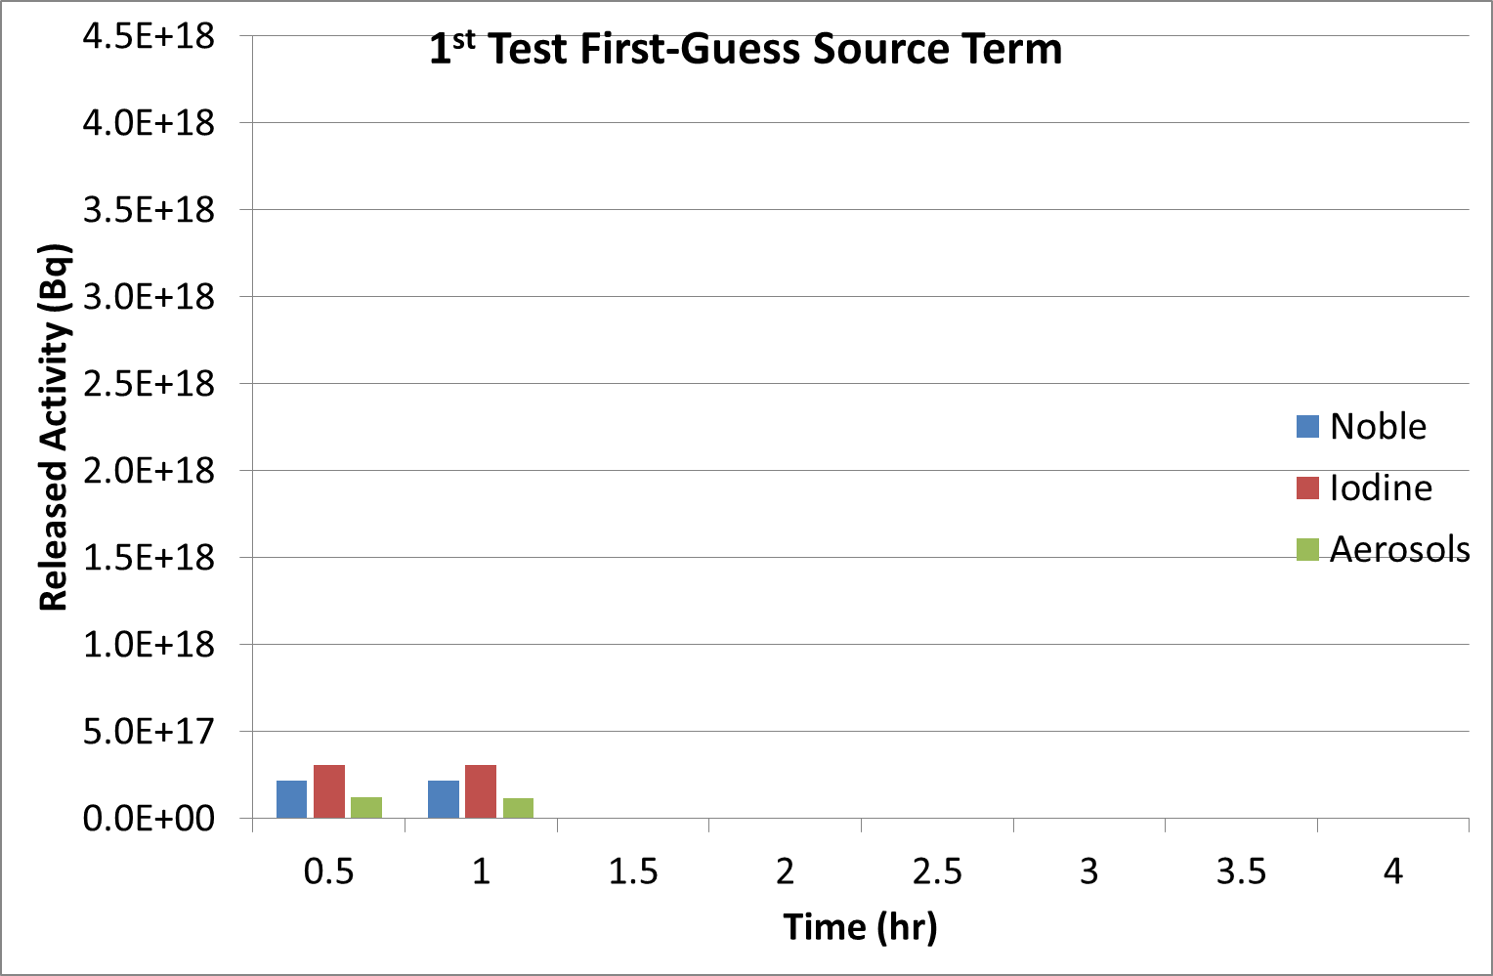
1st test – results – split

Slide 12
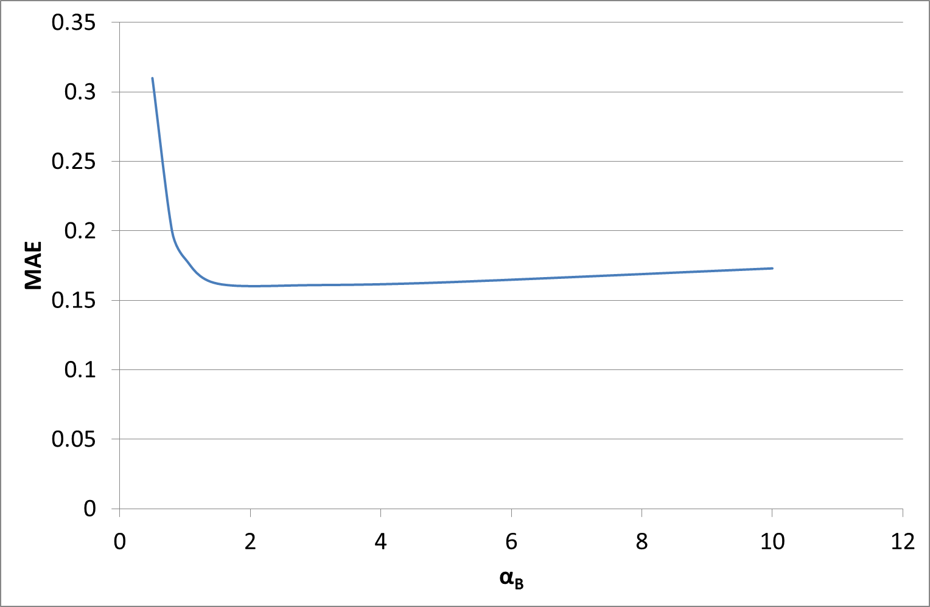
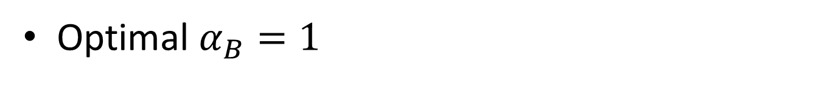
2nd test
First-guess source term equal to 10 times the true one
Optimal $α_{B}=1$

Slide 13
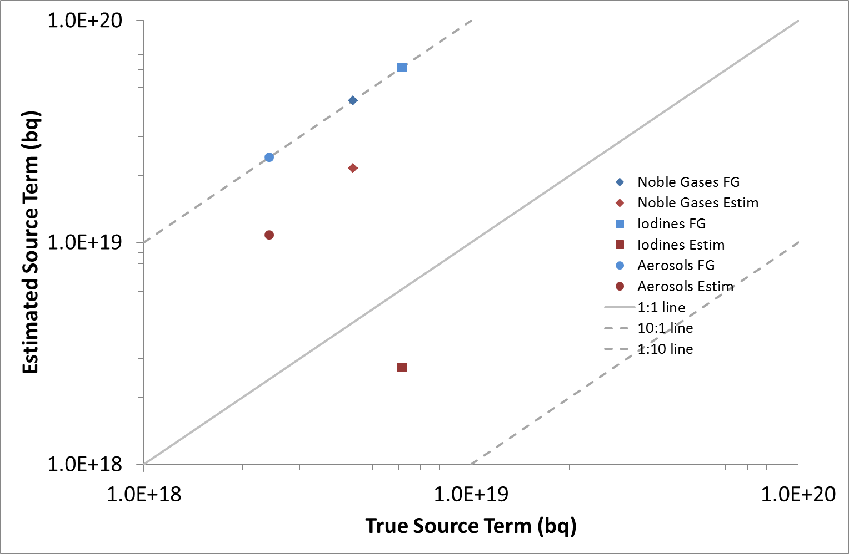
2nd test – results – total releases

Slide 14
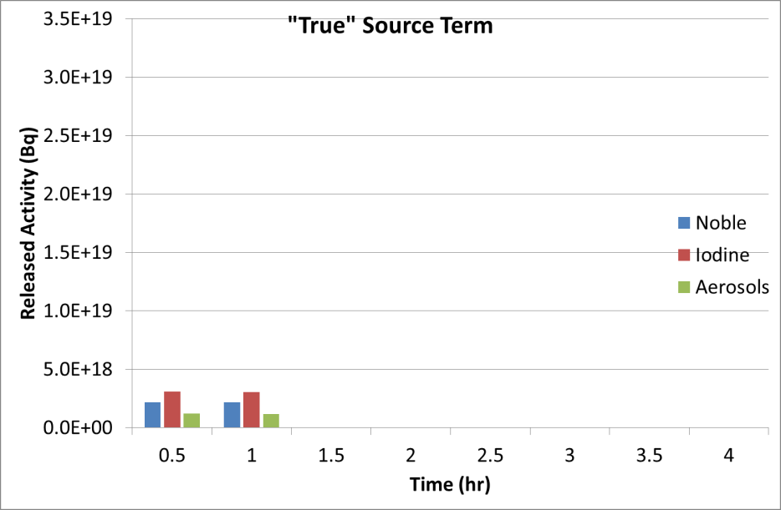
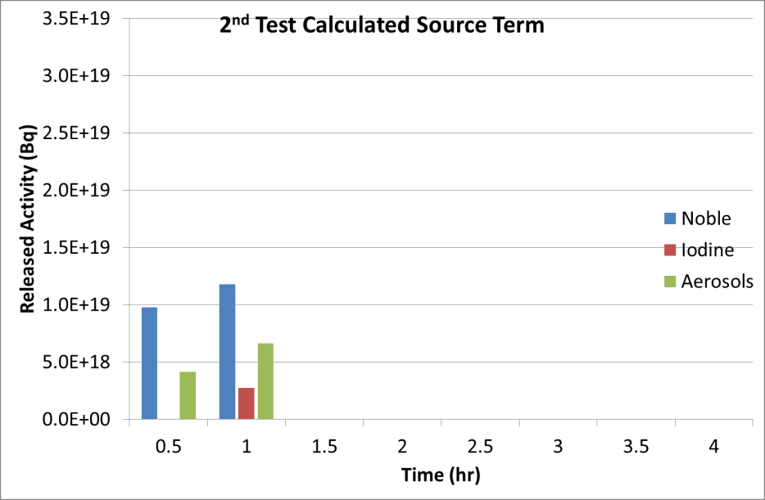
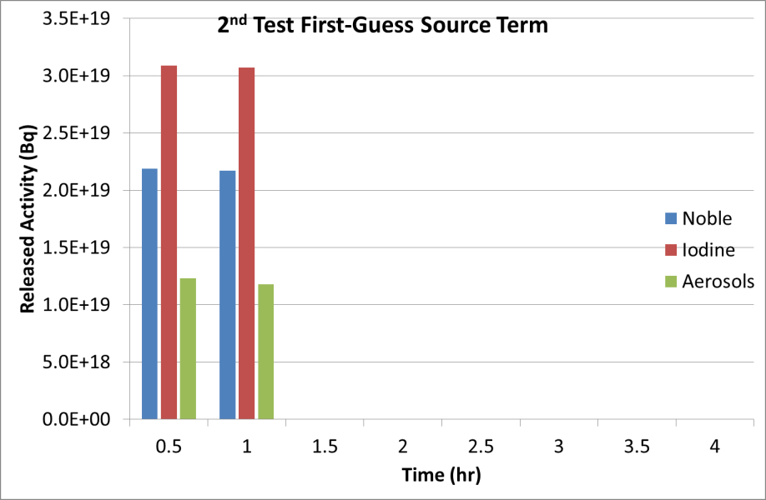
2nd test – results – split

Slide 15
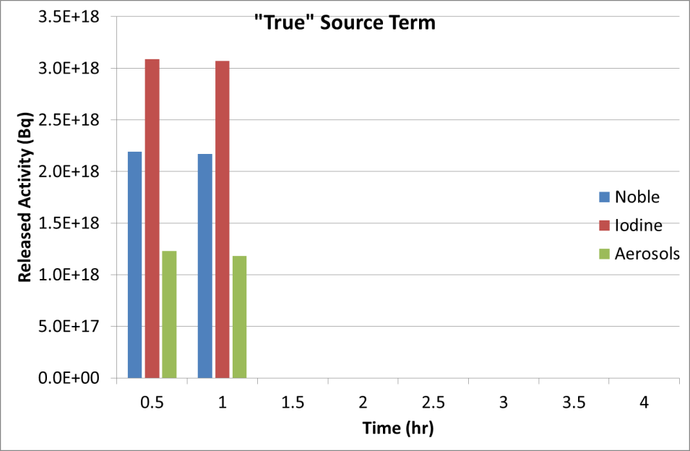
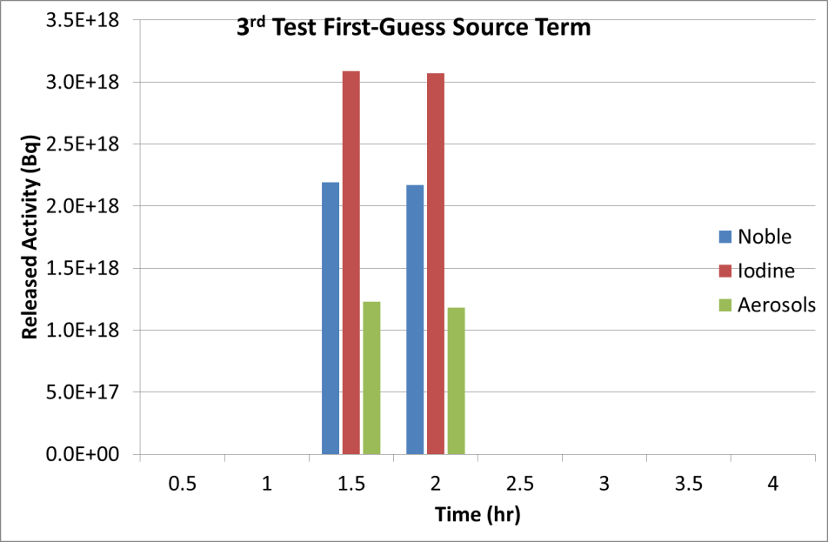
3rd test
First-guess source term equal to true one but shifted in time 1 hr forward

Slide 16
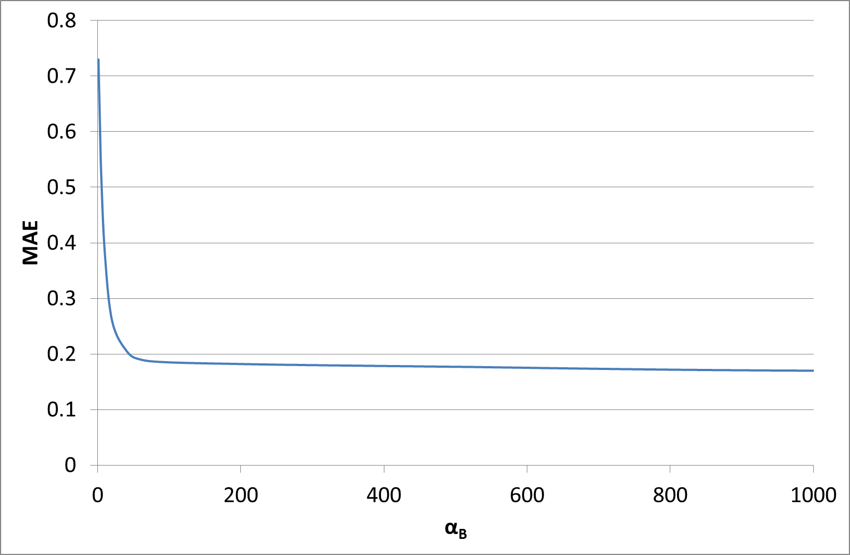
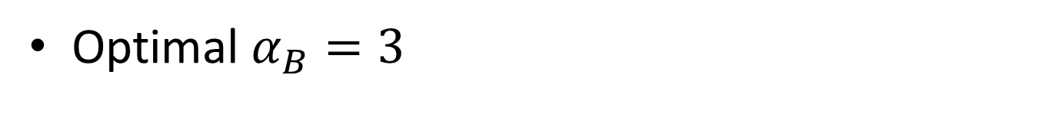

3rd test – optimal $α_{B}$
Optimal $α_{B}=3$

Slide 17
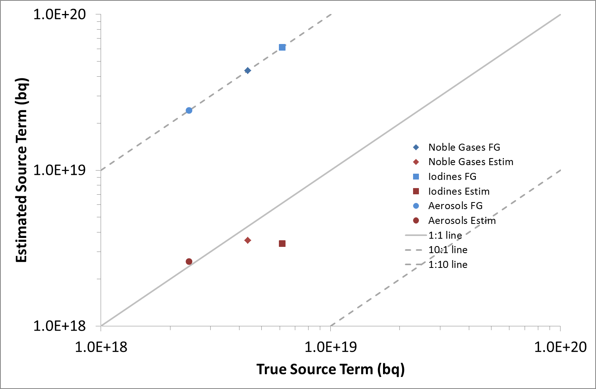
3rd test – results – total releases

Slide 18

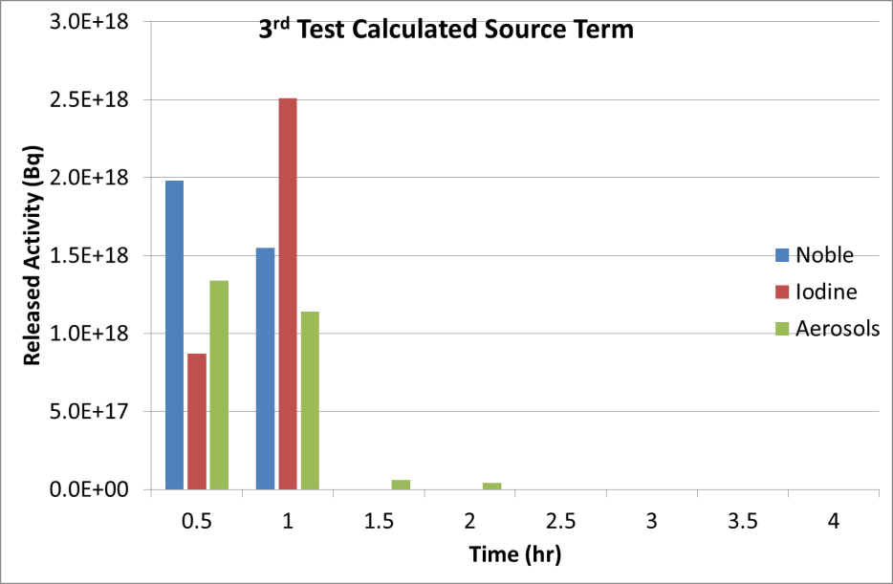

3rd test – results – timing

Slide 19

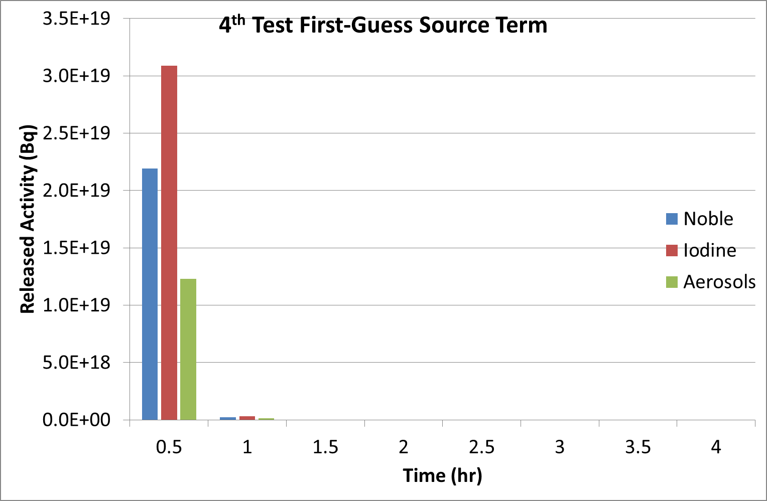
4th test
First guess source term: increased by 10 times during 1st half of release, decreased by 10 times during 2nd half, in relation to true one

Slide 20
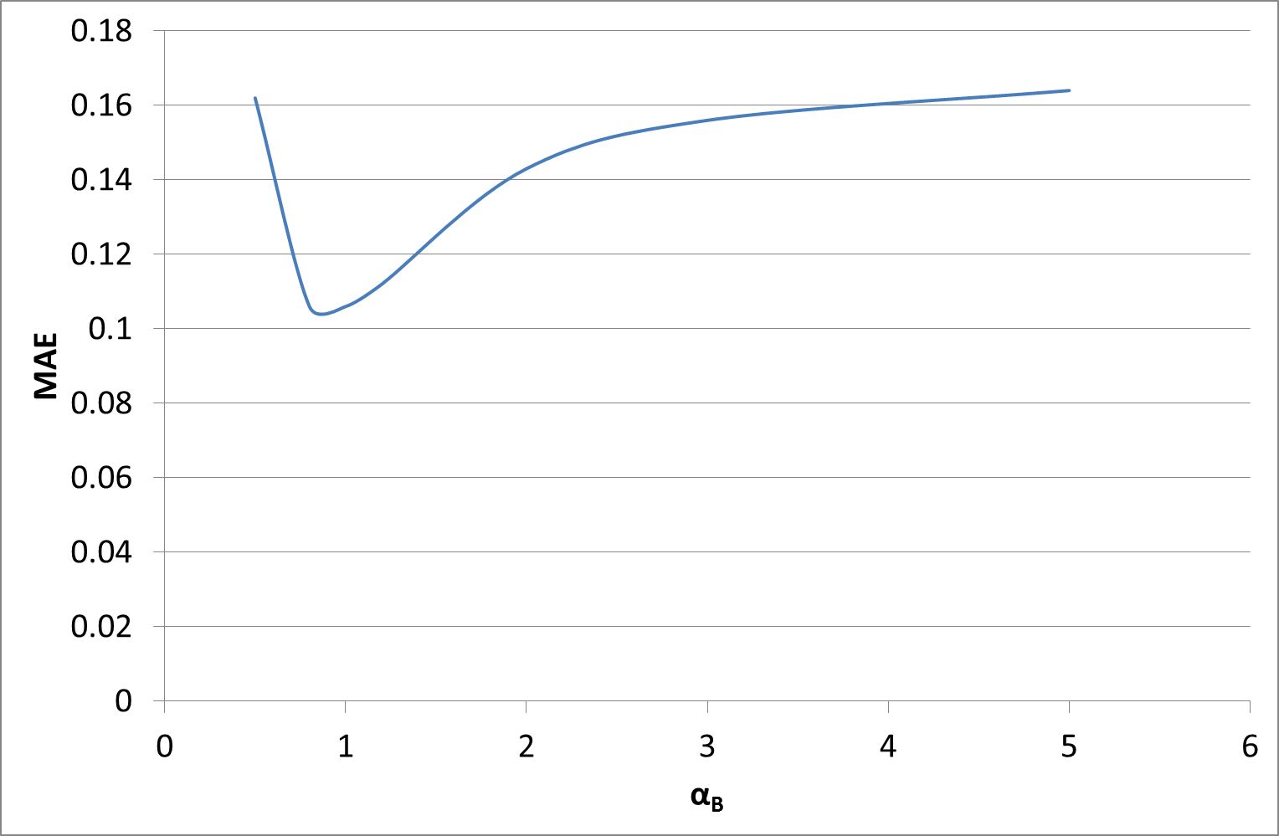

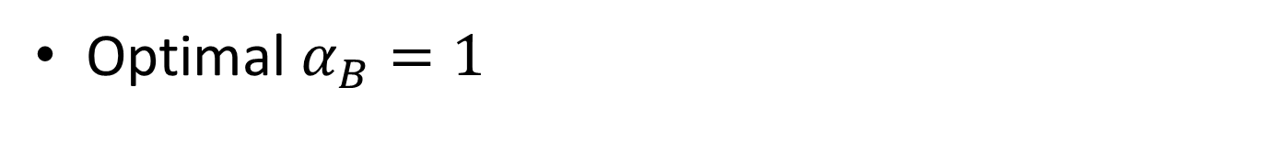
4th test -optimal $α_{B}$
Optimal $α_{B}=1$

Slide 21
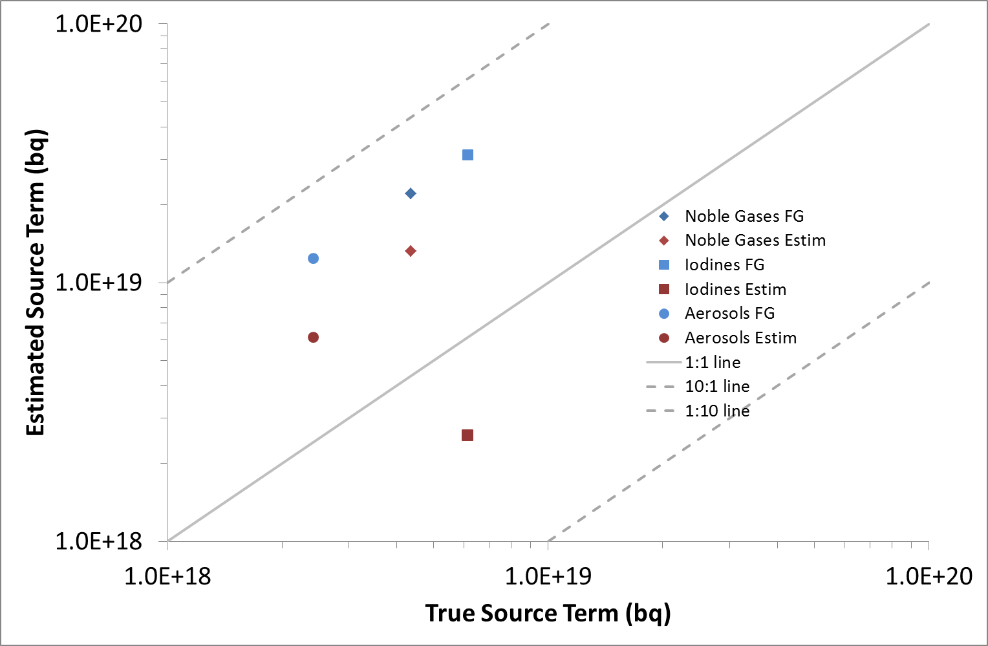
4th test – results – total releases

Slide 22

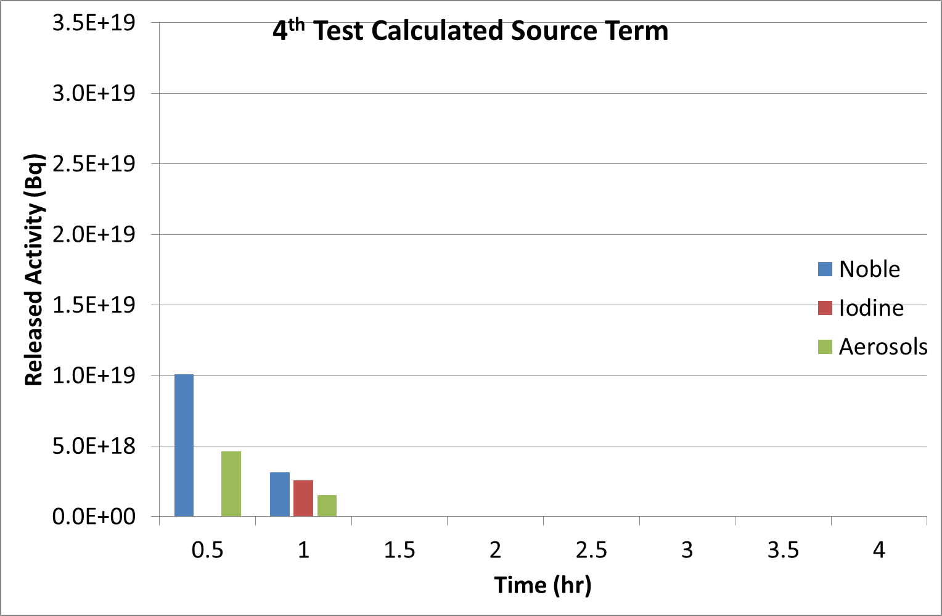
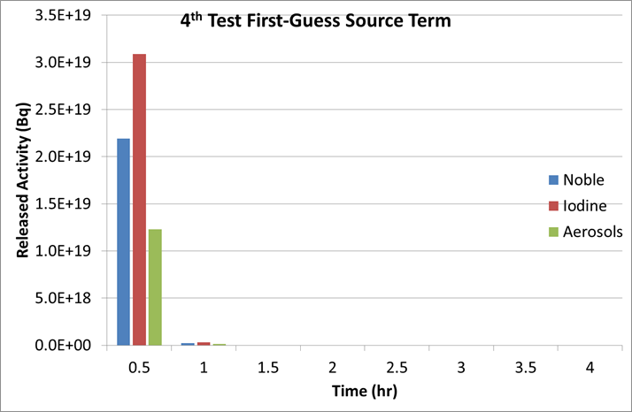
4th test – results – split

Slide 23
Conclusions
In all simulated cases the estimated time-dependent source term was closer to the true one than the first guess
The level of improvement varied between cases
  Test 1: estimated releases of aerosols and noble gases within a factor of 1.5 as compared to the true values; iodine release estimation not improved

Slide 24
Conclusions (cont’d)
  Test 2: estimated releases of all nuclide groups within a factor of 2 to 5 compared to true values (modest improvement)
  Test 3: timing of releases estimated correctly; magnitude of releases estimated within a factor of 1.5 to 2 compared to true values (“best” case)
  Test 4: estimated releases improved; estimated ST RMSE = 1.05×10¹⁵ Bq/s; first-guess ST RMSE = 4.09×10¹⁵ Bq/s (“worst” case)
Future work: calculation of optimal values of parameters; unknown location of release

Slide 25
References
I. Kovalets, I. Ievdin, R. Hofman, P. Seibert, S. Andronopoulos (2016) “Description of software module for source term estimation using advanced method integrated in DSS RODOS”, Report PREPARE(WP4)- (16)-04
Kovalets I. , Andronopoulos S., Hofman R. , Seibert P., Ievdin I. (2016) “Advanced method for source term estimation and status of its integration in JRODOS”. Radioprotection 51 HS2, S121-S124, doi:10.1051/radiopro/2016046
Kovalets I., Andronopoulos S., Hofman R., Seibert P., Ievdin I., Pylypenko O. (2018) “Advanced Source Inversion Module of the JRODOS System”. In: Agarwal R., Agarwal A., Gupta T., Sharma N. (eds) Pollutants from Energy Sources. Energy, Environment, and Sustainability. Springer, Singapore. pp 149-186 DOI: https://doi.org/10.1007/978-981-13-3281-4_10

Slide 26
Thank you very much for your attention!

