Slide 1

Seasonality influence in the elaboration of risk maps associated to the transfer of radioactivity through the food chain
5th NERIS Workshop
3-9 April 2019. Roskilde, Denmark
Montero Prieto, M.¹; Trueba Alonso, C.¹; Sangiorgi, M.²; García- Puerta, B.¹; Hernández-Ceballos, M.A.²; De Felice, L.²
¹ Centro de Investigaciones Energéticas, Medioambientales y Tecnológicas (CIEMAT), Madrid, Spain
² European Commission, Joint Research Centre, Ispra, Italy

Slide 2
Outline
Introduction
Methodology
Results
Conclusions

Slide 3
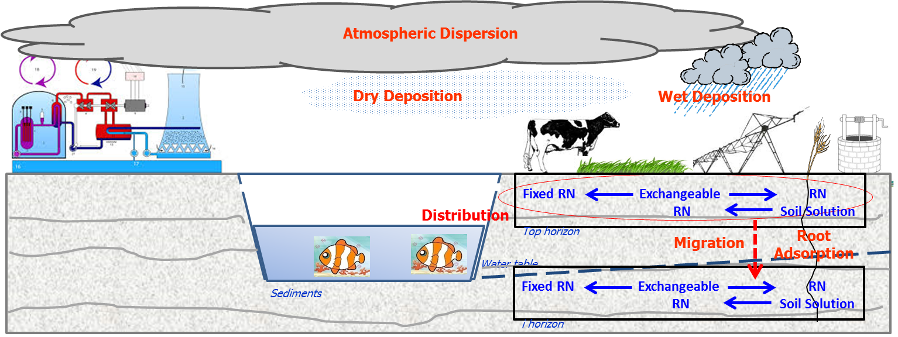
Introduction
The uncontrolled release of RN may affect large areas due to their accumulation in soils. Their transfer through the food chain exposure pathway can give rise to public health and socioeconomic consequences.
The elaboration of risk maps associated to the transfer process depends on factors such as:
The amount and composition of the RN released
Their atmospheric dispersion and deposition pattern
The radiological vulnerability of the affected area (potentiality to transfer the contamination)
The socioeconomic structures affected (nº of persons, land use, husbandry production)
A further step is to assess the seasonal influence in the elaboration of the risk maps associated to the transfer process.

Slide 4
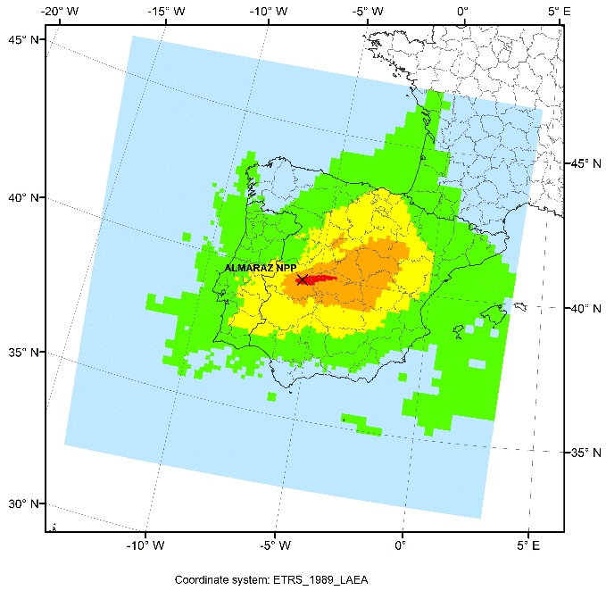
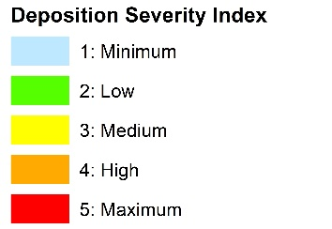
Introduction
Under the framework of ANURE Project (Assessment of the NUclear Risk in Europe - A case study in the Almaraz Nuclear Power Plant (Spain), a JRC-CIEMAT Specific Agreement, a methodology has been designed to establish the geographical distribution of the risk caused by severe accidents in European NPPs, taking into account:
The meteorological conditions that influence the dispersion and deposition of radionuclides,
Their accumulation in soils,
Their transfer to crops according to the soil parameters that influence this transfer potentiality, that is, the soil vulnerability.
Other regional cultural factors, as farming practices
¹³⁷Cs Severity deposition map

Slide 5

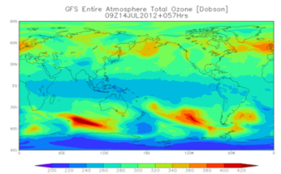

Introduction
Meteorological data
MODELLING
1 simulation/day
release and deposition
(random hours)
Global Forecast System (GFS): 5 year period (2012-2016)
Weather forecast model produced by the National Centers for Environmental Prediction (NCEP)
INPUT DATA
RIMPUFF ADM + FDMT + STATISTICAL Tool
Source term data
RESULTS
Release pattern of an ISLOCA type accident
Of 1825 possible simulations,
for each radionuclide, 1383 are valid due to missing meteorological data
Selected from the results of the SOARCA methodology
Surry NPP (Virginia, EEUU), as surrogate
Applied to the Almaraz inventory: ⁹⁰Sr, ¹³¹I, ¹³⁷Cs
1383 total deposit values per grid cell
(Bq/m²)
35h release + 48h prognosis

Slide 6
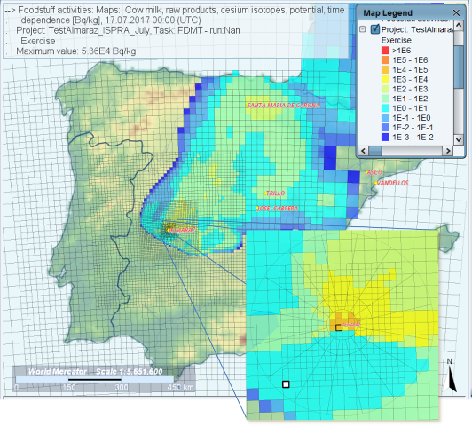
Methodology
Agicultural production – food chain
Leafy veg.
Milk cow
Meat cow
Selection of foodstuffs:
  Importance in the agricultural production
  Importance in the diet
  Useful to represent exposure scenarios with operational purposes (e.g. scenarios Food pre-analysis or Food post-analysis of IAEA OILs)
Activity in foodstuffs (beef cow, leafy vegetables and milk cow), calculated with JRODOS, after the release, using the FDMT model.
Only one grid cell was selected; considerations made for the chosen cell would be valid for all the others.
First studies have been made in the first cell of the grid

Slide 7
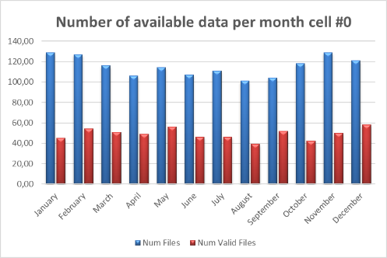
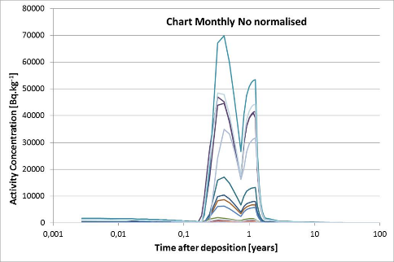
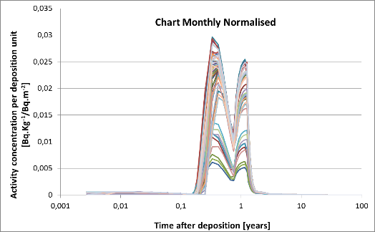
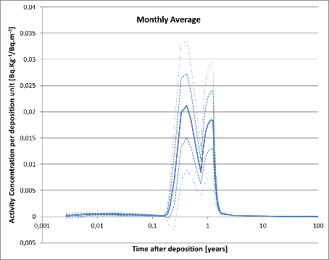
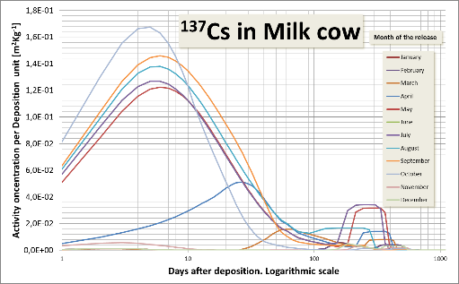
Methodology
≈ 100 runs/month, 40% valid
Grouping the activity concentration [Bq.kg⁻¹] of each RN, in each foodstuff, according to the month in which the release occurred
Normalisation, regarding the total deposition in the cell (by each run) [Bq.kg⁻¹/Bq.m⁻²] and the time after deposition [days or years]
Estimation of the mean, standard deviation and other statistics
Obtaining a ranking of severity of contamination in each foodstuff according to the month of the deposition to map the risk

Slide 8
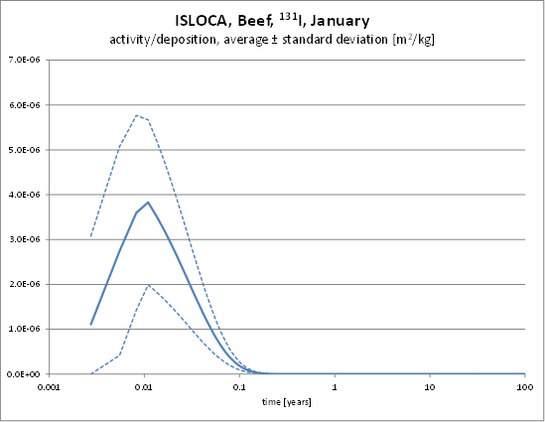
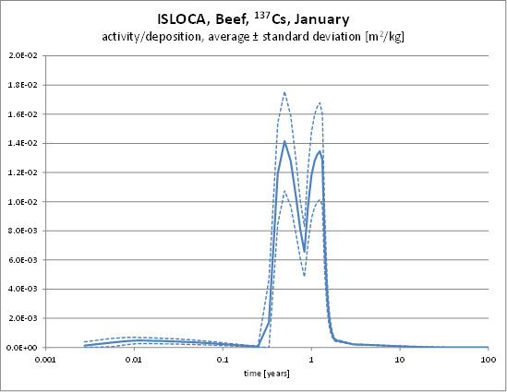
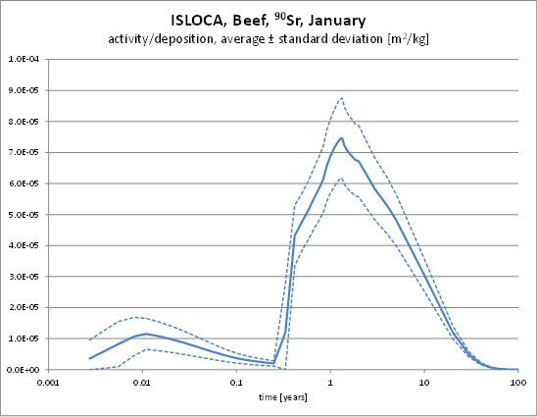
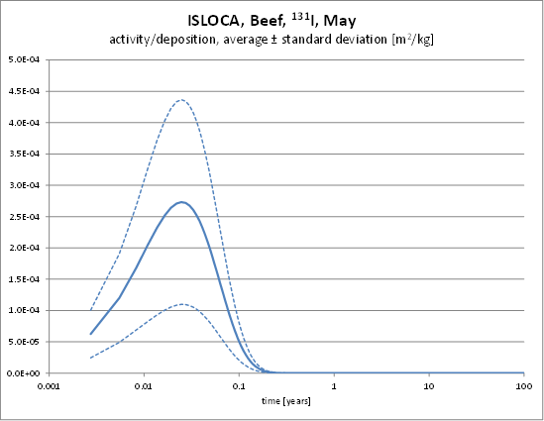
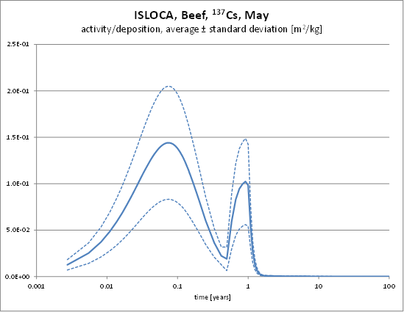
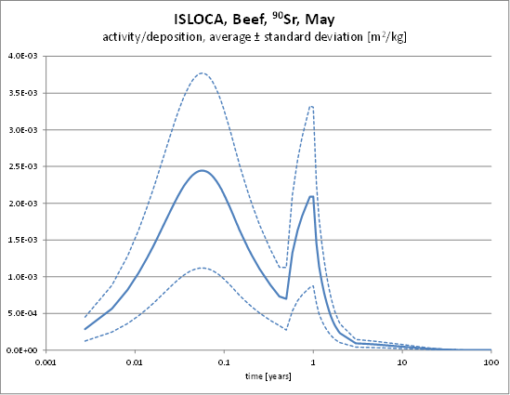
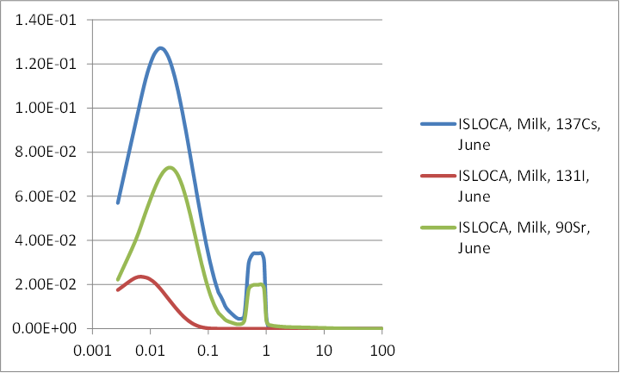
Results
A range of average activity curves, regarding the month of release, for each radionuclide.
The peak of activity differs from nuclide to nuclide, month to month and foodstuff to foodstuff.
¹³¹I
¹³⁷Cs
⁹⁰Sr

Slide 9
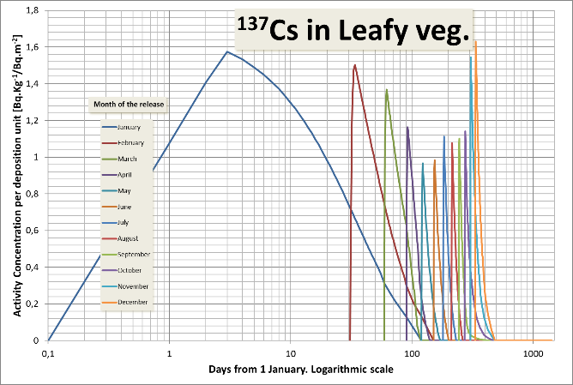
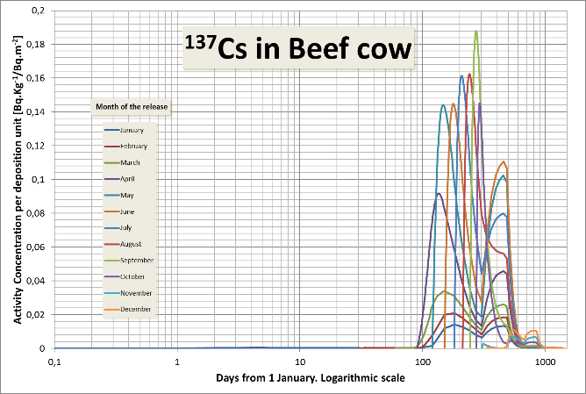
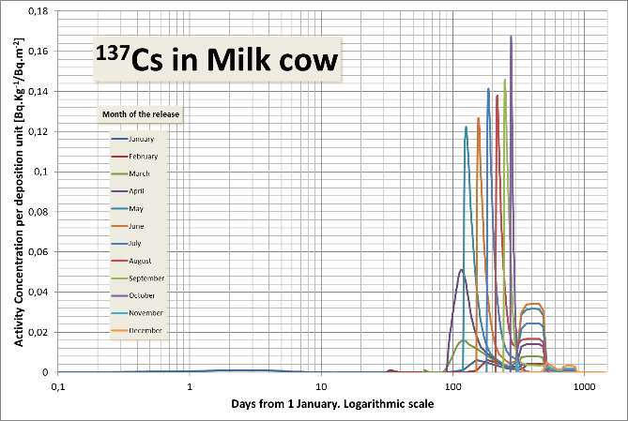
Results – ¹³⁷Cs in foodstuffs
Activity in foodstuff per Deposition unit [Bq.kg⁻¹/Bq.m⁻²]. Seasonal variability regarding the month of deposition
The strength of the activity concentration in each foodstuff changes depending on the month when the deposition takes place.
The contamination situation for leafy vegetables seems that have less fluctuation with the month of deposition than the animal products. It will be necessary to take into account the range of variation of the data, to obtain conclusions.
The worst situation for cow meat and cow milk is given for releases between June and October. Other peaks less important appear in the next years.

Slide 10
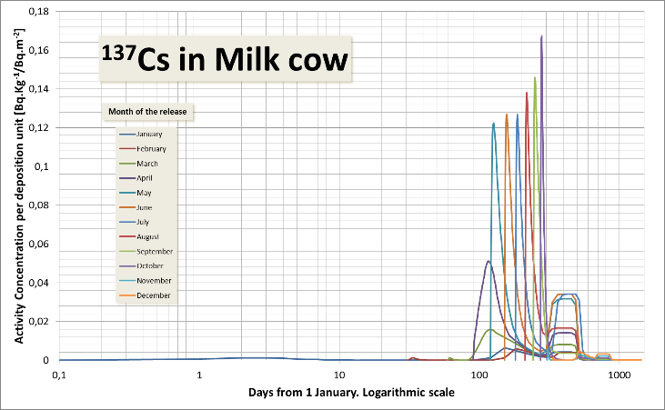
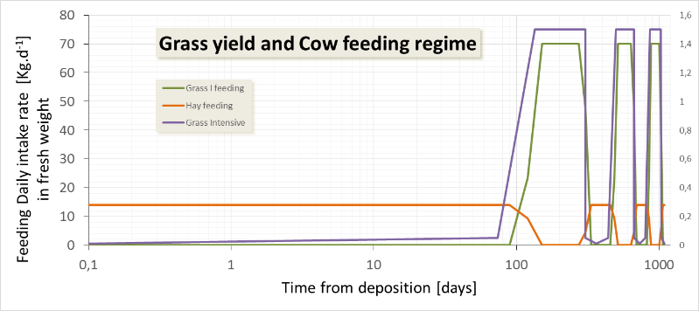
Results – ¹³⁷Cs in foodstuffs
Factors affecting the seasonal variability
This variability is due, mainly to the regional farming practices:
  dates of sowing and harvesting of crops and growth cycle and forage cut of grass and other feedstuffs
  cow feeding regime
In the case of the cow's products, there is a correlation between the maximum activity and the peaks of grass growth, matching also with the grazing period. When the feeding is changed to the hay from the grass cutting, during the maximum yield, there is an increase in the activity concentration in the product, due to the concentration of the contamination in the forage.

Slide 11
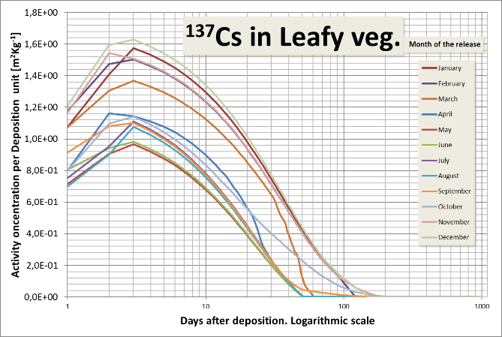
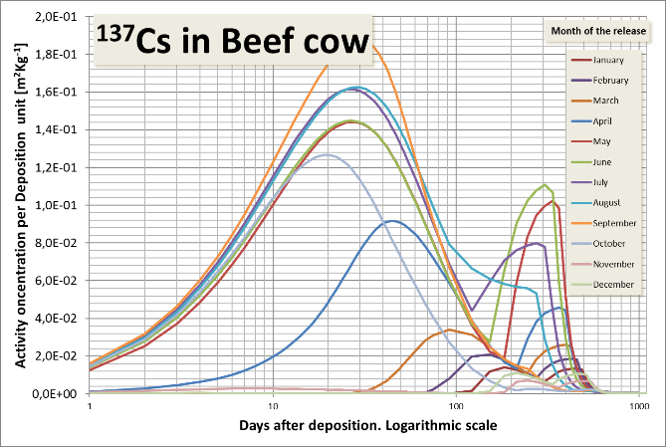
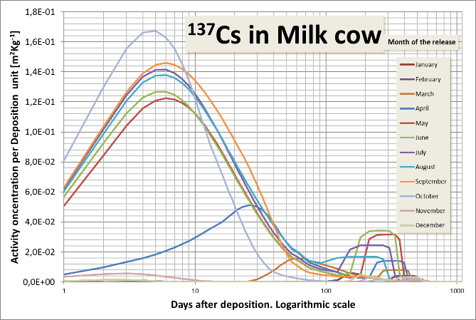
Results – ¹³⁷Cs in foodstuffs
Activity in foodstuff per Deposition unit [Bq.kg⁻¹/Bq.m⁻²] according time after deposition
The curves with respect to time, from the deposition time, allow the comparison of the temporal evolution according to the month of occurrence of the deposit.
The maximum peaks occur during the first days, due to the direct deposit on crops and grass. The difference in the magnitude of such peaks fundamentally reflects the dependence on the growth stage of the crop.
After one year and beyond, the contamination of the products will depend on the soil-plant transfer, which transfers into smaller peaks.

Slide 12
Results – ¹³⁷Cs in foodstuffs
Ranking the peaks
The curves are independent of the type of source term.
The peaks of the curves can be used to create a relative ranking of severity quantifying the importance of the seasonal variability.
Peaks in the firsts days give idea of severity of direct deposition.
Peaks around a year after deposition can be indicators of the risk of contamination through food chain.
Ranking of the severity of contamination in Milk cow as function of the month of deposition

Slide 13
Results – Aplication to operational purposes and preparedness to recovery
MPL for 137Cs in Milk, 1000 [Bq.Kg⁻¹]
Estimation of operational levels useful to plan a protective or recovery action
E.g. Estimation of the deposit activity concentration that would lead to a activity concentration in the food at the maximum permissible level (MPL).

Slide 14
Conclusions
A methodology to obtain the influence of seasonality in the severity of the radioactive contamination in foodstuffs from an accidental deposition has been studied.
The ranking of the seasonal scenarios of contamination can be combined with other indexes of severity, as the strength and probability of deposition and the soil-plant transfer capacity, to map the nuclear risk for preparedness and response in a emergency and post-accidental recovery purposes .
To be done:
  Studies in representative cells with have a significant number of valid values (> 50%)
  Study the influence of factors such as the type of soil in the root-transfer pathway
  Analyze the most sensible crop to seasonality or that of greater economic impact
  Study the influence of regional factors (other climatic environments) on the magnitude and temporal behavior of the activity
  Determine the influence on the determination of other intervention operational levels, such as those proposed by the IAEA

Slide 15
Miguel-Angel.HERNANDEZ-CEBALLOS@ec.europa.eu milagros.montero@ciemat.es

