Slide 1
LESSONS LEARNT FROM THE GAMMA-BASED MONITORING STATIONS OF R.A.R.E. : DEVELOPMENT AND REAL-TIME PERFORMANCE
Workshop 2019, 3-5 April 2019, Roskilde, Denmark
José Ángel Corbacho Merino
Environmental Radioactivity Laboratory. University of Extremadura
Cáceres, SPAIN

Slide 2
Outline
Environmental Radiological Network of Extremadura (R.A.R.E.) Located in Extremadura, SW SPAIN
A brieft presentation
RADIOLOGICAL PARAMETERS
Essential parameter: H*(10) → drawbacks
RARE´S Gamma Spectrometry Systems
SOFTWARE APPLICATIONS
CONCLUSIONS
Notes:
Justificar la conveniencia de los SGC en el ámbito de la redes de alerta

Slide 3
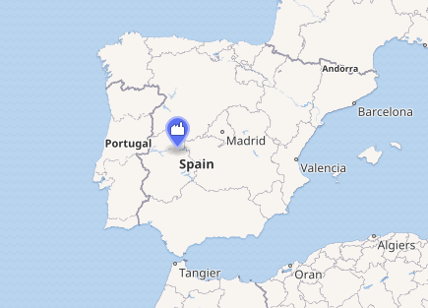
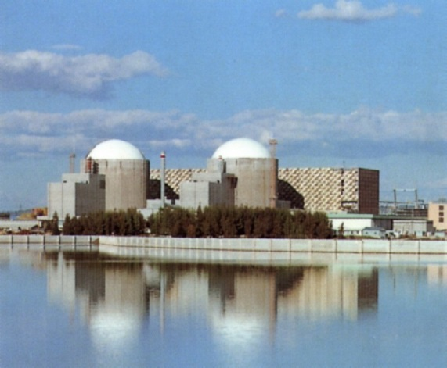
RARE NETWORK
ALMARAZ NUCLEAR POWER PLANT (ANPP)
Commission date: September 1, 1983
Power generation:
Units operational: 1 × 1011 MW + 1 × 1006 MW
Capacity factor: 85.88%
Annual net output:15,174 GW·h (2016)
Notes:
RARE AUTOMATIC RADIATION MONITORING NETWORK

Slide 4
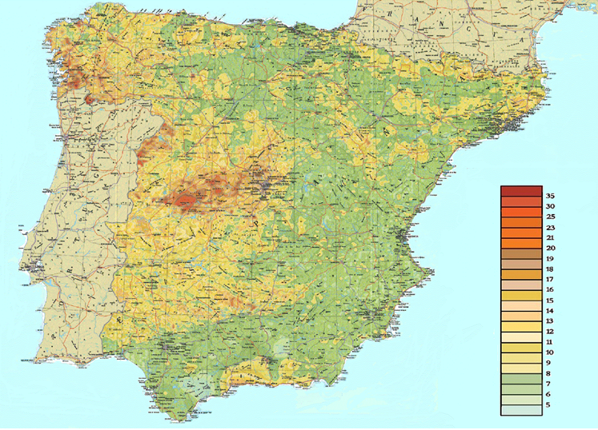
NATURAL BACKGROUND
μR/h

Slide 5
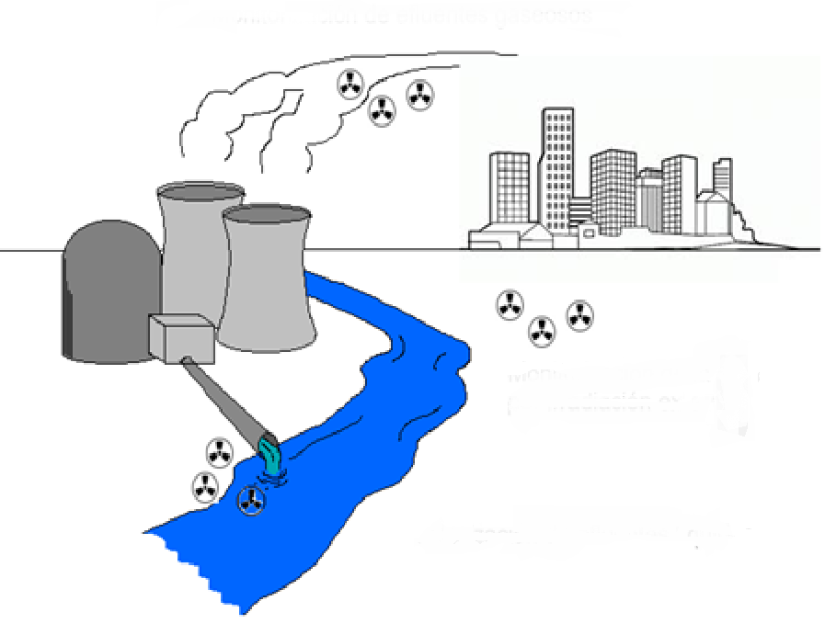
STARTING POINT (1990)
- H*(10) monitors
- water monitoring stations
- airborne monitoring stations

Slide 6
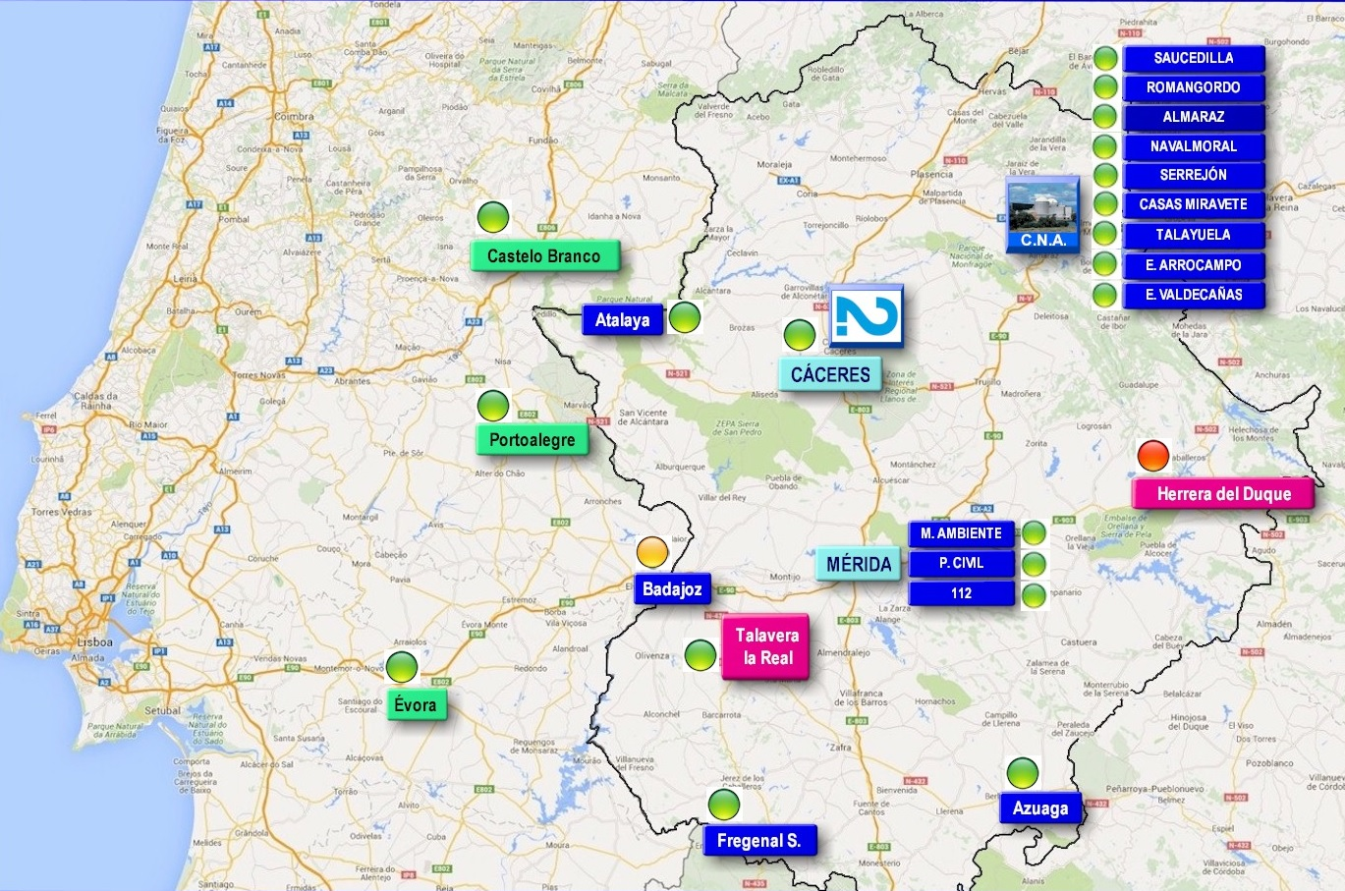
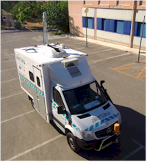
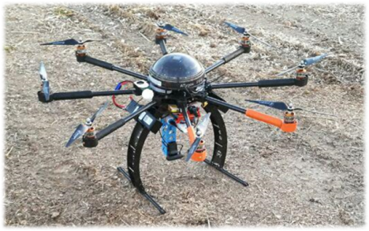
CURRENT STATE (2019)
17 RARE H*(10)
monitoring stations
+
5 RARE air
monitoring stations
+
3 RARE water
monitoring stations
1 monitoring
Mobile Laboratory
2 monitoring drones
(under development)
UNE-EN ISO 9001
ISP/IEC 17025

Slide 7
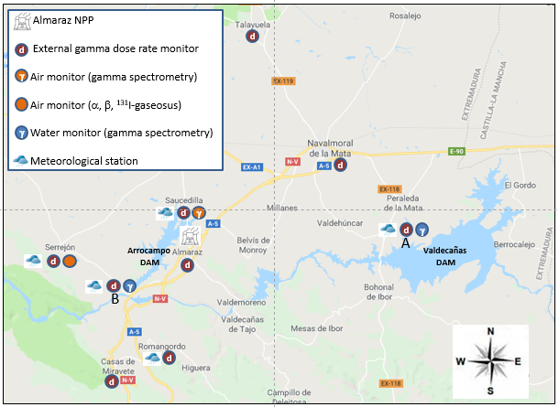
Almaraz NPP vicinity
Almaraz NPP uses for cooling the international Tagus River, that runs into Portugal.

Slide 8
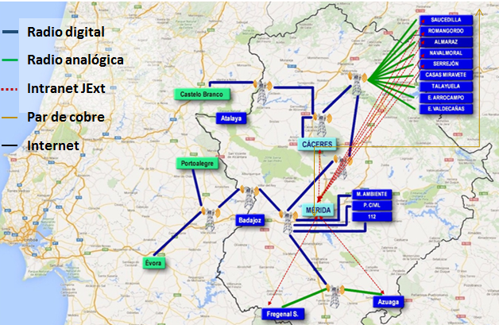
COMMUNICATIONS: ESSENTIAL TOOL.
Digital radio
Analogical radio
Intranet
Twisted pair
Internet
Satellite → Mobile lab
TRANSMISION MODALITIES
The data are sent to RARE’s headquarters in quasi real-time, using at least two communication routes in Almaraz NPP area.

Slide 9
RADIOLOGICAL PARAMETERS
Ambient equivalent dose rate: H*(10) :
fundamental parameter in radioprotection field:
COUNCIL DIRECTIVE 1996/29/EUROATOM
It is usually measured by a Geiger-Müller counter that is a sensitive (over an extended operational range of dose), robust, cheap and easy to use instrument. Therefore, dense networks are available.
It can be considered as a global parameter since most of early warning networks in Europe and world-wide comprise automatic measurement stations equipped with GM tubes.

Slide 10
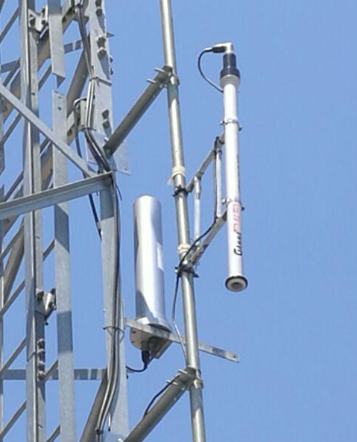
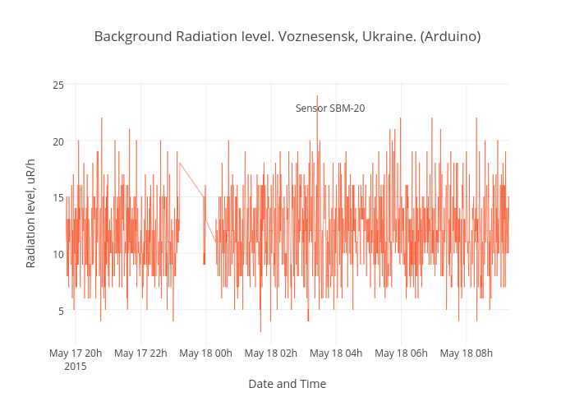
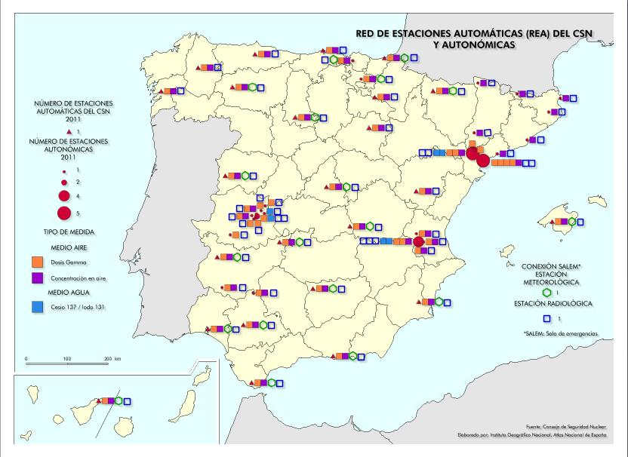
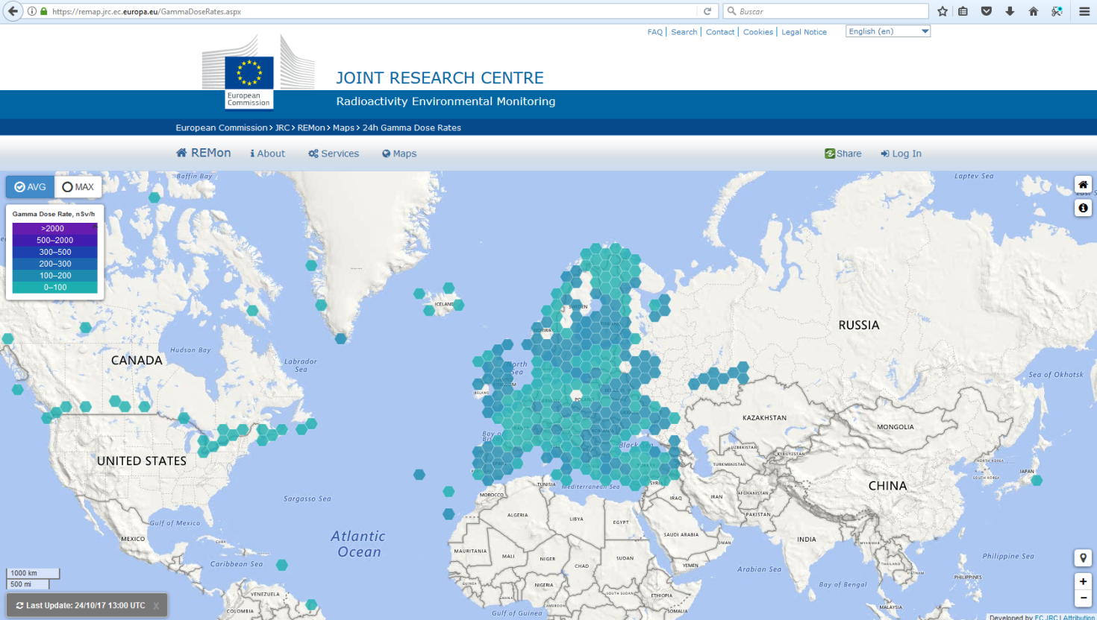
.
H₁₀ (μSv/h)
Geiger-Müller counters
RARE
CSN
EURDEP
Notes:
http://www.larescvalenciana.org/iso-9001-en-residencias-de-ancianos/

Slide 11
RADIOLOGICAL PARAMETERS
OUR EXPERIENCE OVER THE LAST 30 YEARS USING G-M PROBES

Slide 12
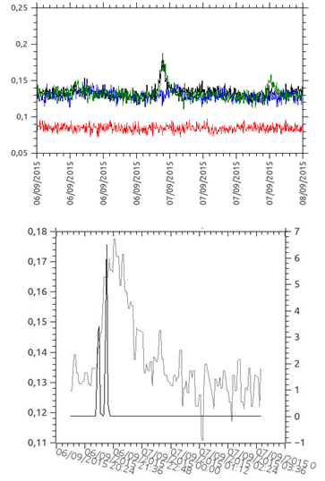
Geiger-Müller´s drawback
A GM tube can only detect the presence and intensity of radiation.
FACTS TO THINK ABOUT
Increment ambient equivalent dose rate due to the scavenging of the airborne naturally occurring radionuclides during precipitation events is a well-known phenomenon
Dose rate (μSv/h)
Could a simultaneous weak man-made radiological anomaly overlook?
Dose rate (μSv/h)
Precipitation (mm)
Notes:
https://www.youtube.com/watch?v=WZ7Bo5CJCik
https://www.enac.es/plan-transicion-iso-17025
http://arrizabalagauriarte.com/iso-iec-170252017-caracteristicas-novedades-la-version-2017/
https://www.ambientalys.com/iso-iec-17025-2017

Slide 13
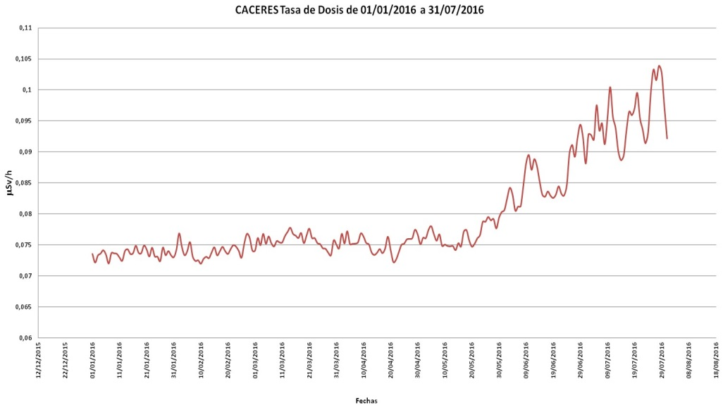
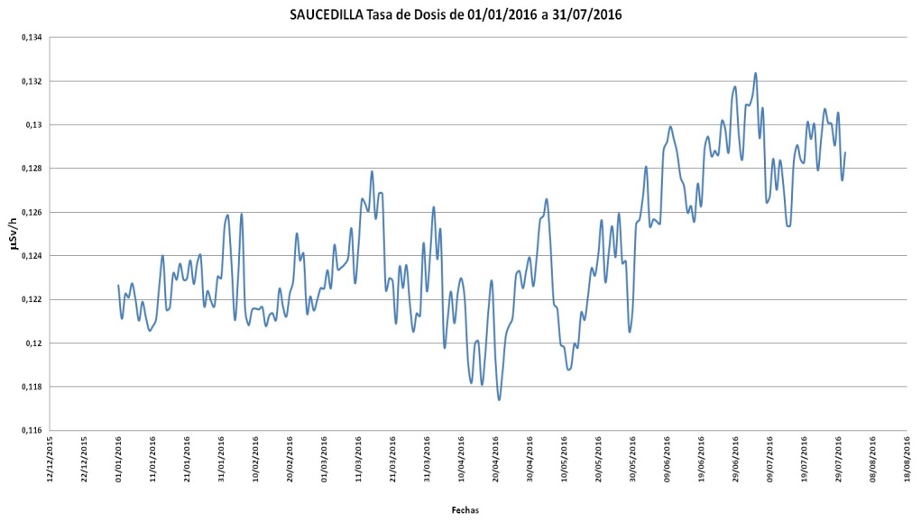
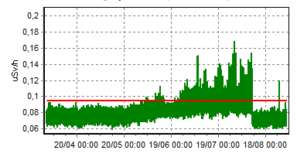
2) Anomalous and continuous increment of H*(10) during summer
Was it a real radiological alteration?
Dose rate increase due to higher Rn-222 concentration in air during summer
GM wrong behaviour due to high temperatures
The damaged monitor was replaced

Slide 14
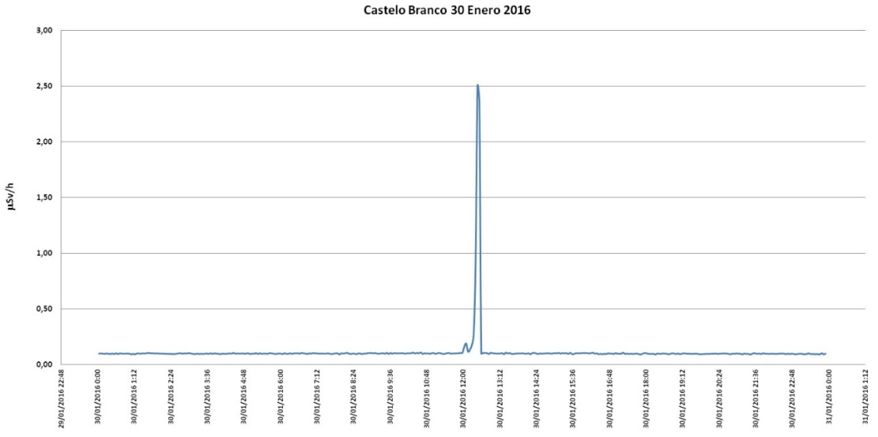
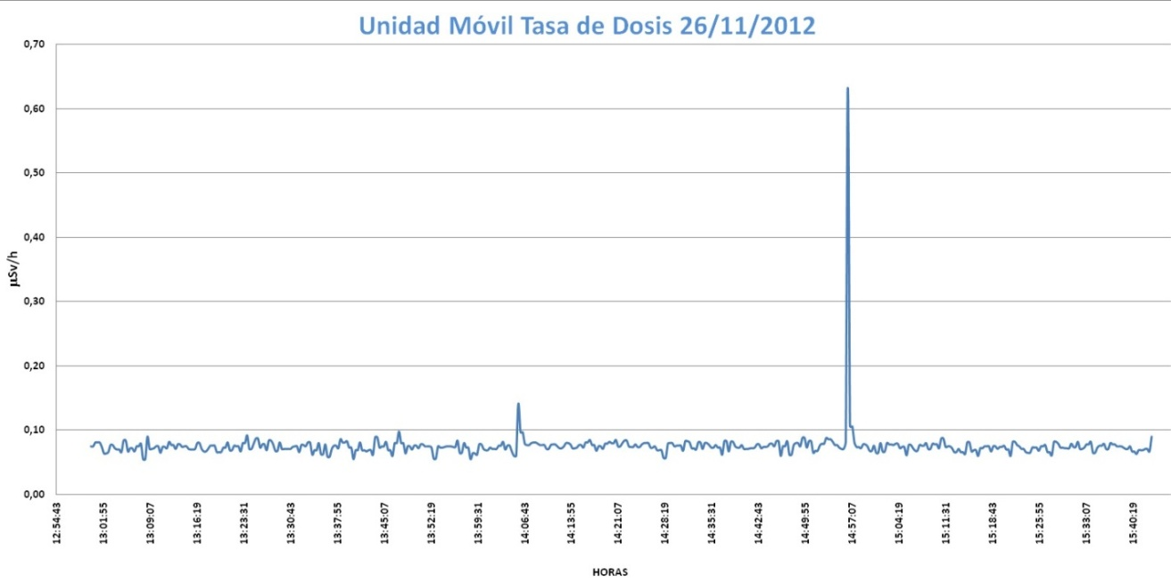
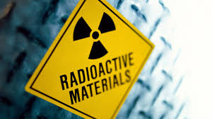
3) Electronic noise or radiological anomaly?
Spurious increment
(electronic noise)
Mobile lab at a petrol station
Was it a real radiological alteration?
The driver of a vehicle with radioactive material stopped for a while at the `petrol station….

Slide 15
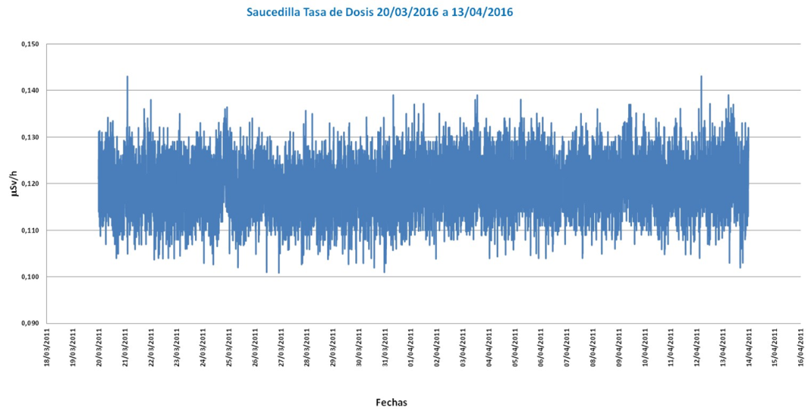
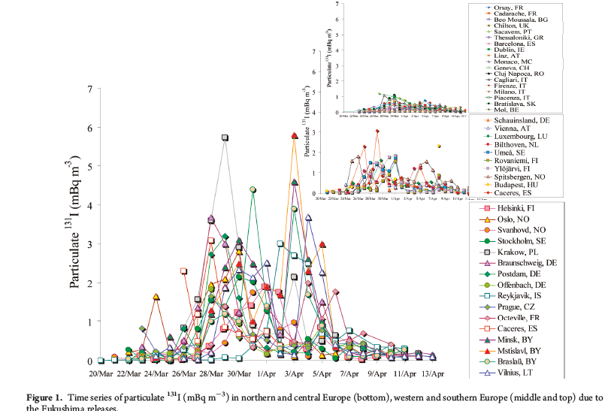
3)Low sensitivity
SAUCEDILLA monitoring station during the days when Fukushima’s radioactive cloud reached Europe
The average daily value of the dose rate monitors did not detect alterations due to radioactive cloud
A_{max}(¹³¹I-part.)= 3 mBq/m³

Slide 16
THE INFORMATION PROVIDE BY G-M PROBES MUST BE COMPLEMENTED BY OTHER MONITORING SYSTEM

Slide 17
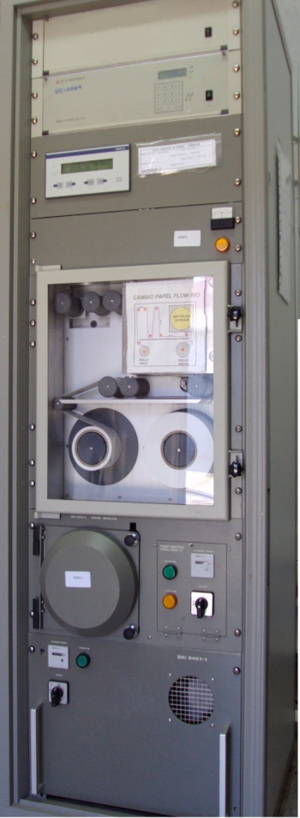
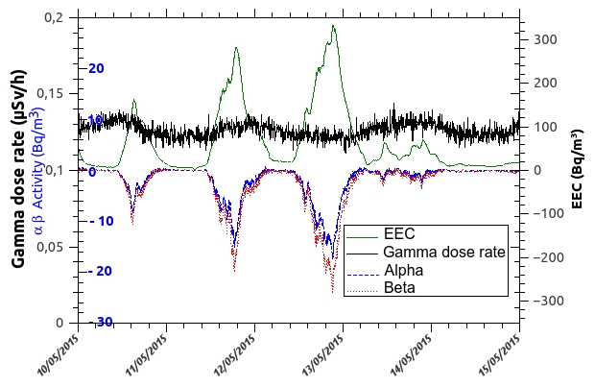
FORMER RARE´S ATMOSPHERIC MONITORING STATION
COMMERCIAL SYSTEM
Particulate fraction: gross α and β parameters (Rn222 compensation algorithm)
Gaseous fraction: Ι−131
Negative gross alpha and beta activity?

Slide 18
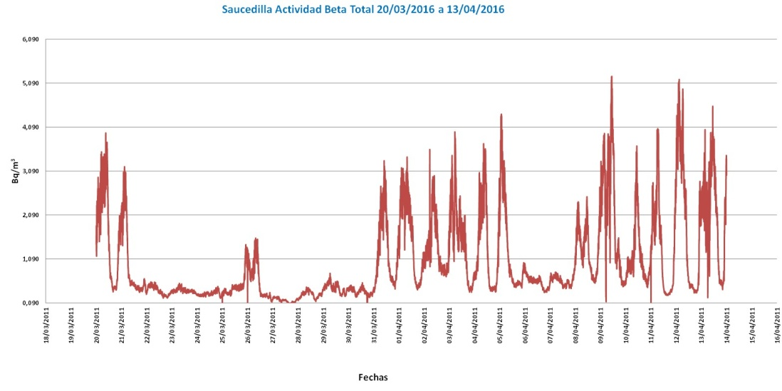
WE COME BACK, AGAIN, TO FUKUSHIMA’S RADIOACTIVE CLOUD OVER RARE’S STATIONS
Could man-made beta emitters be detected in the airborne fraction ?
Gross beta airborne activity
Higher activity detected
ANSWER: They were not detected because the natural gross beta oscillations due Rn-222 daughters were higher

Slide 19
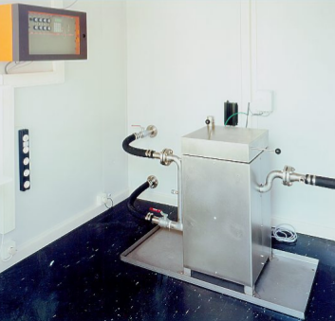
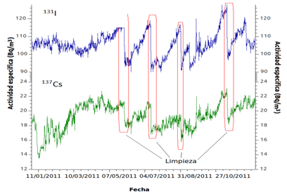
FORMER RARE´S WATER MONITORING STATION
COMMERCIAL SYSTEM
Sludge accumulation at the bottom of the stainless steel vessel
Electronic system based on monochannel.
Continuous net I-131 and Cs-137 activity ?

Slide 20
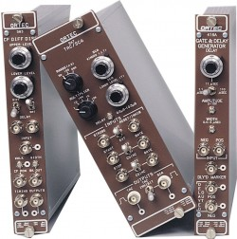
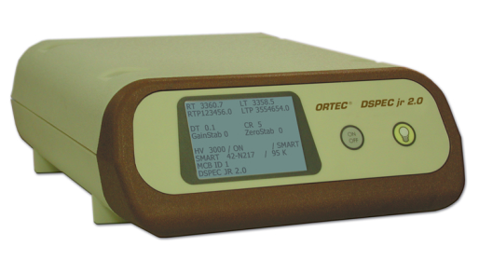
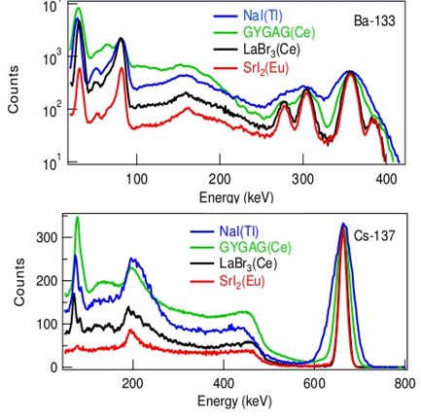
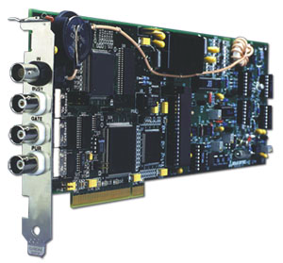
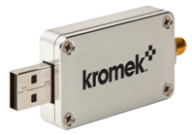
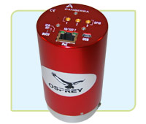
we opt for the gamma spectrometry systems
High variety of gamma detectors
More compact electronics

Slide 21
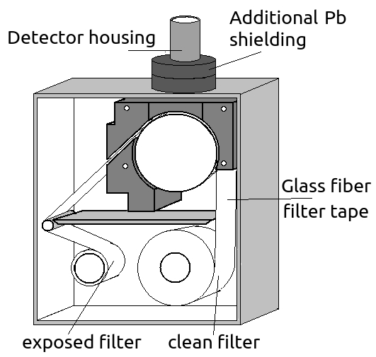
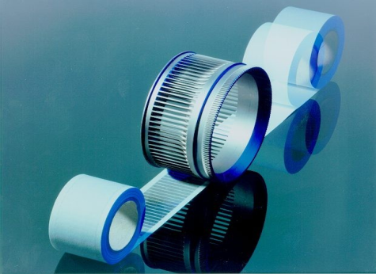
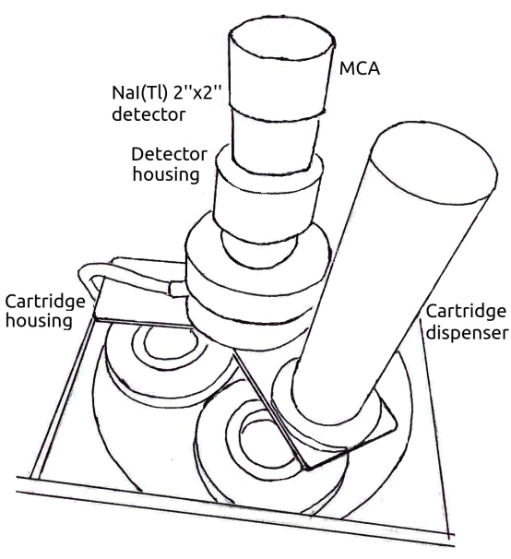
RARE´S ATMOSPHERIC MONITORING STATION
COMMERCIAL SYSTEM
RARE SYSTEM
Particulate fraction:
α and β global parameters
NaI(Tl) 2” x 2” or
LaBr₃(Ce) 1.5” x 1.5”
Gamma spectrometry
Gaseous fraction:
131Ι
NaI(Tl) 2” x 2”

Slide 22
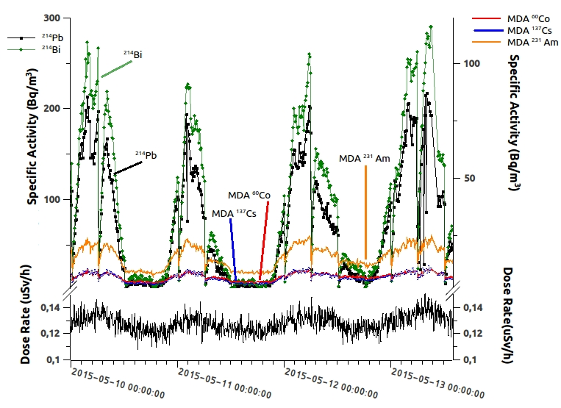
RARE´S ATMOSPHERIC MONITORING STATION
RARE SYSTEM

Slide 23
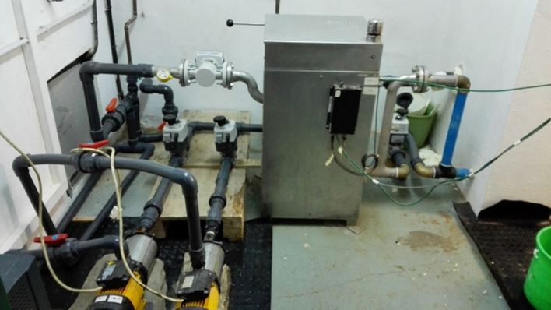
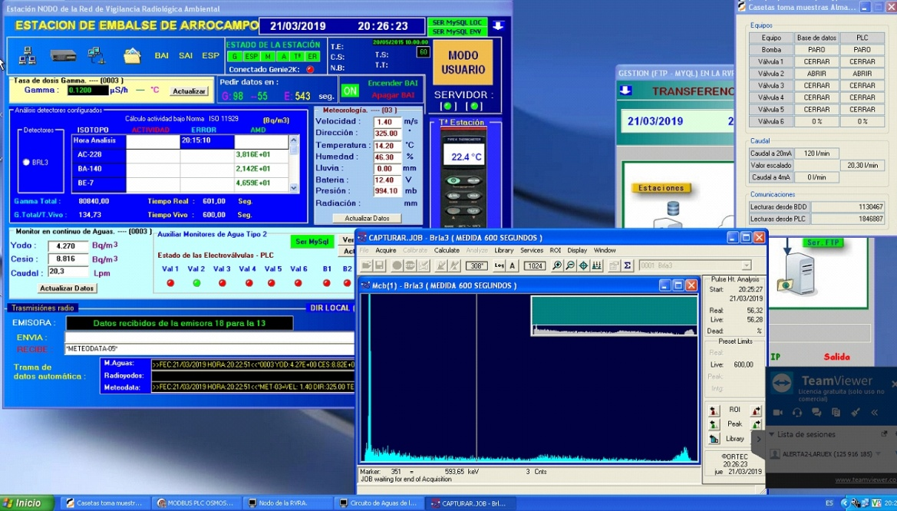
RARE´S WATER MONITORING STATION
NaI(Tl) 2” x 2” or
LaBr₃(Ce) 1.5” x 1.5”
RARE SYSTEM
COMMERCIAL SYSTEM
Gamma spectrometry

Slide 24
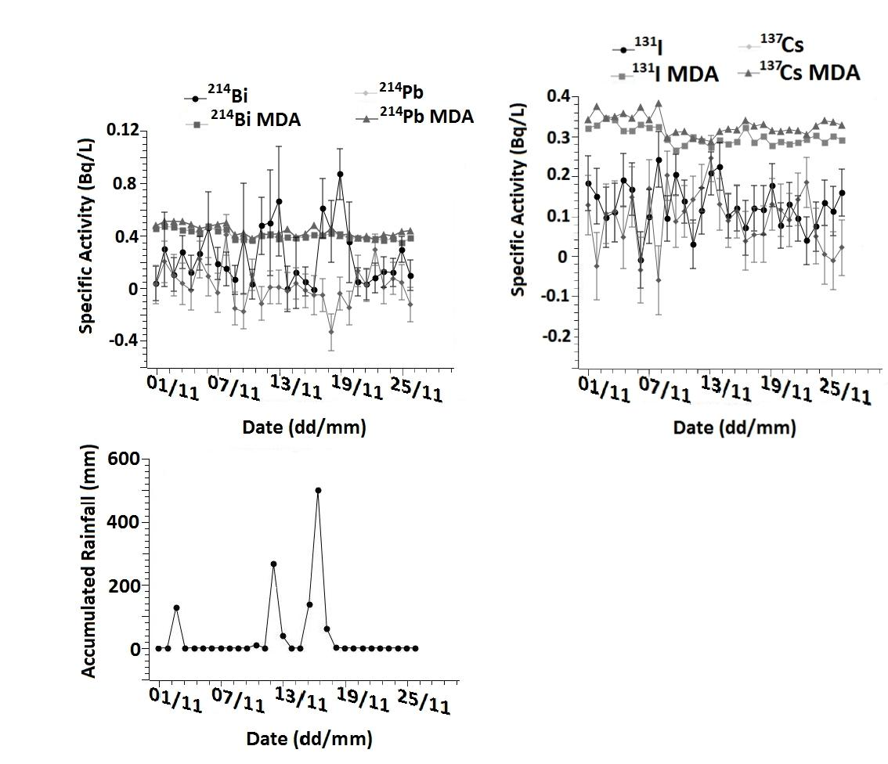
RARE´S WATER MONITORING STATION
Rainfall scavenging

Slide 25
RARE´S GAMMA SPECTROMETRY
routine operation
Airborne monitoring station
Flow: Particulate matter fraction (LaBr3): 25 m³/h
Gaseous fraction (NaI): 8 m³/h
Early warning mode
(10min spectra)
and surveillance mode
(6h and 24h spectra)
 | MDA (Bq/m3)
 | 10 min | 6 h | 24 h
Ba-140 | 35 | 0,18 | 0,022
I-131 particulate | 3 | 0,018 | 0,004
Cs-137 | 5 | 0,025 | 0,003
Co-60 | 6 | 0,011 | 0,004
Zn-65 | 40 | 1,53 | 0,38
I-131 gaseous | 36 | 0,18 | 0,023
Total gamma spectra at day:
141 → 10 min
4 → 6 h
1 → 24 h

Slide 26
THE INFORMATION PROVIDED BY A RADIOLOGICAL NETWORK REQUIRES POWERFULL SOFTWARE
WE HAVE DEVELOPED OUR SOFTWARE TOOLS

Slide 27
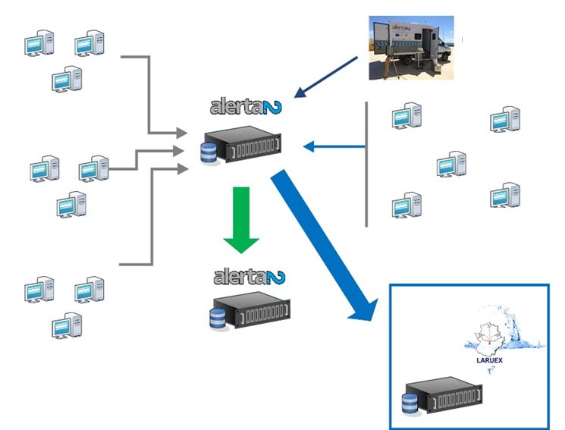
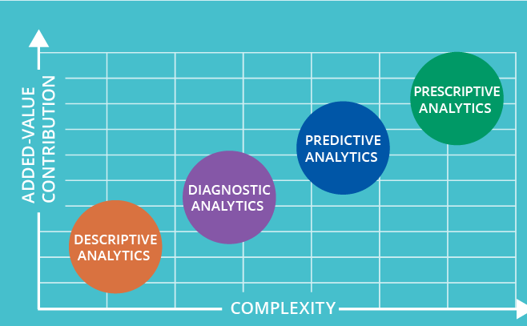
SOFTWARE APPLICATIONS
Considering the number of monitoring stations and their analytical capabilities: 200000 data/day
(radiological, meteorological and operational)
Monitoring stations
Drone
Mobile lab
Vicinity of Almaraz NPP
SOFTWARE TOOLS
SERVER 1
Further Spanish locations
SERVER 3
SERVER 2
(backup)
Portugal
(backup)

Slide 28
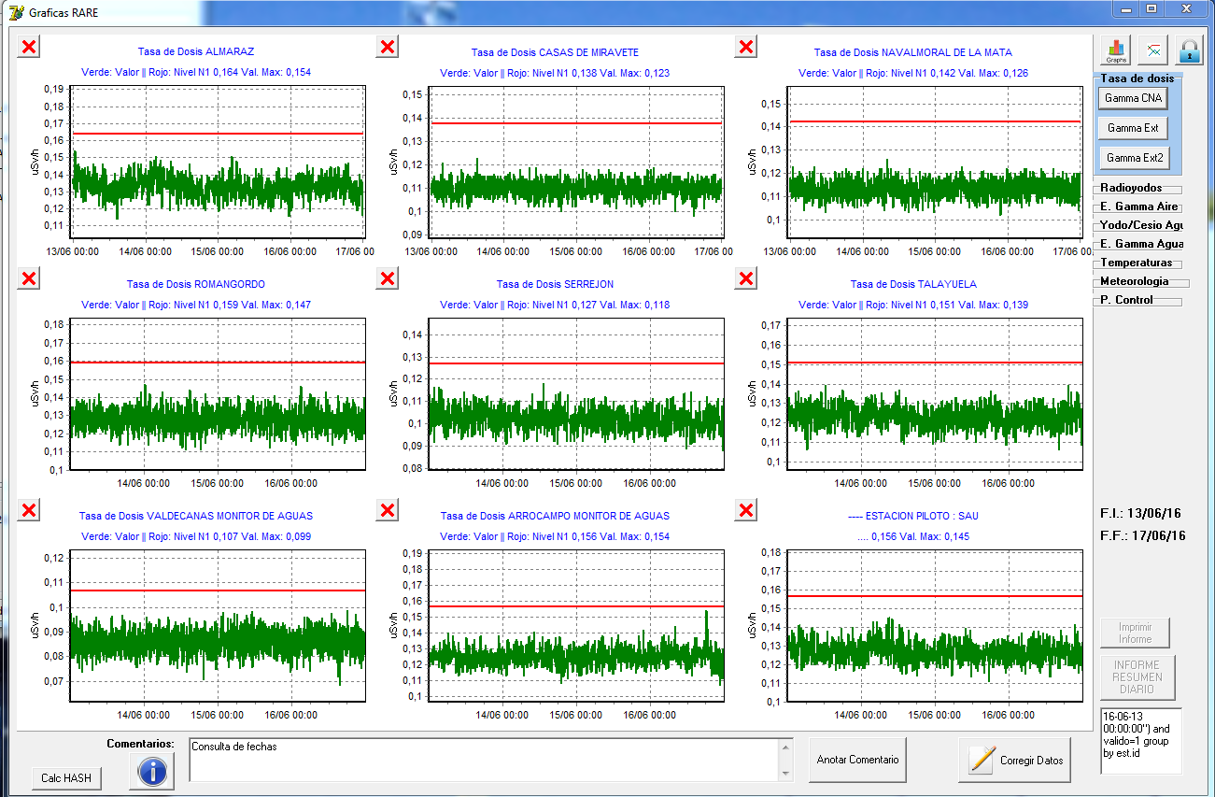
H*(10)
LEVEL 1
Station state
Shut down
Working
Level 1: 30% of monthly average dose rate plus annual average dose rate from natural background.
Level 2: 0.114 μSv·h^{–1} plus annual average dose rate from natural background.
Level 3: 0.228 μSv·h^{–1} plus annual average dose rate from natural background.

Slide 29
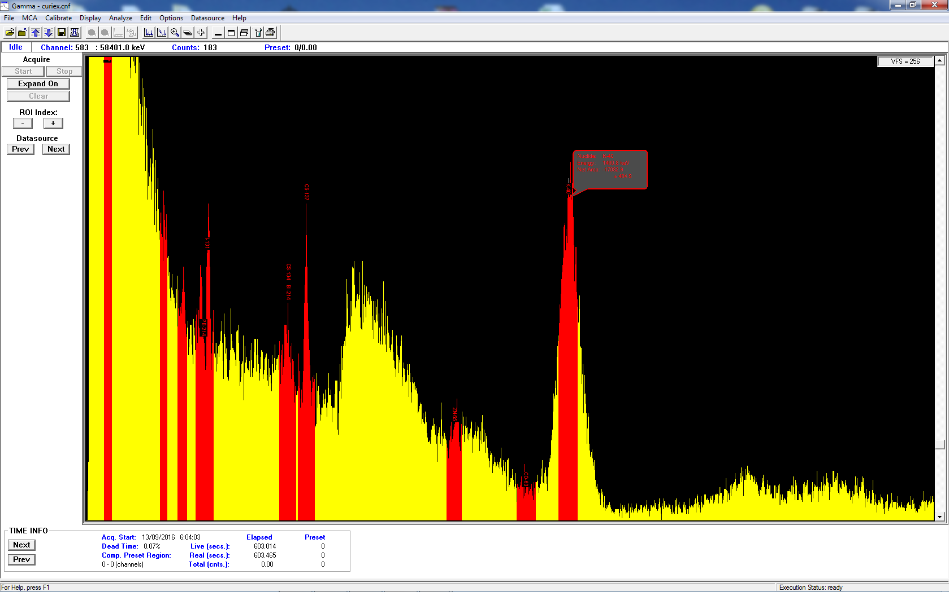
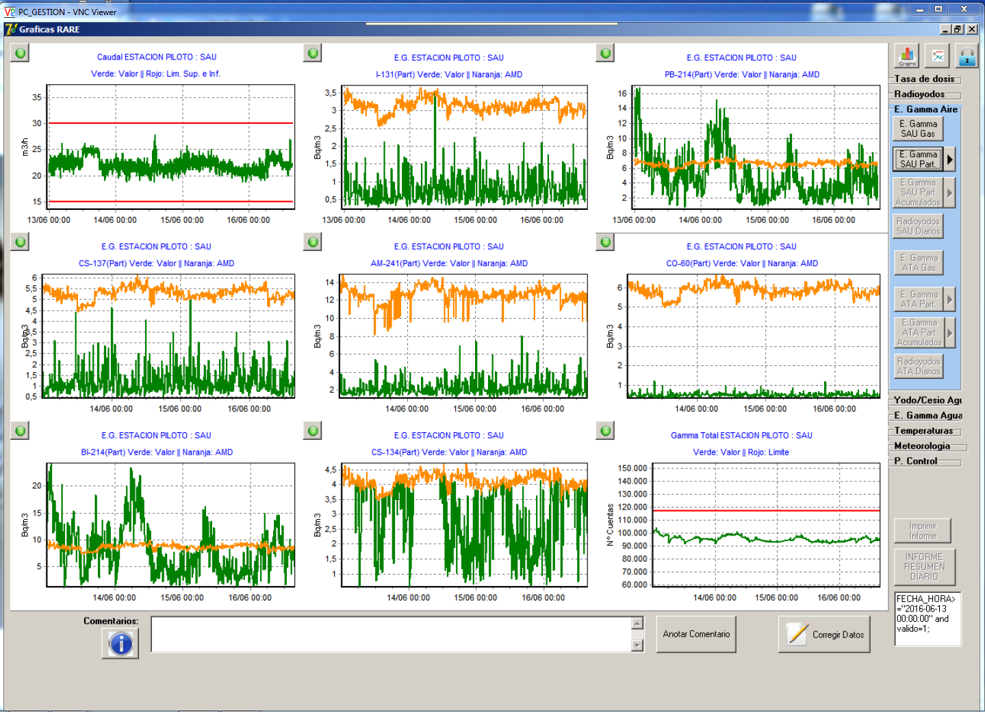
Activity concentrations
Direct access to gamma spectrum for inspection
Activity concentration (green)
and
MDA
(orange)
Air flow and its proper operational range

Slide 30
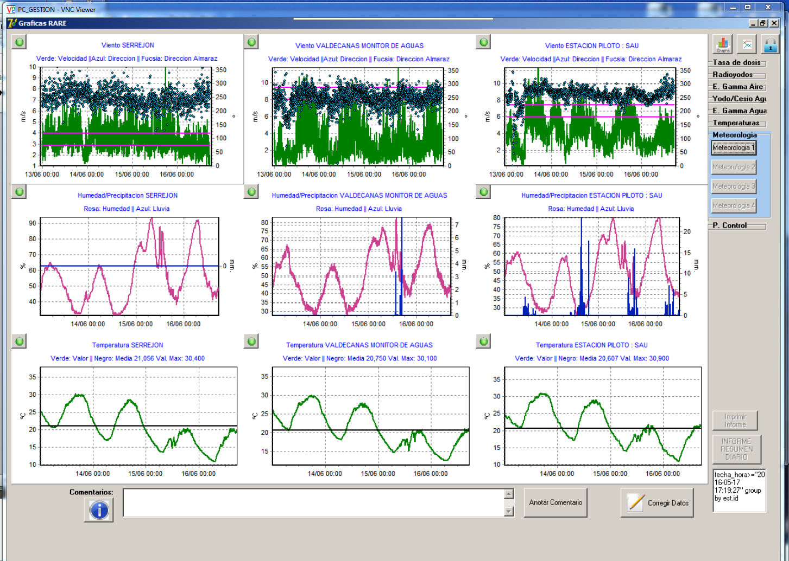
Meteorological data
Wind direction on real-time (blue points)
Direction between the station and Almaraz NPP (pink lines)
WIND
RAIN AND
HUMIDITY
TEMPERATURE

Slide 31
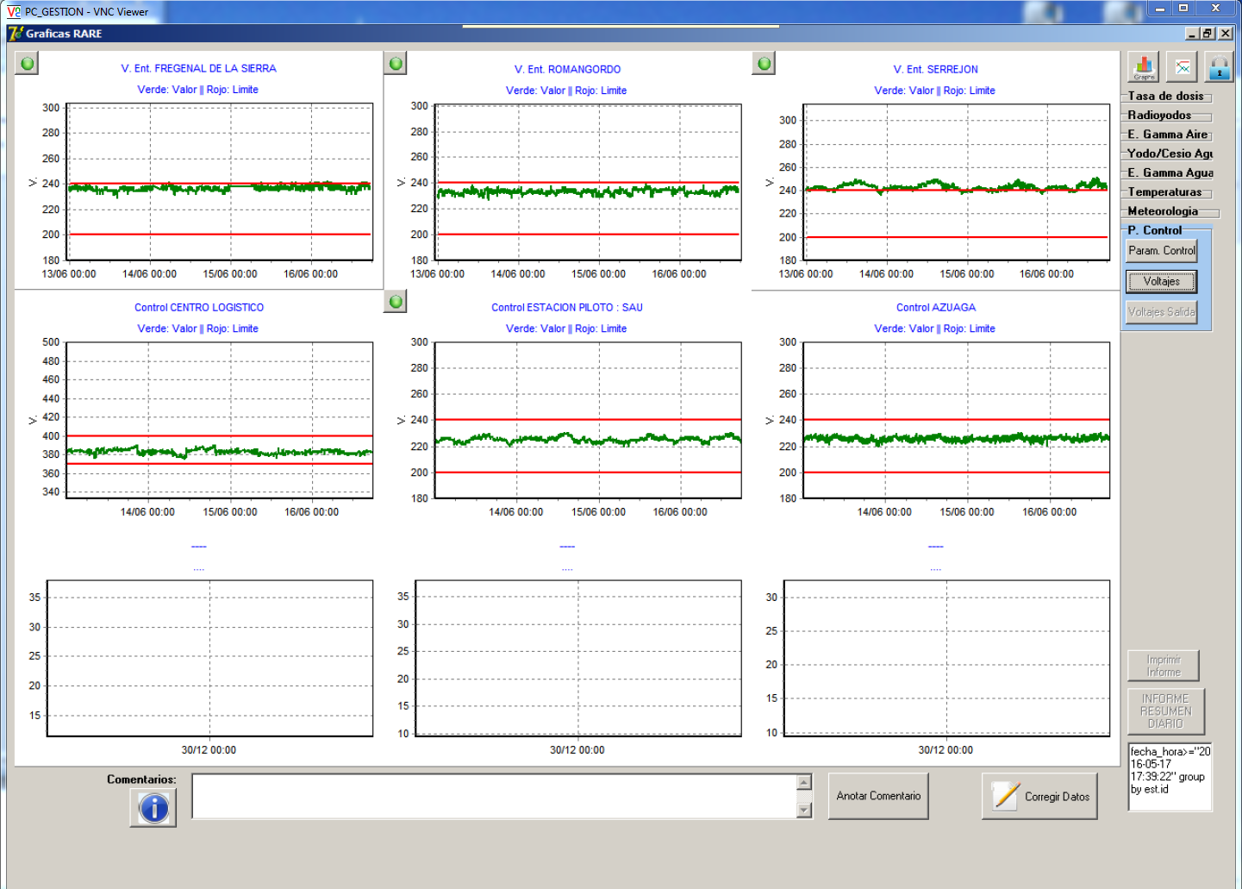
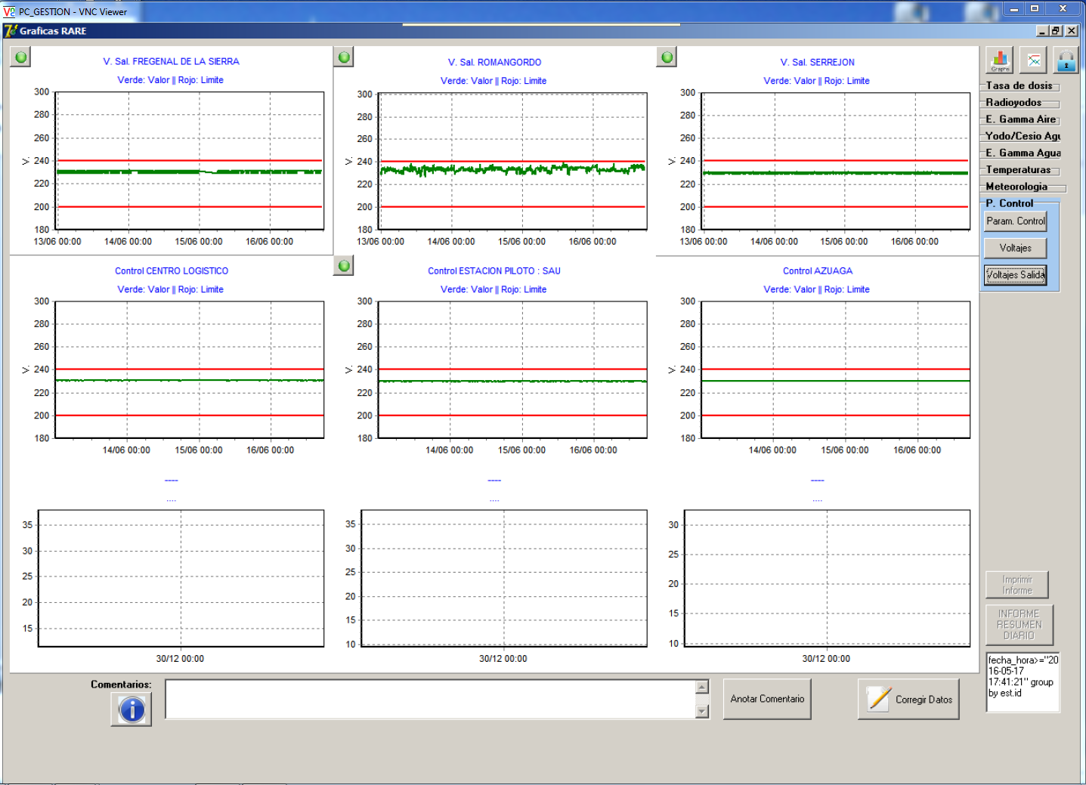
Operational data
Flow, voltage,
indoor temperature
MONITORING OF UPS
INPUT VOLTAGE
OUTPUT VOLTAGE
(stabilized)

Slide 32
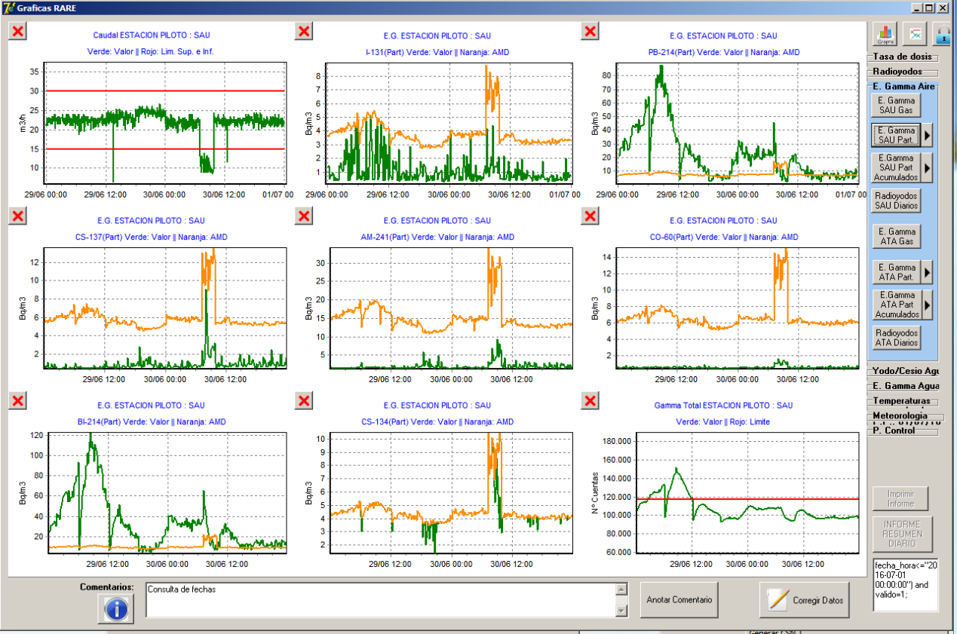
Easy identification of operational anomalies
?
Webcam image (visualized at RARE´s headquarters)
Jammed filter
Flow decreases
Activities increase

Slide 33
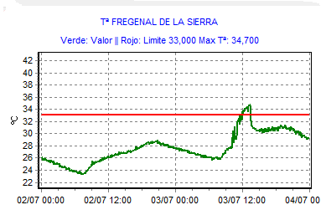
SMS on real time of radiological and operational anomalies
High indoor temperature at FREGENAL. During the last 30 min it is higher than 33ºC
Message 12:44
Shut down of the electronic at FREGENAL since 12:46:21
Message 13:47
Indoor temperature at FREGENAL has decreased. Now it is 29.4ºC
Message 22:49
Operational anomaly has finished
T
H*(10)
V_{IN}
Lack of power supply from the company
Air-conditioned shut down
Automatized electronic shut down (if T>30ºC)
This monitoring station doesn´t have a standby diesel power generator

Slide 34
GAMMA SPECTROMETRY
OUR EXPERIENCE USING GAMMA SPECTROMETRY IN AUTOMATIC MONITORING STATION

Slide 35
The main Gamma spectrometry drawbacks are:
1- Resolution of gamma scintillation detectors NaI(Tl) and LaBr3(Ce)
- The overlaping of photopeaks
I-131 (364 keV) -- Pb-214 (352 keV)
Cs-134 (604 keV) -- Bi-214 (609 keV)
Zn-65 (1115 keV) -- Bi-214 (1120 keV)
FALSE POSITIVES

Slide 36
SOLUTION:
1- Stripping methods → Requires more complex calculation
2- Moved peak area method → Simple and easy calculation.
It solves I-131/Pb-214 and Cs-134/Bi-214 overlapping .
Determination of peak Area of Pb-214 (352 keV) from Pb-214 (295 keV)
Susbtraction of calculated peak area Pb-214 of overlapped peak Pb-214/I-131
Remove > 90% I-131 false positive activity

Slide 37
2- Integration time vs sensitivity
We need an agreement between integration time and sensitivity
SOLUTION:
In early warning mode we have established a integration time of 600 s. But, if a radiological anomaly is detected our software allows to decrease this integration time remotely

Slide 38
Some and general conclusions
The only way to identify radioisotopes and quantify activity concentrations in quasi-real-time is to use automatic gamma spectrometry monitoring station.
RARE´s atmospheric monitoring stations are based not only on gamma dose rate determinations by Geiger-Müller counters (passive measurements) but also on sample retention and the gamma spectrometry of its gaseous and the particulate fractions.
All in situ gamma spectrometry system (passive or active devices) have got some drawbacks but it can be solved using powerful software tools.
Our gamma spectrometry has got the advantage that the geometry is well known and then we can get exact values for the activities.
The drawback of our system is the possibility that radioactive sources far to airborne collector can’t be detected.

Slide 39
Thank you very much
for your attention

