Slide 1

European scenario-based stakeholder discussion panels, to test their engagement in the decision making process during the transition phase of a nuclear emergency
5TH NERIS Workshop
  Key challenges in the preparedness, response and recovery phase of a nuclear or radiological emergency
    3-5 April. Roskilde, Denmark
Montero, M.; Trueba, C.; Sala, R.; García-Puerta, B. et al.

Slide 2












Authors & Contributors
Montero, M.¹; Trueba, C.¹; Sala, R.¹; García-Puerta, B.¹; Abelshausen, B.⁸; Bohunova, J.⁹; Capucho, M.¹¹; Charron, S.⁵; Croüail, P.²; Durand, V.⁵; Duranova, T.⁹; Hilliard, C.³; Madruga, M.J.¹¹; Maitre, M.²; Mitrakos, D.⁴; Monteiro Gil, O.¹¹; Nunes, P.¹⁰; Oliveira, J.¹⁰; Paiva, I.¹¹; Portugal, L.¹⁰; Schneider, T.²; Skuterud, L.⁶; Smith, V.³; Tafili, V.⁴; Turcanu, C.⁸; Twenhöfel, C.⁷; Van Asselt, E.¹²; Vaz, P.¹¹
¹ CIEMAT – Centro de Investigaciones Energéticas, Medioambientales y Tecnológicas, Madrid, Spain.
² CEPN – Centre d’étude sur l’Evaluation de la Protection dans le domaine Nucléaire, Fontenay-Aux-Roses, France.
³ EPA – Environmental Protection Agency, Dublin, Ireland.
⁴ EEAE – Greek Atomic Energy Commission, Athens, Greece.
⁵ IRSN – Institut de Radioprotection et de Sûreté Nucléaire, Fontenay-Aux-Roses, France.
⁶ DSA – Norwegian Radiation and Nuclear Safety Authority, Østerås, Norway.
⁷ RIVM – Rijksinstituut voor Volksgezondheid en Milieu, Bilthoven, The Netherlands.
⁸ SCK-CEN – Belgian Nuclear Research Centre, Mol, Belgium.
⁹ VUJE – VUJE a.s, Trnava, Slovak Republic.
¹⁰ APA – Agência Portuguesa do Ambiente, Amadora, Portugal.
¹¹ IST-C²TN – Instituto Superior Técnico, Centro de Ciências e Tecnologias Nucleares, Lisbon, Portugal.
¹² RIKILT – Institute of Food Safety, Wageningen University & Research, Wageningen, The Netherlands.

Slide 3
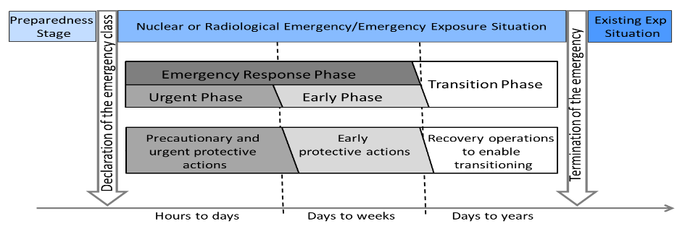
Introduction
CONFIDENCE- WP4: Transition to long term recovery, involving stakeholders in decision making processes
Improve the preparedness and response during the transition phase, identifying and trying to reduce the uncertainties in the subsequent management of the long-term exposure situation.
Structured collaboration involving stakeholders in a sequential process with 3 tasks:
Recovery scenarios planning: establishment and optimization of remediation strategies in generic scenarios
Scenario based stakeholder engagement: in decisions to recover acceptable living conditions
Guidelines and recommendations: to address the planning and decision making during the transition phase
Source: IAEA GSG-11. Arrangements for the Termination of a Nuclear or Radiological Emergency (2018)

Slide 4
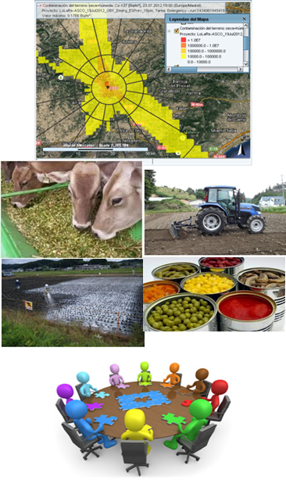
Scenario based stakeholder engagement
A stakeholder participation exercise has been designed in decision-making processes, based on a generic action scenario with the following phases:
Scenario analysis: to establish a generic contaminated scenario to define the decision context for discussions, in which each national stakeholder panel, according to their specific needs, can adapt it. An initial questionnaire was launched among experts and interested parties to assist in this purpose.
Stakeholder discussion panels: organised to test and evaluate the national dialogue process with stakeholders during the transition to recovery. The discussions will focus on what to do and how to proceed in a contaminated scenario and assess the potential impact of their decisions.
Delphi study: a series of three structured surveys are being carried out in parallel with the panels. The objective is to select and prioritise the most relevant preferences and criteria of the different panels to be used by decision-making tools.

Slide 5
Methodology used in the panels – General approach
A document was prepared to guide the organisation and discussions of the national panels [1].
The general approach to engage the stakeholders in the national panels has been as follows:
  A “question-driven” table top exercise to be conducted individually by each participating country (national panel).
  Simulating an intervention scenario from an accidental release in a Nuclear Power Plant (NPP), based in the contamination pattern monitored after the source term has been controlled and all the contamination has been deposited.
  Focussed in the consequence management and the post-emergency preparedness for the long term recovery to carry on during the transition phase.
One or two sessions per panel were foreseen.
1. Montero, M; Trueba, C.; Sala, R. (2018). Scenario-based Stakeholders Engagement. Guidelines for national discussions. (HORIZON 2020 EJP-CONCERT, EC GA 662287). Internal Technical Document CONFIDENCE-WP4/T4.2.1-R01 v1.0 Final, CIEMAT, Madrid, Spain.

Slide 6
Methodology - Scenarios
Scenarios are narrative descriptions of potential futures that focus attention on relationships between events and decisions that have to be taken.
They have been characterized from a point of view radiological, socio-economic and environmental and their evolution in the space and along the time
The majority of scenarios have explored:
  the different recovery alternatives taking into account the potential importance of each element described above
  an estimation and measure of the consequences of the implementation of such planned strategies
  an approach to assess the practicability and optimisation of the strategies assuring the sustainability of the recovery and rehabilitation in terms of social, economic, political, environmental and/or ethical factors
  the uncertainties that arise during the transition phase, associated to the preparedness of the recovery strategies, the decision-making process and the involvement of the stakeholders.

Slide 7
Methodology - List of topics addressed
1. What do the stakeholders (SH) understand by “the transition phase”
2. Main concerns during the transition phase
3. Topics to be addressed during the transition phase:
  E.g. Food and water control, Relocation of people and restoration of living conditions, Application of countermeasures; decontamination…
  4. Objectives and criteria of the restoration plan:
    a. Which objective do we need to achieve? (Minimise dose levels, minimise impacts in the population, maximise public confidence, minimise economic costs, minimise environmental impacts, etc.)
    b. Criteria to assess the recovery strategy (costs, time, effectiveness,…)
  5. Alternative restoration actions: monitored non-intervention, containment, removal, change of use,…)

Slide 8
Objectives pursued by the panels
To understand the transition phase, timeline and challenges in the decision-making process, including the decisions taken in the early phase,
To identify critical aspects in the preparedness and response for the recovery during this phase,
An approach to dealing with the uncertainties arisen to prepare plans for the subsequent recovery,
Explore how and to which degree is the engagement of stakeholders,
Contribute to obtain and prioritize the preferences of the stakeholders that could be incorporated in a multi-criteria decision-making analysis (MCDA).

Slide 9
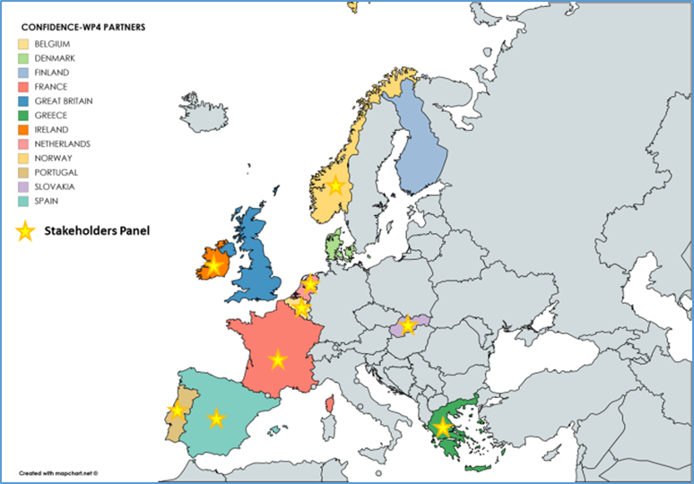
National panels involved in the study
Nine national panels has been set with one or two sessions.
Most panels dealt with decisions taken in the transition phase:
  To recover food production in agricultural environments
  To deal the urban decontamination issues,
  To manage and protect the public and international consumption/marketing
  To cope and minimize the impact of evacuation and relocation and possible reversion.
Additionally, some panels, as in France, Ireland and Slovakia have dealt also issues related to the early phase in a emergency .
In grey, previous Panel meetings out of the scope of CONFIDENCE
Green: Sessions concluded; Orange: Sessions coming-up next

Slide 10
Composition of the panels
The panels have been composed of experts and representatives of stakeholders groups, covering the three broad categories defined as:
    Stakeholders directly involved in the post-emergency planning and management of the transition phase: representatives of Government institutions, agencies or companies directly involved in the management of the transition phase,
  Others affected but not involved in such management: representatives of the population, producers, industries, marketers, directly affected,
  Others unaffected but interested: experts with a high level of knowledge related to the subject or activity, but not directly affected by this type of situation
Tentative number for Norway and Portugal. Their panelss are under preparation

Slide 11

Overview of panels in nuclear countries
Icon made by freepick from www.flaticon.com

Slide 12
Overview of panels in non nuclear countries

Slide 13
Uncertainties identified
Information needed for decision making and planning
  Geographic, environmental, socio-economic, radiological
  Type of information support
Management and decision making
  Regarding decisions
    Moment / time
    Search for balance between the different evaluation criteria
    Impact in the long term
    Consideration of all the interests involved
    Zoning, identification of the areas / sectors subject to the measures adopted
    Involvement of local levels in the decision
    What strategy must be adopted
    Assumption of the worst case scenario

Slide 14
  Management and decision making
    Regarding governance
    Communication
    Social, economic and environmental factors
    Evolution of the situation
  Actions and strategies
    Legal aspects and compensation
    Acceptance by producers and population
    Control and surveillance
    Conservative, political, social, environmental criteria
  Specific management of the economic sectors affected (farming, national / international market)

Slide 15
Summary and conclusions
The nine panels organized in Europe, under the WP4, have allowed to obtain a very broad and complete vision of all issues of interest, and the preferences of stakeholders associated with decision making and the preparation of plans for post-accident recovery, during the transition phase of an emergency.
The impact of the measures implemented during the urgent and early phase over the decisions to be taken in the post-emergency, (when and how to review or lift such measures), or how to manage the consequences of contamination during the transition phase and how to select and evaluate the best strategies to consider in future recovery plans, have been discussed.
The main uncertainties of the process have been identified and categorized.
Urban and agricultural / farming environments have been considered, in nuclear countries, directly affected and in surrounding non-nuclear countries.
Qualitative and quantitative assessments (using the MCDA) of preferences and of decision criteria have been conducted.

Slide 16
Next steps - In-depth analysis of uncertainties
In the coming weeks, we will go in-depth into the panel conclusions:
  Cross-country analysis of panel conclusions
  Categorization of uncertainties
  Combining with Delphi study conclusions
The uncertainties can be categorised regarding their social, economic or environmental consequences / implications in achieving a restoration of the living conditions according the principles of the sustainability (Bardos et al., 2018).
The more and better we can consider and assess all these uncertainties when preparing the plans and strategies for the recovery, it will have greater opportunity to adequately incorporate stakeholders’ preferences and interests.

Slide 17
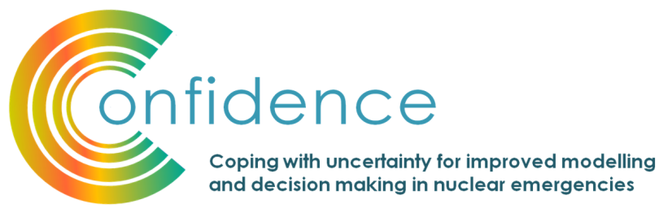

Acknowledgement
This work has been accomplished under the CONFIDENCE project. CONFIDENCE is part of the CONCERT project. This project has received funding from the EURATOM research and training programme 2014-2018 under grant agreement No 662287.

Slide 18
European scenario-based stakeholder discussion panels, to test their engagement in the decision making process during the transition phase of a nuclear emergency
5TH NERIS Workshop
  Key challenges in the preparedness, response and recovery phase of a nuclear or radiological emergency
    3-5 April. Roskilde, Denmark
Thank you for your attention!
milagros.montero@ciemat.es

