Slide 1

Delphi study to support the involvement of stakeholders in the decision-making process during the transition phase of a nuclear emergency
5TH NERIS Workshop
  Key challenges in the preparedness, response and recovery phase of a nuclear or radiological emergency
    3-5 April. Roskilde, Denmark
Sala, R.; Montero, M.; Trueba, C.; García-Puerta, B.; Germán, S.; Oltra, C. & López-Asensio, S.

Slide 2

Introduction
WP4 of CONFIDENCE, aimed at improving the preparedness and response in the transition phase of a nuclear emergency.
Ranking of criteria for planning
an optimal decision-making during transition
Stakeholders engagement
to include their views, needs and preferences in the planning
Stakeholders’ Delphi technique

Slide 3
Objectives
To explore consensus amongst stakeholders of different European countries, concerning most important issues or criteria to address the planning and decision-making during the transition phase of a nuclear emergency.
To obtain a prioritization/ranking from involved stakeholders.

Slide 4
The Delphi method
Developed during the 1950s in the US.
Widely used tool for measuring and aiding forecasting and decision making in a variety of disciplines, by eliciting and combining expert judgments.
In using the Delphi technique, one controls the exchange of information between anonymous panellists over a number of rounds (iterations), taking the average of the estimates on the final round as the group judgment (Linstone & Turoff, 2002; Okoli & Pawlowski, 2004; Rowe & Wright, 2001).

Slide 5
Procedure
The 1st round of the survey was administered in 2018 before the 1st meeting of the panels, in paper or online. Invitations were sent to panelists and other interested stakeholders.
The 2nd round is being administered now.
1st panel meeting
2nd Delphi round
2nd panel meeting
1st Delphi round

Slide 6
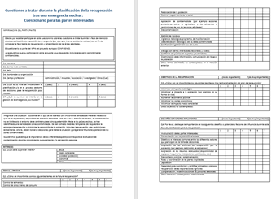
1st round questionnaire
Based on a preliminary qualitative survey administered to 7 experts and a workshop held in Madrid, Nov’17 (Workshop on Scenario Planning during the Transition Phase to support the Preparedness for Post-Accidental Recovery).
Topics:
Initial concerns in the transition phase
Issues to be addressed
Objectives of the restoration plan
Main challenges

Slide 7
Sample
N=71

Slide 8
Sample
N=71

Slide 9
1st round findings

Slide 10
First concerns
No differences by country or professional profile.

Slide 11
Issues to be addressed

Slide 12
Issues to be addressed by country

Slide 13
Objectives

Slide 14
Objectives by country

Slide 15
Challenges

Slide 16
Challenges by country

Slide 17
Agreement
Agreement
Agreement
Agreement
Importance
Importance
Importance

Slide 18
Conclusions
In the 1st round…
Food control, public trust and risk communication were highlighted as the main issues to be addressed during the transition phase; while other-goods control appeared as less important.
To minimise the impact in the living conditions of the population was emphasized as the main objective that the restoration has to pursue.
Communication with the affected population seemed to be the most important challenge during the transition phase.
High level of agreement was found among participants.
Looking forward for 2nd round results!

Slide 19
Limitations
Adaptation/variation of Delphi policy method.
  In its original form, the Delphi method is a long-range forecasting technique that elicits, refines, and draws upon the collective opinion and expertise of a panel of experts (Gupta and Clarke, 1996).
  But we maintain some of its main features: iteration, controlled feedback and statistical group response (Rowe, Wright, & Bolger, 1991).
The findings represent only the views of those involved, mainly public authorities and researchers.
Small sample in some of the involved countries (Ireland and Belgium)

Slide 20
Some preliminary implications
Despite the limited sample sizes, some differences seemed to exist among the participants from different countries, while no significant differences were found by the professional field
Need to take into account the country context when planning the transition phase.
Good input for decision-making tools (MCDA)
Prioritization from stakeholders

Slide 21
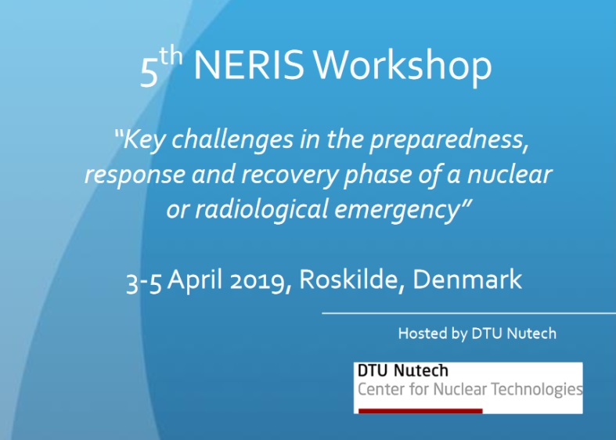
Stakeholder engagement is a key challenge in the preparedness, response and recovery phase of a nuclear or radiological emergency. The Delphi technique could be one of the available tools to address this challenge.

Slide 22
References
Gupta, U. G., & Clarke, R. E. (1996). Theory and applications of the Delphi technique: A bibliography (1975–1994). Technological forecasting and social change, 53(2), 185-211.
Linstone, H. A., & Turoff, M. (Eds.). (1975). The Delphi method: Techniques and applications (Vol. 29). Reading, MA: Addison-Wesley.
Okoli, C., & Pawlowski, S. D. (2004). The Delphi method as a research tool: an example, design considerations and applications. Information & management, 42(1), 15-29.
Rowe, G., Wright, G., & Bolger, F. (1991). Delphi: a reevaluation of research and theory. Technological forecasting and social change, 39(3), 235-251.
Rowe, G., & Wright, G. (2001). Expert opinions in forecasting: the role of the Delphi technique. In Principles of forecasting (pp. 125-144). Springer US.

Slide 23
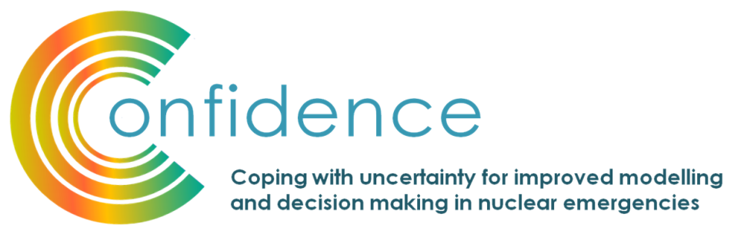

Acknowledgement
This work has been accomplished under the CONFIDENCE project. CONFIDENCE is part of the CONCERT project. This project has received funding from the EURATOM research and training programme 2014-2018 under grant agreement No 662287.

Slide 24

Thank you for your attention! roser.sala@ciemat.es

