Slide 1

Notes:
Today I would like to present to you the ENRAS project.

Slide 2

ENsuring RAdiation Safety
for First Responder Teams in Case of Nuclear or Radiological Accident
NERIS Workshop 2019
Notes:
Regarding firefighters I would like to a critical event on … As you can see due to inadequate training and equipment the firefighters did not recognize the potential treat and could have acted wrongly.

Slide 3

Justifying the need for the project
Formal framework
Goals
Objectives
Methods
Impact
After the project
Outline
NERIS Workshop 2019
Notes:
Firefighters were among the first on the spot. They were not aware of the real threat of radiation . They had no choice, but their behaviour was to a large extent improper. Correct personal protection could have spared at least few lives and reduced the consequences of acute radiation syndrom.

Slide 4
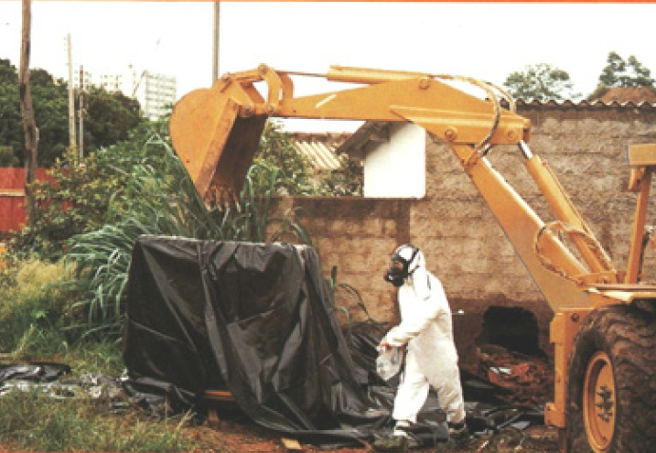
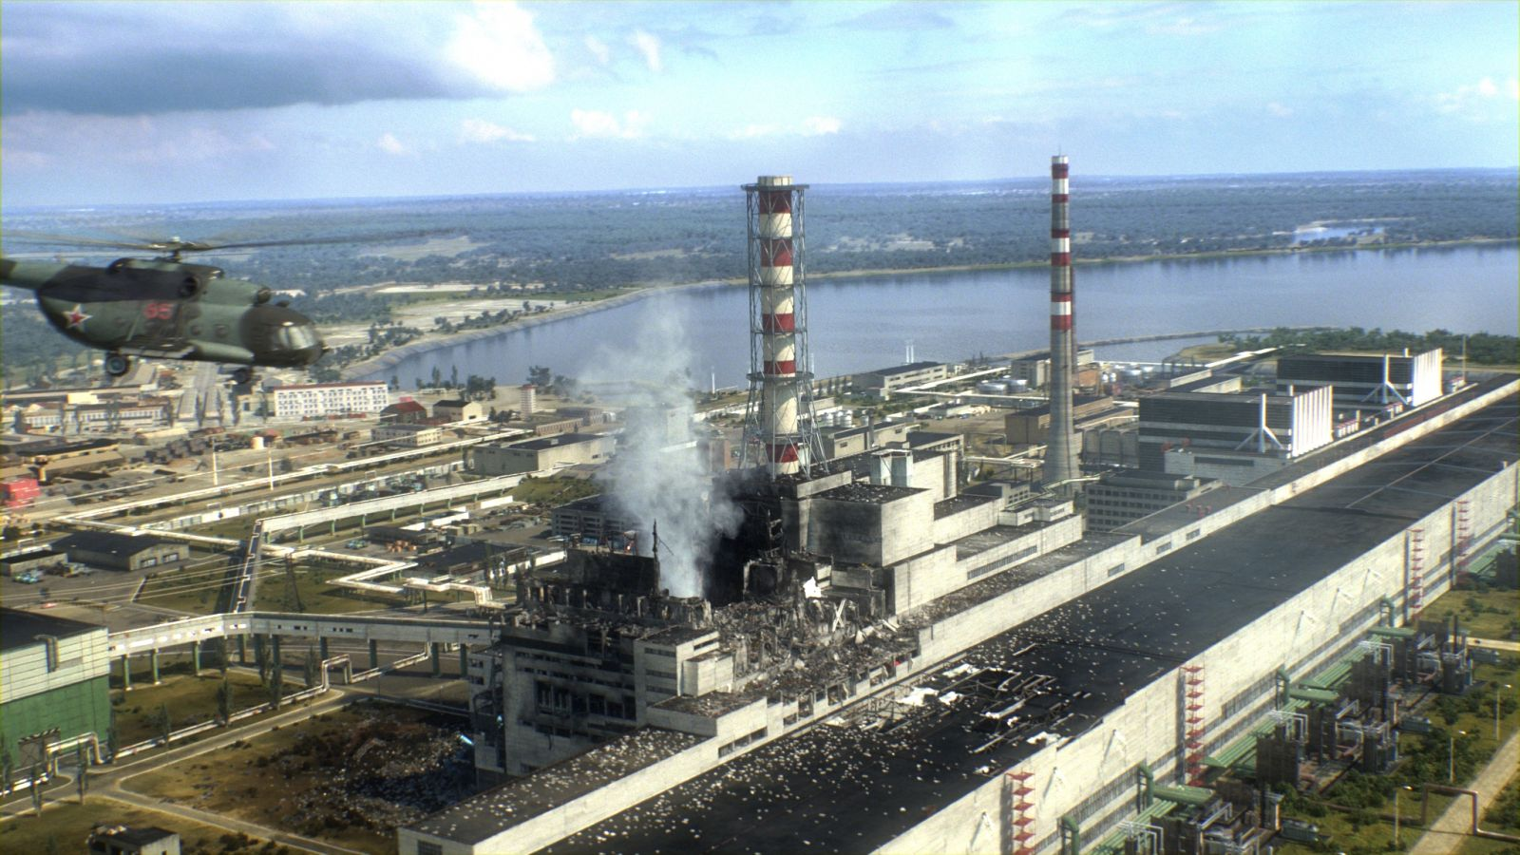
Justifying the need for the project
Major RADIOLOGICAL disaster - GOIANIA
Major NUCLEAR disaster - CHERNOBYL
NERIS Workshop 2019
Notes:
It might not be obvious why one would like to train firefighters with respect to radiation safety. Therefore I would like to mention two well known past which which prove this is necessary. The first one is a major radiological disaster which took place in Goiania and the other one is a major nuclear disaster in Chernobil.

Slide 5
Major RADIOLOGICAL disaster - GOIANIA
Justifying the need for the project
Short summary
13 Sept. two men tried to disassemble abandoned teletherapy unit containing Cs-137
18 Sept. parts of disassembled unit were sold to scrapeyard together with a damaged capsule
21 Sept. a friend of scrapeyard owner removed some Cs-137 from the capsule and distributed fragments to several people due to attractive blue glow emitted from the fragments
25 Sept. lead and rest of the source were sold to Junkyard II.
28. Sept. Remnants of the rotating assembly and the source assembly were taken to the Vigilancia Sanitaria (Health Monitoring Agency)
29. Sept. Due to symptoms revealed by people, who were in contact, a medical physicist was asked to perform some measurements of the suspecious package at Vigilancia Sanitaria.
NERIS Workshop 2019
Notes:
Regarding firefighters I would like to a critical event on … As you can see due to inadequate training and equipment the firefighters did not recognize the potential treat and could have acted wrongly.

Slide 6
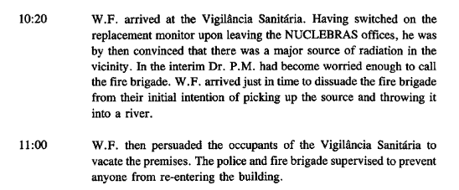
Major RADIOLOGICAL disaster - GOIANIA
Justifying the need for the project
Vigilancia Sanitaria REPRESENTATIVE
Medical Physicist
FIRE BRIGADE
NERIS Workshop 2019
Notes:
In the meantime several people requested medical assistance, of course.
Regarding firefighters I would like to a critical event on … As you can see due to inadequate training and equipment the firefighters did not recognize the potential treat and could have acted wrongly.

Slide 7
Justifying the need for the project
Major NUCLEAR disaster - CHERNOBYL
Firefighters
They had no instruments to measure the dose rate
They were kicking away pieces of graphite and radioactive fuel instead of avoiding them as much as possible
They removed their protection clothes instead of putting on additional protection
WHAT WAS THE PROBLEM?
No one has ever explained to them how to deal with radiation Regarding firefigters
They had little or no understanding how the fire they were fightingwas different from regular fires
Firefighters = = > FIRST RESPONDERS & FIRST VICTIMS
NERIS Workshop 2019
Notes:
Firefighters were among the first on the spot. They were not aware of the real threat of radiation . They had no choice, but their behaviour was to a large extent improper. Correct personal protection could have spared at least few lives and reduced the consequences of acute radiation syndrom.

Slide 8
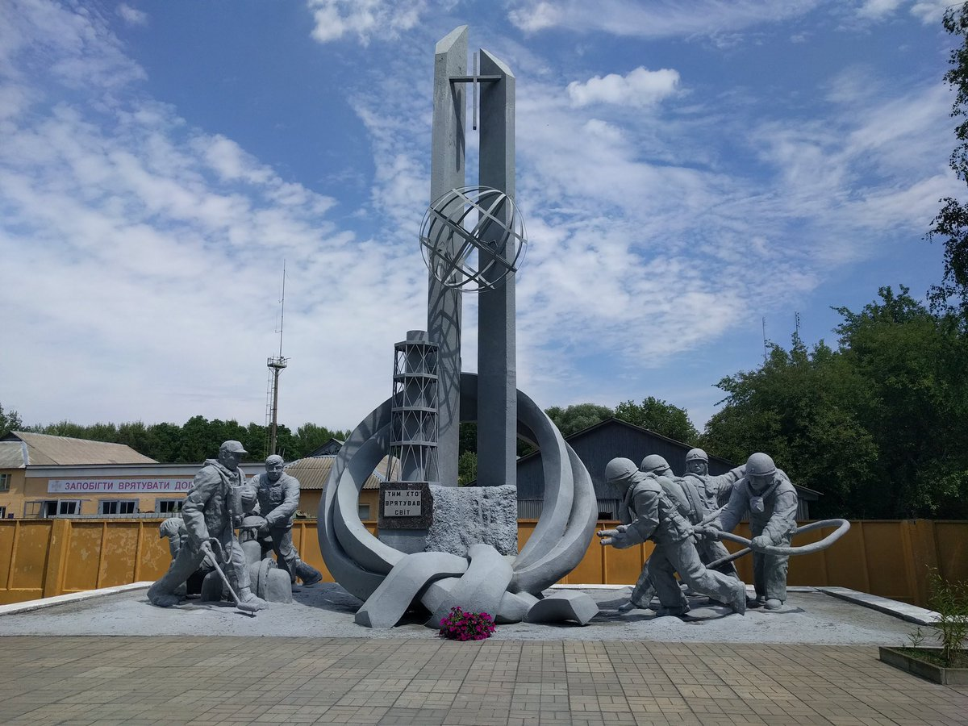
MONUMENT TO THE LIQUIDATORS AND FIREFIGHTERS
Notes:
The Monument to the Chernobyl Liquidators is dedicated to firefighters who took part in the liquidation of the consequences of the Chernobyl Disaster. The inscription "To Those Who Saved the World" implies all heroes who consciously sacrificed their lives for the sake of saving others. Partially it was unavoidable. Still, many lives could be spared if acting properly from the very beginning.
These two examples reveal the need to train first responders to act properly in accidents involving ionising radiation.

Slide 9
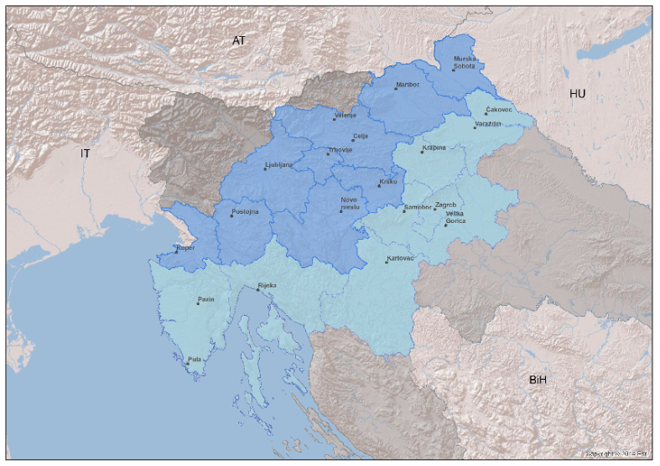
INTERREG V-A Slovenia-Croatia
CROSS-BORDER REGION
NERIS Workshop 2019

Slide 10
ENRAS - GOALS
To design and implement a new system of training for First Responder Teams (firefighters) for safe intervention in accidents involving the risk of radioactive radiation (OCT 2018 – SEP 2020)
To sign an agreement on the establishment of a new cross-border structure that will promote and coordinate cross-border cooperation in the field of safety in accidents involving radioactive radiation (OCT 2020 - )
To develop guidelines for the permanent maintenance of the skills of the intervention workers
To prepare recommendations for equipping intervention units.
NERIS Workshop 2019

Slide 11
ENRAS - OBJECTIVES
Select 60 First Responder teams having licence for dealing with hazardous material
Teach members of each team the necessary basics regarding ionizing radiation
Train members of first responder teams to routinely use hand held survey meters in order to
  be able to detect ionizing radiation and
  assess the severity of the risk
Qualify them to behave properly with respect to (in case of radiological or nuclear accident)
  self-protection and
  protection of the population
Train and assess their skills in exsercises representing comperhensive scenarios involving ionizing radiation
Gather experiences gained during eduction to
  further improve training programme
  determine the frequency of post project training
NERIS Workshop 2019

Slide 12
INDIVIDUAL UNITS` EDUCATION
THEORETICAL
Basics of ionising radiation
Detection of ionizing radiation
Operational quantities (dose rate, dose, contamination)
Protection measures
Operational Intervention Levels
Typical situations where firefighters might expect radioactive sources
PRACTICAL
Demonstration of the state of the art equipment
Training using the equipment posessed by First Responder Teams
  understanding the reading of the instruments
  being able to asses the severity of the situation
  selcting proper response tactics
NERIS Workshop 2019

Slide 13
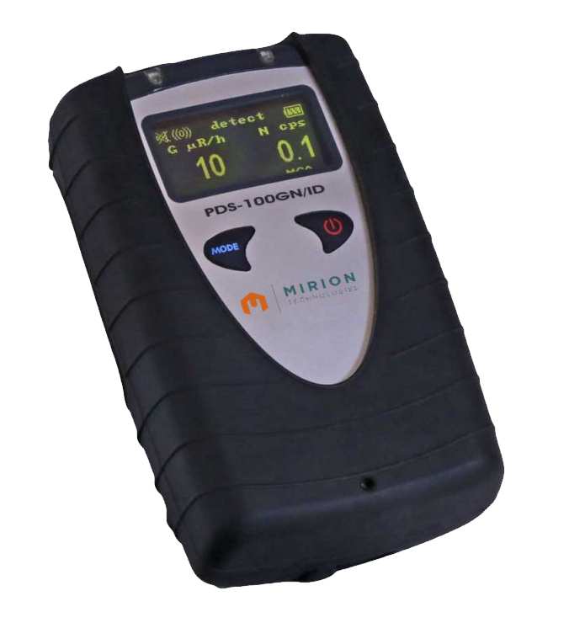
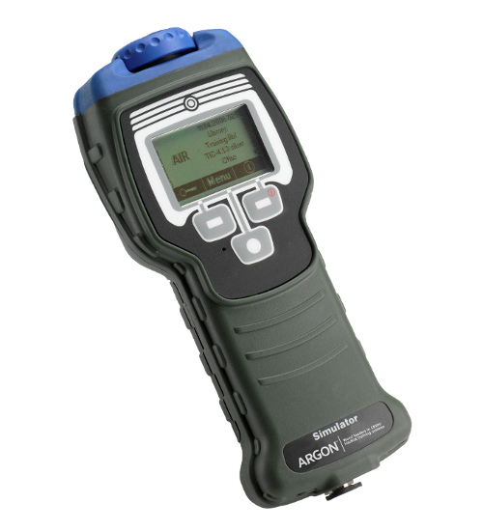
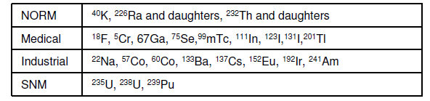
PDS 100 GN/ID
FIRST RESPONDERS EQUIPMENT
Detection
Detector gamma CsI(Tl) 400 cps per μSv/h for 137Cs
Detector neutron LiI(Eu) (GN version only)
Gamma dose rate display 0.01 μSv/h to 100 μSv/h
Radiation Detector Module
Gamma and X-ray radiation
Dose rate
0.04 μSv/h to 100 mSv/h
Energy range
50 keV to 1.3 MeV
Response time
2,5 seconds (fast mode)
3 min (ambient dose rate)
Spectrometry and Identification
512 / 1024 channels spectra
30keV to 1.7 MeV
ChemPro 100i

Slide 14
FIRST RESPONDERS EQUIPMENT
NOT ONLY
TRAIN firefighters using their equipment
BUT ALSO
Try to ESTABLISH whether the equipment is suitable for firefighters` interventions
waterproof
easy to stick
acoustic alarms in order not to look at the screen all the time
AND IF NEEDED
To RECOMMEND ALTERNATIVE equipment
NERIS Workshop 2019
Notes:
These we will be able to check in joint exercises which will represent a simulation of a real firefighters` action.

Slide 15
JOINT EXERCISES
JOINT EXERISES
GOAL => CHECK the acquired knowledge and PROVIDE FURTHER TRAINING
SELECTION OF UNITS => Units that have completed individual training / do not weaken regional response capability
NUMBER OF ATTENDEES => 6 – 8 units (half from Slovenia and half from Croatia) with 30 men altogether will be involved.
REQUIREMENTS =>
  All the rules of firefighter` tactics have to be respected
  Knowledege and proper handling due to the danger of radioactive radiation has to be demonstrated
METHOD => comprehensive fire fighting interventions
SCENARIOS
  Accident of a vehicle for radioactive cargo
  Mediation for spillage of radioactive material
  Fire during industrial radiography
ADDITIONALY
  ELME experts will always be present to evaluate radiological part
  Firefighters` Instructors will evaluate firfighters tactics
NERIS Workshop 2019
Notes:
And we will check and assess this.

Slide 16
YOU ARE INVITED !
FINAL JOINT EXERCISE
JOINT EXERISES
GOAL => DEMONSTRATE the acquired knowledge
SELECTION OF ATTENDEES => 1-2 representatives of EACH UNIT – approximately 120 men will be involved.
REQUIREMENTS =>
  All the rules of firefighter` tactics have to be respected
  Knowledege and proper handling due to the danger of radioactive radiation has to be demonstrated
METHOD => comprehensive fire fighting interventions
SCENARIO
  Accident of a vehicle for radioactive cargo
  Mediation for spillage of radioactive material
  Fire during industrial radiography
ADDITIONALLY
  PUBLIC EVENT
  MEDIA
  COMMENTATOR
Notes:
And we will check and assess this.

Slide 17
IMPACT
Training program for first responders developed and put into practice
60 + intervention units in cross border region qualified for interventions involving radiation
700 + individual firefighters involved in training program
9 joint exercises in cross border regions performed involving first responders from both countries
NERIS Workshop 2019
Notes:
Long term cooperation between responsible parties from both countries.

Slide 18
LONG-TERM IMPACT
SUSTAINABLE CROSS-BORDER STRUCTURE = FORMAL AGREEMENT BETWEEN THE PARTNERS OF THE PROJECT
TO PROMOTE CROSS-BORDER COOPERATION IN THE FIELD OF RADIATION SAFETY
TO MAINTAIN AND FURTHER DEVELOP THE COMPETENCE OF FIRST RESPONDER TEAMS, ACHIEVED DURING THE PROJECT
TO PROMOTE PERIODIC ACTIVITIES
TO MAINTAIN WEB-BASED KNOWLEDGE DATA BASE FOR FIRST RESPONDERS
TO IMPROVE GUIDELINES AND PROTOCOLS (FOR TRAINING AND EQUIPPING INTERVENTION UNITS)
TO HARMONIZE AND FURTHER DEVELOP INTERVENTION PROCEDURES IN CROSS-BORDER REGION
TO TRANSFER THE RECOMMENDATIONS REGARDING RADIOLOGICAL EMERGENCY PREPAREDNESS OF FIRST RESPONDERS BASED ON EXISTING PROJECT INTO THE REGULATORY LEGISLATION
NERIS Workshop 2019
Notes:
Long term cooperation between responsible parties from both countries.

Slide 19
BONUS IMPACT OF ENRAS
BRIDGING THE GAP BETWEEN
  INSTITUTIONS AND SOCIETY
  PROFESSIONALS AND COMMUNITY
VALUABLE EXPERIENCES, GAINED DURING THE PROJECT
MAY BE TEMPLATE FOR SIMILAR STRUCTURES IN CROSS BORDER REGIONS.
NERIS Workshop 2019
Notes:
Last year there were several contributions during the NERIS workshop regarding science for citizens. I had the impression that there is a missing link between the two which would ensure trust and cooperation between the two. I believe that activities within ENRAS represent such a missing link. This will be a very valuable side product of ENRAS. We all know that firefighters have high reputation in society and building close cooperation with firefighters mean building trust of the community in profedsiionals.

Slide 20
Partners
Institute Jožef Stefan (SLO)
Institute for Medical Research (CRO)
Slovenian Firefighters Association (SLO)
Croatian Firefighters Association (CRO)
Administration of the Republic of Slovenia for civil protection and disaster (SLO)
Slovenian Nuclear Safety Administration (SLO)
State Office for Radiological and Nuclear Safety in Croatia (CRO)
THANK YOU FOR YOUR ATTENTION!
NERIS Workshop 2019

