Slide 1
Participation in a ConvEx-2c Exercise: Preparation, Performance and Outcomes as an 'Accident State'
NERIS Workshop, Roskilde, April 2019
Veronica Smith¹, Ciara Hilliard¹, Kevin Kelleher¹, Ciara McMahon¹, Robert Ryan¹ and Kilian Smith²
¹ EPA, Clonskeagh, Dublin, Ireland
² IEC, IAEA, Vienna, Austria

Slide 2
Contents
ConvEx-2c exercises
Exercise scenario in 2018
Preparation in advance of the exercise
Exercise performance
Outcomes and lessons learned

Slide 3
IAEA ConvEx Exercises
ConvEx – Convention Exercises - test the operational arrangements under
Convention on Early Notification of a Nuclear Accident
Convention on Assistance in the Case of a Nuclear Accident or Radiological Emergency
Purpose is to evaluate and further improve the international framework for emergency preparedness and response
Three levels of complexity
ConvEx-1 (test emergency communication links)
ConvEx-2 (test specific parts of the international framework)
ConvEx-3 (full-scale international exercises)

Slide 4
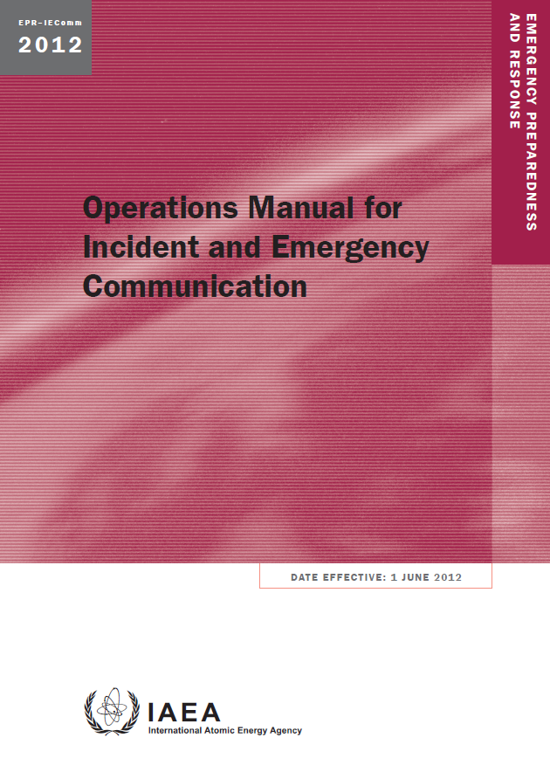
ConvEx-2c Exercises
To test arrangements for a transnational radiological emergency
This exercise is conducted once every two years on a specified announced date

Slide 5
How ConvEx-2c Exercises Operate
The 'Accident State' communicates messages for a hypothetical radiological emergency in their State
The IEC provides input messages in advance if needed
The IEC forwards messages from the 'Accident State' to participating Contact Points and publishes the information submitted on USIE Exercise
Other participating NCAs access information on the USIE Exercise web site and confirm that they have read and understood messages and respond appropriately to any requests for advice or information

Slide 6
Preparation with IEC
The Environmental Protection Agency (EPA) in Ireland accepted an invitation from the Incident and Emergency Centre (IEC) to be the 'Accident State' in September 2018
A national exercise was not planned
Contact points in IEC and EPA were assigned to lead on preparation of arrangements
EPA worked closely with the IEC to develop a scenario which would be of interest to other participating countries
All preparation was done by email and teleconference
Not resource intensive

Slide 7
Preparation in EPA
Engagement with relevant stakeholders with a role in response to CBRN incidents
Refinement of exercise scenario to be realistic while still ambitious
Coordination between in-house teams (Technical Assessment, Media and Information, Regulatory)
Preparation of press releases
Allocation of roles on the day of the exercise

Slide 8
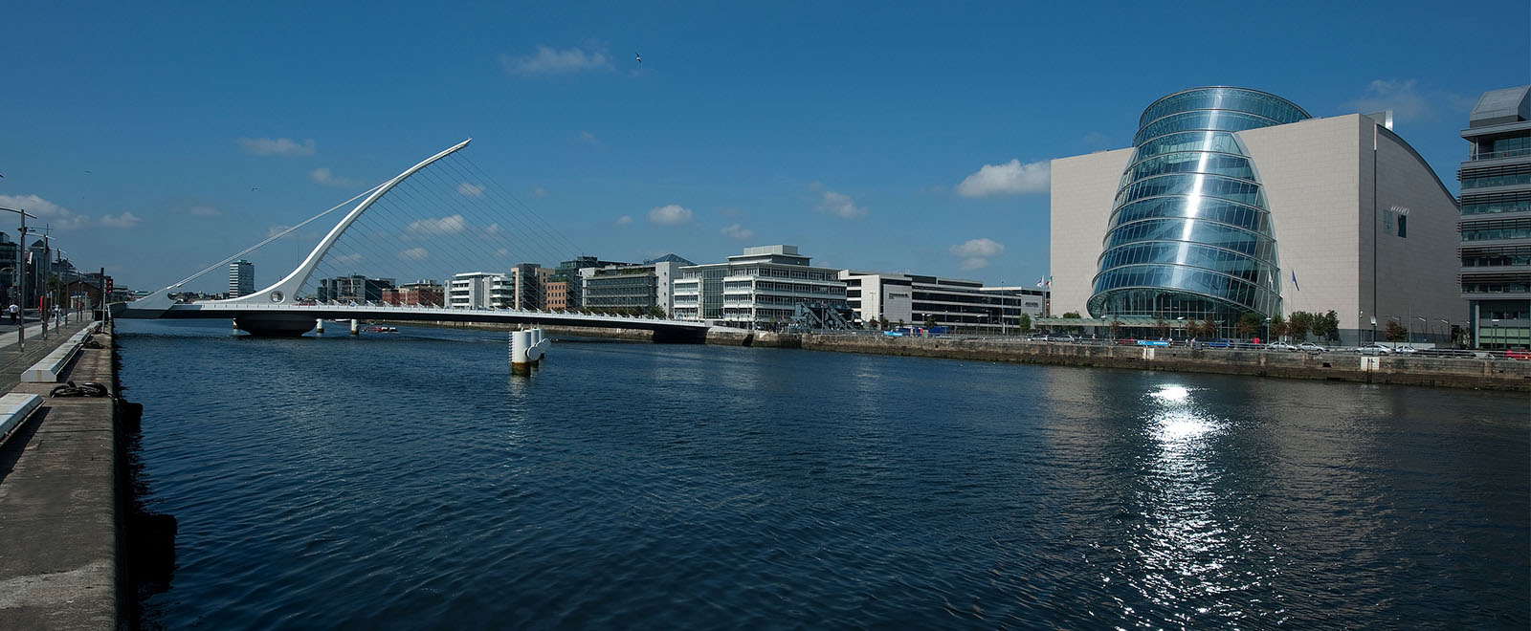
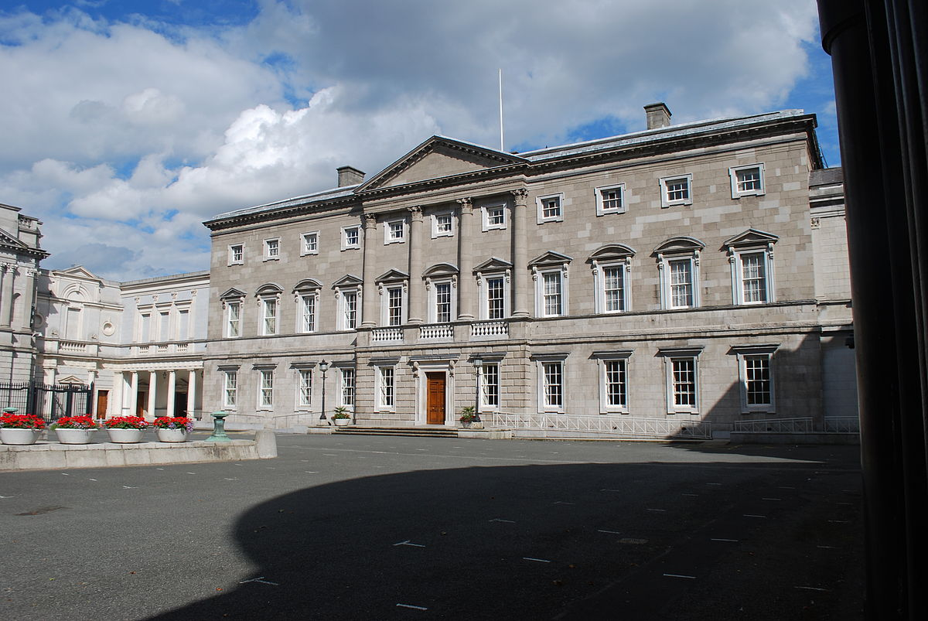
Overview of Exercise Scenario 2018
Two Ir-192 sources which had been stolen some days earlier in Ireland used in two CBRN incidents in Dublin City Centre
Multiple fatalities and casualties (foreign nationals involved)
Convention Centre
Leinster House

Slide 9




Exercise Participants
70 IAEA Member States and five international organisations (including EUROPOL and the Comprehensive Nuclear-Test-Ban Treaty Organization)

Slide 10
Planned Timeline (Main Points) – 27th November 2018
07:20 - First explosion outside Convention Centre in Dublin
- EPDs worn by first responders indicate presence of radiation
- Area evacuated and cordon put in place
- IAEA notified through USIE
09:30 - National Emergency Coordination Group meet
10:35 - Measurement data submitted to IRMIS
11:20 - Patient in regional hospital with symptoms of radiation sickness
12:30 - Second explosion outside Dáil Éireann
- Area evacuated and army bomb disposal unit searching for further devices
14:15 - EPA submit a request for assistance
16:00 - End of exercise

Slide 11
Behind the Scenes in EPA on the day
Response based in EPA offices (Dublin – Technical Assessment Team and Wexford – Media and Information Team), no shift change in EPA staff
Two Standard Report Forms (SRFs) and a press release issued on 21st November regarding stolen sources
Seven SRFs and a Request for Assistance submitted on 27th November
Three press releases prepared and submitted to USIE
After each submission on USIE, IEC contacted EPA to acknowledge the submission and verify the details
Two sets of measurement data submitted to IRMIS

Slide 12
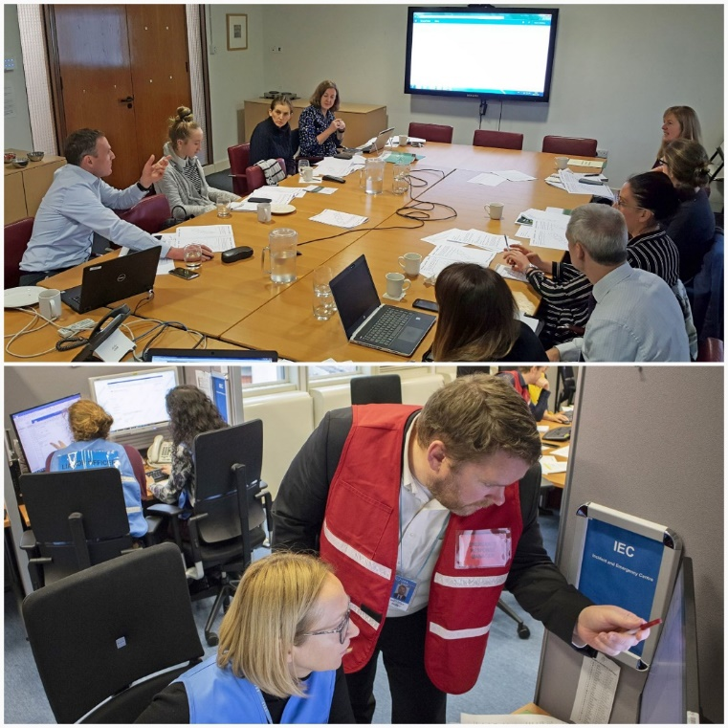
Issues Arising During Exercise
Time pressures – responding to incident and ongoing communication with IEC
Volume of emails from USIE was huge
Access to USIE Exercise website
Scenario perhaps overly ambitious given time period for exercise
Agreeing press releases
Decisions on cordons took longer than expected
Disclosure of information regarding nationality of victims

Slide 13
Lessons Learned Playing as ‘Accident State’
Don’t underestimate the time required for international communications
An excellent practical test of USIE
Due to time pressures scenario timeline was difficult to adhere to – flexibility required
Be aware that a shift change may occur in IEC - allow extra time to accommodate this
All organisations involved in response to this incident type should be present - additional time required for exercise preparation to achieve this
Exercise took place over nine hours – staff operating at full capacity – for longer exercise shift change would be required

Slide 14
Lessons Learned for Ireland’s Response
Availability of EPDs for First Responders (fire service, police)
Convening (circumstances, timing etc.) of the National Emergency Coordination Group for an incident such as this
Ireland CBRN protocol envisages a high level group convened to provide advice for senior officer in charge of the incident
Clarity around release of victims’ identities
We need to continue to build relationships and raise awareness amongst the relevant stakeholders involved in this exercise

Slide 15
Information on Victims
IEC provided EPA with a list of countries who had citizens who were victims
Many requests received from Members States on the nationality and identity of victims
This information could not be released during the exercise
In Ireland, this information can only be released by coroner
Victims’ families must be notified first
Family liaison officers may need to be appointed to obtain DNA from family members to help identify victims
Incident sites are crime scenes - need to be preserved for evidence gathering
Security issues

Slide 16
In Conclusion
Valuable experience for Ireland acting as the 'Accident State'
In order to make best use of the experience, sufficient time is required for preparation
To take part as the 'Accident State' at the same time as a national exercise would be ideal
Don’t underestimate the time it takes to modify pre-prepared press statements
IEC were very helpful and supportive at all stages
From our experience we encourage other countries to volunteer to act as the 'Accident State' for future exercises

Slide 17

Any questions

