Slide 1
The use of non-radiological resources to support nuclear and radiological emergency response
NERIS Workshop, Roskilde, April 2019
Environmental Protection Agency
Robert Ryan, Ciara Hilliard, Kevin Kelleher, Ciara McMahon, Veronica Smith

Slide 2
Contents
Merger of RPII and EPA
National Emergency Plan for Nuclear Accidents
Extending EPA Capabilities
Training EPA staff
Raising Awareness of EPR
Strengths and Challenges

Slide 3


Merger of RPII and EPA (2014)
44 employees
332 employees
Office of Radiation Protection and Environmental Monitoring
Office of Communications and Corporate Services
Office of Environmental Enforcement
Office of Environmental Sustainability
Office of Evidence and Assessment
376 employees
Notes:
RPII Established: 1992
RPII Mission: To protect people in Ireland from the harmful effects of radiation (whether the origin of the radiation is the nuclear industry, radon gas in buildings or its multiple uses in medicine and industry)
EPA Established: 1993
EPA Mission: To protect and improve the environment as a valuable asset for the people of Ireland
As part of the Government's Public Sector Reform Plan, the Government decided in 2012 to merge the Environmental Protection Agency (EPA) and the Radiological Protection Institute of Ireland (RPII).
EPA Responsibilities:
Environmental licensing
Enforcement of environmental law
Environmental planning, education and guidance
Monitoring, analysing and reporting on the environment
Regulating Ireland's greenhouse gas emissions
Environmental research development
Waste management
Radiological protection

Slide 4




Impact of RPII-EPA Merger
RPII
EPA
Notes:
The merger resulted in a much larger organisation with additional human and laboratory (non-radiological chemistry/water) resources that had the potential to increase capacity to respond to nuclear or radiological emergencies on a national level
Starting in 2018, the Emergency Preparedness section undertook work to ensure the EPA could make full use of regional resources and skills available in the organisation.

Slide 5
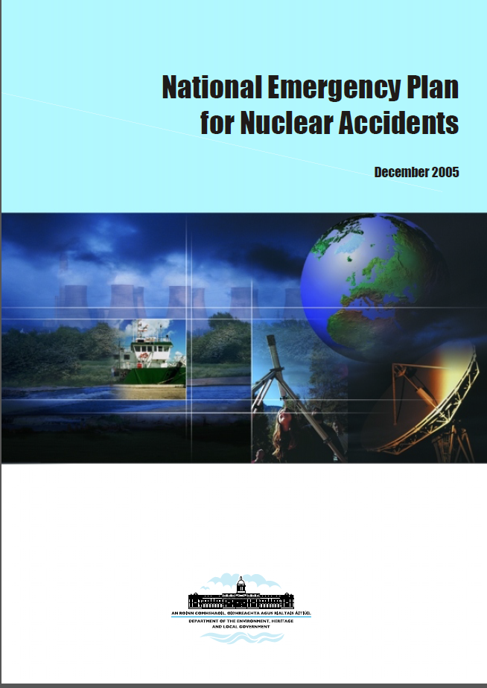
National Emergency Plan for
Nuclear Accidents (NEPNA)
Sets out a framework for a coordinated response at a national level to radiological incidents abroad with widespread consequences for Ireland.
Legal basis for plan in SI 125 (2000).
EPA would play a key role in its implementation.
Update to NEPNA to be published in 2019.
Legal basis for plan in SI 30 (2019).
National Plan for Nuclear and Radiological Emergency Exposures.
Notes:
NEPNA Put in place following Chernobyl Accident
Caters for a major emergency at a nuclear facility abroad resulting in radioactive contamination reaching Ireland and other nuclear and radiological incidents
Updated NEPNA follows guidelines of COUNCIL DIRECTIVE 2013/59/EURATOM (Basic Safety Standards), IRRS findings, IAEA General Safety Requirements Part 7, Risk Assessment, Response and Stakeholder panel

Slide 6
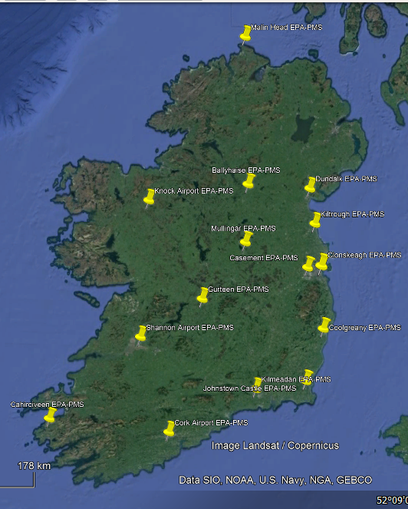
Role of EPA in NEPNA
16 roles for the EPA such as:
  Early warning and activation of the emergency response.
  Maintenance of the radiation monitoring network.
  Carrying out a technical assessment.
  Providing advice on protective actions.
  Analysing environmental and food samples.
  Providing advice to field monitoring teams (Defence Forces, Civil Defence).

Slide 7
EPA NEPNA Sub-Plan
All organisations with roles in NEPNA have to prepare a sub-plan describing their contribution
EPA NEPNA sub-plan
  EPA’s preparedness arrangements.
  EPA radiation emergency response structure.
  Roles of teams and individual staff members in responding to a radiation emergency.
  Living document maintained by Emergency Preparedness section.
National Emergency Plan for Nuclear Accidents
EPA Sub-Plan
Framework Document
1 June 2017

Slide 8
EPA Strategic Plan 2016-2020
One of the Strategic Actions in the EPA’s Strategic Plan 2016-2020 is to extend
  The EPA’s capabilities to respond to environmental and radiation emergencies.
  The NEPNA (National Emergency Plan for Nuclear Accidents) sub-plan to include all relevant EPA capabilities.
Notes:
Includes air monitoring

Slide 9
Extending EPA Capabilities
Work to date has primarily focussed on 3 areas:
Raising Awareness
Provision of Training and Equipment
Using EPA’s Regional Presence
Notes:
Raising Awareness of the EPA’s role in nuclear and radiological emergencies and incidents.
Utilising the Regional Presence of the organisation to respond to radiological incidents.
Provision of Training and equipment to the EPA’s chemistry laboratories to expand radiation measurement capabilities within the organisation.

Slide 10

EPA Coordination Meetings
Meetings between Emergency Preparedness and Environmental Monitoring sections.
Purpose: To ensure effective co-operation in the event of a nuclear or radiological emergency.
January 2018 to Date.
  Sample collection, management and measurement capacity in the event of a nuclear emergency.
  Foster links with a nearby university to gain access to their Gamma radiation detector to increase the EPA’s measurement capabilities.

Slide 11
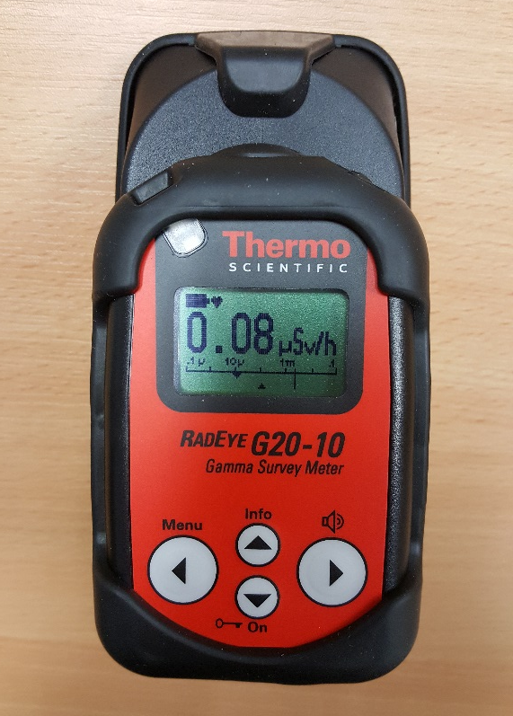
Training EPA Staff
This work has been also been conducted through specific training sessions to laboratory staff involving:
  A presentation on the basic concepts of radioactivity and radiation protection.
  Practical sessions on radiation detection and measurement.
February 2018 to Date
Emergency Preparedness section purchased radiation survey meters and electronic personal dosimeters for all EPA Regional Offices.

Slide 12

Raising Awareness of EPR
This work has been conducted through general communications to staff such as:
  Regular internal meetings and newsletter articles.
  Information Stand at EPA Agency Day, April 2018.

Slide 13
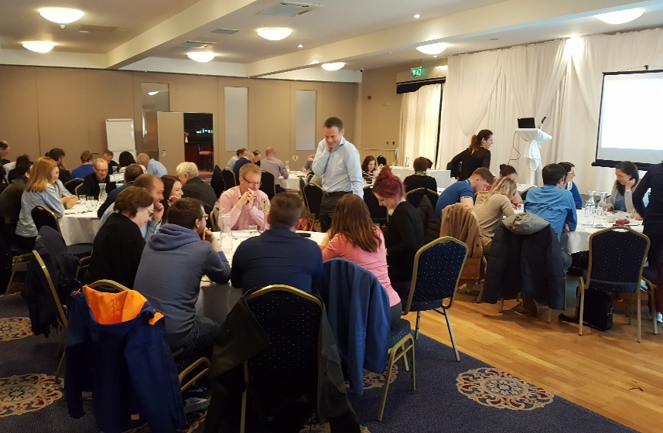
Office Day Table-Top Exercise
Purpose:
  To raise awareness of the role of the EPA in nuclear and environmental emergencies.
  To identify areas of expertise and skills that could be utilised by the EPA in an emergency.
  To identify knowledge gaps and areas for improvement that need to be addressed in order for the EPA to prepare and respond effectively in an emergency.
May 2018
Notes:
Exercise scenario: Severe nuclear accident at a proposed nuclear power plant in the UK impacted on Ireland.

Slide 14
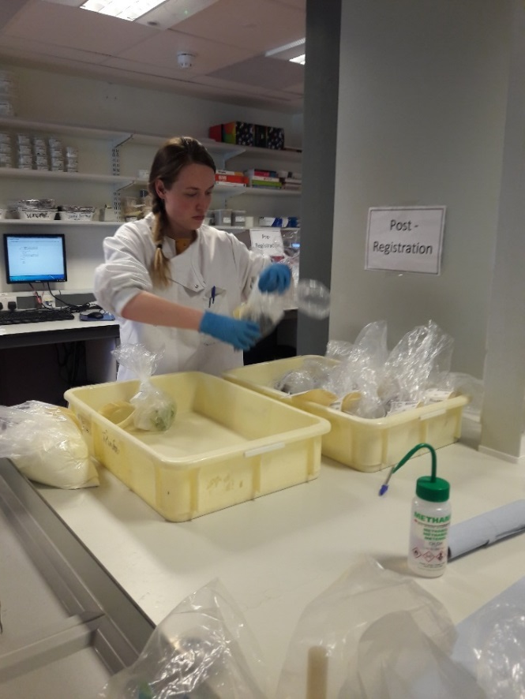
Office Day Exercise Outcomes (Strengths)
Can use EPA’s regional presence in an emergency to:
  Log samples into the EPA’s Laboratory Information Management System and screen them for radioactivity content.
  Send samples that require a higher accuracy measurement to the Dublin laboratory - the only laboratory in Ireland with ISO 17025 accreditation for the measurement of radioactivity in food and environmental samples.
Notes:
ISO/IEC 17025 General requirements for the competence of testing and calibration laboratories is the main ISO standard used by testing and calibration laboratories. In most countries, ISO/IEC 17025 is the standard for which most labs must hold accreditation in order to be deemed technically competent.

Slide 15

Office Day Exercise Outcomes (Strengths)
All ORM staff are willing to help in the event of an emergency.
Can use existing EPA contacts with other State and non-governmental bodies (local authorities, third level bodies) to carry out sampling.
Can use EPA vehicles to transport samples.

Slide 16

Office Day Exercise Outcomes (Challenges)
To improve in the areas of EPR, the EPA needs to carry out further work to:
  Educate staff in the basics of radioactivity.
  Overcome resistance to becoming involved as staff may think EPR is not relevant to them.
  Improve staff awareness of the emergency plans currently in place and inform them of their role in these plans.
  Equip all laboratories appropriately and adequately train staff in the use of monitoring and measurement equipment.

Slide 17

Office Day Exercise Outcomes (Challenges)
Conduct emergency exercises on a regular basis to ensure plans remain up to date and staff will know what to do in the event of an emergency.
Inform EPA staff about the Emergency Response Management Information System (ERMIS) on the EPA’s intranet.
Identify a designated contact person for emergencies in each EPA Region so staff know who to contact in the event of an emergency.

Slide 18

Future Work
Improve internal practical arrangements.
Build on improved collaboration between EPA staff.
Continue training, information sessions and emergency exercises.
Engage with regional laboratories to purchase equipment, train staff and develop their IT systems.
Notes:
Since January 2018, the Emergency Preparedness section has undertaken significant work to raise the awareness of how the EPA can respond as a national organisation to nuclear or radiological emergencies.
To ensure regional laboratories are better prepared to respond in an emergency

Slide 19
Conclusion
Merger of RPII and EPA
National Emergency Plan for Nuclear Accidents
Extending EPA Capabilities
Training EPA staff
Raising Awareness of EPR
Strengths and Challenges

