Slide 1
Local stakeholders confronted to
mid- and long-term uncertainties
in a post-nuclear accident situation
Outputs from the TERRITORIES WP3 Workshop
Pascal Croüail, Mélanie Maître, Thierry Schneider (CEPN)
Sylvie Charron, Véronique Leroyer (IRSN)
Xavier Paulmaz (CLIN)
4 April 2019, Roskilde, Denmark
NERIS Workshop

Slide 2

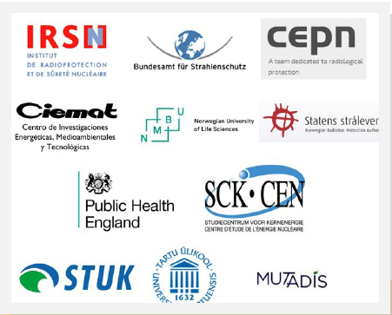
To Enhance unceRtainties Reduction and
stakeholders Involvement
TOwards integrated and graded Risk management
of humans and wildlife
In long-lasting radiological Exposure Situations
11 partners in 8 countries (France, Germany, Spain, Norway, UK, Belgium, Finland, Estonia)

Slide 3
The TERRITORIES Project
January 2017 – December 2019
5 work packages :
  WP1 = Characterisation of territories (surveillance et modelisation)
  WP2 = Characterisatin of exposure scenarios, social and ethical perspective
  WP3 = Engagement of local stakeholders to improve management of uncertainty in risk assessment and decision-making processes including remediation strategies
  WP4 = Dissemination, E&T
  WP5 = Project Management
A dozen « territories » studied
  🇫🇷 case study: a territory affected by a hypothetical NPP accident

Slide 4
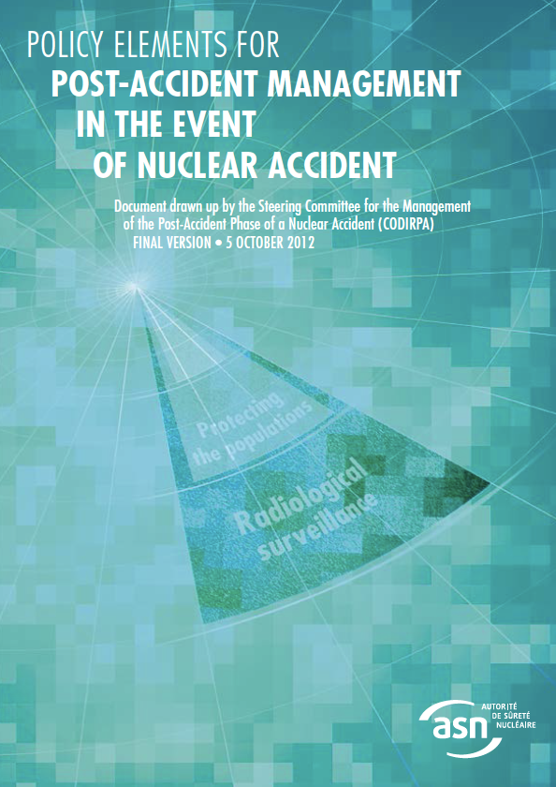
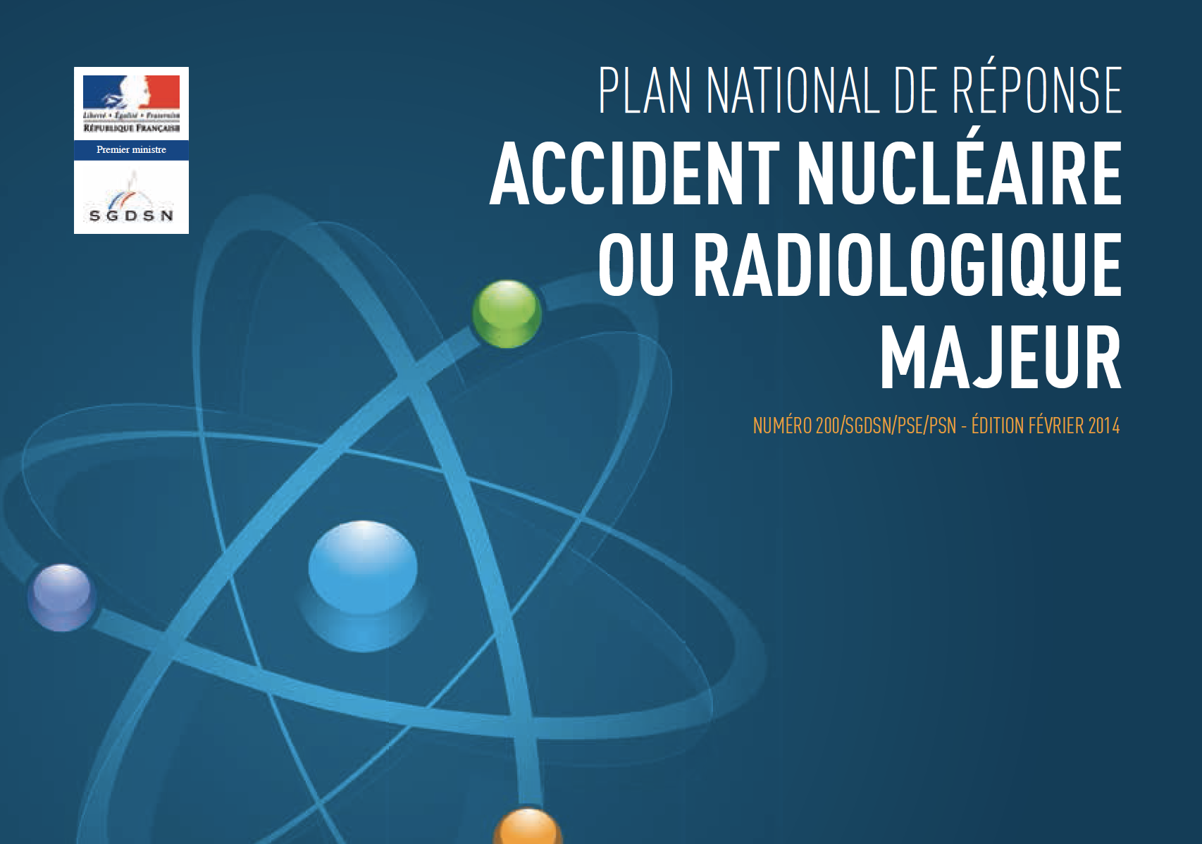
Post-Accident situation management context in France
LATE PHASE: The 2005-2012 French Post-Accident Management Elements of Doctrine (on-going update at the light of post-Fukushima accident management feedback)
EMERGENCY: The 2014 National Response Plan in case of a Nuclear accident or serious radiological event
But, are the local stakeholder aware of existing strategies?
Do the plans fit with local concerns and issues at stake locally? What matters to them?
Are local stakeholders ready to engage, and to what extent (in peace time / if an accident would occur)?

Slide 5

Case study - Scenario
Accident scenario at the Blayais NPP
  Core meltdown + radioactive releases
  Summer time
  2 wind directions
  2 different parts of the region affected by deposits (Médoc, Cognac)
  OPAL ‘sensitization/vizualisation tool’ (accident patterns and data set)
  GIS (eco-, agri-, socio-, environmental urban & rural vulnerabilities)
Gironde district
Geographic
Information
System
Affected areas visualized on
OPAL tool

Slide 6
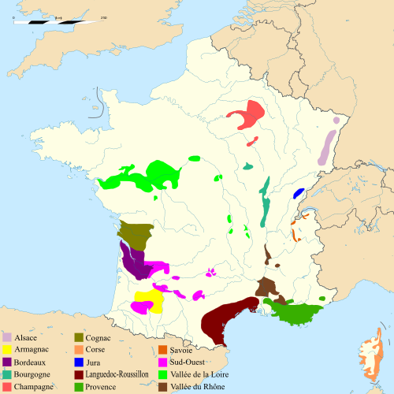
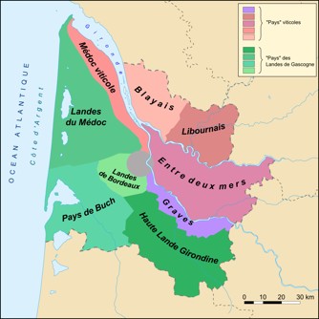
Case study - Territory
  Stakeholder panel
  in Bordeaux (Regional Council Headquarters 11-12 Dec. 2018)
60 km
Cognac
Blayais NPP
50 km
Bordeaux
Main vulnerabilities:
Wine, Tourism, Food, Forest

Slide 7
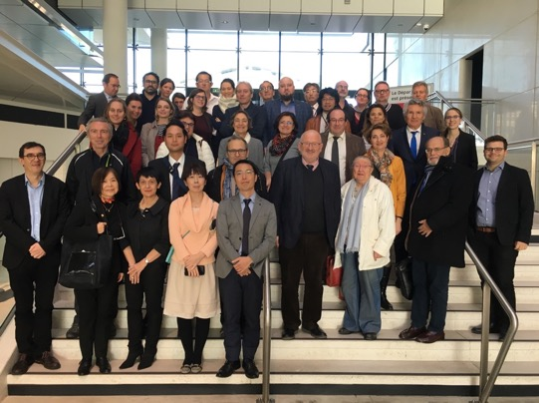
Case study - Panel
Organisation of a working group of local actors living in the Medoc region, close to Bordeaux city and Blayais NPP
  ~ 50 participants / ~ 30 locals:
  Farmers (asparagus, chestnut), wine-growers, representatives of wine industry and of the Chamber of Agriculture of Gironde, foresters
  Environmental NGOs (river/estuary fishing, Greenpeace, Nature-Environnement, etc.)
  members of the Local Commission of Information on Nuclear issues around NPPs (CLI), members of the national association of CLIs (ANCCLI), local elected people
  ethnologist, anthropologist (University)
  experts (nuclear safety, RP, agriculture, health, ecology, etc.)

Slide 8
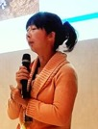
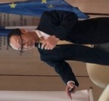
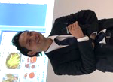
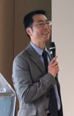
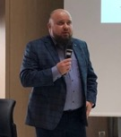
Methodology – Day 1: Testimonies
Post-Fukushima Daiichi NPP accident (+7y)
  Description of the local initiatives of the Suetsugi community (in monitoring food and environment) by Ryoko ANDO (villager, Ethos in Fukushima)
Presentation of the difficulties faced by the producers of Anpokaki (persimmon) following the Fukushima accident by Hiroshi TAKAHASHI (Fukushima Miraï agricultural coop)
  Story of the challenges associated with the recovery of the horticultural activity in the Yamakiya village by Akihiko HIRONO (horticulturist in the Yamakiya village)
Description of the role as scientific expert in helping rural communities to resume farming by Tetsuo YATSUTAKA (researcher, AIST)
Post-Chernobyl NPP accident (+32y)
Presentation of the agricultural countermeasures implemented in Belarus and actions implemented to develop a practical radiological protection culture among the local population by Andreï MOSTOVENKO (radiological monitoring specialist, RIR)
Notes:
Concerning the testimonies, we had 5 presentations from Japanese and Belarussian actors
The first one was made by Ryoko Ando who proposed a description of the local initiative of … which have implemented their own means to assess the radiological situation
The second speaker was…
Then, Akihiko HIRONO told us his own story about..
And Tetsuo YATSUTAKA who is an expert at AIST who has been involved in the Yamakiya village presented his role in…
The last presentation was made by Andreï MOSTOVENKO who insisted in the agricultural countermeasures …

Slide 9
Methodology
Day 2 – Discussion Panel (local accident case study)
  “After a nuclear accident at the Blayais NPP, you come back to live (or you stayed) in the territory which is now considered as a low-contaminated area”. Based on the testimonies made by the Japanese and Belarussian actors, what are your thoughts on this situation? Especially with regard to:
  The monitoring of the radiological situation of the people and the affected territory.
  The future of the agricultural sector in the affected territory.
  The challenges for restoring the quality of life in the territory.
  The conservation and the recovery of a sustainable socio-economic activity in the territory.
  These 4 issues being have been discussed by local actors in topical subgroups
😱 😴

Slide 10
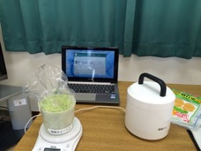
The monitoring of the radiological situation of the people and the affected territory
From mistrust towards authorities and official experts to a duplication of initiatives to measure the radioactivity
  Citizens, farmers, wine growers, agricultural coops, unions, etc. will all take initiatives to measure their own products and environment.
Monitoring network
  During the preparedness phase or even in ‘peace time’, how to inform people about radioactivity issues and train them to measure?
  How to coordinate/collect all these measurement results?
  How to control the respect of the measurement protocols? How to - and who will - ensure the reliability of the results?
  How to share and communicate the results?
Need to rely on existing actors
  Key actors as medical doctors, pharmacist, local elected people will have to answer to the population’s concerns and need to be prepared. Need for guidance (common language).
  CLIN du Blayais, ANCCLI may play key role by raising awareness about these issues.

Slide 11
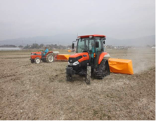
The future of the agricultural sector in the affected territory
The major impact: the loss of image and reputation
  Loss of image of the Bordeaux wine quite certain but beyond, what would be the impact on wine production at the national scale? What would be the impact on other local products?
  Stigma directly caused by the name of the Blayais NPP: asparagus of Blayais, Côtes-de-Blaye, etc.
Towards an appropriate communication
  Huge work to rebuild the consumers’ confidence: need to dialogue and inform them.
  Need to communicate quickly about the actual levels of contamination of the vineyard and wine;
  Consensual messages - in common language - exchanged and disseminated by all actors: wine growers, agricultural cooperatives, professional unions, experts, etc.
Towards the recovery of the agricultural activities
  For now, producers have no information on the agricultural countermeasures that could be implemented in case of an accident;
  Information on the evolution of contamination over time could help producers for the recovery process;
  Solidarity between producers would be developed. An option could be to opt for agricultural reconversion, implementation of innovative processes, etc.
Strong need for support
  RP Experts will be needed to help in implementing and evaluating countermeasure strategies;
  Compensation schemes and rules have to be anticipated
  Need to engage dialogue with experts in the preparedness phase.

Slide 12
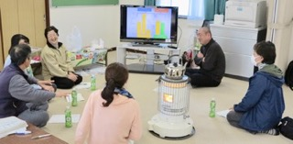
The challenges for restoring the quality of life in the territory
What is quality of life?
  A philosophical question… it depends on the values of each individual;
  A kind of (return to) serenity, the possibility of having prospects, a future.
Elements contributing to the quality of life (well being)
  After a nuclear accident, the quality of life implies an absolute transparency on the radiological situation and a prerequisite: the absence of health impacts;
  The situation must be ‘equivalent’ to that before the accident (maintenance of the community life);
  Need to have infrastructures: transport, access to health care, local shops, schools opened and in service, etc.;
  An attractive territory (for relatives/tourists) and job opportunities
Levers to recover the quality of life
  Collective actions, of solidarity between affected inhabitants through local association could help to cope with the situation;
  Support from authorities by financing local infrastructures and collective projects for the territory;
  Dialogue with experts to answer to the expectations and concerns of local inhabitants and to help them to cope with their situation;
  Support coming from outside the region, to prove the absence of stigmatisation (solidarity)

Slide 13
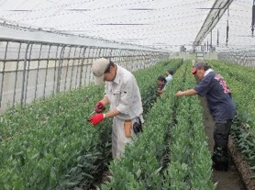
The conservation and the recovery of a sustainable socio-economic activity in the territory
The case of the wine sector
  Viticulture is the major socio-economic activity in the Bordeaux region;
  What would be the impact of the accident on wine sales? Loss of reputation? What would be the impact of the evacuation on vine maintenance?
  How to cope with the lack of manpower after a depopulation due to the accident?
  Rethink the wine industry and turn to new technologies, new innovative processes, or even envisage a conversion of the whole territory?
  Other socio-economic activities
  Important tourism activity of the region: seaside, cultural, and wine tourism;
  Will the entire French Atlantic coast be impacted ?
  What would be the impact on the port, estuary, forests, & other agricultural activities?
  What support for the socio-economic actors?
  Need to prepare socio-economic actors in advance and discuss with them the recovery of their activities in post-accident situations (time constraints, costs, organizations, roles);
  Examine the possibility and modalities of economic compensation (with justice/equity)

Slide 14
Perspectives
  CLIN of Blayais decided to continue working on preparedness with local stakeholders :
    Complete the data ‘layers’ on the economic activities (updating the GIS)
    Meet local economic stakeholders and representatives (to increase awareness)
    Exchange with some municipal councils about nuclear risk and post-accidental issues (increase decision-maker preparedness)
  Create a pluralistic working group (experts-locals) for a better appropriation/sharing of agriculture and other production issues
  Disseminate the content of the existing handbook on food management & agricultural countermeasures toward local professionals / Adapt and update it?
  Anticipate local monitoring needs and capabilities & anticipate data sharing / networking between actors
  Exercise local actors
  TERRITORIES panel report (June 2019): Uncertainties identified by local stakeholders i.e. issues at stake at the local level
  TERRITORIES guidance (November 2019)

Slide 15
20 March 2019 💥🔊 !!! Earthquake Magnitude 4.9
Thank you for your attention!

