Slide 1
How the EU strengthens CBRN response capacities outside the European Union
2 examples from the Westerns Balkans and the Black Sea Region
Katrijn Vandersteen & Klaas van der Meer
Belgian Nuclear Research Centre, SCK•CEN, Mol, Belgium
E-mail: katrijn.vandersteen@sckcen.be

Slide 2
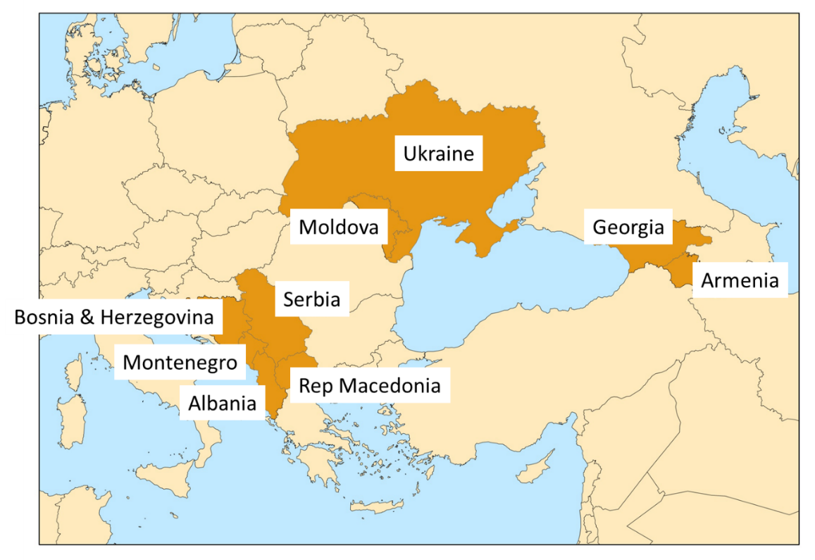
The European Union Chemical Biological Radiological and Nuclear Risk Mitigation Centres of Excellence Initiative
Aim:
  Strengthen the capacity of countries outside the European Union with respect to mitigating CBRN risks
Eight regions, headed up by a secretariat at regional level
P44 (2015 – 2018) and P57 (2017 – 2019): two projects in Western Balkans and Black Sea region
Implemented by consortium lead by SCK•CEN

Slide 3
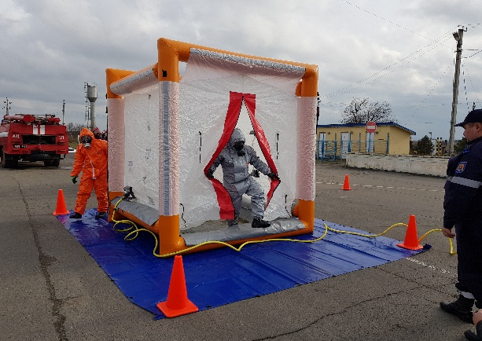
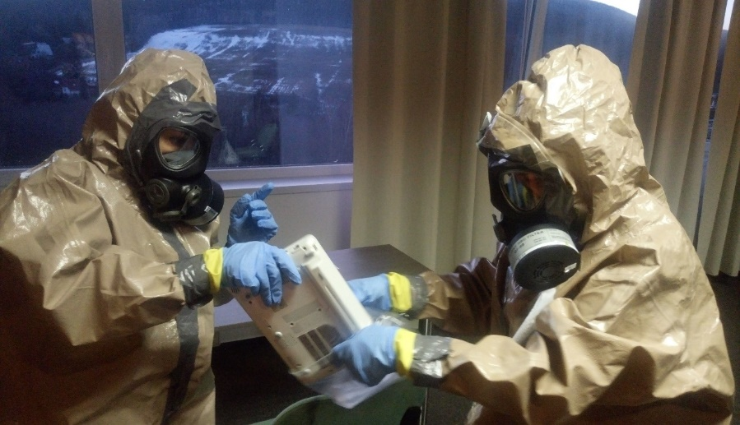
Objectives of P44 and P57
Training and exercises
  first responders (P44)
    Improve ability of first responders to respond to a CBRN incident
  Forensic science institutes’ staff (P57)
    Strengthen forensic expertise for crime scene investigation in the environment of a CBRN incident
Enhancing cooperation and networking between countries in the region
Focus on project sustainability by increasing local ownership & involving local expertise

Slide 4
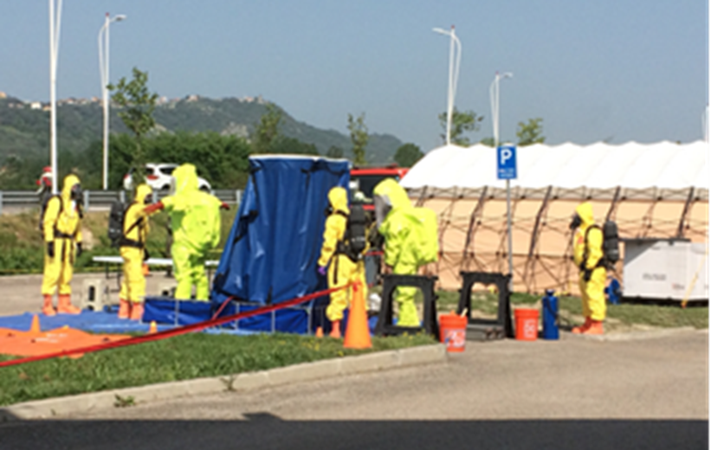
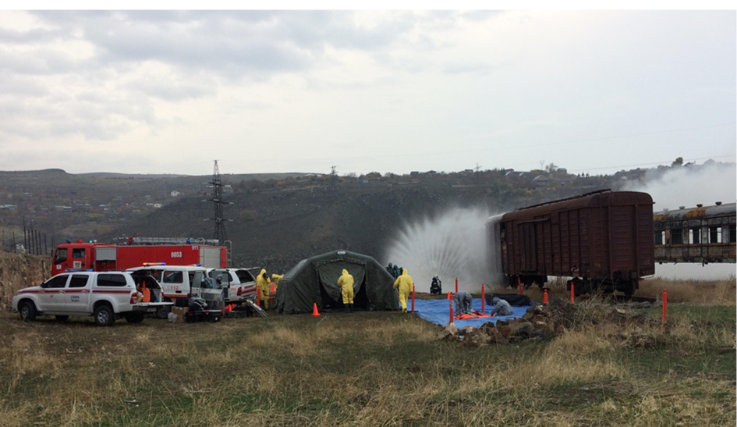
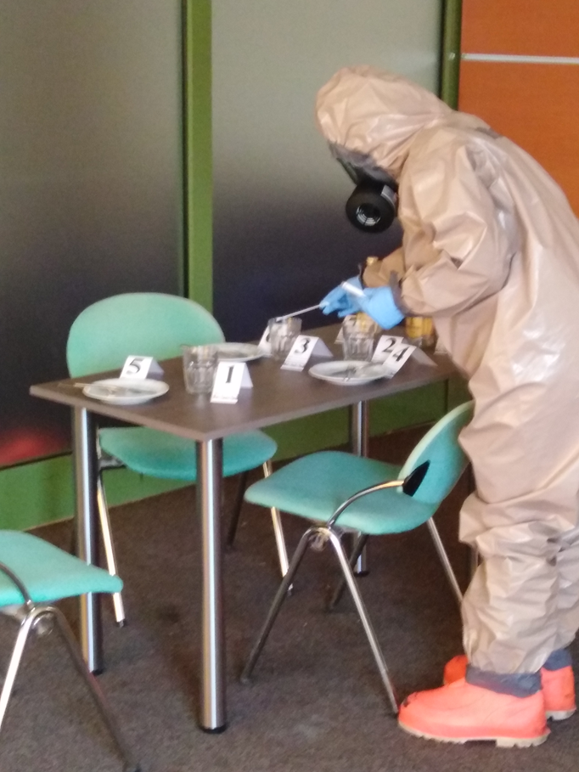
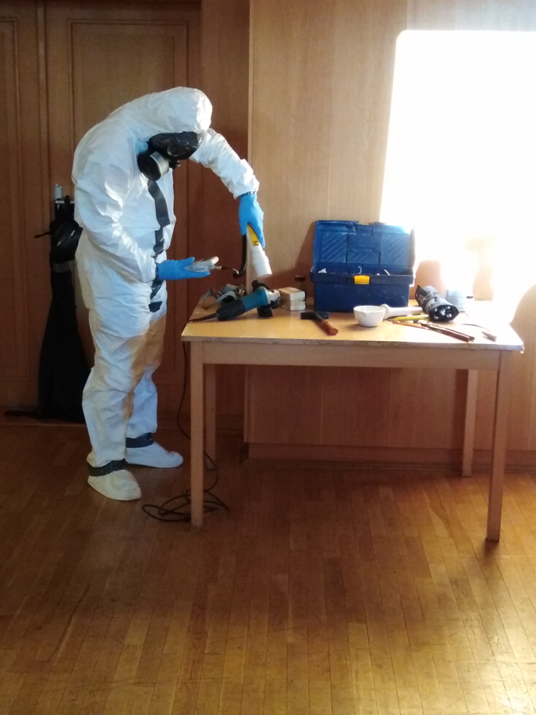
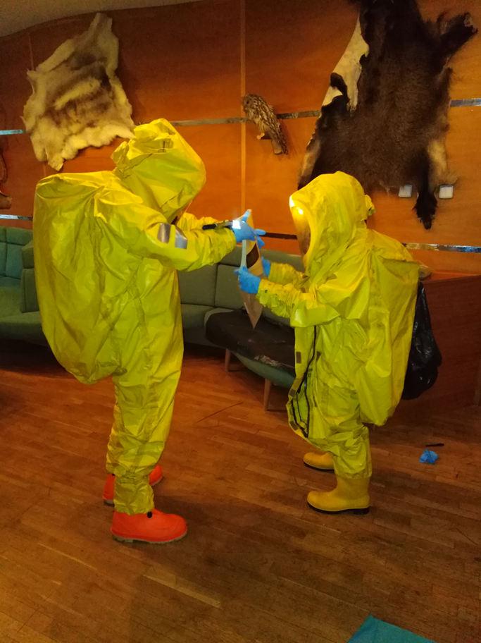
Highlights on some activities
P44 national and sub-regional field exercises
P57 Train-the-Trainer course

Slide 5
Copyright © 2019 - SCK•CEN
PLEASE NOTE!
This presentation contains data, information and formats for dedicated use only and may not be communicated, copied, reproduced, distributed or cited without the explicit written permission of SCK•CEN.
If this explicit written permission has been obtained, please reference the author, followed by ‘by courtesy of SCK•CEN’.
Any infringement to this rule is illegal and entitles to claim damages from the infringer, without prejudice to any other right in case of granting a patent or registration in the field of intellectual property.
SCK•CEN
Studiecentrum voor Kernenergie
Centre d'Etude de l'Energie Nucléaire
Belgian Nuclear Research Centre
Stichting van Openbaar Nut
Fondation d'Utilité Publique
Foundation of Public Utility
Registered Office: Avenue Herrmann-Debrouxlaan 40 – BE-1160 BRUSSELS
Operational Office: Boeretang 200 – BE-2400 MOL

