Slide 1

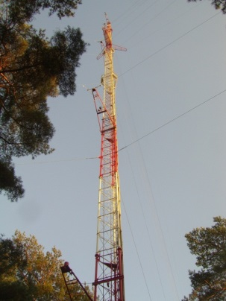
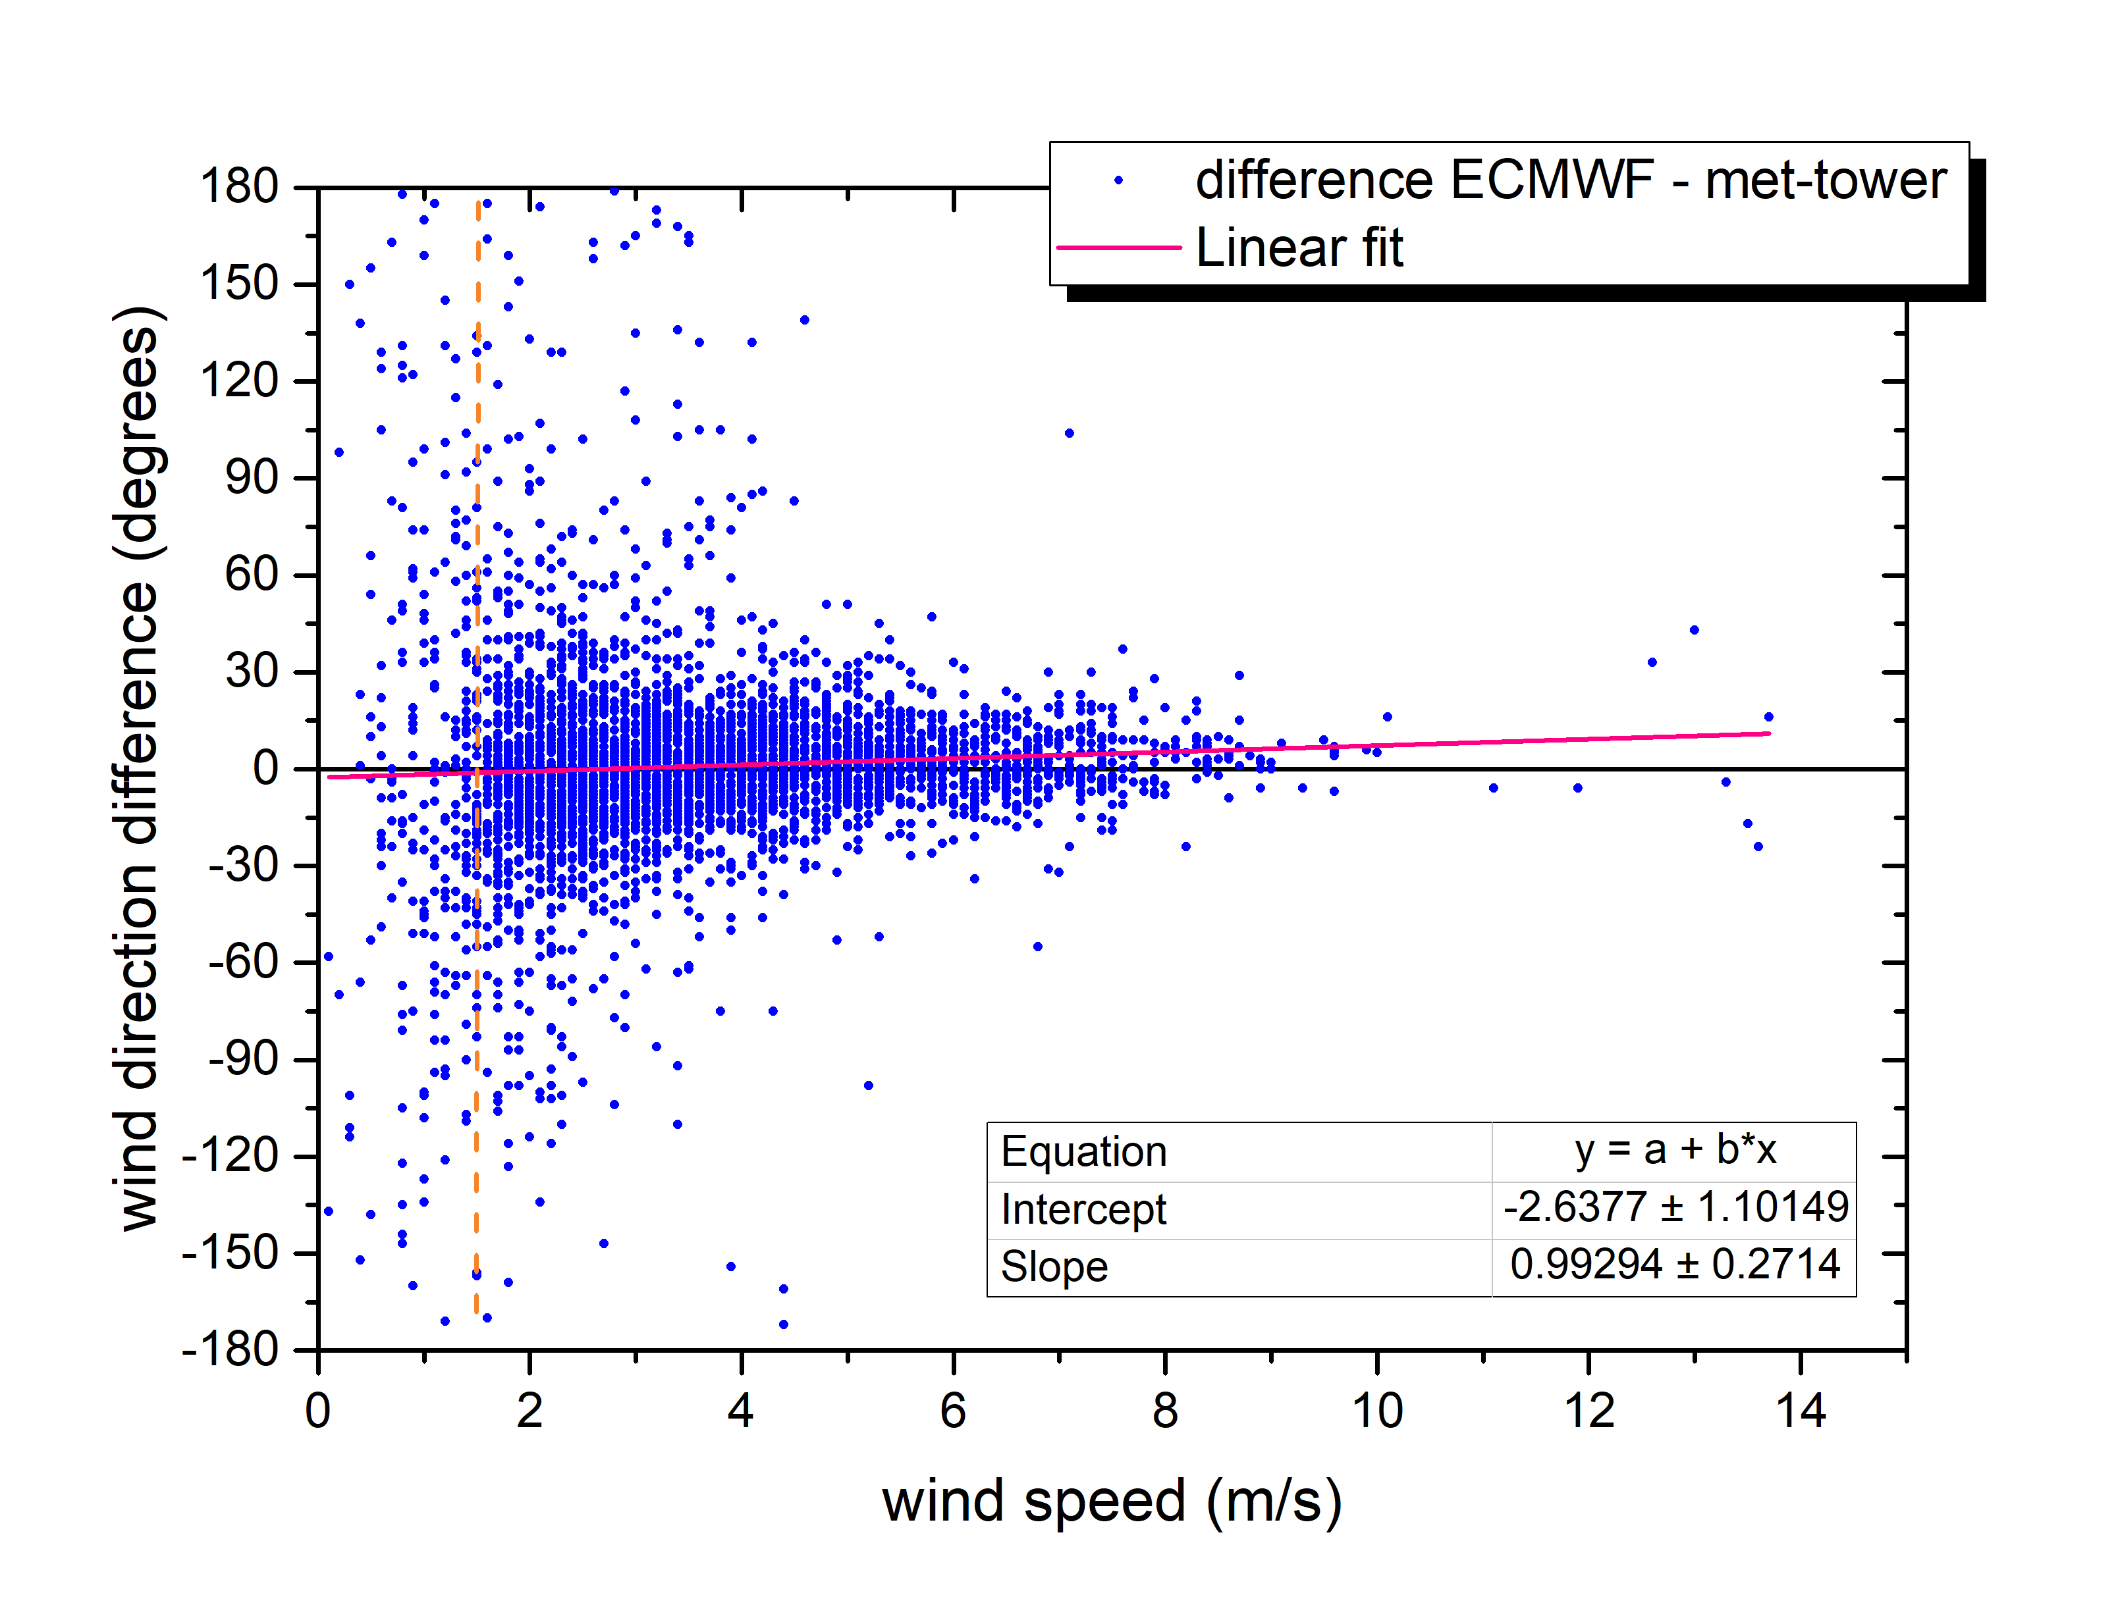
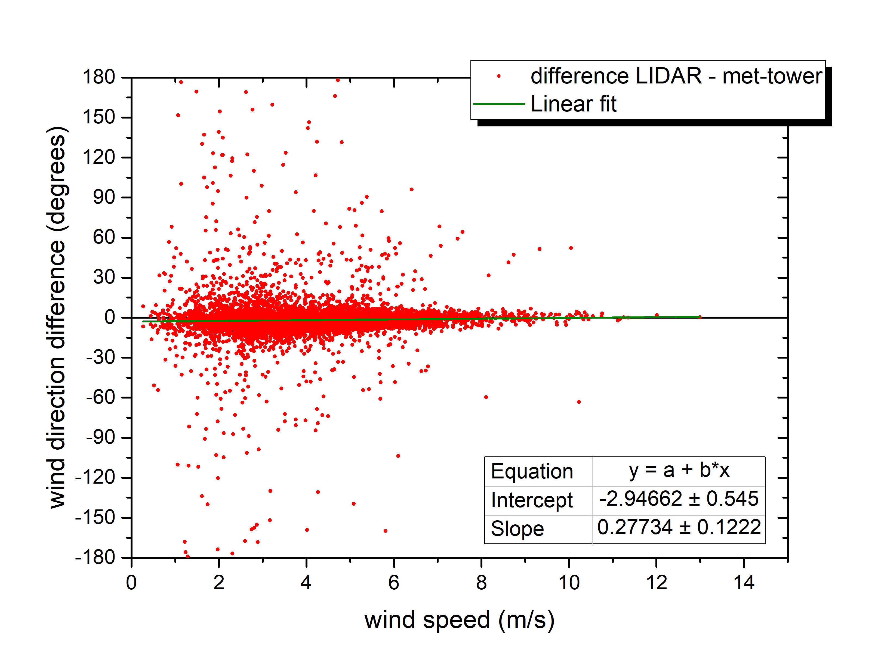
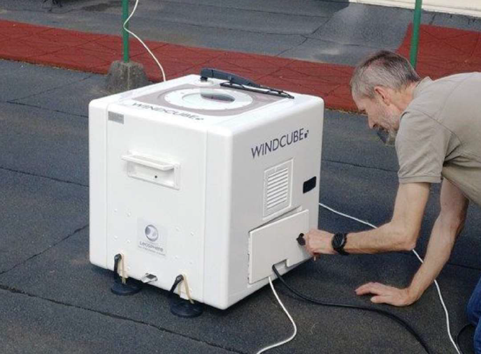
Use of different meteorological data for near-range assessments during a nuclear emergency
Johan Camps¹, Johan Paridaens¹ and Andy Delcloo²
¹ Belgian Nuclear Research Centre, SCK•CEN, Mol, Belgium
²Royal Meteorological Institute of Belgium (RMI), Uccle, Belgium
1
2
E
C
M
W
F
114 m high met-tower
3
Windcube LIDAR
NERIS Workshop – Roskilde, Denmark – 3-5 April 2019

Slide 2
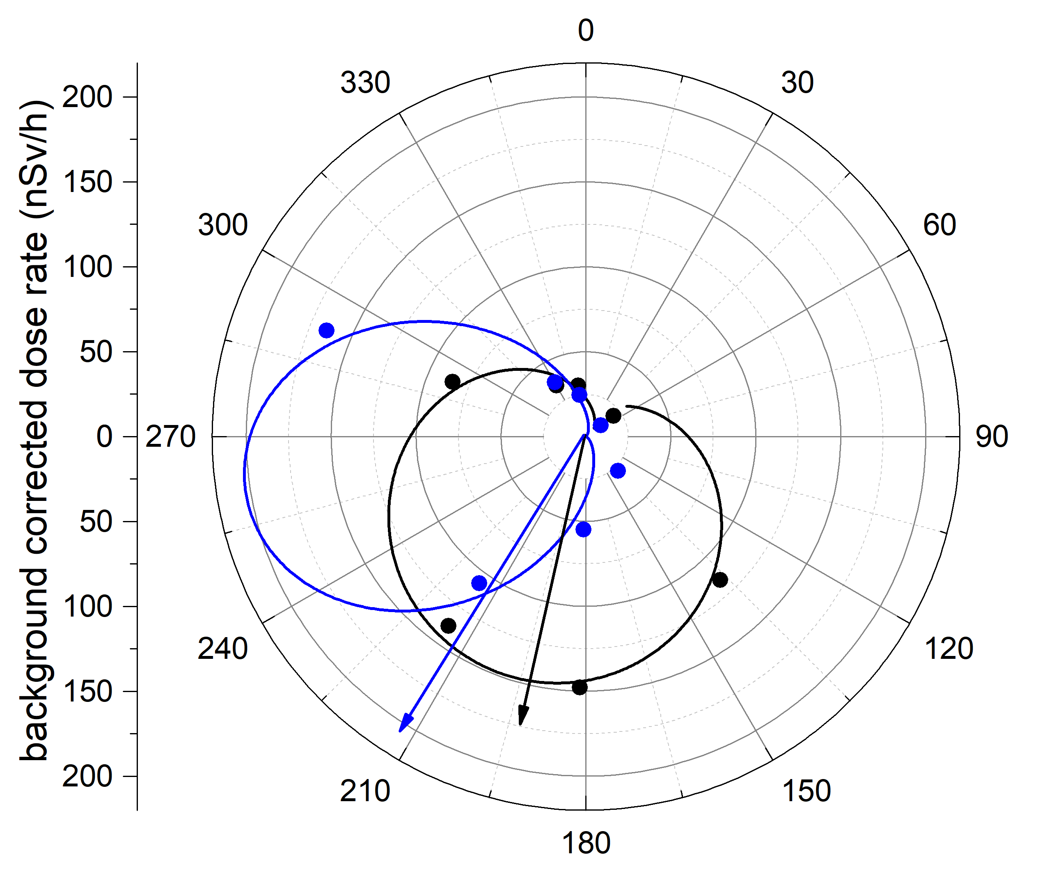
Discussion & Conclusions
ECMWF data good correlation with met-tower, except at wind speeds < 1.5 m/s
  Smooth use of on-site – ECMWF data for ADM from near-range to meso-scale
LIDAR data are a very good alternative for met-tower data (also at low wind speeds)
  Easy to install at accident site
Ring station measurements from routine releases at low wind speeds give diffuse picture → more data needed
Thank you
NERIS Workshop – Roskilde, Denmark – 3-5 April 2019

