Slide 1

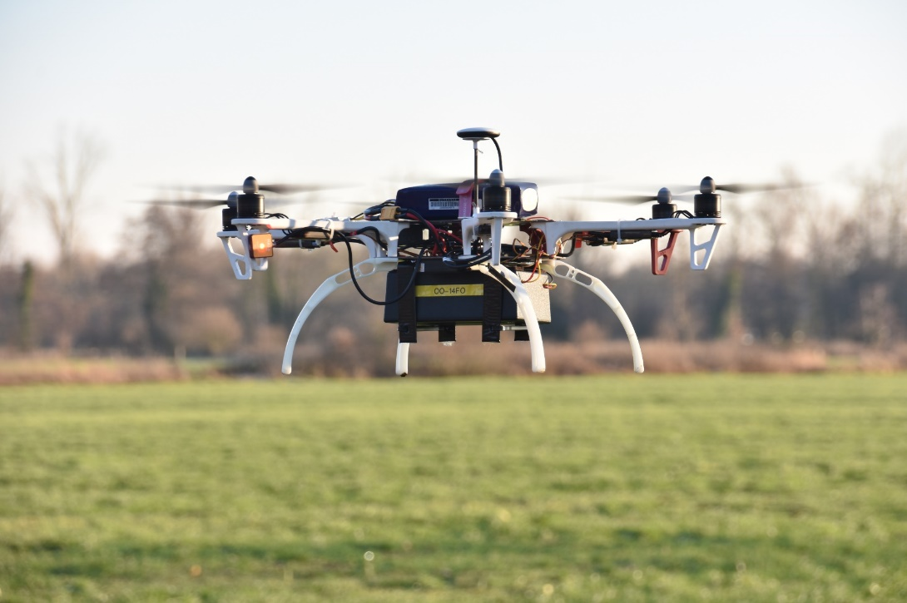
Efficiency of a drone measuring radioactivity
Stef Geelen^{1,2}, Johan Camps¹, Tim Vidmar¹ & Wouter Schroeyers²
¹Belgian Nuclear Research Centre, SCK•CEN, Mol, Belgium
²University of Hasselt, Uhasselt, NuTeC, Diepenbeek, Belgium
Evaluation of Multicopter VTOL Drones equipped with radiological detectors for use by first responders/measurement teams:
What are the detection limits for point sources and deposited radioactivity
What is the spatial resolution
all depending on source characteristics, flight parameters, ….
SCK•CEN drone equipped with a dose rate detector for testing

Slide 2
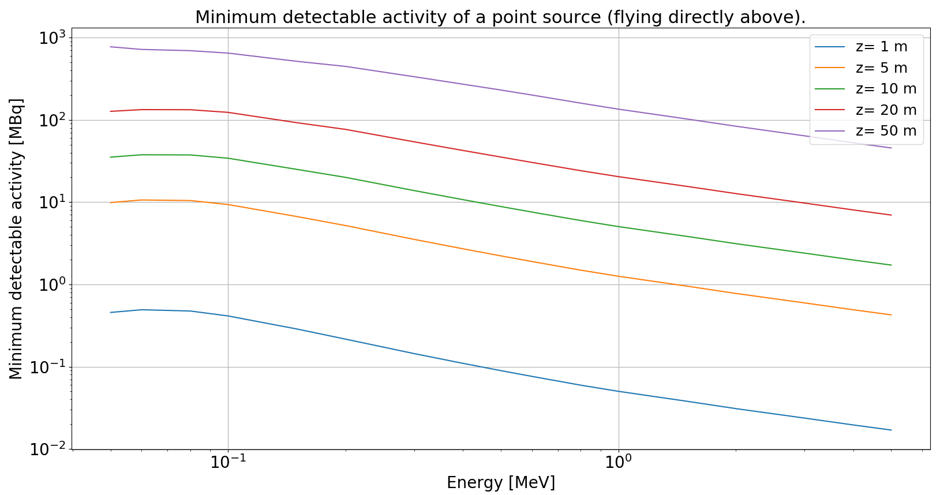
Methods and results
Python code was developed in which
  source can be represented by a large set of point sources
  Analytical formula’s are used to calculated air-kerma at position of drone
Currently implemented for ambient dose rate detectors with MDA expressed for x times background
More results:
see poster
Thank you
Example output: MDA for a point source

