Slide 1



Simulations of decontamination scenarios using the system dynamics approach
Anna Selivanova, Igor Krejčí
Anna.Selivanova@suro.cz

Slide 2

Introduction
Test attempt to estimate decontamination costs and benefits after nuclear or radiation accident
System dynamics methods and simulations in the Vensim PLE software
Collaboration between the National Radiation Protection Institute (SÚRO) and the Czech University of Life Sciences
Project of the Ministry of the Interior of the Czech Republic VH172020015: Recovery Management Strategy for Affected Areas after Radiation Emergency

Slide 3
Goals
Creation of decontamination scenarios supposing contamination with artificial radionuclides and an annual effective dose 20 mSv (and less)
Preparation of resource materials for remediation strategies after nuclear or radiation accident and for decision-making in population protection (e.g. return after evacuation) in the Czech environment
Creation of a dynamic mathematical model and its validation
Simulations of proposed scenarios and its mutual comparison

Slide 4
System dynamics and the Vensim software
Complex systems with non-linear behavior (e.g. radioactive decay)
Many parameters/variables with difficult interrelations
Clarity of relations between parameters/variables
Easy to change and simple model editing – applicable for different objects
  Full control over the model and simulations
Working with layers – possible to connect different fields in one model, e.g. dosimetry with economics
“What if” scenarios simulations

Slide 5
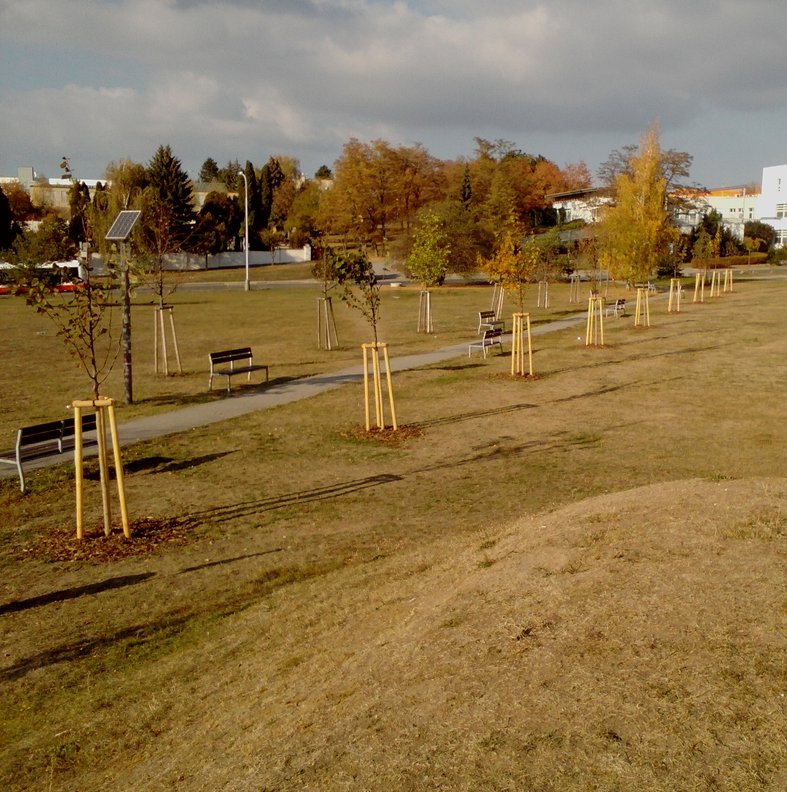
Real object
Large recreation meadow ground
Grassed area – roughly 60 ths. m²
Previous partial decontamination (trees,
streetlamps etc.) considered
Simulation of decontamination scenarios of
  grassed area only
The meadow is not situated in an emergency
planning zone

Slide 6
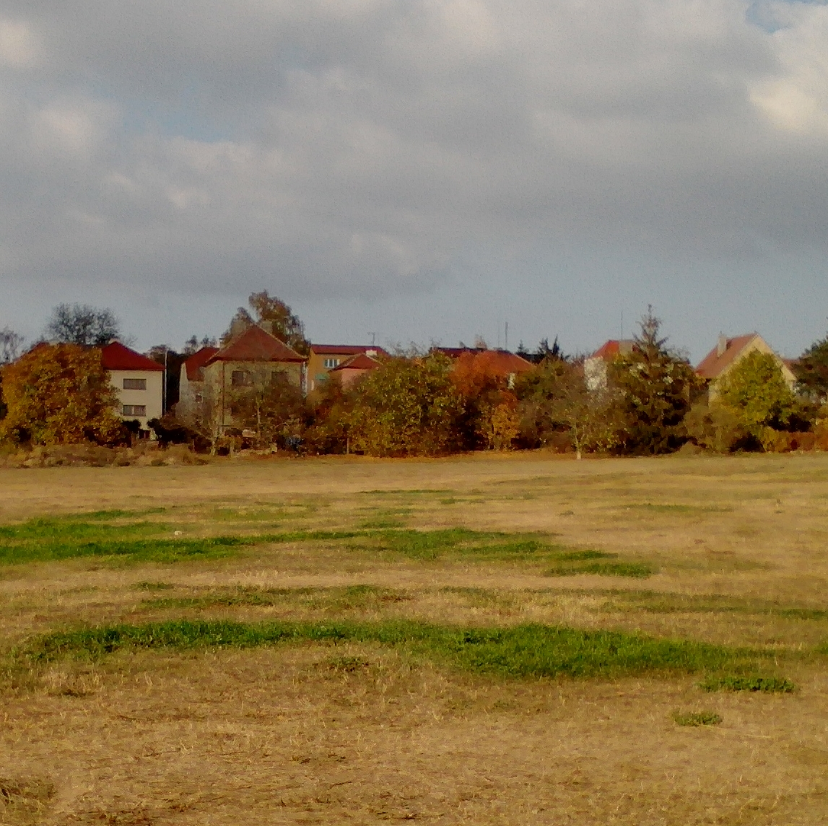
Population exposure
Expected group of the most irradiated persons
Estimation based on data from the Czech
Statistical Office
  Average number of persons per house/apartment
  Known number of buildings
  Very quick, but rough assessment
  Only adults
  631 persons

Slide 7
Dose estimation and model validation
Expected contamination with ¹³⁷Cs and ¹³⁴Cs only (total surface activity approximately 2 MBq m⁻²)
Short-lived isotopes, e.g. ¹³¹I or ¹³²Te etc., were excluded due to short half-lives (for now)
Expected activities were converted to annual effective external doses:
  Included radioactive decay (λ_{r}), natural dispersion rate (λ_{w}) and estimated decontamination rates (λ_{d}), dose conversion coefficients (DF), shielding factors (SF), corrections for time indoor (Δ_{outdoor}) and outdoor (Δ_{indoor})
  Dose rate reductions for different scenarios … estimation of λ_{d} (in the model depends on dose rate reductions, remediation area, decontamination speed)
Collective effective dose estimation including benefits calculation for selected decontamination scenarios (averted doses multiplied by financial coefficient for accidents)
Model validation – simulation with parameters from literature (activities, shielding factors) and the Units check test in the Vensim PLE software

Slide 8
Model description
13 working layers – dose estimation, total costs of remediation, duration of remediation, waste handling, population estimation, each scenario estimation and its costs, workers and vehicles decontamination + summary page with links to the most important results and scenario switches (with short description)
Model allows to follow activity and ambient dose rate decrease, effective dose accumulation (for population and workers in each stage of remediation), total costs of remediation, costs of remediation related to 1 m², duration of remediation and costs of health detriment
Scenario simulations were implemented using SWITCHES (1 or 0), Boolean operators and conditional expressions IF THEN ELSE

Slide 9
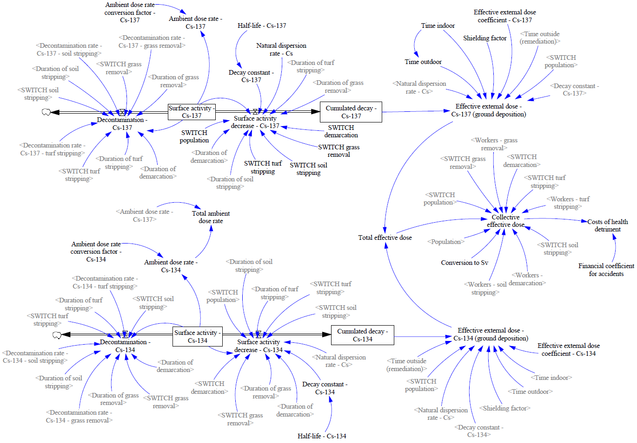

Slide 10
Scenarios
Three scenarios considering return of population – no decontamination during one year (e.g. due to financial limitations), turf stripping and soil stripping
  Other methods of decontamination were excluded due to expected higher soil specific activity – about 8 kBq kg⁻¹ (recalculated surface activity considering a soil density 1,6 g cm⁻³ and a depth 15 cm)
All scenarios included the meadow demarcation with fences, warning tapes and boards and decontamination of workers and vehicles with water
  Labour costs, personal protective equipment, costs of personal electronic dosimeters, costs of fences, tapes and boards, fuel and water consumption
Turf stripping and soil stripping scenarios included grass removal and manual collection of waste residues using shovels, brooms and garden carts
  Waste bags costs, waste transportation (grass, soil, turf), costs of shovels, brooms and carts, consumption of fixed capital (tractors with mowers, sod harvesters, excavators), correction for inflation

Slide 12
Simulation results – no decontamination (demarcation only)
  Total costs – 0,4 mln. Kč (16 ths. EU)
    7 Kč m⁻² (0,3 EU m⁻²)
  1 day of work
  Effective dose – 20 mSv a⁻¹ for population
    No averted dose
  “Zero” benefits

Slide 13
Simulation results – turf stripping
  Total costs – 6 mln. Kč (240 ths. EU)
    99 Kč m⁻² (4 EU m⁻²)
  15 days of work
  Effective dose – 10 mSv a⁻¹ for population
    Averted dose 10 mSv
  Estimated benefits – 16 mln. Kč (0,6 mln. EU)

Slide 14
Simulation results – soil stripping
  Total costs – 7 mln. Kč (280 ths. EU)
    109 Kč m⁻² (4,4 EU m⁻²)
  33 days of work
  Effective dose – 3 mSv a⁻¹ for population
    Averted dose 17 mSv
  Estimated benefits – 27 mln. Kč (1,1 mln. EU)

Slide 15
Conclusion and future work
Benefits of both decontamination scenarios are higher than its costs
Costs of turf stripping and soil stripping are of the same order of magnitude (roughly 240–280 ths. EU); soil stripping is expected to be longer, but more efficient
Possible future improvements:
  Full area decontamination (including trees, streetlamps, pavements, benches etc.)
  Environmental half-lives – short and long components
  Adding short-lived isotopes (e.g. ¹³¹I)
  New scenarios for different levels of contamination
  More detailed estimation of population
  Improvements in waste handling

Slide 16
Selected references
Ahn, Joonhong et al., 2014. Reflections on the Fukushima Daiichi nuclear accident – toward social-scientific literacy and engineering resilience. New York: Springer Berlin Heidelberg, 2014. ISBN 978-3-319-12089-8.
Andersson, Kasper G. et al., 2000. A guide to countermeasures for implementation in the event of a nuclear accident affecting Nordic food-producing areas (NKS-16). Roskilde: Nordic nuclear safety research, 2000. ISBN 87-7893-066-9.
IAEA, 2001. Generic models for use in assessing the impact of discharges of radioactive substances to the environment (Safety Reports Standards No. 19). Vienna: International Atomic Energy Agency, 2001. ISBN 92-0-100501-6.
Roed, J. et al., 1998. Mechanical decontamination tests in areas affected by the Chernobyl accident. Roskilde: Risø National Laboratory, 1998. ISBN 87-550-2361-4.
U.S. EPA, 2016. Current and emerging post-Fukushima technologies, and techniques, and practices for wide area radiological survey, remediation, and waste management. Washington, DC: Office of Research and Development, Homeland Security Research Center, 2016.

Slide 17
Thank you ^_^

