Slide 1
Identification of mental models of uncertainty management in emergency situations
Nadja Zeleznik, EIMV, Ludger Benighaus, DIALOGIC, VasilikiTafili, EEAE, Tatiana Duranova, VUJE, Roser Sala, CIEMAT,
NERIS WORKSHOP 2019
3 – 5 April 2019
Roskilde, Denmark

Slide 2
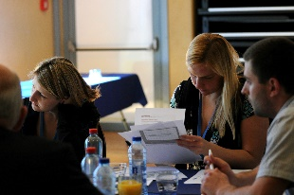
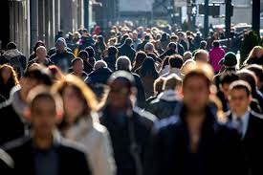
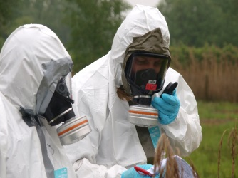
Part of WP5 in CONFIDENCE
Identifying of societal uncertainties in emergency and post-accident situations, from the early phase to recovery;
Highlighting ethical implications of uncertainty management;
Studying lay person and emergency actors’ understanding and processing of uncertain information, and subsequent decision-making behavior; → MENTAL MODEL STUDY
Designing and testing improved tools for communication of uncertainties, specifically for low radiation doses.

Slide 3
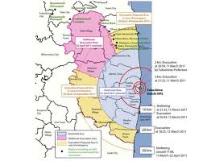
Background
Emergency Preparedness and Response (EP&R) plans are prepared for many radiological threats at different levels: national, regional, local, off-site, on site, for individual organization, for facilities etc.
All these plans are usually prepared by responsible authorities/institutions and very rarely developed based on public involvement or consultations.
As a consequences, they are sometimes lacking the appropriate information, not addressing relevant uncertainties and public concerns.
Mental models investigation of understanding, processing & management of uncertainties in EP&R has been performed with the aim to improve EP&R planning, preparedness and response:
  How experts frame the topic
  What do lay people* believe
*person who does not have specialized or professional knowledge of a subject.

Slide 4
Scope and objectives
Performed in five countries (Germany, Greece, Slovak Republic, Slovenia and Spain) with different nuclear experiences:
  no NPP,
  long history of nuclear energy production (one, several NPPs),
  nuclear phase out.
The objectives of investigation were to address the following questions:
  What are the mental models present within the potentially affected public regarding emergency management and associated uncertainties?
  What are the differences, gaps, misunderstandings and perceptions in the public compared with the ones provided by experts in the field?
  What are the similarities and differences on mental models between the countries in which the investigation took place?
  What is lesson learned from the performed investigation and how the findings can be introduced in the improved communication and activities?

Slide 5
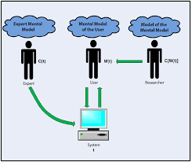
Mental models - background
Mental models are cognitive schemas through which people explain individual processes or phenomena in which they are participating.
Characteristics of mental models:
  Are incomplete, limited and fragmentary, usualy wrong, contradictory and inconsistent, not science founded,
  Are unstable, evolving, people forget details and are mixing old and new information,
  Are not having clear and firm boundaries, different models are mixed and changed,
  Are limited and enable simplified interpretation of complex processes.
Mental model investigations performed:
  Radioactivity, radioactive waste in Slovenia;
  Ionizing radiation in France, Poland, Romania and Slovenia.

Slide 6
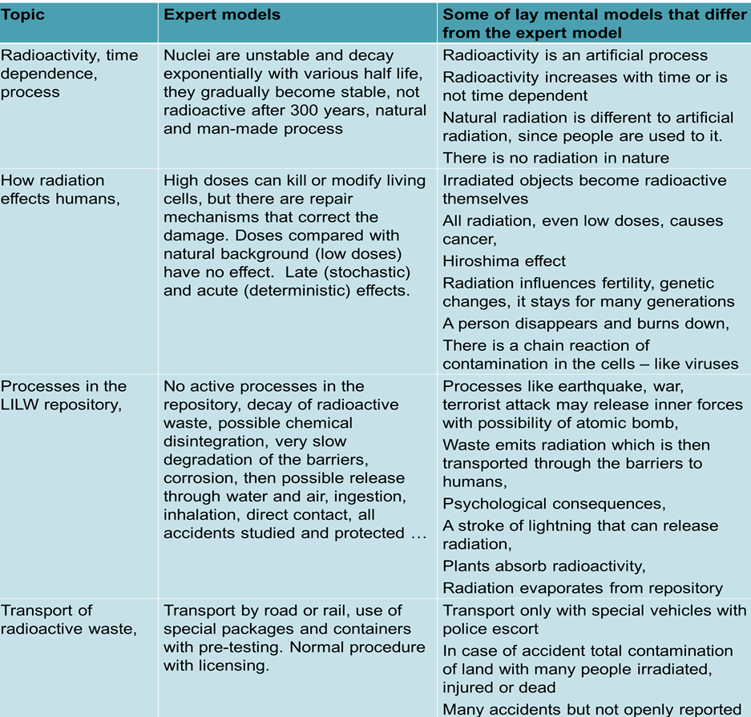
Previous results

Slide 7
Methodology for investigation
Mental model approach:
  The experts‘ understanding of uncertainties in EP&R was obtained via interviews,
  The interviews with lay people were performed within approximately 15- 20 different individuals in countries, tracing the concepts and understandings, but also other important points of lay people.
  These results from discussions were compared with the findings of the interviews with professionals to obtain similarities and differences between the mental models.
  The analyses performed is the base for improved communication strategies and tools.
Special protocol which trace the main understanding of uncertainties in EP&R and other socio-demographic variables affecting people’s behaviour and information needs was used:
  Section 1 (Warming up): start the discussion on the EP&R in case of radiological or nuclear accident but also experiences with some other accidents.
  Section 2 (Core of investigation): requires detail discussion with the interviewees in order to recognize their understanding of EP&R plans, main uncertainties of emergency management and associated elements (protective measures, their characteristics, risks, information and trust).
  Section 3 (Addition): experiences and memories from major nuclear accidents.
  Section 4 (Socio-demographics data).
All findings were recorded and report prepared (on website D.27 http://www.concert-h2020.eu/en/Publications)

Slide 8
Expert models -1
Based on:
  analyses of national EP&R plans with information what is the concept of emergency management, what is included and how different areas are addressed,
  discussions with several experts (Ireland, Slovenia, France):
    structure of EP&R plans,
    individual elements description,
    what uncertainties could be associated with actions/activities/topics within different EP&R areas.
EP&R rely on threat and risk assessments with possible reasons for accidents, their probability, level of threat, course and possible extent of the accidents, identification of endangered inhabitants, possible consequences and plans for protection measures.
In general – structure is similar:
  differences occur due to country specific situations (with or without NPP),
  observed between the provisions on zones, reference levels, intervention levels and similar,
  lead for response is not nuclear or radiation protection regulatory body but civil protection or disaster protection authorities.

Slide 9
Expert models -2
Source of uncertainties in nuclear or radiological emergency:
  knowledge on ionizing radiation, consequences, associated hazard and real impacts is relatively low within institutions and services foreseen to manage the emergency situation → training and education would be very needed.
  development of accident is quite unpredictable, like what meteorological factors to be used for modelling, how the radioactive plum will be dispersed and where it will be deposited → very difficult to foresee the preventive measures.
  impact of accident in the areas which are foreseen for relocation of population → could not be used for the purpose.
  how people would actually react in nuclear emergency and follow assumptions from EP&R plans → linked with trust of people to information where it is important who delivers the data → work on building of trust.
  no exercises and drills on local level with involvement of all services, institutions (schools, hospitals, nursing homes,….) and population → improve the approach.
  no agreements for some services foreseen in the EP&R plans (e.g. mobile unit for radiological accidents) and limited number of experts → increase the capacity.
  food security measures are seen as particular challenging, as it is very difficult to harmonise the reference levels and limitation, also due to export and import of products → improve and harmonise food product limitations.
  communication with public (general and local) and with media would present a big source of uncertainty: there would be many sources of information including social media, also those with wrong information, which could be source of panic and chaos → be proactive and establish communication channel before emergency.

Slide 10
Lay models – summary of findings - 1
Participants have a general idea on what are the basic elements of the emergency plan, but only vague knowledge of each specific protective measure.
Interviewees differentiate in general two possible situations in case of accident in NPP:
  In major accident, we find out a fatalistic belief that nothing would help as the accident would have very rapid and deterministic effects (death and devastation),
  In minor accident, they believe the emergency plan would be useful.
The memory of major nuclear accidents in Fukushima and Chernobyl is still present and defines the models people have in relation to a nuclear accident:
  similar accidents would have big impacts with dangerous consequences, bringing fear and dread across the borders of the accident, even to all continents,
  consequences would stay for very long periods and could impact the whole lifetime of several generations,
  number of dead is believed to be high and the trust in reporting by governments is low.
Communication:
  people believe that there are no sufficient and relevant available information for population and that the responsible poorly communicate with public.
  distrust in competent and responsible authorities which make the communication even more difficult.
  interviewees state that too much and too intensive communication could increase the concerns and could lead to panic and chaos.

Slide 11
Lay models – summary of findings - 2
Planned measures:
  different ideas about sheltering where people understand that special underground bunkers should be used for such case, they would need to stay inside for many days (problem with food and drink),
  lack of information about the iodine prophylaxes and what it is used for, where to get iodine tablets,
  clear difference between evacuation leaded by authorities and spontaneous or private evacuation:
    in case of governmental evacuation probably buses will be used to avoid traffic problems. Assembly points will be used to gather people, accommodation would be provided,
    If the evacuation is spontaneous, private cars will be used, people would go as far as possible, to a second residence if possible or even abroad.
  evacuation of school children is mentioned as an important uncertainty,
  what is decontamination and how to apply measures – external v internal contamination,
  believe that milk, vegetables and water would be affected in case of accident, but they do not have any idea of what food security measures would present.

Slide 12
Main uncertainities
Some uncertainties and disagreements coming from the emergency plans are highlighted by participants:
  What information should be available? Currently it is not clear what information are available and what should be known by all. The new ways of communication should be implemented, also based on the social media and other alternatives (like citizens science and measurements). In addition, there should be exercises performed and practice at all levels: local and national.
  What to do? Some people would not follow the instructions as they do not trust the government and institutions. There would be panic and as they are not really informed, they would use their own imagination what to do.
  Are plans harmonised with behaviour of population? There is question if plans foresee the real behaviour of citizens. Some areas of disagreement were pointed out (children in schools and kindergartens, self-evacuation).
  What are the risks they will face? The associated risk is assessed as very high and some elements of fatalism are present that nothing can be done.

Slide 13
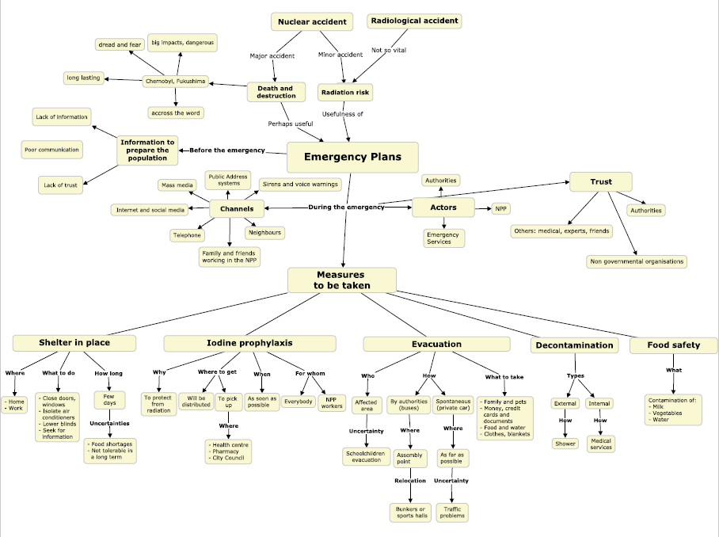
Lay people preveiling mental models

Slide 14
Suggestions
In all countries better, more proactive provision of information before emergency should be organised.
Risk communication activities shall take into account the national (radiological) threat assessment, taking into account also perceived risk by public.
Better understanding of the protection measures should be communicated, using modern approaches and also by inclusion of affected population in exercises.
Clarification regarding the roles of different emergency response players should be emphasized and resources shall be available in order to support the increased needs of information during emergencies.
Building of trust is still among the most important preconditions to assure effective management of real accident.

Slide 15
Conclusions
Mental model investigation in five CONFIDENCE countries revealed main uncertainties of EP&R management.
In general – there are no major differences between countries – nuclear or no nuclear.
There are discrepancies between EP&R plans and perception of public:
  Familiarity with and knowledge of emergency plans,
  Risk perception,
  Understanding of measures,
  Follow up of governmental instructions,
  Information sources,
  Trust.
Also experts pointed out some similar uncertainties, but as the EP&R system is so complex and include many different actors, it is difficult to change the used approaches.

